Slide 1
Chapter 1
Linear Equations and Functions

Slide 2
1.6 Applications of Functions in Business and Economics :
Objectives :
To formulate and evaluate total cost, total revenue, and profit functions
To find marginal cost, revenue, and profit, given linear total cost, total revenue, and profit functions|
To find market equilibrium

Slide 3
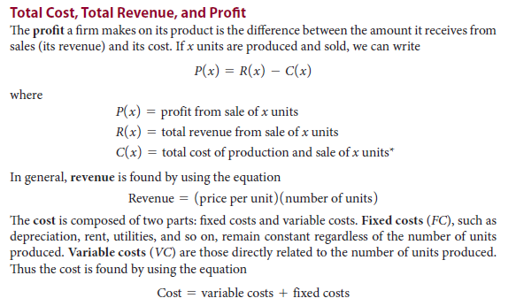

Slide 5
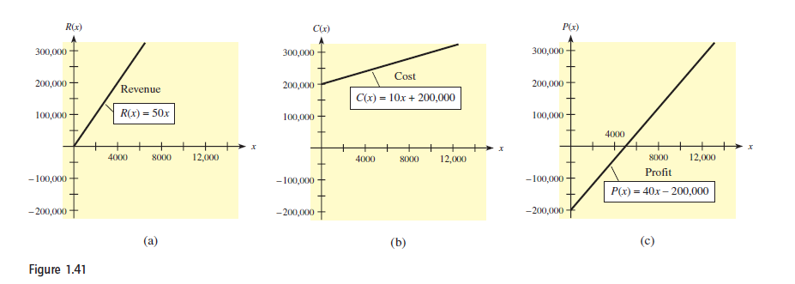

Slide 9
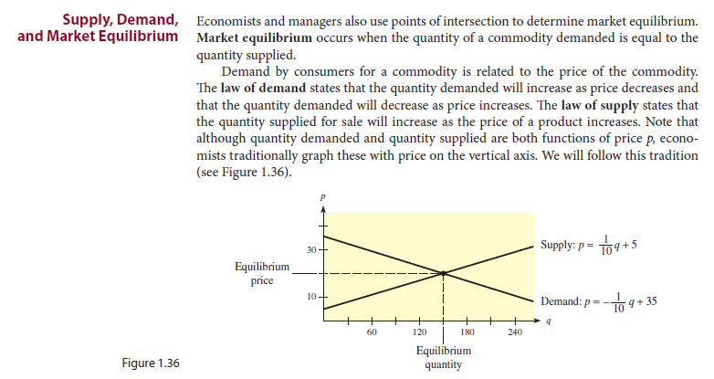

Slide 10
