Slide 1
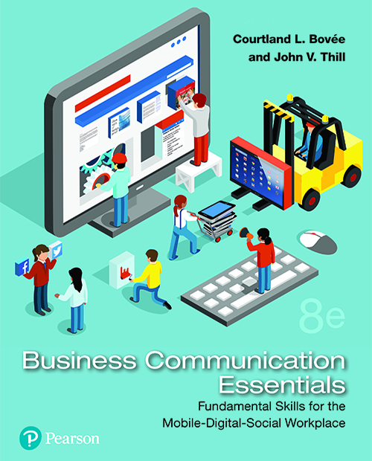
Business Communication Essentials
Eighth Edition
Chapter 5
Completing Business Messages
Copyright © 2019, 2016, 2014 Pearson Education, Inc. All Rights Reserved.
Notes:
If this PowerPoint presentation contains mathematical equations, you may need to check that your computer has the following installed:
1) MathType Plugin
2) Math Player (free versions available)
3) NVDA Reader (free versions available)

Slide 2
Learning Objectives (1 of 2)
5.1 Discuss the value of careful revision, and describe tasks involved in evaluating your first drafts and the work of other writers.
5.2 List four techniques you can use to improve the readability of your messages.
5.3 Describe steps you can take to improve the clarity of your writing, and give four tips for making your writing more concise.

Slide 3
Learning Objectives (2 of 2)
5.4 List four principles of effective design, and explain the role of major design elements in document readability.
5.5 Explain the importance of proofreading, and give six tips for successful proofreading.
5.6 Discuss the most important issues to consider when distributing your messages.

Slide 4
Revising Your Message: Evaluating the First Draft
LO 5.1 Discuss the value of careful revision, and describe the tasks involved in evaluating your first drafts and the work of other writers.
Notes:
This chapter covers the tasks in the third step of the three-step writing process: revising your message, and then producing, proofreading, and distributing it.
Successful communicators recognize that a first draft is rarely as tight, clean, and compelling as it needs to be. Careful revision will improve the effectiveness of your messages and send a strong signal to your readers that you respect their time and care about their opinions.

Slide 5
Evaluating Your Message
Content
Clear and Accurate
Relevant and Complete
Organization
Order and Emphasis
Repetition and Grouping
Tone
Is It Too Formal?
Is It Too Casual?
Notes:
When you begin the revision process, focus your attention on content, organization, and tone. Today’s readers want messages that convey important content clearly and quickly. To evaluate the content of your message, make sure it is accurate, relevant to the audience, and complete.
Once you are satisfied with the content of your message, you can review its organization by asking the following questions:
Are all your points covered in the most logical order?
Do the most important ideas receive the most space and the greatest emphasis?
Are any points repeated unnecessarily?
Are details grouped together logically, or are some still scattered through the document?
With the content in place and effectively organized, next consider whether you have achieved the right tone for your audience. Spend a few extra moments on the beginning and end of your message; these sections usually have the greatest impact on the audience. Is your writing formal enough to meet the audience’s expectations without being too formal or academic? Is it too casual for a serious subject?

Slide 6
Evaluating, Editing, and Revising the Work of Other Writers
Promote the Writer’s Success
Help the Writer Succeed.
Don’t Impose Your Own Style or Agenda.
Support the Writer’s Intent
Learn What the Writer Wanted to Accomplish.
Base Suggestions on the Writer’s Goals.
Notes:
At many points in your career, you will be asked to evaluate, edit, or revise the work of others. Before you dive into someone else’s work, recognize the dual responsibility that doing so entails.
First, unless you have specifically been asked to rewrite something in your own style, remember that your job is to help the other writer succeed at his or her task, not to impose your writing style or pursue your own agenda. In other words, make sure your input focuses on making the piece more effective, not on making it more like something you would have written.
Second, make sure you understand the writer’s intent before you begin suggesting or making changes. If you try to edit or revise without knowing what the writer hoped to accomplish, you run the risk of making the piece less effective, not more.

Slide 7
Questions for Evaluating Someone Else’s Writing (1 of 2)
What Is the Purpose of the Message?
Who Is the Audience? What Do They Need?
Are There Special Circumstances or Issues?
Is the Document Well Organized?
Does the Writing Convey a “You” Attitude?
Is the Tone of the Writing Appropriate?
Can the Readability Be Improved?
Is the Writing Clear? Can It Be Improved?
Notes:
Ask yourself the following questions as you evaluate someone else’s writing:
What is the purpose of this document or message?
Who is the target audience? What information does the audience need?
Are there any special circumstances or sensitive issues that the writer had to consider (or should have considered)?
Does the document provide this information in a well-organized way?
Does the writing demonstrate the “you” attitude toward the audience?

Slide 8
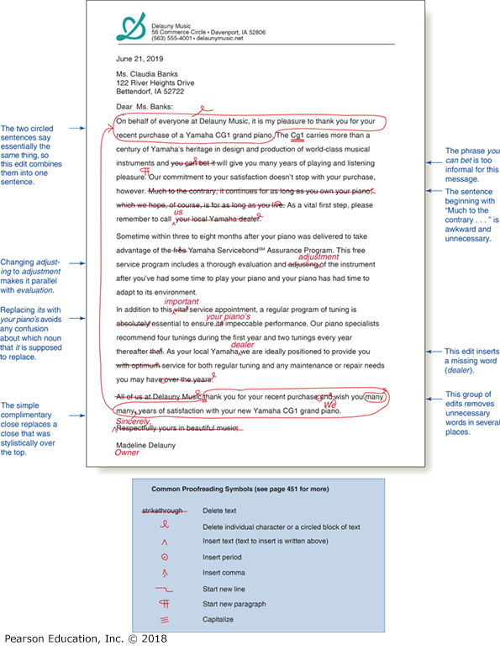
Questions for Evaluating Someone Else’s Writing (2 of 2)
Is the Writing as Concise as It Should Be?
Does the Design Support the Message?
Notes:
Is the tone of the writing appropriate for the audience and the situation?
Can the readability be improved?
Is the writing clear? If not, how can it be improved?
Is the writing as concise as it could be?
Does the page or screen design support the intended message?

Slide 9
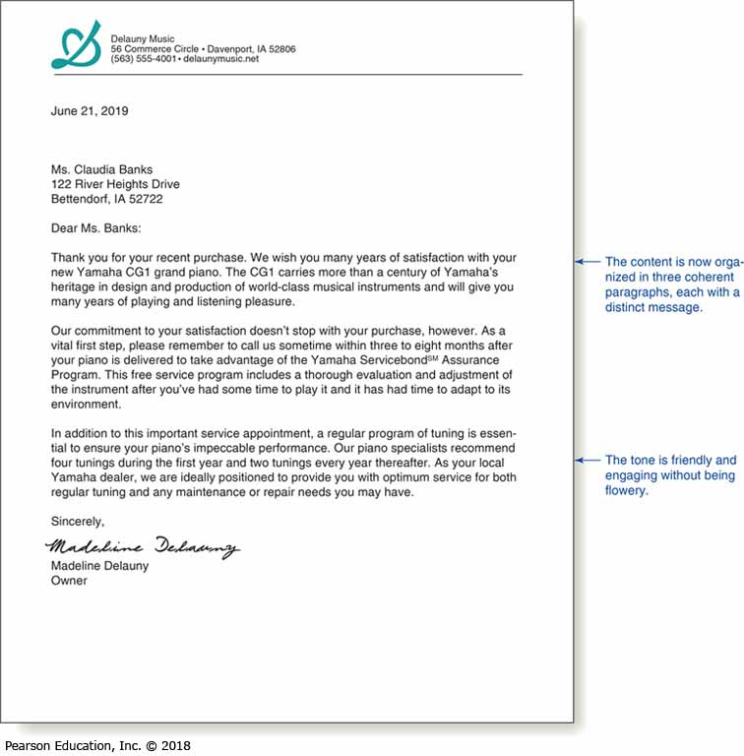
A Professional Business Letter
Notes:
This is an example of a business letter that has been proofread and corrected. This has a clear purpose, is appropriate for the target audience, provides necessary information and is well organized and professional.

Slide 10
Summary of Discussion (1 of 6)
In this section, we discussed the following:
The Importance of Revision
Evaluating Your Message
Evaluating, Editing, and Revising the Work of Other Writers
The next section will cover Revising to Improve Readability.

Slide 11
Revising to Improve Readability
LO 5.2 List four techniques you can use to improve the readability of your messages.
Notes:
After confirming the content, organization, and tone of your message, make a second pass to improve readability. Four powerful techniques for improving readability are varying your sentence length, using shorter paragraphs, replacing narrative with lists, and adding effective headings and subheadings.

Slide 12
Varying Your Sentence Length
Notes:
Varying sentence length is a good way to maintain reader interest and control the emphasis given to major and minor points. Look for ways to combine a mixture of sentences that are short (up to 15 words or so), medium (15–25 words), and long (more than 25 words). Each sentence length has advantages. Short sentences can be processed quickly and are easier for nonnative speakers and translators to interpret. Medium-length sentences are useful for showing the relationships among ideas. Long sentences are often the best way to convey complex ideas, to list a number of related points, or to summarize or preview information.
Of course, each sentence length also has disadvantages. Too many short sentences in a row can make your writing choppy and disconnected. Medium sentences lack the punch of short ones and the informative power of longer sentences. Long sentences are usually harder to understand than short sentences because they are packed with information. They are also harder to skim because readers can absorb only a few words per glance.

Slide 13
Keeping Paragraphs Short
Average 100 Words
Make Reading Easier
Promote Careful Reading
Emphasize Key Ideas
Maintain Clear Flow
Don’t Go Overboard
Connect Your Ideas
Guide with Transitions
Notes:
Large blocks of text can be intimidating, even to the most dedicated reader. Short paragraphs (of 100 words or fewer) are easier to read than long ones, and they make your writing look inviting. They also help audiences read more carefully. You can also emphasize an idea by isolating it in a short, forceful paragraph.
However, don’t go overboard with short paragraphs at the expense of maintaining a smooth, clear flow of information. In particular, be careful to use one-sentence paragraphs only occasionally and only for emphasis. In addition, if you need to divide a subject into several pieces in order to keep paragraphs short, be sure to help your readers keep the ideas connected by guiding them with plenty of transitional elements.

Slide 14
Using Lists and Bullets to Clarify and Emphasize
Set Off Ideas in a List
Sequence Ideas
Heighten Visual Impact
Surface Key Points
Simplify Complex Subjects
Highlight Main Points
Enable Skimming
Notes:
An effective alternative to using conventional sentences in some instances is to set off important ideas in a list. Lists can show the sequence of your ideas, heighten their impact visually, and increase the likelihood that readers will find your key points. In addition, lists simplify complex subjects, highlight the main points, enable skimming, and give readers a breather.

Slide 15
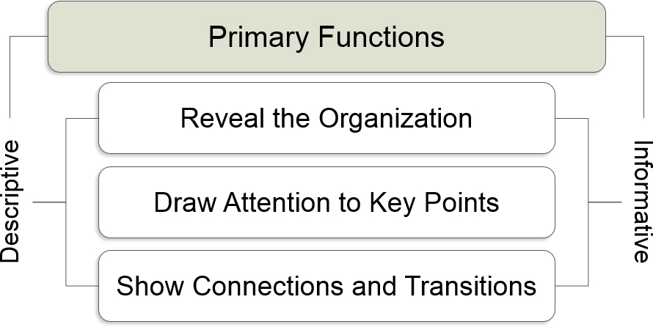
Adding Headings and Subheadings
Notes:
A heading is a brief title that tells readers about the content of the section that follows. Subheadings indicate subsections within a major section; complex documents may have several levels of subheadings.
Descriptive headings, such as “Cost Considerations,” identify a topic but do little more. Informative headings, such as “Redesigning Material Flow to Cut Production Costs,” put your reader right into the context of your message.
Well-written, informative headings are self-contained, which means that readers can skim just the headings and subheadings and understand them without reading the rest of the document. Headings and subheadings help in three important ways:
They show readers at a glance how the material is organized.
They call attention to important points.
They highlight connections and transitions between ideas.

Slide 16
Summary of Discussion (2 of 6)
In this section, we discussed the following:
Varying Your Sentence Length
Keeping Paragraphs Short
Using Lists and Bullets to Clarify and Emphasize
Adding Headings and Subheadings
The next section will cover Editing for Clarity and Conciseness.

Slide 17
Editing for Clarity and Conciseness
LO 5.3 Describe the steps you can take to improve the clarity of your writing, and give four tips for making your writing more concise.
Notes:
After you’ve reviewed and revised your message for readability, your next step is to make sure your message is as clear and as concise as possible.

Slide 18
Editing for Clarity
Break Up Overly Long Sentences
Rewrite Hedging Sentences
Impose Parallel Structure
Correct Dangling Modifiers
Reword Long Noun Sequences
Replace Camouflaged Verbs
Clarify Sentence Structure
Clarify Awkward References
Notes:
Use the following guidelines to make sure that your message is clear:
Break up overly long sentences. You can often clarify your writing style by breaking overly long sentences into shorter individual sentences.
Rewrite hedging sentences. Sometimes you have to write may or seems to avoid stating a judgment as a fact. Nevertheless, when you have too many such hedges, you aren’t really saying anything.
Impose parallelism. When you have two or more similar (parallel) ideas to express, use parallel construction—the same grammatical pattern for each related idea. Parallelism can be achieved by repeating the pattern in words, phrases, clauses, or entire sentences.
Correct dangling modifiers. Sometimes a modifier is not just an adjective or an adverb but an entire phrase modifying a noun or a verb. Be careful not to leave this type of modifier dangling with no connection to the subject of the sentence.

Slide 19
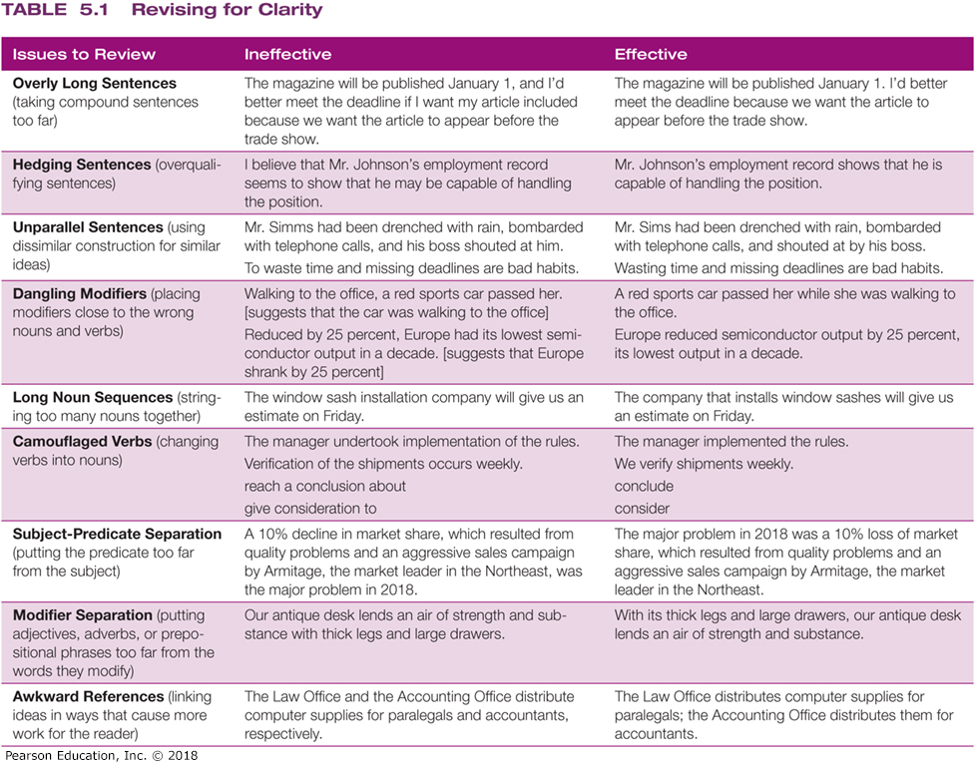
Editing for Clarity
Notes:
Reword long noun sequences. When nouns are strung together as modifiers, the resulting sentence is hard to read. You can clarify the sentence by putting some of the nouns in a modifying phrase. Although you add a few more words, your audience won’t have to work as hard to understand the sentence.
Replace camouflaged verbs. Watch for word endings, such as -ion, -tion, -ing, -ment, -ant, -ent, -ence, -ance, and -ency. Most of them change verbs into nouns and adjectives. Get rid of them. Also try not to transform verbs into nouns (writing “we performed an analysis of” rather than “we analyzed”).
Clarify sentence structure. Keep the subject and predicate of a sentence as close together as possible. When subject and predicate are far apart, readers have to read the sentence twice to figure out who did what. Similarly, adjectives, adverbs, and prepositional phrases usually make the most sense when they’re placed as close as possible to the words they modify.
Clarify awkward references. Business writers sometimes use expressions such as the above-mentioned, as mentioned above, the aforementioned, the former, the latter, and respectively. These words cause readers to jump from point to point, which hinders effective communication. Use specific references, even if you must add a few more words.

Slide 20
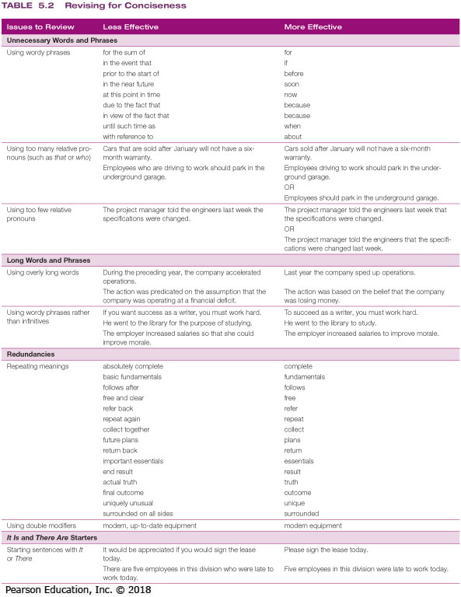
Editing for Conciseness
Delete Unnecessary Words and Phrases
Replace Long Words and Phrases
Eliminate Redundant Word Combinations
Recast “It is/There are” Starters
Notes:
Once you have edited your sentences for clarity, focus on conciseness. Three-fourths of the executives who participated in one survey complained that most written messages are too long. Use the following guidelines to write concisely:
Delete unnecessary words and phrases. Some combinations of words have more efficient, one-word equivalents. However, well-placed relative pronouns and articles can prevent confusion. Avoid the clutter of too many or poorly placed relative pronouns (who, that, which). Even articles can be excessive (mostly too many the’s).
Replace long words and phrases. Short words are generally more vivid and easier to read than long words. The idea is to use short, simple words, not simple concepts. Plus, by using infinitives in place of some phrases, you not only shorten your sentences but also make them clearer.
Eliminate redundancies. In some word combinations, the words tend to say the same thing. For instance, “visible to the eye” is redundant because visible is enough; nothing can be “visible to the ear.”
Recast “It is/There are” starters. If you start a sentence with an indefinite pronoun (an expletive) such as it or there, odds are that the sentence could be shorter.

Slide 21
Summary of Discussion (3 of 6)
In this section, we discussed the following:
Editing for Clarity
Editing for Conciseness
The next section will cover Producing Your Message.

Slide 22
Producing Your Message
LO 5.4 List four principles of effective design, and explain the role of major design elements in document readability.
Notes:
Now it’s time to put your hard work on display. The production quality of your message—the total effect of page or screen design, graphical elements, typography, and so on—plays an important role in its effectiveness. A polished, inviting design not only makes your document easier to read but also conveys a sense of professionalism and importance.

Slide 23
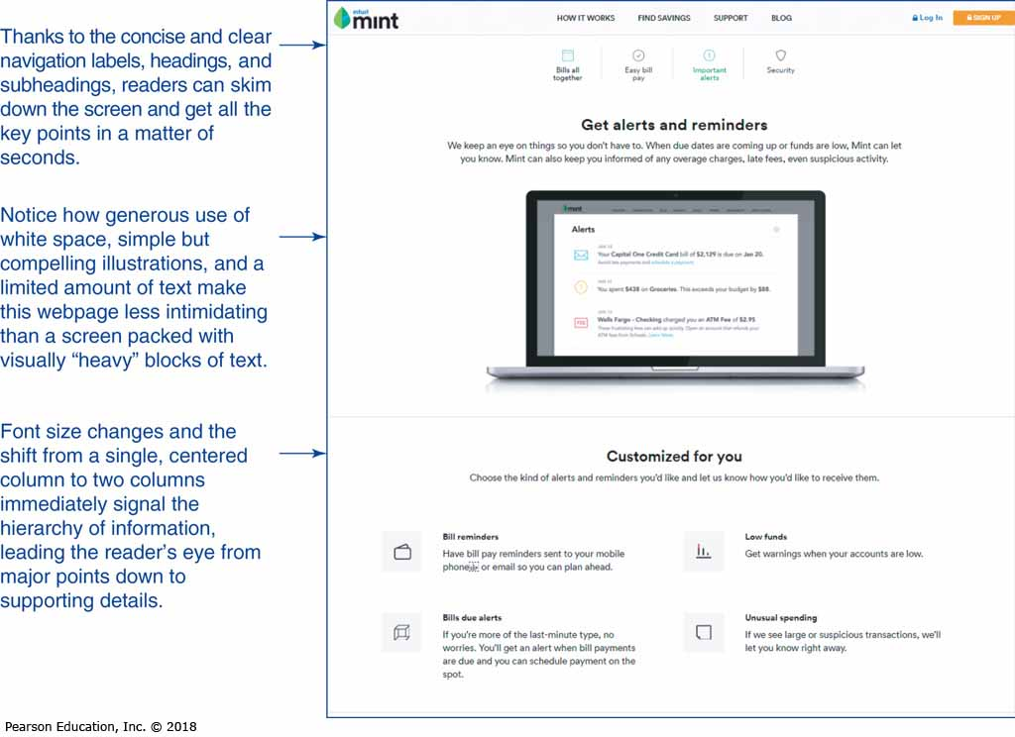
Designing for Readability
Design Elements
Consistency
Balance
Detail
Restraint
Notes:
Design elements can increase or decrease the effectiveness of your message. In addition, design elements send a nonverbal message to your readers, influencing their perceptions before they read a single word. To achieve an effective design, pay careful attention to the following design elements:
Consistency. Throughout a message, be consistent in your use of margins, typeface, type size, and spacing. Also, be consistent when using recurring design elements, such as vertical lines, columns, and borders.
Balance. To create a pleasing design, balance all visual elements; that is text, artwork, and white space.
Detail. Pay attention to details that affect your design and thus your message. For instance, headings and subheadings that appear at the bottom of a column or a page can offend readers when the promised information doesn’t appear until the next column or page. And narrow columns with too much space between words can be distracting.
Restraint. Strive for simplicity in design. Don’t clutter your message with too many design elements, too much highlighting, or too many decorative touches.

Slide 24
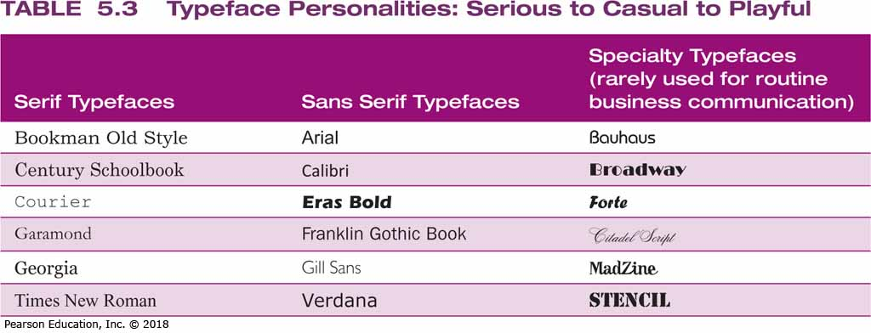
Readability Issues
White Space
Margins and Justification
Typeface
Notes:
Any space free of text or artwork is considered white space.
Margins define the space around text and between text columns
Typeface refers to the physical design of letters, numbers, and other text characters.

Slide 25
Designing for Mobile Devices
Think in Small Chunks
Use Plenty of White Space
Keep the Format Simple
Experiment with Layouts
Notes:
In addition to making your content mobile-friendly (using the writing tips in Chapter 4), you can follow these steps to format that content for mobile devices:
Think in small chunks. Mobile users consume information one screen at a time, so try to divide your message into independent, easy-to-consume bites. If readers have to scroll through a dozen screens to piece together your message, they might miss your point or just give up entirely.
Make generous use of white space. White space is critical on small screens because users are trying to get the point of every message as quickly as possible. Keep your paragraphs short (4–6 lines) and separate them with blank lines.
Format simply. Avoid anything that is likely to get in the way of fast, easy reading, including busy typefaces, complex graphics, and complicated layouts.
Consider horizontal and vertical layouts. Most phones and tablets can automatically rotate their screen content from horizontal to vertical as the user rotates the device. A layout that doesn’t work well with the narrow vertical perspective might be acceptable at the wider horizontal perspective.

Slide 26
Summary of Discussion (4 of 6)
In this section, we discussed the following:
Designing for Readability
Applying Key Design Elements
Designing for Mobile Devices
The next section will cover Proofreading Your Message.

Slide 27
Proofreading Your Message
LO 5.5 Explain the importance of proofreading, and give six tips for successful proofreading.
Notes:
Proofreading is the quality inspection stage for your documents. It is your last chance to make sure your document is ready to carry your message—and your reputation—to the intended audience. Even a small mistake can doom your efforts, so take proofreading seriously.

Slide 28
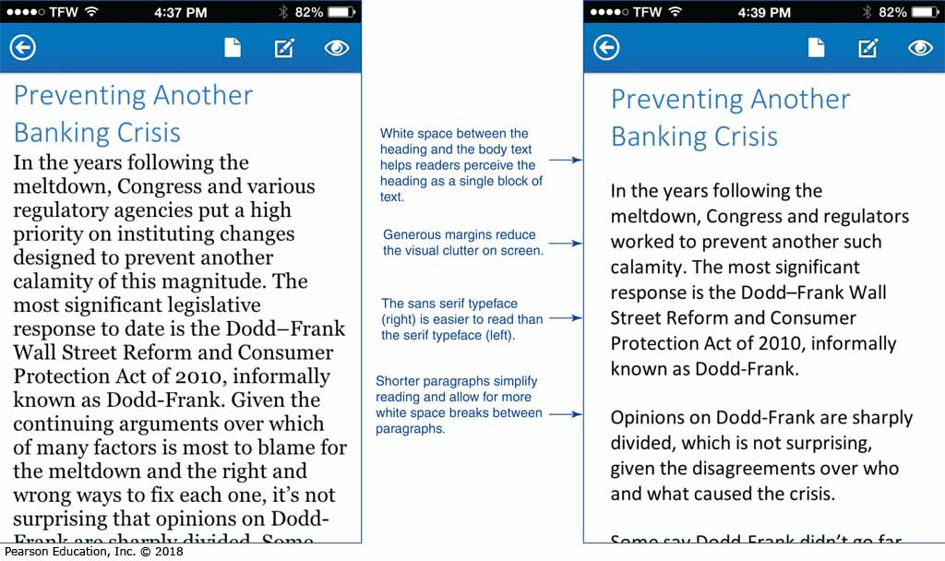
Typical Sources of Problems
Writing Stage
Design Stage
Layout Stage
Production Process
Notes:
When you’re proofreading, look for two types of problems: (1) undetected mistakes from the writing, design, and layout stages and (2) mistakes that crept in during production. Be particularly vigilant with complex documents and complex production processes that involve teams of people and multiple computers.

Slide 29
Proofreading Carefully
Make Multiple Passes
Use Perceptual Tricks
Check High-Priority Items
Get Some Distance
Stay Focused and Vigilant
Review Complex Documents on Paper
Don’t Rush Proofreading
Notes:
Proofreading should be a methodical procedure in which you look for specific problems. Here is some advice:
Make multiple passes. Go through the document several times, focusing on a different aspect each time.
Use perceptual tricks. To keep from missing things that are “in plain sight,” try reading pages backward, placing your finger under each word and reading it silently, covering everything but the line you’re currently reading, and reading the document aloud.
Focus on high-priority items. Double-check names, titles, dates, addresses, and numbers.

Slide 30
Proofreading Tips
Notes:
Use the tips in Table 5.4 to improve the proofreading process and outcomes.

Slide 31
Summary of Discussion (5 of 6)
In this section, we discussed the following:
Typical Sources of Problems
Proofreading Carefully
The next section will cover Distributing Your Message.

Slide 32
Distributing Your Message
LO 5.6 Discuss the most important issues to consider when distributing your messages.
Notes:
With the production finished, you’re ready to distribute your message. You often have several options for distribution; therefore, consider the factors on the following slide when making your choice.

Slide 33
Distributing Messages
Factors of Distribution
Concerns with Cost
Overall Convenience
Time Constraints
Security and Privacy
Notes:
You don’t always have a choice of which distribution method to use, but if you do, consider the following factors:
Cost. This is not a concern for most messages, but for lengthy reports or multimedia productions, it might well be. Printing, binding, and delivering reports can be an expensive proposition, so weigh the cost versus the benefits before you decide.
Convenience. How much work is involved for you and your audience? Sending large files via a company network can work well. However, large files can be difficult to handle on mobile devices via wireless networks.
Time. How soon does the message need to reach the audience? Don't waste money on overnight delivery if the recipient won’t read the report for a week.
Security and privacy. The convenience offered by IM, email, and other technologies must be weighed against security and privacy concerns.
Distribution technologies continue to advance, so be on the lookout for new ways to put your messages into the hands of your audience.

Slide 34
Summary of Discussion (6 of 6)
In this section, we discussed the following:
Distributing Your Message
This concludes our discussion of Chapter 5: Completing Business Messages.

Slide 35
Copyright

