Slide 1
Chapter 2
Decision Making

Slide 2
Learning Objectives
2.1 Describe the eight steps in the decision-making process.
Develop your skill at being creative.
2.2 Explain the four ways managers make decisions.
2.3 Classify decisions and decision-making conditions.
2.4 Describe how biases affect decision making.
Know how to recognize when you’re using decision-making errors and biases and what to do about it
2.5 Identify effective decision-making techniques.

Slide 3
Be A Better Decision-Maker
A key to success in management and in your career is knowing how to be an effective decision-maker.

Slide 4
What is a Decision?
Decision—a choice among two or more alternatives
Notes:
Managers at all levels and in all areas of organizations make decisions. That is, they make choices. Although decision-making is typically described as choosing among alternatives, this view is too simplistic. Why? Because decision-making is (and should be) a process, not just a simple act of choosing among alternatives.
Source: Alex Segre/Alamy

Slide 5
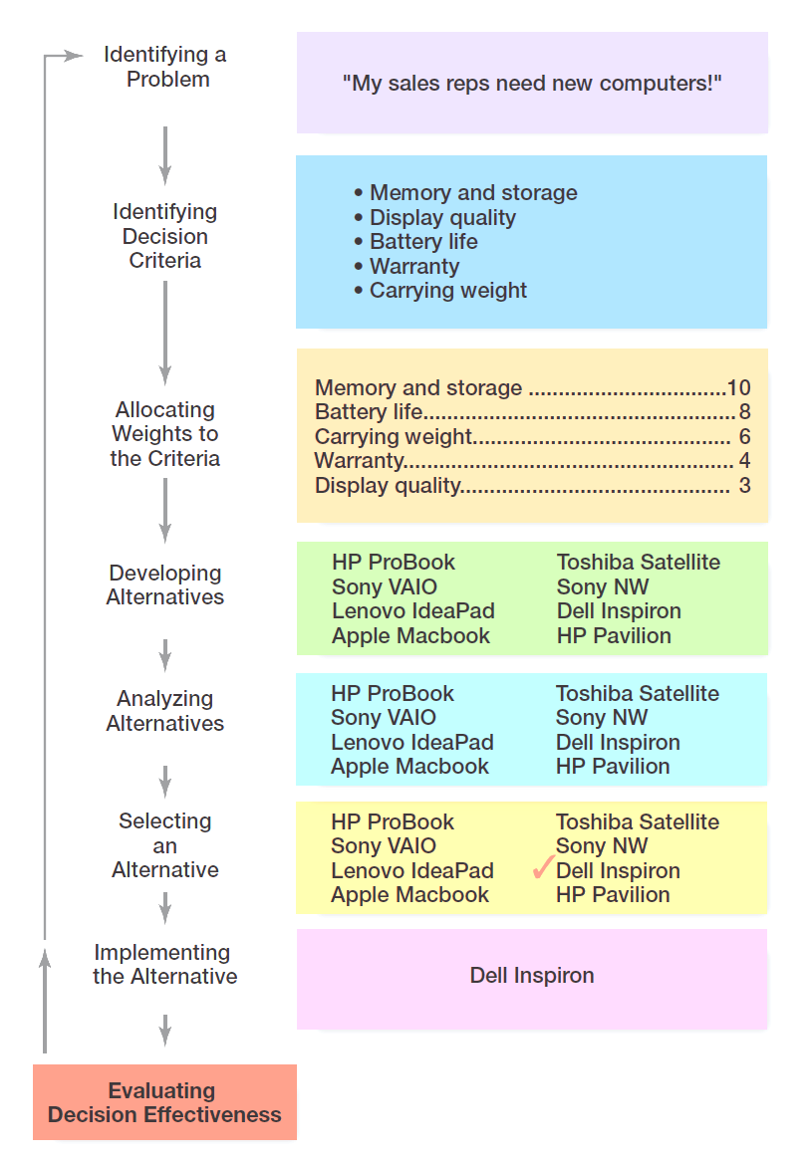
Exhibit 2-1 Decision-Making Process

Slide 6
Decision-Making Process Step 1: Identify a Problem
Problem: an obstacle that makes it difficult to achieve a desired goal or purpose.
Every decision starts with a problem, a discrepancy “conflict” between an existing and a desired condition.
This might seem self-evident but you’d be surprised at how many people try to jump in with a quick and easy solution without having spent time to first understand and then define the problem. When you do that, you might come up with a solution . . . to the wrong problem!
Example: Amanda is a sales manager whose reps need new laptops.
Notes:
Every decision starts with a problem, a discrepancy between an existing and a desired condition. For our example, Amanda is a sales manager whose reps need new laptops because their old ones are outdated and inadequate for doing their job. To make it simple, assume it’s not economical to add memory to the old computers and it’s the company’s policy to purchase, not lease. Now we have a problem—a disparity between the sales reps’ current computers (existing condition) and their need to have more efficient ones (desired condition). Amanda has a decision to make.

Slide 7
Decision-Making Process Step 2: Identify the Decision Criteria
Decision criteria are factors that are important to resolving the problem.
Every decision-maker has criteria guiding his or her decisions even if they’re not clearly declared.
Example: Amanda decides that memory and storage capabilities, display quality, battery life, warranty, and carrying weight are the relevant criteria in her decision
Notes:
Once a manager has identified a problem, he or she must identify the decision criteria important or relevant to resolving
the problem. Every decision-maker has criteria guiding his or her decisions even if they’re not explicitly stated. In our example,
Amanda decides after careful consideration that memory and storage capabilities, display quality, battery life, warranty, and carrying weight are the relevant criteria in her decision.

Slide 8
Decision-Making Process Step 3: Allocate Weights to the Criteria
If the relevant criteria aren’t equally important, the decision maker must weight the items in order to give them the correct priority in the decision.
Example: The weighted criteria for Amanda’s computer purchase are shown in Exhibit 2-2.
Notes:
If the relevant criteria aren’t equally important, the decision maker must weight the items in order to give them the correct
priority in the decision. How? A simple way is to give the most important criterion a weight of 10 and then assign weights to the rest using that standard. Of course, you could use any number as the highest weight. The weighted criteria for our example is shown in Exhibit 2-2.

Slide 9
Exhibit 2-2 Important Decision Criteria
Criterion | Weight
Memory and storage | 10
Battery life | 8
Carrying weight | 6
Warranty | 4
Display quality | 3

Slide 10
Decision-Making Process Step 4: Develop Alternatives
List viable alternatives that could solve the problem.
Example: Amanda identifies eight laptops as possible choices (shown in Exhibit 2-3).
Notes:
The fourth step in the decision-making process requires the decision maker to list viable alternatives that could resolve the problem. In this step, a decision maker needs to be creative, and the alternatives are only listed—not evaluated—just yet. Our sales manager, Amanda, identifies eight laptops as possible choices (see Exhibit 2-3).

Slide 11
Exhibit 2-3 Possible Alternatives
Laptop | Memory and Storage | Battery Life | Carrying Weight | Warranty | Display Quality
HP ProBook | 10 | 3 | 10 | 8 | 5
Lenovo IdeaPad | 8 | 5 | 7 | 10 | 10
Apple MacBook | 8 | 7 | 7 | 8 | 7
Toshiba Satellite | 7 | 8 | 7 | 8 | 7
Apple MacBook Air | 8 | 3 | 6 | 10 | 8
Dell Inspirion | 10 | 7 | 8 | 6 | 7
HP Pavilion | 4 | 10 | 4 | 8 | 10

Slide 12
Decision-Making Process Step 5: Analyze Alternatives
The eight-step decision-making process begins with identifying a problem and ends with evaluating the result of the decision. After identifying the need to buy new laptop computers for her secretary, the manager must identify relevant criteria such as price, display quality, and memory that will help guide her final decision.
Sometimes a decision-maker might be able to skip this step. If one alternative scores highest on every criterion, you wouldn’t need to consider the weights because that alternative would already be the top choice

Slide 13
Decision-Making Process Step 6: Select an Alternative
Choose the alternative that generates the highest total in Step 5.
The sixth step in the decision-making process is choosing the best alternative or the one that generated the highest total in Step 5. In our example (Exhibit 2-4), Amanda would choose the Dell Inspiron because it scored higher than all other alternatives (249 total).
Notes:
The sixth step in the decision-making process is choosing the best alternative or the one that generated the highest total in Step 5. In our example (Exhibit 2-4), Amanda would choose the Dell Inspiron because it scored higher than all other alternatives (249 total).

Slide 14
Exhibit 2-4 Evaluation of Alternatives
Laptop | Memory and Storage | Battery Life | Carrying Weight | Warranty | Display Quality | Total
HP ProBook | 100 | 24 | 60 | 32 | 15 | 231
Lenovo IdeaPad | 80 | 40 | 42 | 40 | 30 | 232
Apple MacBook | 80 | 56 | 42 | 32 | 21 | 231
Toshiba Satellite | 70 | 64 | 42 | 32 | 21 | 229
Apple MacBook Air | 80 | 24 | 36 | 40 | 24 | 204
Dell Inspirion | 100 | 56 | 48 | 24 | 21 | 249
HP Pavilion | 40 | 80 | 24 | 32 | 30 | 206

Slide 15
Decision-Making Process Step 7: Implement the Alternative
Put the chosen alternative into action.
Convey “transfer” the decision to those affected and get their commitment to it.
Managers may need to do during implementation is reassess the environment for any changes, especially if it’s a long-term decision. Are the criteria, alternatives, and choices still the best ones, or has the environment changed in such a way that we need to reevaluate?
Notes:
In Step 7 in the decision-making process, you put the decision into action by conveying it to those affected and getting their commitment to it. We know that if the people who must implement a decision participate in the process, they’re more likely to support it than if you just tell them what to do. Another thing managers may need to do during implementation is reassess the environment for any changes, especially if it’s a long-term decision. Are the criteria, alternatives, and choice still the best ones, or has the environment changed in such a way that we need to reevaluate?

Slide 16
Decision-Making Process Step 8: Evaluate Decision Effectiveness
Evaluate the result or outcome of the decision to see if the problem was resolved.
If it wasn’t resolved, what went wrong?
If the evaluation shows that the problem still exists, then the manager needs to assess what went wrong. Was the problem incorrectly defined? Were errors made when evaluating alternatives? Was the right alternative selected but poorly implemented? The answers might lead you to redo an earlier step or might even require starting the whole process over.
Notes:
The last step in the decision-making process involves evaluating the outcome or result of the decision to see whether the problem was resolved. If the evaluation shows that the problem still exists, then the manager needs to assess what went wrong. Was the problem incorrectly defined? Were errors made when evaluating alternatives? Was the right alternative selected but poorly implemented? The answers might lead you to redo an earlier step or might even require starting the whole process over.

