Slide 2
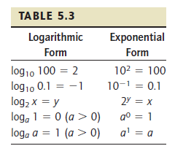

Slide 3
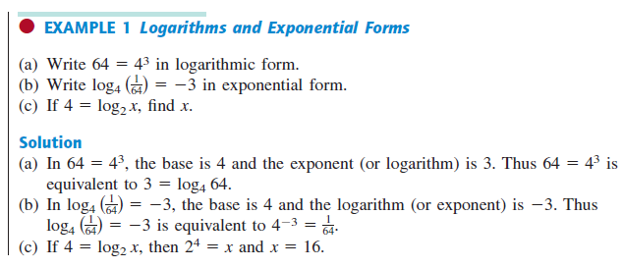

Slide 5
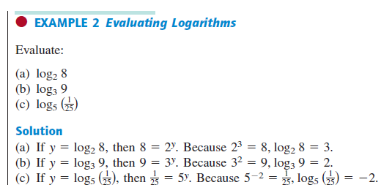
$y=\log_{2}{8}→2^{y}$=8$→2^{y}\text{=}2^{3}→y=3$
$y=\log_{5}{\frac{1}{25}=\log_{5}{\frac{1}{5^{2}}}}=\log_{5}{5^{−2}}→5^{y}$=$5^{−2}→y=−2$

Slide 6
$${y=−3→x=2^{y}→x=2}^{−3}=\frac{1}{2^{3}}=\frac{1}{8}→x=\frac{1}{8}$$
$${y=−2→x=2^{y}→x=2}^{−2}=\frac{1}{2^{2}}=\frac{1}{4}→x=\frac{1}{4}$$
$${y=−1→x=2^{y}→x=2}^{−1}=\frac{1}{2^{1}}=\frac{1}{2}→x=\frac{1}{2}$$
$${y=0→x=2^{y}→x=2}^{0}=1→x=1$$
$${y=1→x=2^{y}→x=2}^{1}=2→x=2$$
$${y=2→x=2^{y}→x=2}^{2}=4→x=4$$

Slide 7
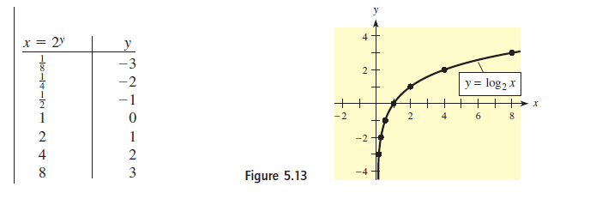

Slide 9
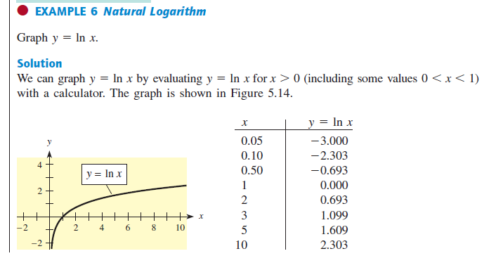

Slide 10
$${y\left(1\right)=log}_{a}{1}=0$$

Slide 11
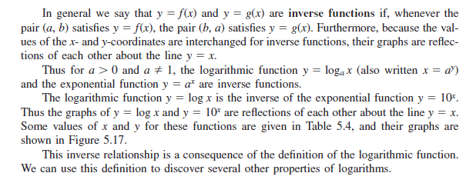

Slide 12
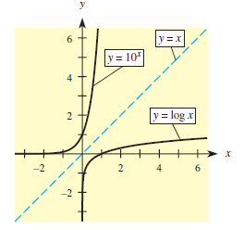
$${y=log}_{a}{x} is the inverse of y=a^{x}$$
$$y={\log{x}} is the inverse of y={10}^{x}$$
$${y=log}_{e}{x→y=\ln{x}} is the inverse of y=e^{x}$$
${the graph of y=log}_{a}{x} and y=a^{x}$ are reflection of each other about the line $y=x$
the graph of $y=\log{x }and y={10}^{x}$ are reflection of each other about the line $y=x$

Slide 13
$$\log_{3}{9^{2}=2\log_{3}{9}}=2\log_{3}{3^{2}=2∗2∗\log_{3}{3=2∗2∗1=4}}$$

Slide 14
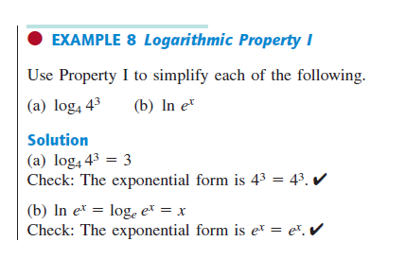
$$\log_{4}{4^{3}=3\log_{4}{4=3∗1=3}}$$
$$\ln{e^{x}=\log_{e}{e^{x}=x∗\log_{e}{e=x∗1=x}}}$$

Slide 15
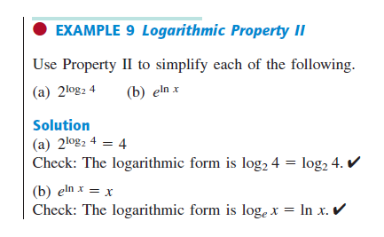
$$e^{\log_{e}{x}}=x$$

Slide 16
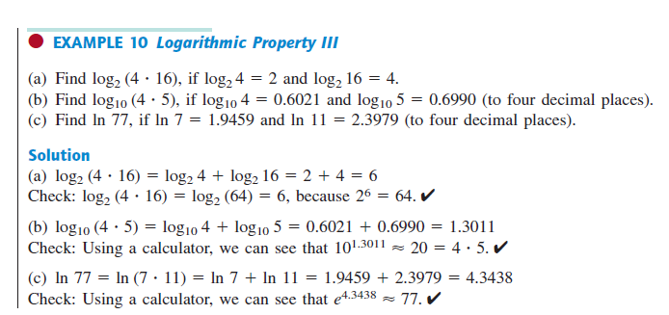
$$\log_{2}\left(4 . 16\right)=\log_{2}{4}+\log_{2}{16}=\log_{2}{2^{2}}+\log_{2}{2^{4}}=2\log_{2}{2}+4\log_{2}{2}=2∗1+4∗1=2+4=6$$

Slide 17
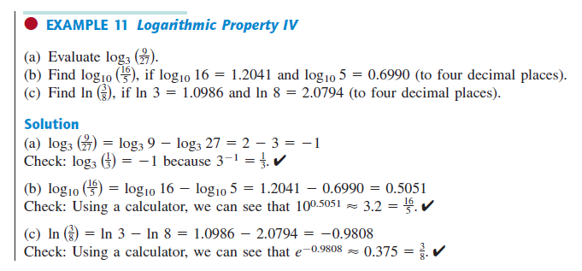
$${a) log}_{3}{\frac{9}{27}=\log_{3}{9}−\log_{3}{27}=\log_{3}{3^{2}}−\log_{3}{3^{3}=2\log_{3}{3}−3\log_{3}{3=2−3=−1}}}$$

Slide 18
