Slide 1
Object-Oriented Programming: Inheritance
Prepared by: Jomana Yousef Khaseeb

Slide 2
What is Inheritance??
Inheritance is a form of software reuse in which a new class is created by absorbing an existing class’s members and embellishing them with new or modified capabilities.
Inheritance is a mechanism in which one object acquires all the properties and behaviors of a parent object.
With inheritance, you can save time during program development.

Slide 3
Why use inheritance in java?
For Method Overriding.
For Code Reusability.

Slide 4
Terms used in Inheritance
Sub Class/Child Class: Subclass is a class which inherits the other class. It is also called a derived class, extended class, or child class.
Super Class/Parent Class: Superclass is the class from where a subclass inherits the features. It is also called a base class or a parent class.
Reusability: As the name specifies, reusability is a mechanism which facilitates you to reuse the fields and methods of the existing class when you create a new class. You can use the same fields and methods already defined in the previous class.

Slide 5
The syntax of Java Inheritance
The extends keyword indicates that you are making a new class that derives from an existing class. The meaning of "extends" is to increase the functionality.

Slide 6
Java Inheritance Example
As displayed in the above figure, Programmer is the subclass and Employee is the superclass. The relationship between the two classes is Programmer is an Employee. It means that Programmer is a type of Employee.

Slide 7
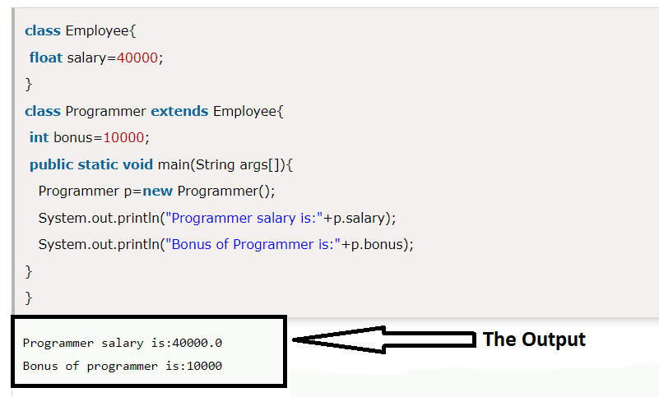
Java Inheritance Example

Slide 8
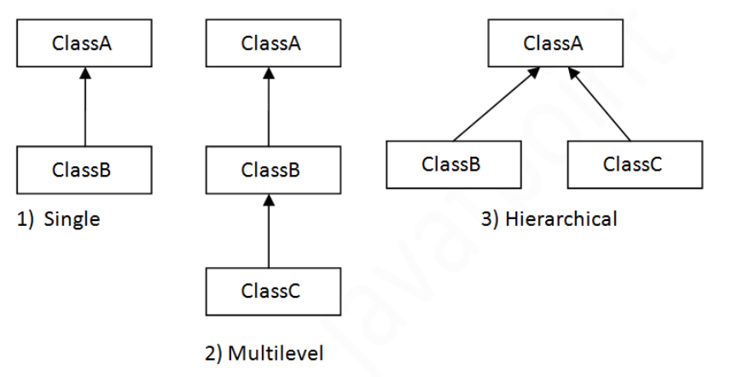
Types of inheritance in java

Slide 9
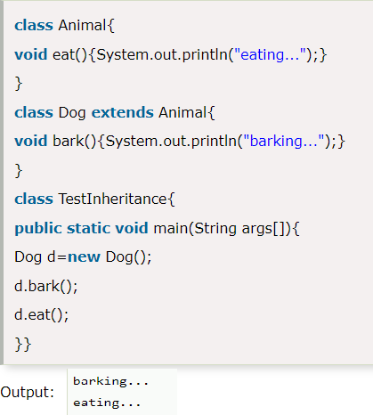
Single Inheritance Example

Slide 10
Multilevel Inheritance Example

Slide 11
Hierarchical Inheritance Example

Slide 12
Think!!!!
Why multiple inheritance is not supported in java?

Slide 13
Method Overriding in Java
If subclass (child class) has the same method as declared in the parent class, it is known as method overriding in Java.
In other words, If a subclass provides the specific implementation of the method that has been declared by one of its parent class, it is known as method overriding.
Static methods cannot be overridden.

Slide 14
Usage of Java Method Overriding
Method overriding is used to provide the specific implementation of a method which is already provided by its superclass.
Method overriding is used for runtime polymorphism.

Slide 15
Rules for Java Method Overriding
The method must have the same name as in the parent class.
The method must have the same parameter as in the parent class.

Slide 16
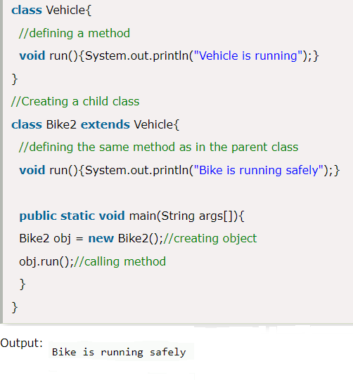
Example of method overriding

Slide 17
Super Keyword in Java
The super keyword in Java is a reference variable which is used to refer immediate parent class object.
Whenever you create the instance of subclass, an instance of parent class is created implicitly which is referred by super reference variable.

Slide 18
Usage of Java super Keyword
super can be used to refer immediate parent class instance variable.
super can be used to invoke immediate parent class method.
super() can be used to invoke immediate parent class constructor.

Slide 19
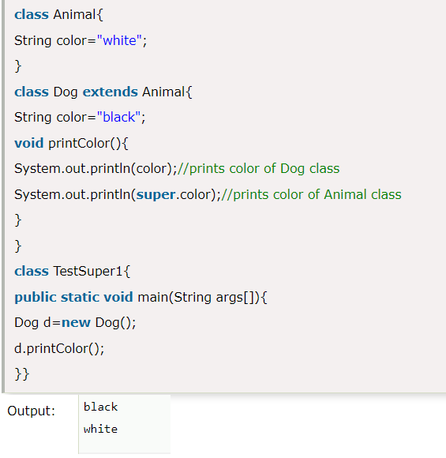
Super Keyword in Java
Super is used to refer immediate parent class instance variable:

Slide 20
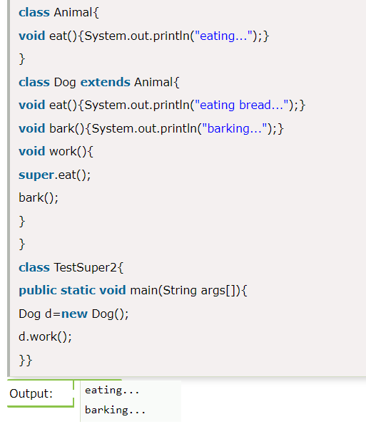
Super Keyword in Java
Super can be used to invoke parent class method:

Slide 21
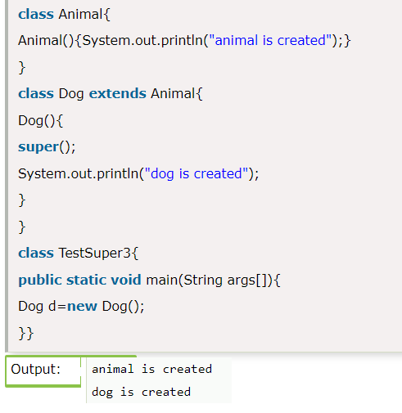
Super Keyword in Java
Super is used to invoke parent class constructor:

