Slide 1
Encapsulation
Prepared By: Jomana Yousef

Slide 2
Object and Classes
Object − Objects have states and behaviors. Example: A dog has states - color, name as well as behaviors – wagging the tail, barking, eating. An object is an instance of a class.
Class − A class can be defined as a template/blueprint that describes the behavior/state that the object of its type support.

Slide 3
Object and Classes

Slide 4
Object and Classes

Slide 5
Object and Classes

Slide 6
Object and Classes

Slide 7
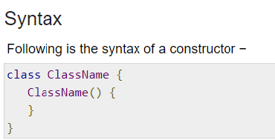
Constructors
A constructor initializes an object when it is created. It has the same name as its class and is syntactically similar to a method.
Typically, you will use a constructor to give initial values to the instance variables defined by the class, or to perform any other start-up procedures required to create a fully formed object.
All classes have constructors, whether you define one or not, because Java automatically provides a default constructor that initializes all member variables to zero.

Slide 8
Constructors

Slide 9
Encapsulation

Slide 10
Encapsulation
Encapsulation is one of the four fundamental OOP concepts. The other three are inheritance, polymorphism, and abstraction.
Encapsulation in Java is a mechanism of wrapping the data (variables) and code acting on the data (methods) together as a single unit. In encapsulation, the variables of a class will be hidden from other classes, and can be accessed only through the methods of their current class. Therefore, it is also known as data hiding.
To achieve encapsulation in Java −
Declare the variables of a class as private.
Provide public setter and getter methods to modify and view the variables values.

