Slide 1
Chapter 2
Quadratic and Other Special Functions
2.1 Quadratic Equations

Slide 2
Objectives :
To solve quadratic equations with factoring methods
To solve quadratic equations with the quadratic formula

Slide 3
Quadratic Equations :

Slide 4
Factoring Methods :

Slide 6
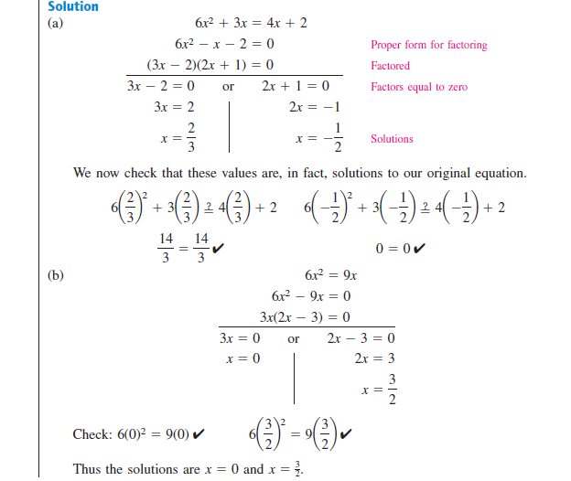

Slide 7
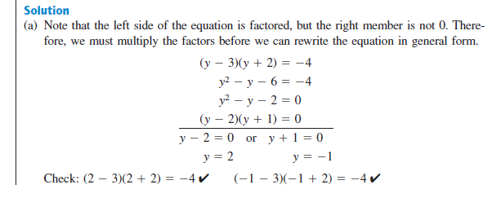

Slide 9
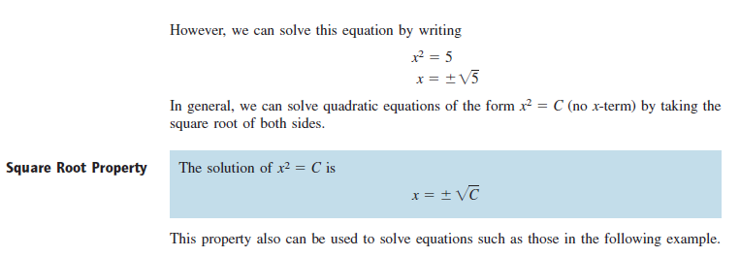
The Quadratic Formula :

Slide 10
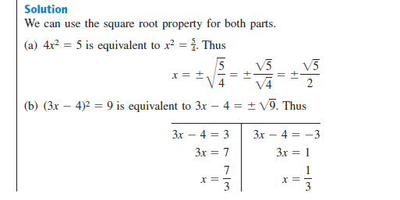

Slide 12
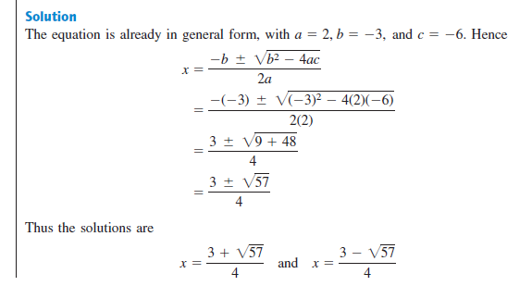

Slide 13
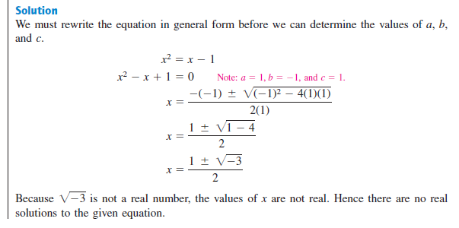

Slide 14
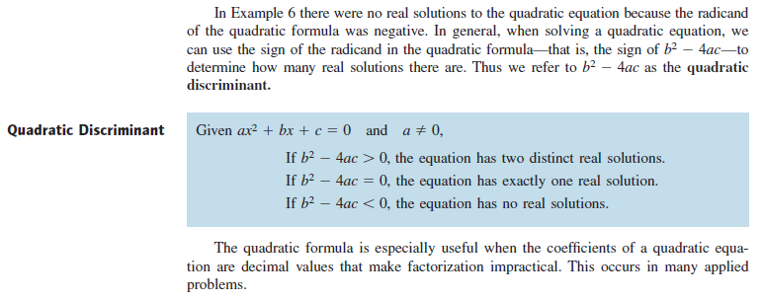

Slide 15
