Slide 1
Chapter 3
Matrices
3.1 Operations with Matrices

Slide 2
Introduction:

Slide 9
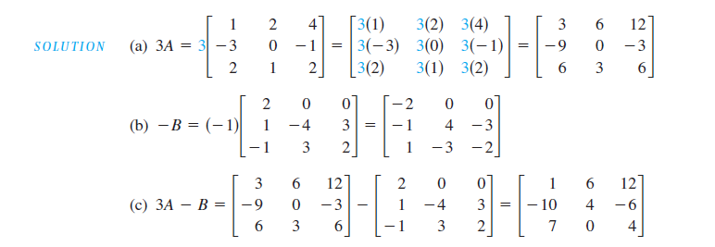

Slide 10
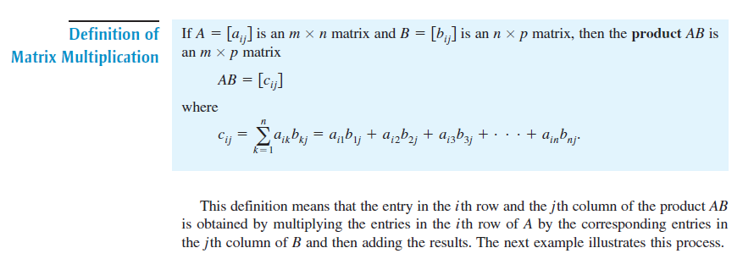
Matrix Multiplication:

Slide 12
