Slide 1
William Stallings Computer Organization and Architecture 10th Edition
Notes:
Lecture slides prepared for “Computer Organization and Architecture”, 10/e, by William Stallings, Chapter 3 “A Top Level View of Computer Function and Interconnection”.

Slide 2
Chapter 3
A Top-Level View of Computer
Function and Interconnection
Notes:
At a top level, a computer consists of CPU (central processing unit), memory, and
I/O components, with one or more modules of each type. These components are
interconnected in some fashion to achieve the basic function of the computer, which
is to execute programs. Thus, at a top level, we can characterize a computer system
by describing (1) the external behavior of each component, that is, the data and
control signals that it exchanges with other components and (2) the interconnection
structure and the controls required to manage the use of the interconnection
structure.
This top-level view of structure and function is important because of its
explanatory power in understanding the nature of a computer. Equally important is
its use to understand the increasingly complex issues of performance evaluation. A
grasp of the top-level structure and function offers insight into system bottlenecks,
alternate pathways, the magnitude of system failures if a component fails, and the
ease of adding performance enhancements. In many cases, requirements for greater
system power and fail-safe capabilities are being met by changing the design rather
than merely increasing the speed and reliability of individual components.
This chapter focuses on the basic structures used for computer component
interconnection. As background, the chapter begins with a brief examination of the
basic components and their interface requirements. Then a functional overview is
provided. We are then prepared to examine the use of buses to interconnect system
components.

Slide 3
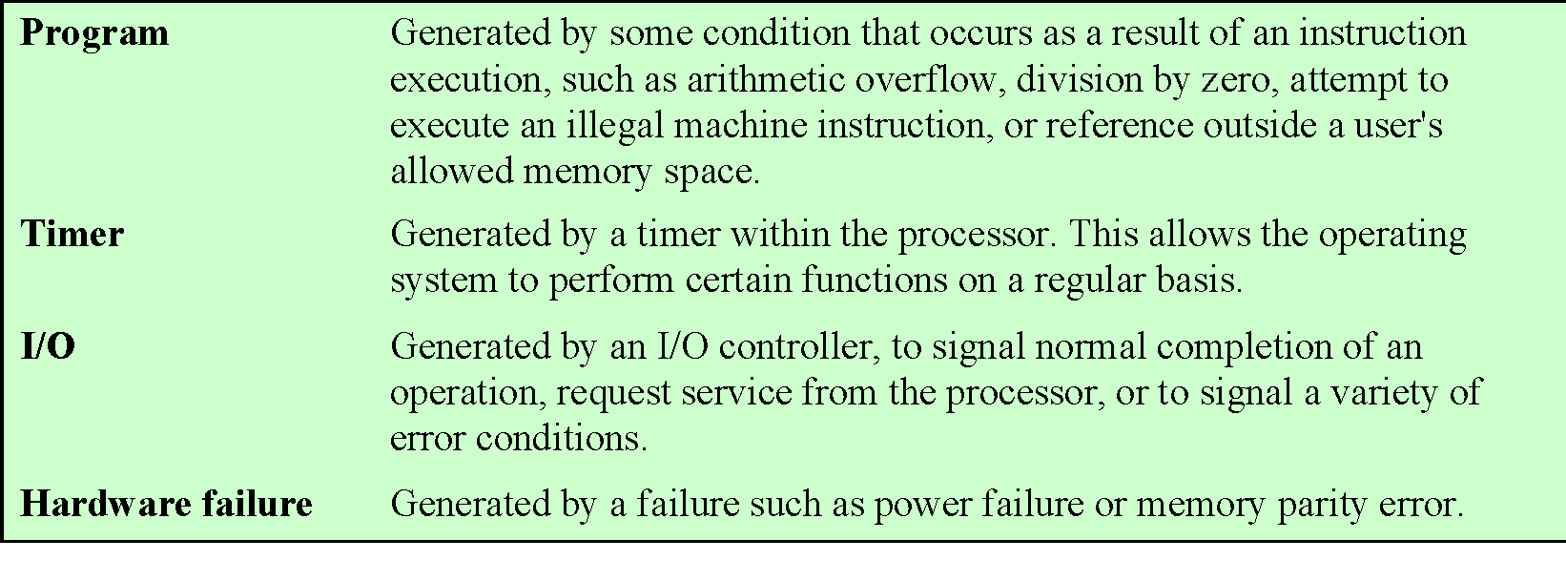
Table 3.1
Classes of Interrupts
Notes:
Virtually all computers provide a mechanism by which other modules (I/O, memory)
may interrupt the normal processing of the processor. Table 3.1 lists the most common
classes of interrupts. The specific nature of these interrupts is examined
later in this book, especially in Chapters 7 and 14. However, we need to introduce the concept
now to understand more clearly the nature of the instruction cycle and the implications
of interrupts on the interconnection structure.

Slide 4
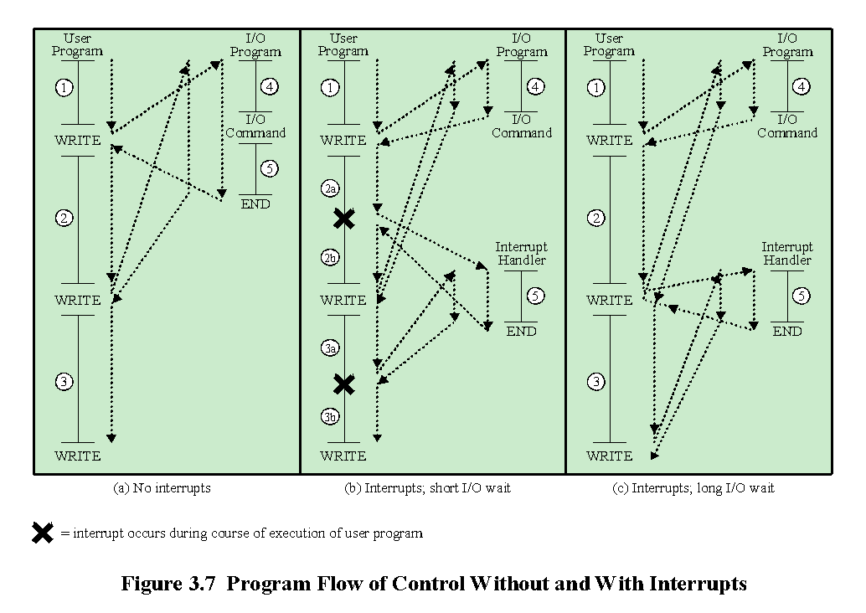
Notes:
Interrupts are provided primarily as a way to improve processing efficiency.
For example, most external devices are much slower than the processor. Suppose
that the processor is transferring data to a printer using the instruction cycle scheme
of Figure 3.3. After each write operation, the processor must pause and remain
idle until the printer catches up. The length of this pause may be on the order of
many hundreds or even thousands of instruction cycles that do not involve memory.
Clearly, this is a very wasteful use of the processor.
Figure 3.7a illustrates this state of affairs. The user program performs a series
of WRITE calls interleaved with processing. Code segments 1, 2, and 3 refer to
sequences of instructions that do not involve I/O. The WRITE calls are to an I/O
program that is a system utility and that will perform the actual I/O operation. The
I/O program consists of three sections:
• A sequence of instructions, labeled 4 in the figure, to prepare for the actual
I/O operation. This may include copying the data to be output into a special
buffer and preparing the parameters for a device command.
• The actual I/O command. Without the use of interrupts, once this command is
issued, the program must wait for the I/O device to perform the requested function
(or periodically poll the device). The program might wait by simply repeatedly
performing a test operation to determine if the I/O operation is done.
• A sequence of instructions, labeled 5 in the figure, to complete the operation.
This may include setting a flag indicating the success or failure of the operation.
Because the I/O operation may take a relatively long time to complete, the I/O
program is hung up waiting for the operation to complete; hence, the user program
is stopped at the point of the WRITE call for some considerable period of time.
With interrupts, the processor can
be engaged in executing other instructions while an I/O operation is in progress.
Consider the flow of control in Figure 3.7b. As before, the user program reaches a
point at which it makes a system call in the form of a WRITE call. The I/O program
that is invoked in this case consists only of the preparation code and the actual I/O
command. After these few instructions have been executed, control returns to the
user program. Meanwhile, the external device is busy accepting data from computer
memory and printing it. This I/O operation is conducted concurrently with the
execution of instructions in the user program.
When the external device becomes ready to be serviced—that is, when it is
ready to accept more data from the processor—the I/O module for that external
device sends an interrupt request signal to the processor. The processor responds by
suspending operation of the current program, branching off to a program to service
that particular I/O device, known as an interrupt handler, and resuming the original
execution after the device is serviced. The points at which such interrupts occur are
indicated by an asterisk in Figure 3.7b.
Let us try to clarify what is happening in Figure 3.7. We have a user program
that contains two WRITE commands. There is a segment of code at the beginning,
then one WRITE command, then a second segment of code, then a second WRITE
command, then a third and final segment of code. The WRITE command invokes the
I/O program provided by the OS. Similarly, the I/O program consists of a segment
of code, followed by an I/O command, followed by another segment of code. The I/O
command invokes a hardware I/O operation.

Slide 5
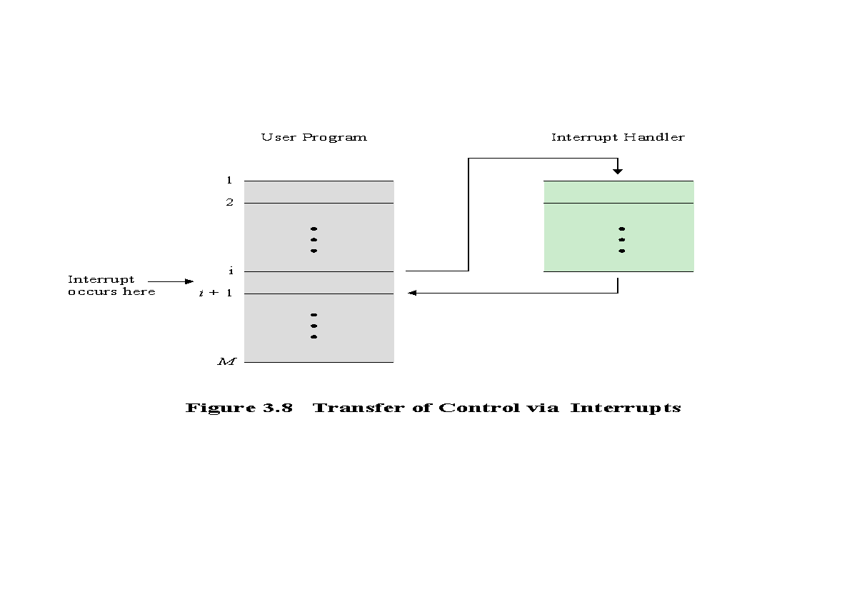
Notes:
From the point of view of the user program, an interrupt is just that: an interruption
of the normal sequence of execution. When the interrupt processing is completed,
execution resumes (Figure 3.8). Thus, the user program does not have to contain any
special code to accommodate interrupts; the processor and the operating system are
responsible for suspending the user program and then resuming it at the same point.

Slide 6
Notes:
To accommodate interrupts, an interrupt cycle is added to the instruction
cycle, as shown in Figure 3.9. In the interrupt cycle, the processor checks to see if
any interrupts have occurred, indicated by the presence of an interrupt signal. If no
interrupts are pending, the processor proceeds to the fetch cycle and fetches the
next instruction of the current program. If an interrupt is pending, the processor
does the following:
• It suspends execution of the current program being executed and saves its
context. This means saving the address of the next instruction to be executed
(current contents of the program counter) and any other data relevant to the
processor’s current activity.
• It sets the program counter to the starting address of an interrupt handler routine.
The processor now proceeds to the fetch cycle and fetches the first instruction
in the interrupt handler program, which will service the interrupt. The interrupt
handler program is generally part of the operating system. Typically, this program
determines the nature of the interrupt and performs whatever actions are needed.
In the example we have been using, the handler determines which I/O module
generated the interrupt and may branch to a program that will write more data out
to that I/O module. When the interrupt handler routine is completed, the processor
can resume execution of the user program at the point of interruption.
It is clear that there is some overhead involved in this process. Extra instructions
must be executed (in the interrupt handler) to determine the nature of the interrupt
and to decide on the appropriate action. Nevertheless, because of the relatively large
amount of time that would be wasted by simply waiting on an I/O operation, the
processor can be employed much more efficiently with the use of interrupts.

Slide 7
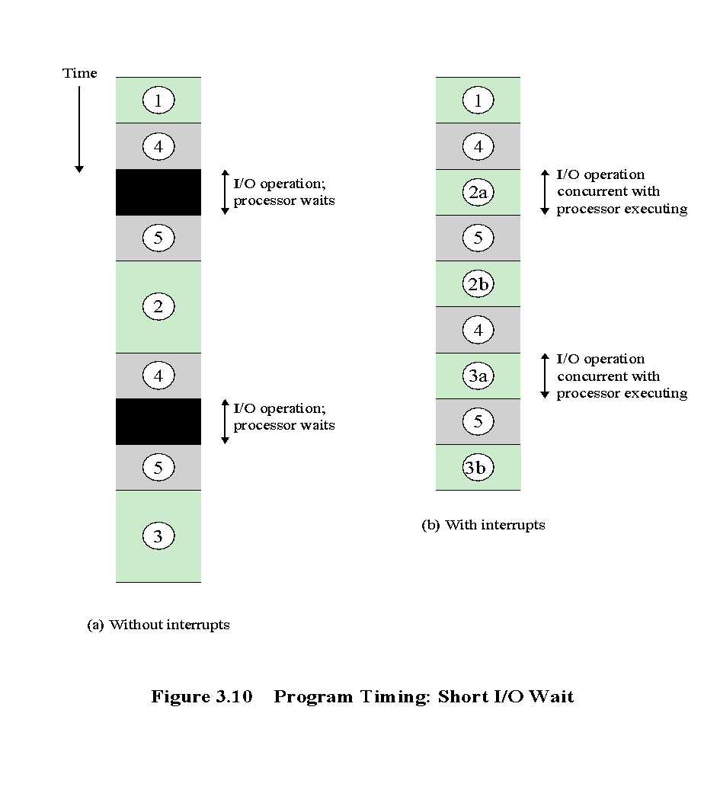
Notes:
To appreciate the gain in efficiency, consider Figure 3.10, which is a timing diagram
based on the flow of control in Figures 3.7a and 3.7b. In this figure, user program
code segments are shaded green, and I/O program code segments are shaded
gray. Figure 3.10a shows the case in which interrupts are not used. The processor must
wait while an I/O operation is performed.
Figures 3.7b and 3.10b assume that the time required for the I/O operation is
relatively short: less than the time to complete the execution of instructions between write
operations in the user program. In this case, the segment of code labeled code segment
2 is interrupted. A portion of the code (2a) executes (while the I/O operation is performed)
and then the interrupt occurs (upon the completion of the I/O operation). After
the interrupt is serviced, execution resumes with the remainder of code segment 2 (2b).

Slide 8
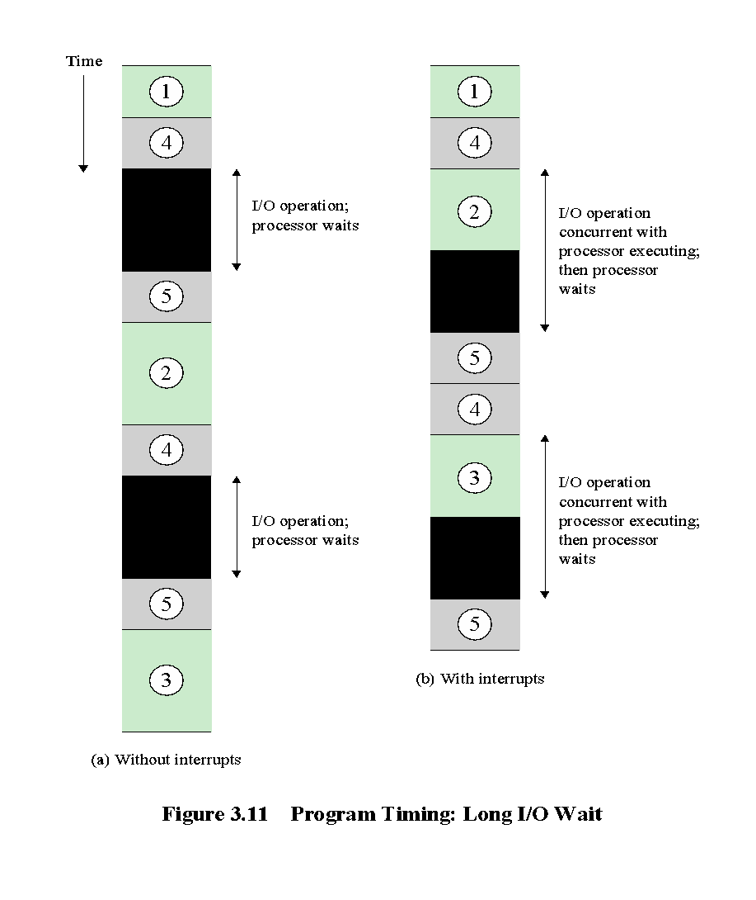
Notes:
The more typical case, especially for a slow device such as a printer, is that the
I/O operation will take much more time than executing a sequence of user instructions.
Figure 3.7c indicates this state of affairs. In this case, the user program reaches
the second WRITE call before the I/O operation spawned by the first call is complete.
The result is that the user program is hung up at that point. When the preceding
I/O operation is completed, this new WRITE call may be processed, and a new
I/O operation may be started. Figure 3.11 shows the timing for this situation with
and without the use of interrupts. We can see that there is still a gain in efficiency
because part of the time during which the I/O operation is under way overlaps with
the execution of user instructions.

Slide 9
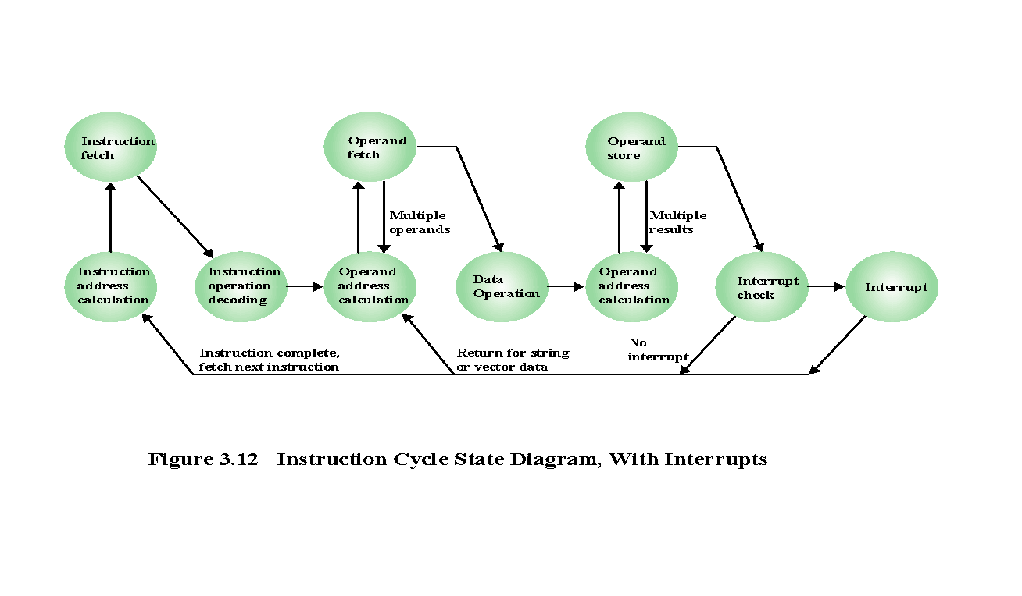
Notes:
Figure 3.12 shows a revised instruction cycle state diagram that includes
interrupt cycle processing.

Slide 10
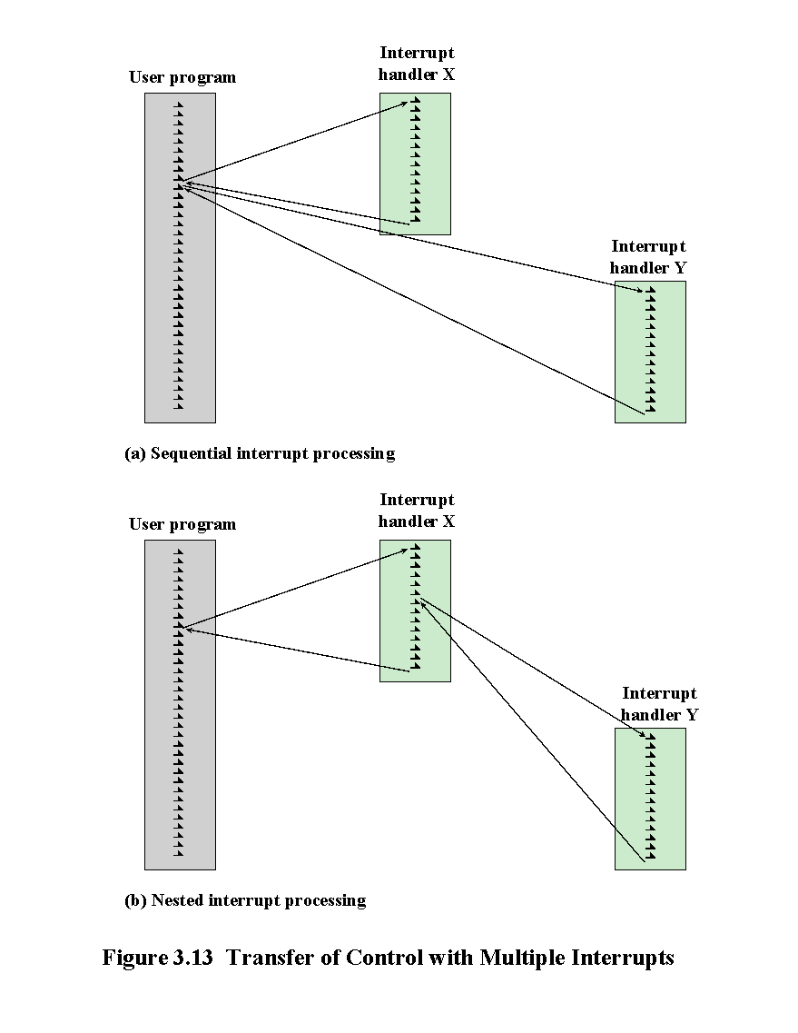
Notes:
Two approaches can be taken to dealing with multiple interrupts. The first is to
disable interrupts while an interrupt is being processed. A disabled interrupt simply
means that the processor can and will ignore that interrupt request signal. If an interrupt
occurs during this time, it generally remains pending and will be checked by
the processor after the processor has enabled interrupts. Thus, when a user program
is executing and an interrupt occurs, interrupts are disabled immediately. After the
interrupt handler routine completes, interrupts are enabled before resuming the
user program, and the processor checks to see if additional interrupts have occurred.
This approach is nice and simple, as interrupts are handled in strict sequential order
(Figure 3.13a).
The drawback to the preceding approach is that it does not take into account
relative priority or time-critical needs. For example, when input arrives from the
communications line, it may need to be absorbed rapidly to make room for more
input. If the first batch of input has not been processed before the second batch
arrives, data may be lost.
A second approach is to define priorities for interrupts and to allow an
interrupt of higher priority to cause a lower-priority interrupt handler to be itself
interrupted (Figure 3.13b).

Slide 11
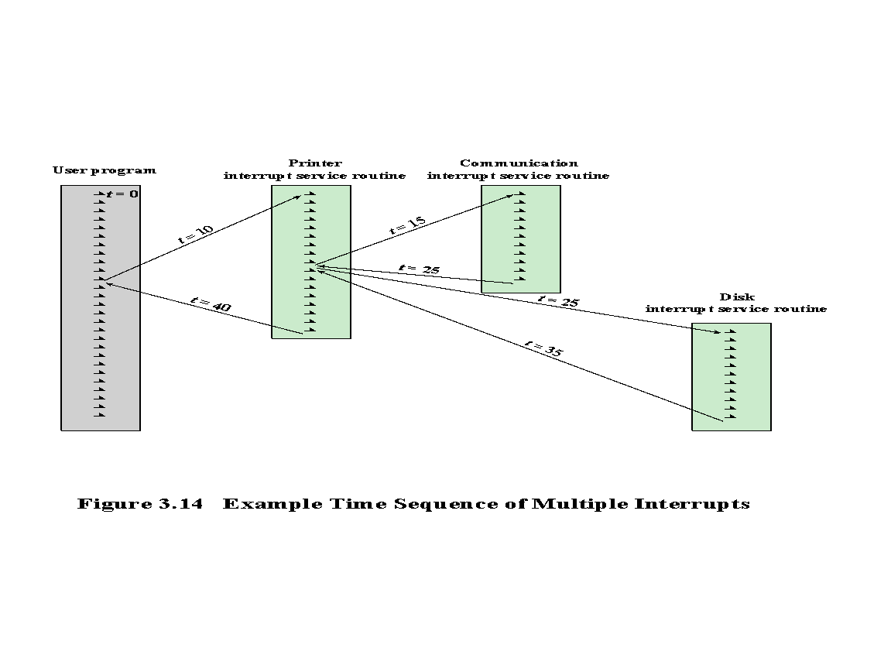
Notes:
As an example of this second approach, consider a
system with three I/O devices: a printer, a disk, and a communications line, with
increasing priorities of 2, 4, and 5, respectively. Figure 3.14 illustrates a possible
sequence. A user program begins at t = 0. At t = 10, a printer interrupt occurs; user
information is placed on the system stack and execution continues at the printer
interrupt service routine (ISR). While this routine is still executing, at t = 15, a
communications interrupt occurs. Because the communications line has higher
priority than the printer, the interrupt is honored. The printer ISR is interrupted,
its state is pushed onto the stack, and execution
continues at the communications ISR. While this routine is executing, a disk interrupt
occurs (t = 20). Because this interrupt is of lower priority, it is simply held, and the communications ISR runs
to completion.
When the communications ISR is complete (t = 25), the previous processor
state is restored, which is the execution of the printer ISR. However, before even a
single instruction in that routine can be executed, the processor honors the higher priority
disk interrupt and control transfers to the disk ISR. Only when that routine
is complete
(t = 35) is the printer ISR resumed. When that routine completes (t = 40),
control finally returns to the user program.

