Slide 1
Chapter 04
Intermediate SQL

Slide 2
Join Expressions
4.1

Slide 3
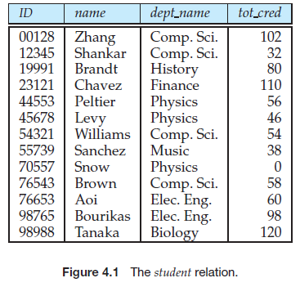
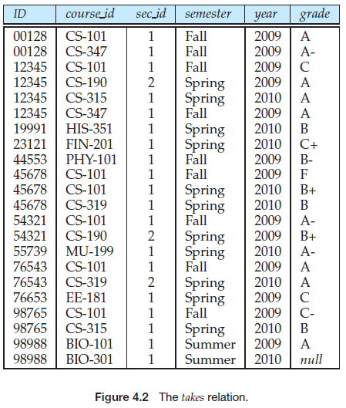
Join Expressions

Slide 4
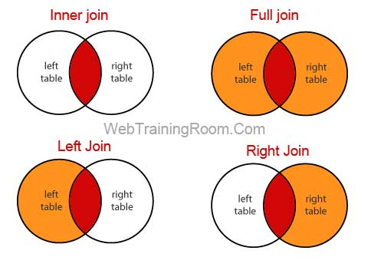

Slide 5
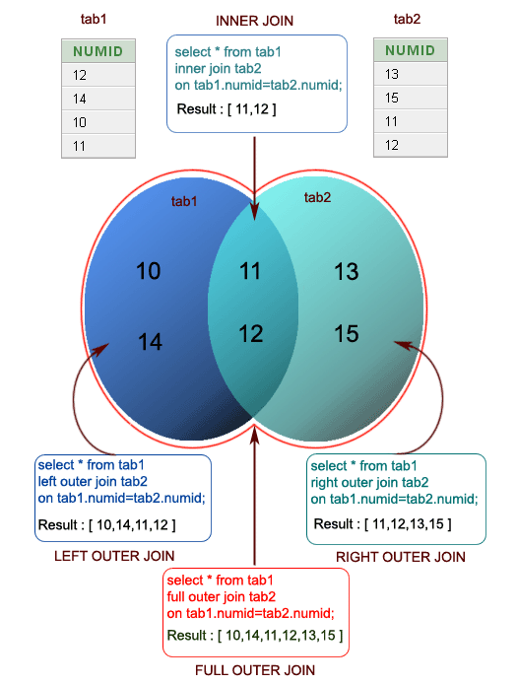

Slide 6
Join Expressions
Select *
From student natural join takes

Slide 7
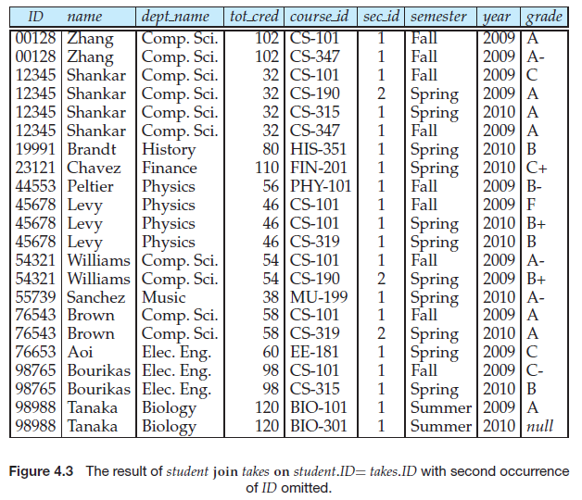
Notes:
select *
from student join takes
on student.id=takes.id

Slide 8
Why do we need on condition
There are two good reasons for introducing the on condition.
First, for a kind of join called an outer join, on conditions do behave in a manner different from where conditions.
Second, an SQL query is often more readable by humans if the join condition is specified in the on clause and the rest of the conditions appear in the where clause

Slide 9
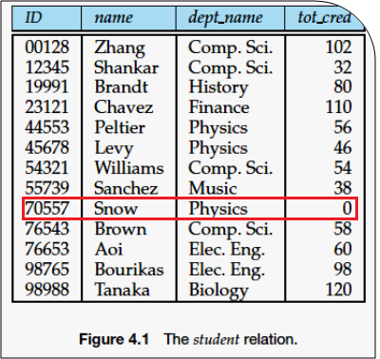
Outer Join
Notes:
select *
from instructor natural left outer join department
select *
from department natural left outer join instructor
select *
from instructor natural left outer join teaches
select *
from teaches natural left outer join instructor
select department.DEPT_NAME, count(ID)
from department left outer join instructor
on department.dept_name = instructor.dept_name
group by department.DEPT_NAME
select DEPT_NAME, count(ID)
from department natural join instructor
group by DEPT_NAME
select department.DEPT_NAME, count(ID)
from department inner join instructor
on department.dept_name = instructor.dept_name
group by department.DEPT_NAME

Slide 10
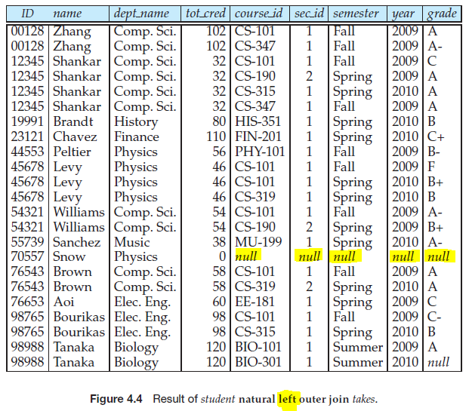
Left outer join

Slide 11
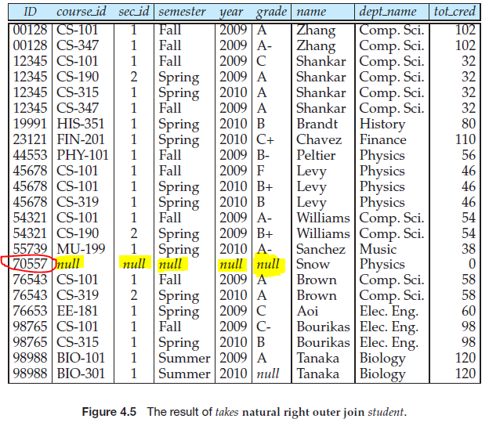
Right outer join
Notes:
select *
from instructor natural right outer join department
select *
from department natural right outer join instructor

Slide 12
Notes:
select *
from department natural left outer join instructor
where id is null
select *
from instructor natural left outer join department
where id is null

Slide 13
الاعمدة لها نفس الاسم
الاعمدة اذا كام لها مش نفس الاسم
Both of them have the same output
Notes:
select *
from department natural left outer join instructor
select *
from department left outer join instructor on department.dept_name=instructor.dept_name

Slide 14
Full outer join
select *
from department natural full outer join instructor
select *
from instructor natural full outer join department
select *
from department full outer join instructor on department.dept_name=instructor.dept_name

Slide 15
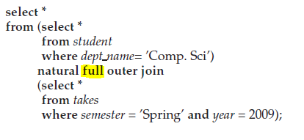
Example
Display a list of all students in the Comp. Sci. department, along with the course sections, if any, that they have taken in Spring 2009; all course sections from Spring 2009 must be displayed, even if no student from the Comp. Sci. department has taken the course section.

Slide 16
Inner join
select *
from department natural inner join instructor
select *
from instructor natural inner join department
select *
from department inner join instructor on department.dept_name=instructor.dept_name

Slide 17
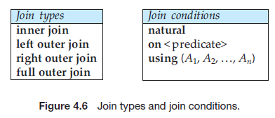
Join Types and Conditions
Select *
From takes right outer join student on takes.ID = student.ID
Select *
From takes right outer join student using (ID)

