Slide 1
Chapter 2
Overview of the
Financial System

Slide 2
Chapter Preview
Suppose you want to start a business manufacturing a household cleaning robot, but you have no funds.
At the same time, Walter has money he wishes to invest for his retirement.
If the two of you could get together, perhaps both of your needs can be met. But how does that happen?

Slide 3
Chapter Preview
As simple as this example is, it highlights the importance of financial markets and financial intermediaries in our economy.
We need to acquire an understanding of their general structure and operation before we can appreciate their role in our economy.

Slide 4
Chapter Preview
In this chapter, we examine the role of the financial system in an advanced economy. We study the effects of financial markets and institutions on the economy, and look at their general structure and operations. Topics include:
Function of Financial Markets
Structure of Financial Markets
Internationalization of Financial Markets
Function of Financial Intermediaries: Indirect Finance
Types of Financial Intermediaries
Regulation of the Financial System

Slide 5
Function of Financial Markets
Channels funds from person or business without investment opportunities (i.e., “Lender-Savers”) to one who has them (i.e., “Borrower-Spenders”)
Improves economic efficiency

Slide 6
Financial Markets Funds Transferees
Lender-Savers
Households
Business firms
Government
Foreigners
Borrower-Spenders
Business firms
Government
Households
Foreigners

Slide 7
Segments of Financial Markets
Direct Finance
Borrowers borrow directly from lenders in financial markets by selling financial instruments which are claims on the borrower’s future income or assets
Indirect Finance
Borrowers borrow indirectly from lenders via financial intermediaries (established to source both loanable funds and loan opportunities) by issuing financial instruments which are claims on the borrower’s future income or assets

Slide 8
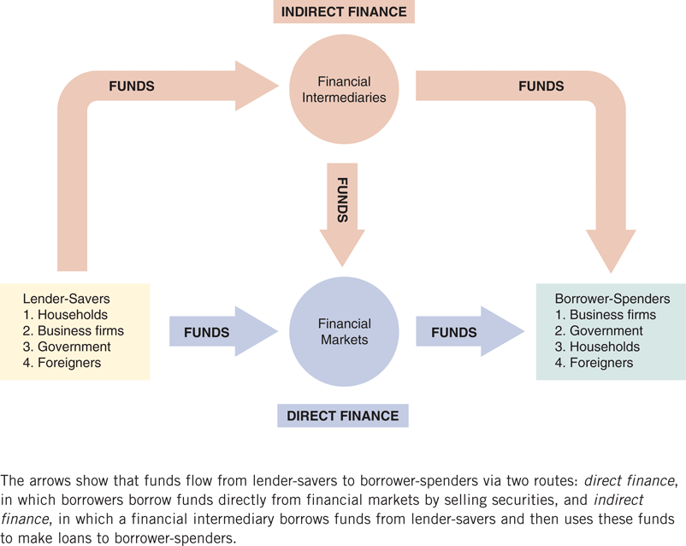
Function of Financial Markets
Figure 2.1 Flows of Funds Through the Financial System

Slide 9
Importance of Financial Markets
This is important. For example, if you save $1,000, but there are no financial markets, then you can earn no return on this - might as well put the money under your mattress.
However, if a carpenter could use that money to buy a new saw (increasing her productivity), then she is willing to pay you some interest for the use of the funds.

Slide 10
Importance of Financial Markets
Financial markets are critical for producing an efficient allocation of capital, allowing funds to move from people who lack productive investment opportunities to people who have them.
Financial markets also improve the well-being of consumers, allowing them to time their purchases better.

Slide 11
Structure of Financial Markets
It helps to define financial markets along a variety of dimensions (not necessarily mutually exclusive). For starters…

Slide 12
Structure of Financial Markets
Debt Markets
Short-Term (maturity < 1 year)
Long-Term (maturity > 10 year)
Intermediate term (maturity in-between)
Represented $38.2 trillion at the end of 2012.
Equity Markets
Pay dividends, in theory forever
Represents an ownership claim in the firm
Total value of all U.S. equity was $18.7 trillion at the end of 2012.

Slide 13
Structure of Financial Markets
Primary Market
New security issues sold to initial buyers
Typically involves an investment bank who underwrites the offering
Secondary Market
Securities previously issued are bought and sold
Examples include the NYSE and Nasdaq
Involves both brokers and dealers (do you know the difference?)

Slide 14
Structure of Financial Markets
Even though firms don’t get any money, per se, from the secondary market, it serves two important functions:
Provides liquidity, making it easy to buy and sell the securities of the companies
Establishes a price for the securities (useful for company valuation)

Slide 15
Structure of Financial Markets
We can further classify secondary markets as follows:
Exchanges
Trades conducted in central locations (e.g., New York Stock Exchange, CBT)
Over-the-Counter Markets
Dealers at different locations buy and sell
Best example is the market for Treasury Securities

Slide 16
Classifications of Financial Markets
We can also classify markets by the maturity of the securities:
Money Market: Short-Term (maturity < 1 year)
Capital Market: Long-Term (maturity > 1 year) plus equities (no maturity)

Slide 17
Internationalization of Financial Markets
The internationalization of markets is an important trend. The U.S. no longer dominates the world stage.
International Bond Market & Eurobonds
Foreign bonds
Denominated in a foreign currency
Targeted at a foreign market
Eurobonds
Denominated in one currency, but sold in a different market
Now larger than U.S. corporate bond market
Over 80% of new bonds are Eurobonds

Slide 18
Internationalization of Financial Markets
Eurocurrency Market
Foreign currency deposited outside of home country
Eurodollars are U.S. dollars deposited, say, London.
Gives U.S. borrows an alternative source for dollars.
World Stock Markets
U.S. stock markets are no longer always the largest—at one point, Japan’s was larger

Slide 19
Internationalization of Financial Markets
As the next slide shows, the number of international stock market indexes is quite large. For many of us, the level of the Dow or the S&P 500 is known. How about the Nikkei 225? Or the FTSE 100? Do you know what countries these represent?

Slide 20
Internationalization of Financial Markets

Slide 21
Global Perspective: Relative Decline of U.S. Capital Markets
The U.S. has lost its dominance in many industries: automobiles and consumer electronics, to name a few.
A similar trend appears at work for U.S. financial markets, as London and Hong Kong compete. Indeed, many U.S. firms use these markets over the U.S.

Slide 22
Global Perspective: Relative Decline of U.S. Capital Markets
Why?
New technology in foreign exchanges
9-11 made U.S. regulations tighter
Greater risk of lawsuit in the U.S.
Sarbanes-Oxley has increased the cost of being a U.S.-listed public company

Slide 23
Function of Financial Intermediaries: Indirect Finance
We now turn our attention to the top part of Figure 2.1—indirect finance.

Slide 24
Function of Financial Intermediaries: Indirect Finance
Instead of savers lending/investing directly with borrowers, a financial intermediary (such as a bank) plays as the middleman:
the intermediary obtains funds from savers
the intermediary then makes loans/investments with borrowers

Slide 25
Function of Financial Intermediaries: Indirect Finance
This process, called financial intermediation, is actually the primary means of moving funds from lenders to borrowers.
More important source of finance than securities markets (such as stocks)
Needed because of transactions costs, risk sharing, and asymmetric information

Slide 26
Function of Financial Intermediaries: Indirect Finance
Transactions Costs
Financial intermediaries make profits by reducing transactions costs
Reduce transactions costs by developing expertise and taking advantage of economies of scale

Slide 27
Function of Financial Intermediaries: Indirect Finance
A financial intermediary’s low transaction costs mean that it can provide its customers with liquidity services, services that make it easier for customers to conduct transactions
Banks provide depositors with checking accounts that enable them to pay their bills easily
Depositors can earn interest on checking and savings accounts and yet still convert them into goods and services whenever necessary

Slide 28
Global: The Importance of Financial Intermediaries Relative to Securities Markets
Studies show that firms in the U.S., Canada, the U.K., and other developed nations usually obtain funds from financial intermediaries, not directly from capital markets.
In Germany and Japan, financing from financial intermediaries exceeds capital market financing 10-fold.
However, the relative use of bonds versus equity does differ by country.

Slide 29
Function of Financial Intermediaries: Indirect Finance
Another benefit made possible by the FI’s low transaction costs is that they can help reduce the exposure of investors to risk, through a process known as risk sharing
FIs create and sell assets with lesser risk to one party in order to buy assets with greater risk from another party
This process is referred to as asset transformation, because in a sense risky assets are turned into safer assets for investors

Slide 30
Function of Financial Intermediaries: Indirect Finance
Financial intermediaries also help by providing the means for individuals and businesses to diversify their asset holdings.
Low transaction costs allow them to buy a range of assets, pool them, and then sell rights to the diversified pool to individuals.

Slide 31
Function of Financial Intermediaries: Indirect Finance
Another reason FIs exist is to reduce the impact of asymmetric information.
One party lacks crucial information about another party, impacting decision-making.
We usually discuss this problem along two fronts: adverse selection and moral hazard.

Slide 32
Function of Financial Intermediaries: Indirect Finance
Adverse Selection
Before transaction occurs
Potential borrowers most likely to produce adverse outcome are ones most likely to seek a loan
Similar problems occur with insurance where unhealthy people want their known medical problems covered

Slide 33
Asymmetric Information: Adverse Selection and Moral Hazard
Moral Hazard
After transaction occurs
Hazard that borrower has incentives to engage in undesirable (immoral) activities making it more likely that won’t pay loan back
Again, with insurance, people may engage in risky activities only after being insured
Another view is a conflict of interest

Slide 34
Asymmetric Information: Adverse Selection and Moral Hazard
Financial intermediaries reduce adverse selection and moral hazard problems, enabling them to make profits. How they accomplish this is covered in many of the chapters to come.

Slide 35
Economies of Scope and Conflicts of Interest
FIs are able to lower the production cost of information by using the information for multiple services: bank accounts, loans, auto insurance, retirement savings, etc. This is called economies of scope.
But, providing multiple services may lead to conflicts of interest, perhaps causing one area of the FI to hide or conceal information from another area (or the economy as a whole). This may actually make financial markets less efficient!

Slide 36
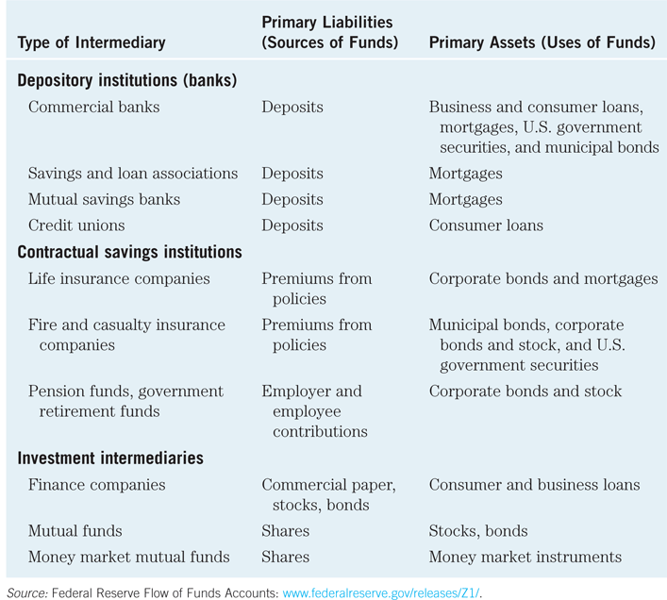
Types of Financial Intermediaries
Table 2.1 Primary Assets and Liabilities of Financial Intermediaries

Slide 37
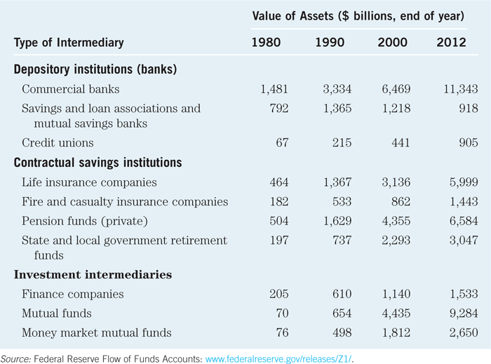
Types of Financial Intermediaries
Table 2.2 Principal Financial Intermediaries and Value of Their Assets

Slide 38
Types of Financial Intermediaries
Depository Institutions (Banks): accept deposits and make loans. These include commercial banks and thrifts.
Commercial banks (11,343 at end of 2012)
Raise funds primarily by issuing checkable, savings, and time deposits which are used to make commercial, consumer and mortgage loans
Collectively, these banks comprise the largest financial intermediary and have the most diversified asset portfolios

Slide 39
Types of Financial Intermediaries
Thrifts: S&Ls & Mutual Savings Banks (918) and Credit Unions (905)
Raise funds primarily by issuing savings, time, and checkable deposits which are most often used to make mortgage and consumer loans, with commercial loans also becoming more prevalent at S&Ls and Mutual Savings Banks
Mutual savings banks and credit unions issue deposits as shares and are owned collectively by their depositors, most of which at credit unions belong to a particular group, e.g., a company’s workers

Slide 40
Contractual Savings Institutions (CSIs)
All CSIs acquire funds from clients at periodic intervals on a contractual basis and have fairly predictable future payout requirements.
Life Insurance Companies receive funds from policy premiums, can invest in less liquid corporate securities and mortgages, since actual benefit pay outs are close to those predicted by actuarial analysis
Fire and Casualty Insurance Companies receive funds from policy premiums, must invest most in liquid government and corporate securities, since loss events are harder to predict

Slide 41
Contractual Savings Institutions (CSIs)
All CSIs acquire funds from clients at periodic intervals on a contractual basis and have fairly predictable future payout requirements.
Pension and Government Retirement Funds hosted by corporations and state and local governments acquire funds through employee and employer payroll contributions, invest in corporate securities, and provide retirement income via annuities

Slide 42
Types of Financial Intermediaries
Finance Companies sell commercial paper (a short-term debt instrument) and issue bonds and stocks to raise funds to lend to consumers to buy durable goods, and to small businesses for operations.
Mutual Funds acquire funds by selling shares to individual investors (many of whose shares are held in retirement accounts) and use the proceeds to purchase large, diversified portfolios of stocks and bonds.

Slide 43
Types of Financial Intermediaries
Money Market Mutual Funds acquire funds by selling checkable deposit-like shares to individual investors and use the proceeds to purchase highly liquid and safe short-term money market instruments.
Investment Banks advise companies on securities to issue, underwriting security offerings, offer M&A assistance, and act as dealers in security markets.

Slide 44
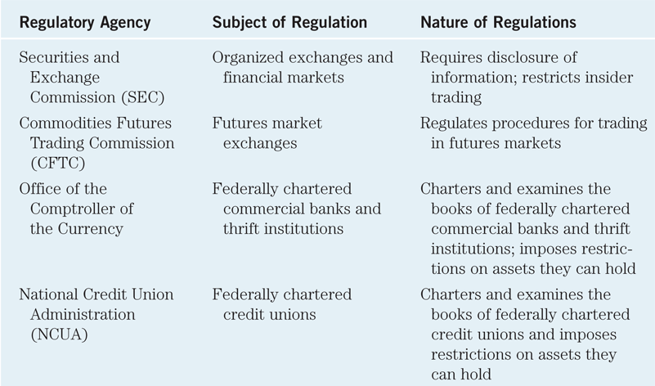
Regulatory Agencies
Table 2.3 Principal Regulatory Agencies of the U.S. Financial System (continued)

Slide 45
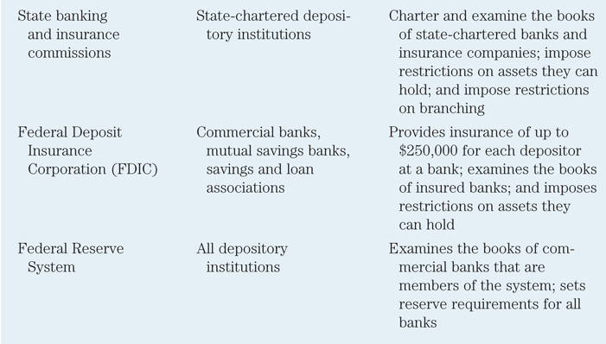
Regulatory Agencies (cont.)
Table 2.3 Principal Regulatory Agencies of the U.S. Financial System

Slide 46
Regulation of Financial Markets
Main Reasons for Regulation
Increase Information to Investors
Ensure the Soundness of Financial Intermediaries

Slide 47
Regulation Reason: Increase Investor Information
Asymmetric information in financial markets means that investors may be subject to adverse selection and moral hazard problems that may hinder the efficient operation of financial markets and may also keep investors away from financial markets.
The Securities and Exchange Commission (SEC) requires corporations issuing securities to disclose certain information about their sales, assets, and earnings to the public and restricts trading by the largest stockholders (known as insiders) in the corporation.

Slide 48
Regulation Reason: Increase Investor Information
Such government regulation can reduce adverse selection and moral hazard problems in financial markets and increase their efficiency by increasing the amount of information available to investors. Indeed, the SEC has been particularly active recently in pursuing illegal insider trading.

Slide 49
Regulation Reason: Ensure Soundness of Financial Intermediaries
Providers of funds (depositors, like you) to financial intermediaries may not be able to assess whether the institutions holding their funds are sound or not.
If they have doubts about the overall health of financial intermediaries, they may want to pull their funds out of both sound and unsound institutions, which can lead to a financial panic.
Such panics produces large losses for the public and causes serious damage to the economy.

Slide 50
Regulation Reason: Ensure Soundness of Financial Intermediaries (cont.)
To protect the public and the economy from financial panics, the government has implemented six types of regulations:
Restrictions on Entry
Disclosure
Restrictions on Assets and Activities
Deposit Insurance
Limits on Competition
Restrictions on Interest Rates

Slide 51
Regulation: Restriction on Entry
Restrictions on Entry
Regulators have created tight regulations as to who is allowed to set up a financial intermediary
Individuals or groups that want to establish a financial intermediary, such as a bank or an insurance company, must obtain a charter from the state or the federal government
Only if they are upstanding citizens with impeccable credentials and a large amount of initial funds will they be given a charter

Slide 52
Regulation: Disclosure
There are stringent reporting requirements for financial intermediaries
Their bookkeeping must follow certain strict principles
Their books are subject to periodic inspection
They must make certain information available to the public

Slide 53
Regulation: Restriction on Assets and Activities
There are restrictions on what financial intermediaries are allowed to do and what assets they can hold
Before you put your funds into a bank or some other similar institution, you want to know that your funds are safe and that the financial intermediary will be able to meet its obligations to you

Slide 54
Regulation: Restriction on Assets and Activities
One way of doing this is to restrict the financial intermediary from engaging in certain risky activities
Another way is to restrict financial intermediaries from holding certain risky assets, or at least from holding a greater quantity of these risky assets than is prudent

Slide 55
Regulation: Deposit Insurance
The government can insure people’s deposits to a financial intermediary from any financial loss if the financial intermediary should fail
The Federal Deposit Insurance Corporation (FDIC) insures each depositor at a commercial bank or mutual savings bank up to a loss of $250,000 per account

Slide 56
Regulation: Deposit Insurance
Similar government agencies exist for other depository institutions:
The National Credit Union Share Insurance Fund (NCUSIF) provides insurance for credit unions

Slide 57
Regulation: Limits on Competition
Evidence is weak showing that competition among financial intermediaries promotes failures that will harm the public. However, such evidence has not stopped the state and federal governments from imposing many restrictive regulations.
In the past, banks were not allowed to open branches in other states, and in some states banks were restricted from opening additional locations.

Slide 58
Regulation: Restrictions on Interest Rates
Competition has also been inhibited by regulations that impose restrictions on interest rates that can be paid on deposits
These regulations were instituted because of the widespread belief that unrestricted interest-rate competition helped encourage bank failures during the Great Depression
Later evidence did not support this view, and restrictions on interest rates have been abolished

Slide 59
Regulation Reason: Improve Monetary Control
Because banks play a very important role in determining the supply of money (which in turn affects many aspects of the economy), regulation of these financial intermediaries is intended to improve control over the money supply
One example is reserve requirements, which make it obligatory for all depository institutions to keep a certain fraction of their deposits in accounts with the Federal Reserve System (the Fed), the central bank in the United States
Reserve requirements help the Fed exercise more precise control over the money supply

Slide 60
Financial Regulation Abroad
Those countries with similar economic systems also implement financial regulation consistent with the U.S. model: Japan, Canada, and Western Europe
Financial reporting for corporations is required
Financial intermediaries are heavily regulated
However, U.S. banks are more regulated along dimensions of branching and services than their foreign counterparts

Slide 61
Chapter Summary
Function of Financial Markets: We examined the flow of funds through the financial system and the role of intermediaries in this process.
Structure of Financial Markets: We examined market structure from several perspectives, including types of instruments, purpose, organization, and time horizon.

Slide 62
Chapter Summary (cont.)
Internationalization of Financial Markets: We briefly examined how debt and equity markets have expanded in the international setting.
Function of Financial Intermediaries: We examined the roles of intermediaries in reducing transaction costs, sharing risk, and reducing information problems.

Slide 63
Chapter Summary (cont.)
Types of Financial Intermediaries: We outlined the numerous types of financial intermediaries to be further examined in later chapters.
Regulation of the Financial System: We outlined some of the agencies charged with the oversight of various institutions and markets.

