Slide 1
SQL Constraints
Lab Session

Slide 2
SQL Constraints

Slide 3
SQL Constraints
NOT NULL :
Ensures that a column cannot have a NULL value
UNIQUE :
Ensures that all values in a column are different
PRIMARY KEY :
A combination of a NOT NULL and UNIQUE. Uniquely identifies each row in a table
FOREIGN KEY :
Uniquely identifies a row/record in another table
CHECK :
Ensures that all values in a column satisfies a specific condition
DEFAULT :
Sets a default value for a column when no value is specified
INDEX :
Used to create and retrieve data from the database very quickly

Slide 4
NOT NULL
By default, a column can hold NULL values.
The NOT NULL constraint enforces a column to NOT accept NULL values; When insert it.
This enforces a field to always contain a value, which means that you cannot insert a new record, or update a record without adding a value to this field.
CREATE TABLE Persons ( ID int NOT NULL, LastName varchar(255) NOT NULL, FirstName varchar(255) NOT NULL, Age int );
Notes:
create table Persons(ID int not null, LastName varchar(255) not null, FirstName varchar(255) not null,age int);

Slide 5
NOT NULL
-------NOT NULL on ALTER TABLE-------
To create a NOT NULL constraint on the "Age" column when the "Persons" table is already created, use the following SQL:
ALTER TABLE Persons MODIFY Age NOT NULL;
Notes:
alter table Persons modify Age not null;

Slide 6
UNIQUE
The UNIQUE constraint ensures that all values in a column are different.
Both the UNIQUE and PRIMARY KEY constraints provide a guarantee for uniqueness for a column or set of columns.
A PRIMARY KEY constraint automatically has a UNIQUE constraint.
However, you can have many UNIQUE constraints per table, but only one PRIMARY KEY constraint per table.
CREATE TABLE Persons1 ( ID int NOT NULL UNIQUE, LastName varchar(255) NOT NULL UNIQUE, FirstName varchar(255), Age int );
Notes:
create table Persons1(ID int not null unique, LastName varchar(255) not null unique, FirstName varchar(255) not null,age int);

Slide 7
UNIQUE
To name a UNIQUE constraint, and to define a UNIQUE constraint on multiple columns, use the following SQL syntax:
CREATE TABLE Persons2 ( ID int NOT NULL, LastName varchar(255) NOT NULL, FirstName varchar(255), Age int,
CONSTRAINT UC_Person UNIQUE (ID,LastName)
);
Notes:
create table Persons2(ID int not null, LastName varchar(255) not null, FirstName varchar(255) not null,age int, constraint UC_Person unique (ID,LastName) );

Slide 8
UNIQUE
-----UNIQUE on ALTER TABLE-----
To create a UNIQUE constraint on the “FirstName" column when the table is already created, use the following SQL:
ALTER TABLE Persons2 ADD UNIQUE (FirstName);
To name a UNIQUE constraint, and to define a UNIQUE constraint on multiple columns, use the following SQL syntax:
ALTER TABLE Persons1 ADD CONSTRAINT UC_Person1 UNIQUE (FirstName,LastName);
To drop a UNIQUE constraint, use the following SQL:
ALTER TABLE Persons DROP CONSTRAINT UC_Person;
Notes:
alter table Persons2 add unique (FirstName);
Alter table Persons1 add constraint UC_Persons1 unique (FirstName,LastName);
Alter table Persons1 drop constraint UC_Persons1;

Slide 9
PRIMARY KEY
The PRIMARY KEY constraint uniquely identifies each record in a database table.
Primary keys must contain UNIQUE values, and cannot contain NULL values.
A table can have only ONE primary key; and in the table, this primary key can consist of single or multiple columns (fields).
table, but only one PRIMARY KEY constraint per table.
CREATE TABLE Persons3 ( ID int PRIMARY KEY, LastName varchar(255) NOT NULL UNIQUE, FirstName varchar(255), Age int );
Notes:
create table Persons3(ID int primary key, LastName varchar(255) not null unique, FirstName varchar(255) ,age int);

Slide 10
PRIMARY KEY
To allow naming of a PRIMARY KEY constraint, and for defining a PRIMARY KEY constraint on multiple columns, use the following SQL syntax:
CREATE TABLE Persons4 ( ID int NOT NULL, LastName varchar(255) NOT NULL, FirstName varchar(255), Age int, CONSTRAINT PK_Person PRIMARY KEY (ID, LastName)
// CONSTRAINT PK_Person PRIMARY KEY (ID) );
Note: In the example above there is only ONE PRIMARY KEY (PK_Person). However, the VALUE of the primary key is made up of TWO COLUMNS (ID + LastName).
Notes:
create table Persons4(ID int not null, LastName varchar(255) not null, FirstName varchar(255) ,age int, constraint PK_Persons4 primary key (ID, LastName));

Slide 11
PRIMARY KEY
------PRIMARY KEY on ALTER TABLE------
To create a PRIMARY KEY constraint on the "ID" column when the table is already created, use the following SQL:
ALTER TABLE Persons ADD PRIMARY KEY (ID);
To allow naming of a PRIMARY KEY constraint, and for defining a PRIMARY KEY constraint on multiple columns, use the following S
QL syntax:
ALTER TABLE Persons1 ADD CONSTRAINT PK_Person1 PRIMARY KEY (ID,LastName);
Note: If you use ALTER TABLE to add a primary key, the primary key column(s) must have been declared to not contain NULL values (when the table was first created)
Notes:
Alter table Persons Add primary key (ID);
Alter table Persons1 Add constraint PK_Person1 primary key (ID,LastName);

Slide 12
PRIMARY KEY
To drop a PRIMARY KEY constraint, use the following SQL:
ALTER TABLE Persons1 DROP CONSTRAINT PK_Person1;
Notes:
Alter table Persons1 drop constraint PK_Person1;

Slide 13
SQL FOREIGN KEY Constraint
A FOREIGN KEY is a key used to link two tables together.
A FOREIGN KEY is a field (or collection of fields) in one table that refers to the PRIMARY KEY in another table.
The table containing the foreign key is called the child table, and the table containing the candidate key is called the referenced or parent table.
CREATE TABLE Orders (
OrderID int NOT NULL PRIMARY KEY,
OrderNumber int NOT NULL,
PersonID int,
FOREIGN KEY (PersonID) REFERENCES persons(ID)
);
Notes:
create table Orders(OrderID int not null primary key, orderNumber int not null, PersonID int, foreign key (PersonID) references Persons(ID));

Slide 14
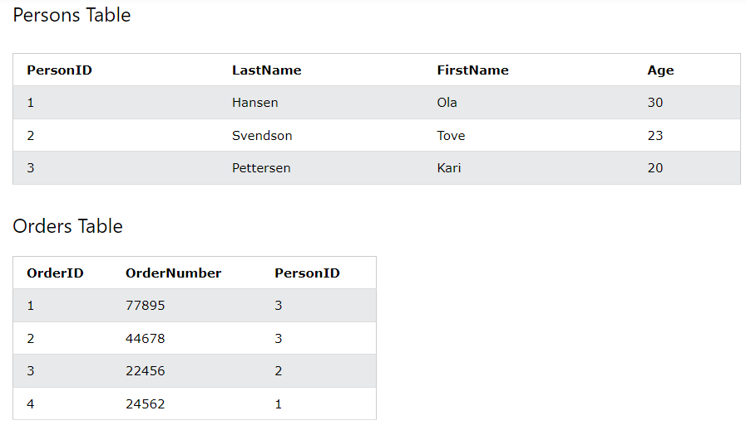
FOREIGN KEY
The FOREIGN KEY constraint prevents invalid data from being inserted into the foreign key column, because it has to be one of the values contained in the parent table.

Slide 15
FOREIGN KEY
To allow naming of a FOREIGN KEY constraint, and for defining a FOREIGN KEY constraint on multiple columns, use the following SQL syntax:
CREATE TABLE Orders1 (
OrderID int NOT NULL PRIMARY KEY,
OrderNumber int NOT NULL,
PersonID int,
CONSTRAINT FK_PersonOrder FOREIGN KEY (PersonID) REFERENCES Persons(ID)
);
Notes:
create table Orders1(OrderID int not null primary key, orderNumber int not null, PersonID int, constraint FK_PersonOrder foreign key (PersonID) references Persons(ID));

Slide 16
FOREIGN KEY
------FOREIGN KEY on ALTER TABLE------
To create a FOREIGN KEY constraint on the "PersonID" column when the "Orders" table is already created, use the following SQL:
ALTER TABLE Orders2 ADD FOREIGN KEY (PersonID) REFERENCES Persons(ID);
To allow naming of a FOREIGN KEY constraint, and for defining a FOREIGN KEY constraint on multiple columns, use the following SQL syntax:
ALTER TABLE Orders3 ADD CONSTRAINT FK_PersonOrder1 FOREIGN KEY (PersonID) REFERENCES Persons(ID);
Notes:
create table Orders2(OrderID int not null primary key, orderNumber int not null, PersonID int);
Alter table Orders2 add foreign key (PersonID) References Persons(ID);
create table Orders3(OrderID int not null primary key, orderNumber int not null, PersonID int);
Alter table Orders3 add constraint FK_PersonOrder1 foreign key (PersonID) references Persons(ID);

Slide 17
FOREIGN KEY
To drop a FOREIGN KEY constraint, use the following SQL:
ALTER TABLE Orders3 DROP CONSTRAINT FK_PersonOrder1;
Notes:
Alter table Orders3 Drop constraint FK_PersonOrder1;

Slide 18
CHECK
The CHECK constraint is used to limit the value range that can be placed in a column.
If you define a CHECK constraint on a single column it allows only certain values for this column.
If you define a CHECK constraint on a table it can limit the values in certain columns based on values in other columns in the row.
CREATE TABLE Persons5 ( ID int NOT NULL, LastName varchar(255) NOT NULL, FirstName varchar(255), Age int CHECK (Age>=18) );
Notes:
create table Persons5(ID int not null, LastName varchar(255) not null, FirstName varchar(255) ,age int CHECK (age >= 18));

Slide 19
CHECK
To allow naming of a CHECK constraint, and for defining a CHECK constraint on multiple columns, use the following SQL:
CREATE TABLE Persons6 ( ID int NOT NULL, LastName varchar(255) NOT NULL, FirstName varchar(255), Age int,
City varchar(255), CONSTRAINT CHK_Person CHECK (Age>=18 AND City='Sandnes') );
Notes:
create table Persons6(ID int not null, LastName varchar(255) not null, FirstName varchar(255) ,age int, City varchar(255), Constraint CHK_Person CHECK (age >= 18 AND City='Sandnes'));

Slide 20
CHECK
-------CHECK on ALTER TABLE-------
To create a CHECK constraint on the "Age" column when the table is already created, use the following SQL:
ALTER TABLE Persons ADD CHECK (Age>=18);
To allow naming of a CHECK constraint, and for defining a CHECK constraint on multiple columns, use the following SQL syntax:
ALTER TABLE Persons6 ADD CONSTRAINT CHK_PersonAge CHECK (Age>=18 AND City='Sandnes');
To drop a CHECK constraint, use the following SQL:
ALTER TABLE Persons6 DROP CONSTRAINT CHK_PersonAge;
Notes:
Alter Table Persons Add check (age >= 18);
Alter Table Persons6 Add Constraint CHK_PersonAge check (age >= 18 AND City=‘Sandnes’);
Alter Table Persons6 drop constraint CHK_PersonAge ;

Slide 21
DEFAULT
The DEFAULT constraint is used to provide a default value for a column.
The default value will be added to all new records IF no other value is specified.
CREATE TABLE Persons8 ( ID int NOT NULL, LastName varchar(255) NOT NULL, FirstName varchar(255), Age int, City varchar(255) DEFAULT 'Sandnes' );
Notes:
create table Persons8(ID int not null, LastName varchar(255) not null, FirstName varchar(255) ,age int, City varchar(255) default 'Sandnes');

Slide 22
DEFAULT
----------DEFAULT on ALTER TABLE--------
To create a DEFAULT constraint on the "City" column when the table is already created, use the following SQL:
ALTER TABLE Persons8 MODIFY City DEFAULT 'Sandnes';
To drop a DEFAULT constraint, use the following SQL:
ALTER TABLE Persons8 ALTER COLUMN City DROP DEFAULT;
Notes:
Alter table Persons8 modify city default ‘Sandnes’;
Alter Table Persons8 alter column City Drop default;

