Slide 1
Chapter 2
Quadratic and Other Special Functions
2.2 Quadratic Functions: Parabolas

Slide 2
Objectives :
To find the vertex of the graph of a quadratic function
To determine whether a vertex is a maximum point or a minimum point
To find the zeros of a quadratic function
To graph quadratic functions

Slide 3
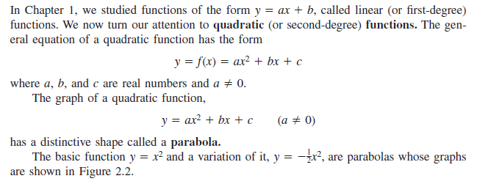
Parabolas :

Slide 4
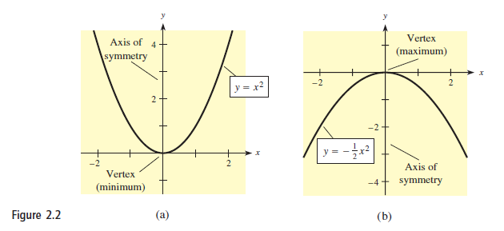

Slide 5
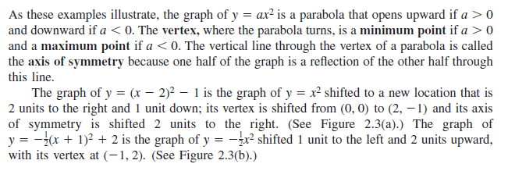
Vertex of a Parabola :

Slide 6
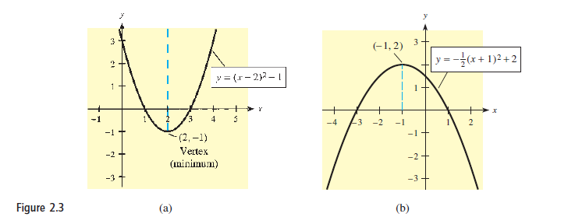

Slide 7
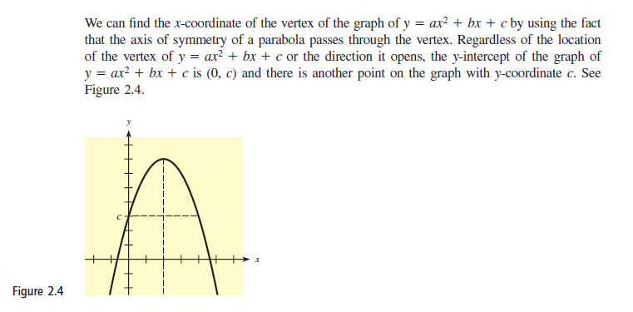

Slide 8
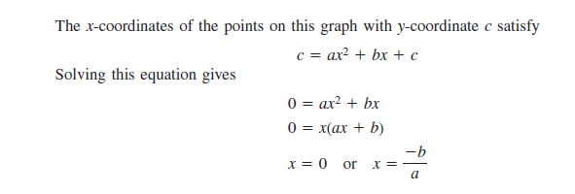

Slide 10
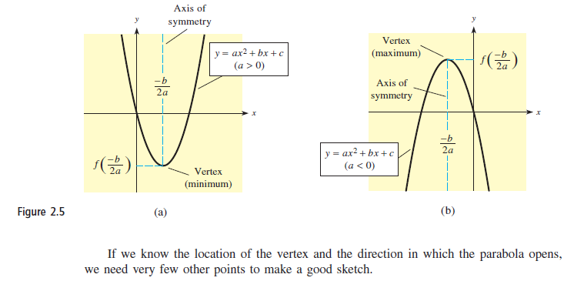

Slide 11
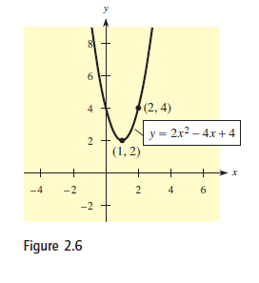

Slide 12
Zeros of Quadratic Functions :

Slide 13
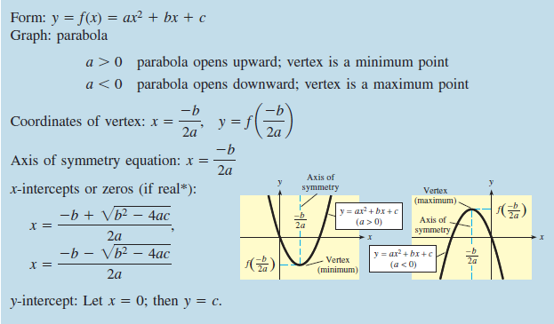

Slide 14
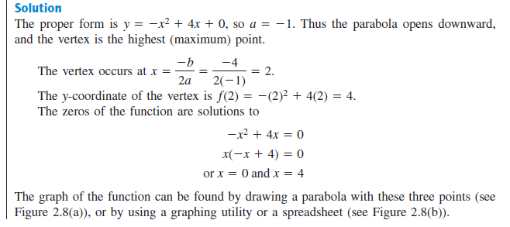

Slide 15
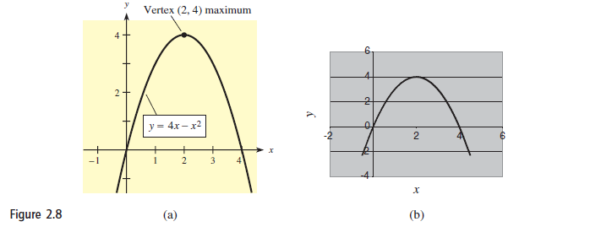

Slide 16
