Slide 1
SQL (DML)

Slide 2
Data Manipulating Language (DML)
Data Manipulation Language (DML) statements are used for managing data within schema objects.
Some examples:
INSERT - insert data into a table.
SELECT - retrieve data from the database.
UPDATE - updates existing data within a table.
DELETE - deletes all records from a table, the space for the records remain.

Slide 3
Insert into
The SQL INSERT INTO Statement is used to add new rows of data to a table in the database.
There are two basic syntaxes of INSERT INTO statement as follows:
INSERT INTO TABLE_NAME (column1, column2, column3,...columnN)] VALUES (value1, value2, value3,...valueN);
INSERT INTO TABLE_NAME VALUES (value1,value2,value3,...valueN);

Slide 4
Insert Into Example
INSERT INTO CUSTOMERS (ID,NAME,AGE,ADDRESS,SALARY)VALUES (1, 'Ramesh', 32, 'Ahmed abad', 2000.00 );
INSERT INTO CUSTOMERS VALUES (7, 'Muffy', 24, 'Indore', 10000.00 );

Slide 5
Select
SQL SELECT statement is used to fetch the data from a database table which returns data in the form of result table. These result tables are called result-sets.
The basic syntax of SELECT statement is as follows:
SELECT column1, column2, columnN FROM table_name;
SELECT * FROM table_name;

Slide 6
Basic Select Examples
SELECT ID, NAME, SALARY FROM CUSTOMERS;
SELECT * FROM CUSTOMERS;

Slide 7
Where / and / or - Clause
Where clause:
The SQL WHERE clause is used to specify a condition while fetching the data from single table or joining with multiple tables.
AND | OR clause
YOU CAN JOIN SEVERAL CONDITIONS USING (AND, OR)

Slide 8
Where clause:
WHERE salary>1300
WHERE name=’Ahmad’;
WHERE city IN (‘Jenin’, ‘Ram Allah’);
WHERE salary BETWEEN 1500 and 3000;
WHERE OrderDate BETWEEN #07/04/1996# AND #07/09/1996#;
WHERE salary NOT BETWEEN 1500 and 3000;

Slide 9
LIKE clause
The SQL LIKE clause is used to compare a value to similar values using wildcard operators. There are two wildcards used in conjunction with the LIKE operator:
The percent sign (%) ; the percent sign represents zero, one, or multiple characters.
The underscore (_); the underscore represents a single number or character.
The symbols can be used in combinations ( _ _ _), But if ;for example; city name contains ( _ ) like Jenin_City then we can use ( \ ) to treats ( _ ) as a character.
Examples
WHERE city_name LIKE ‘%in\_City’;
WHERE name like ‘Mr. %’;
WHERE product like ‘% table%’;

Slide 10
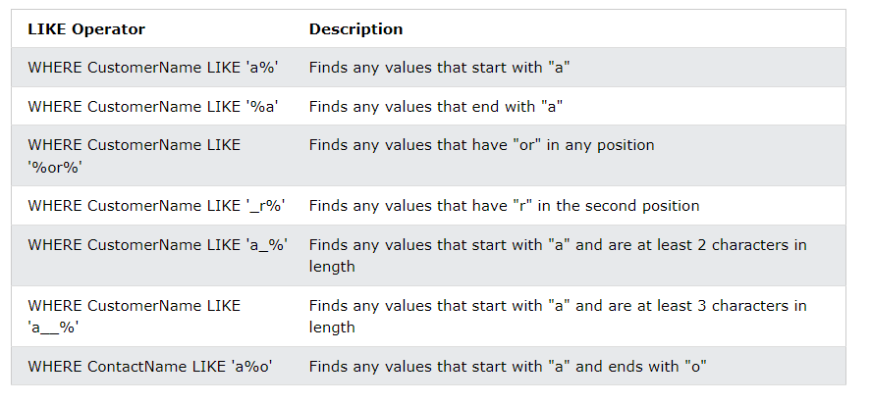

Slide 11
ORDER BY clause
SELECT column-list FROM table_name [WHERE condition] [ORDER BY column1, column2, .. columnN] [ASC | DESC];
SELECT * FROM CUSTOMERS ORDER BY NAME, SALARY;
SELECT * FROM CUSTOMERS ORDER BY NAME DESC;

Slide 12
DISTINCT
The SELECT DISTINCT statement is used to return only distinct (different) values.
Inside a table, a column often contains many duplicate values; and sometimes you only want to list the different (distinct) values.
SELECT DISTINCT column1, column2, ... FROM table_name;

Slide 13
Insert / select
You can populate data into a table through select statement over another table provided another table has a set of fields, which are required to populate first table. Here is the syntax:
INSERT INTO first_table_name [(column1, column2, ... columnN)] SELECT column1, column2, ...columnN FROM second_table_name [WHERE condition];
INSERT INTO table2 SELECT * FROM table1 WHERE condition;

