Slide 1
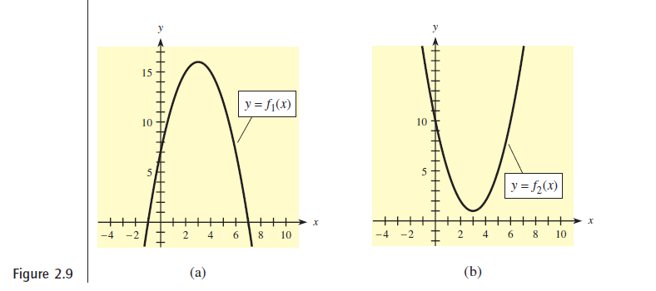

Slide 3
Chapter 2
Quadratic and Other Special Functions
2.3 Business Applications of Quadratic Functions

Slide 4
Supply, Demand, and Market Equilibrium :

Slide 5
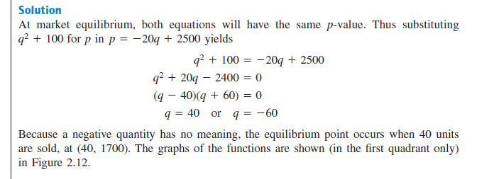
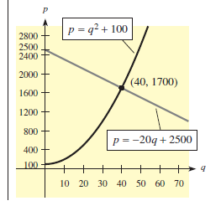

Slide 6
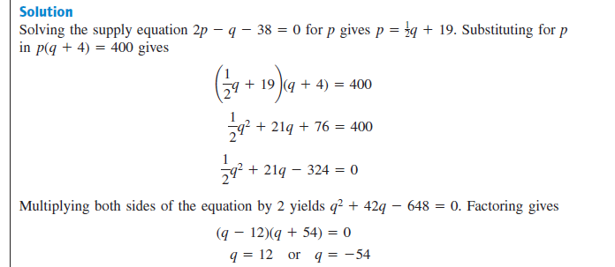

Slide 7
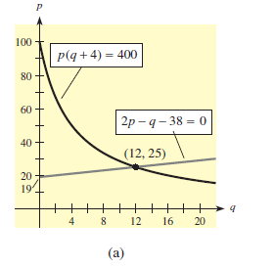

Slide 9
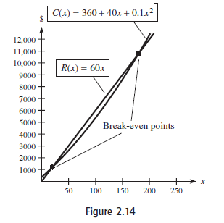
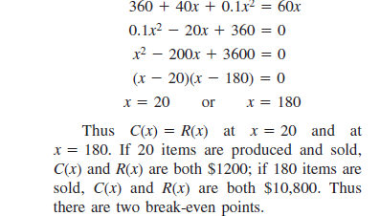
Break-Even Points and Maximization:

Slide 11
