Slide 1
Structural chromosomal abnormalities

Slide 2
Structural chromosome abnormalities
Deletion
Duplication
Inversion
translocation
insertion
Ring chromosome
Isochromosome
occur in single chromosome

Slide 3
Structural chromosome abnormalities

Slide 4
Structural chromosome abnormalities Nomenclature

Slide 5
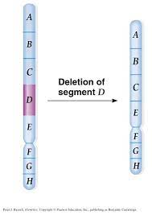
Structural chromosome abnormalities: Deletion
A part of a chromosome is missing or deleted
Interstitial or terminal
It is a copy number variation
Unbalanced
The more genes involved, the more sever the phenotype
Can be detected by Chromosome banding, FISH, and CGH ( microdeletions)
Example of chromosome deletions syndromes:
-5p minus syndrome or cri-du-chat syndrome
-4p minus syndrome or Wolf-Hirschhorn syndrome
-DiGeorge syndrome (22q11.2 deletion syndrome)
Copy number variations: Stretches of genomic DNA present in more than or less than two copies that can range in size from kilobases (kb) to megabases (Mb)
Haploinsufficiancy: when one copy of a gene is inactivated or deleted and the remaining functional copy of the gene is not adequate to produce the needed gene product to preserve normal function

Slide 6
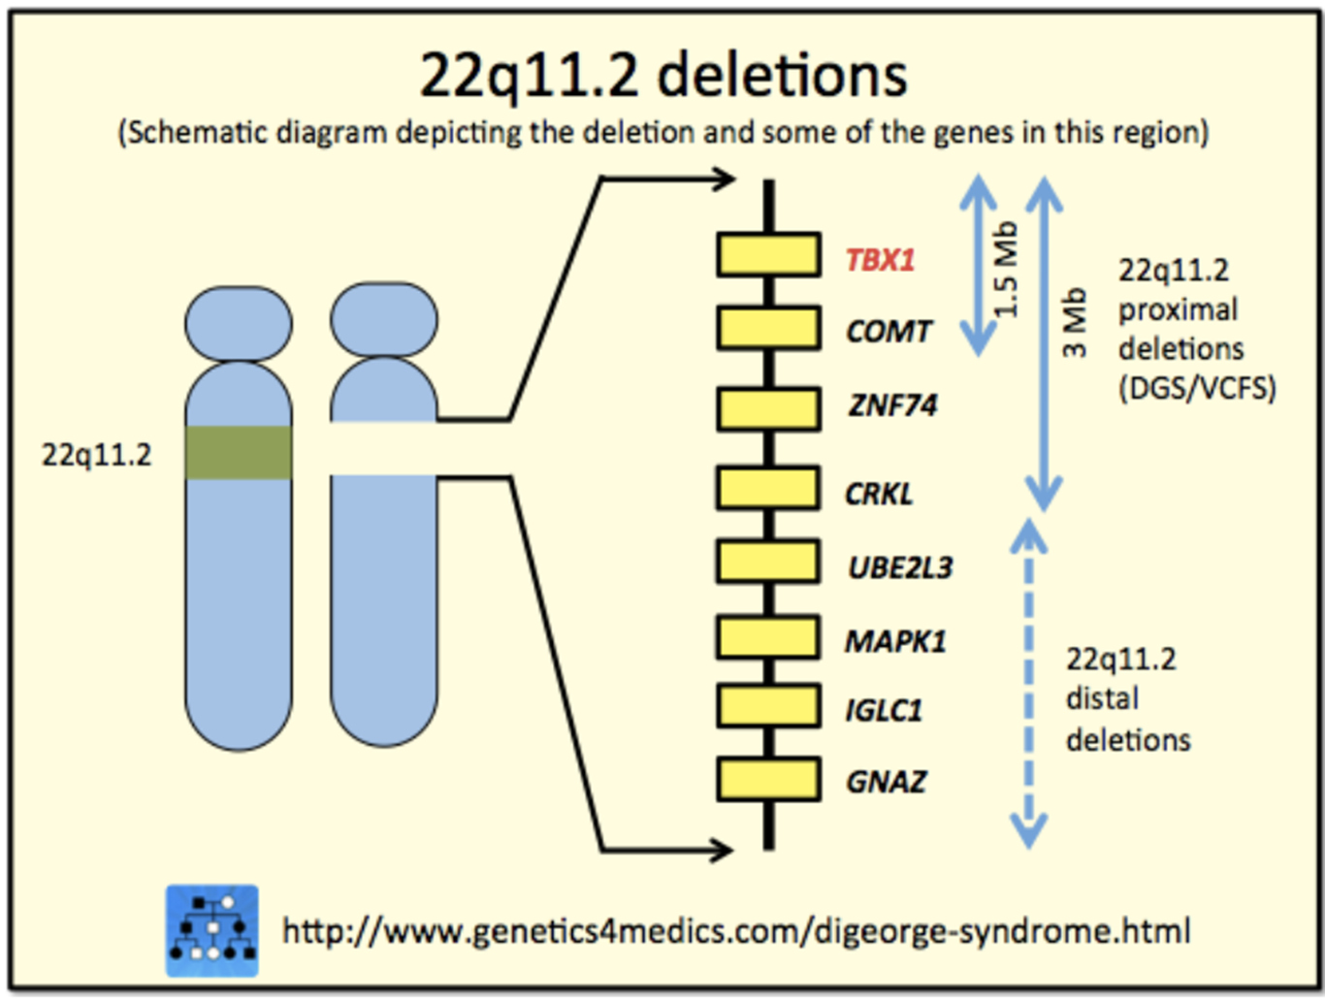
DiGeorge syndrome (22q11.2 deletion syndrome)
DiGeorge syndrome is caused by a 1.5-3 Mb hemizygous deletion of chromosome 22q11.2
Within this deletion region is a key gene for early vertebrate development, TBX1. Haploinsufficiency of TBX1 is responsible for major phenotypes that are seen in individuals with DiGeorge syndrome
However, the variability of phenotypic features with a deletion of TBX1 suggests that altered interaction with downstream genes and environmental effects also affect the disease presentation
As in all microdeletion syndromes, inheritance is autosomal dominant, however most cases of DiGeorge syndrome result from a de novo microdeletion

Slide 7
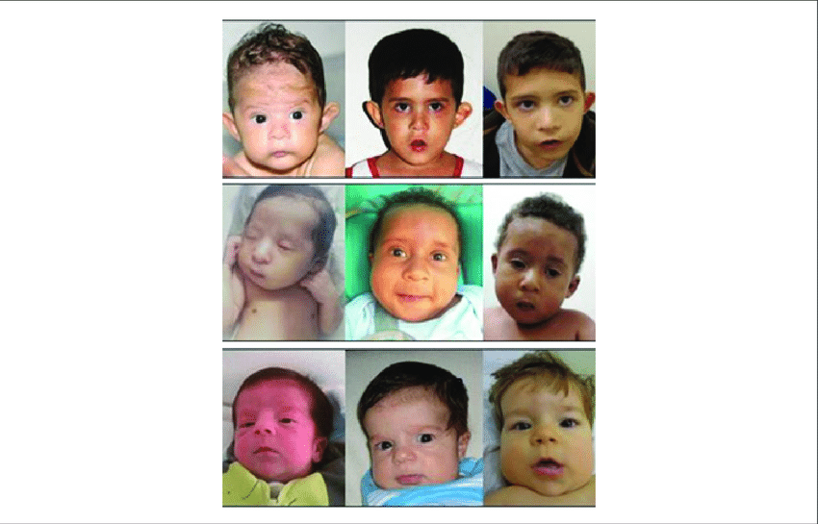
DiGeorge syndrome (22q11.2 deletion syndrome)
DiGeorge Syndrome is commonly diagnosed prenatally.
Recurrence risk
Germline mosaicism
Recurrence risk: the likelihood that a hereditary trait or disorder present in one family member will occur again in other family members.

Slide 8
What is Germline Mosaicism:
In germline mosaicism, the mutation is not in somatic cells and an individual is unaware of the mutation until an affected offspring is born.

Slide 9
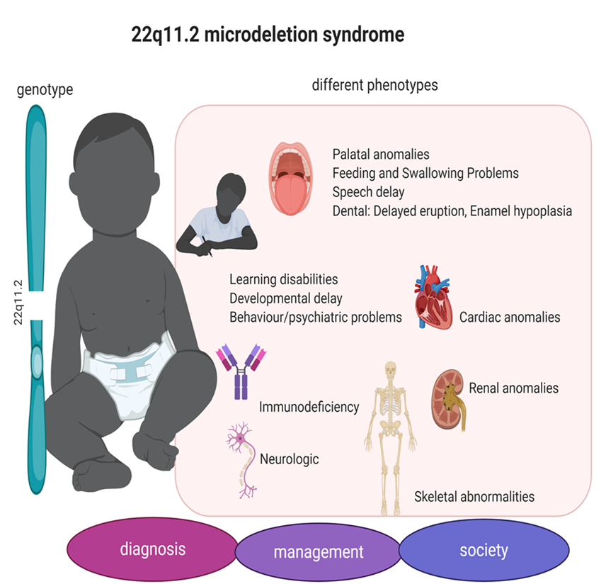

Slide 10
Structural chromosome abnormalities Nomenclature
46, XX,del(22)(q11.2)

Slide 11
Structural chromosome abnormalities: Duplication
A part of a chromosome is duplicated , extra genetic material
It is a copy number variation
Unbalanced
Can be detected by Chromosome banding, FISH, and CGH ( microdeletions)
Examples:
- Chromosome 1q21.1 duplication syndrome
- 7q11. 23 duplication syndrome

Slide 12
7q11. 23 duplication syndrome
Extra copies of several of the genes in the duplicated region, including the ELN and GTF2I genes, likely contribute to the characteristic features of 7q11.23 duplication syndrome.
7q11.23 duplication syndrome is considered autosomal dominant
People with 7q11.23 duplication syndrome typically have delayed development of speech and motor skills such as crawling and walking

Slide 13
Structural chromosome abnormalities: Inversion
The detachment, 180° rotation and reinsertion of part of a chromosome
Unless they disrupt a gene sequence, inversions only change gene orientation and are likely to have more mild effects than aneuploid errors. However, altered gene orientation can result in functional changes because regulators of gene expression could move out of position with respect to their targets, causing aberrant levels of gene products.
An inversion can be pericentric and include the centromere, or paracentric and occur outside the centromere

Slide 14
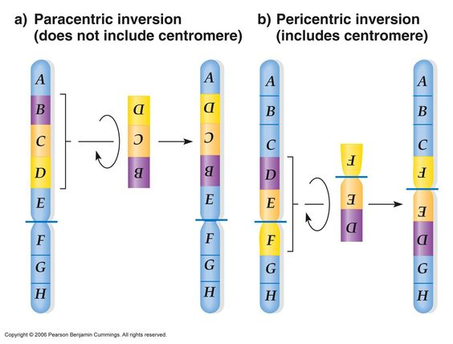
Structural chromosome abnormalities: Inversion

Slide 15
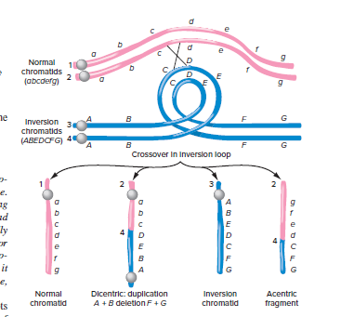
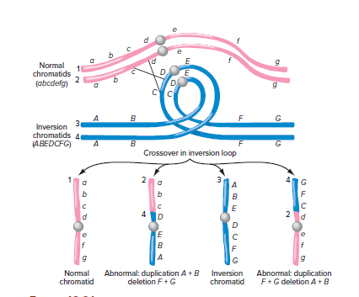
Inversions interfere with crossing over
When one homologous chromosome undergoes an inversion but the other does not, the individual is an inversion heterozygote. To maintain point-for-point synapsis during meiosis, one homolog must form a loop, and the other homolog must mold around it. Although this topology can ensure that the genes correctly align, it also forces the homologs to stretch and can occur with imprecise synapsis regions
Notes:
https://www.youtube.com/watch?v=ZcnyMMHLkAw

Slide 16
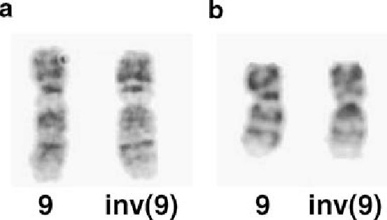
Structural chromosome abnormalities: Inversion: Chromosome 9 inversion

Slide 17
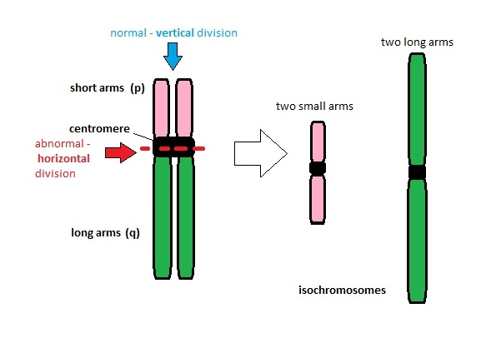
Structural chromosome abnormalities: Isochromosomes
result of meiotic error
It is a chromosome that has identical arms.
An isochromosome forms when, during division, the centromeres part in the wrong plane
Unbalanced
It is a huge problem during fertilization. Because fetus then get a trisomy for one arm and a monosomy for the second arm.

Slide 18
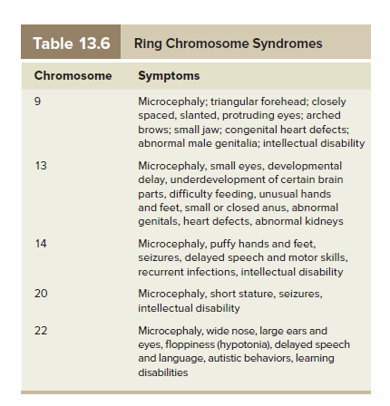
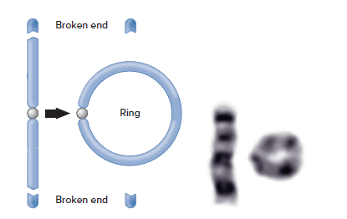
Structural chromosome abnormalities: Ring chromosome
Ring chromosomes may arise when telomeres are lost

Slide 19
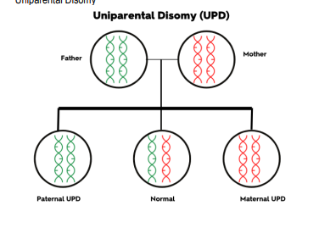
Uniparental Disomy
Uniparental disomy (UPD) occurs when an individual inherits a pair of chromosomes (i.e. chromosome 7) from the same parent, and none from the other parent.

Slide 20
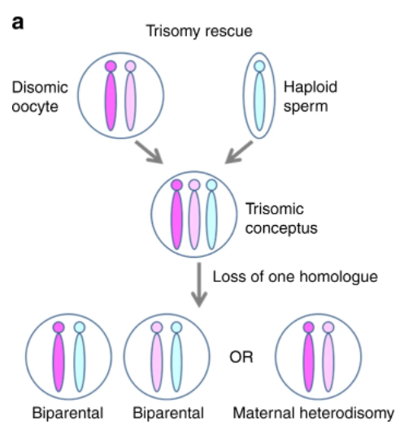
Mechanisms leading to Uniparental Disomy
Trisomy rescue.
Autosomal trisomy in a zygote is not usually compatible with life and leads to early miscarriage.
However, if the chromosomal complement number is “normalized” by the loss of one of the trisomic chromosomes, the conceptus is likely to survive to term.
Maternal UPD

Slide 21
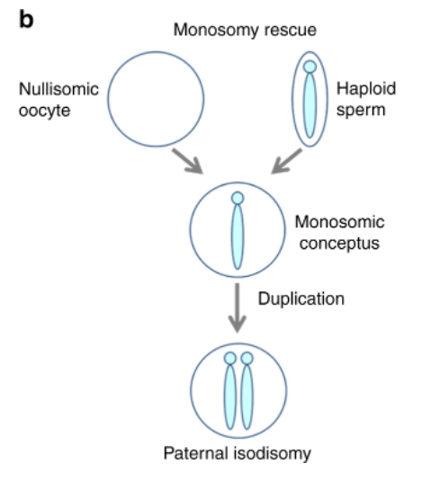
Mechanisms leading to Uniparental Disomy
Monosomy rescue.
duplication of the single, available chromosome

Slide 22
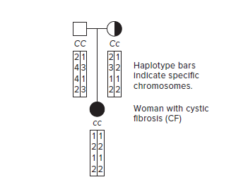
Uniparental Disomy
Uniparental disomy (UPD) leads to an abnormal phenotype if UPD results in homozygosity for a pathogenic variant resulting in an autosomal recessive condition or if the chromosome involved has imprinted gene(s)

Slide 23
Uniparental Disomy can disrupt imprinting
UPD may cause disease if it removes the contribution of the important parent for an imprinted gene.
If UPD removes the parental genetic material that must be present for a critical gene to be expressed, a mutant phenotype results.
The classic example of UPD disrupting imprinting is Prader-Willi syndrome and Angelman syndrome, for which UPD causes 20 to 30 percent of cases

Slide 24
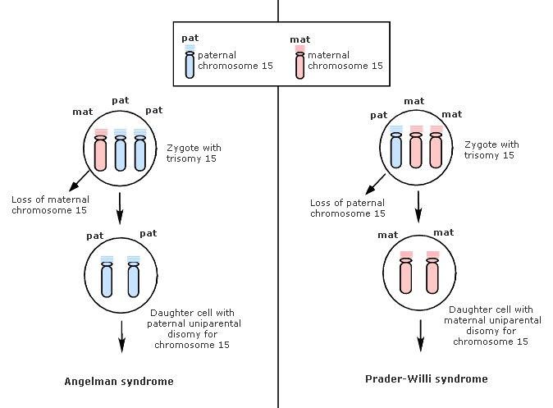
Prader-Willi syndrome and Angelman syndrome
A Region on the chromosome15 (15q11-13)
Notes:
SNRPN: important for pre mRNA processing
Necdin: growth suppressor neurons

Slide 25
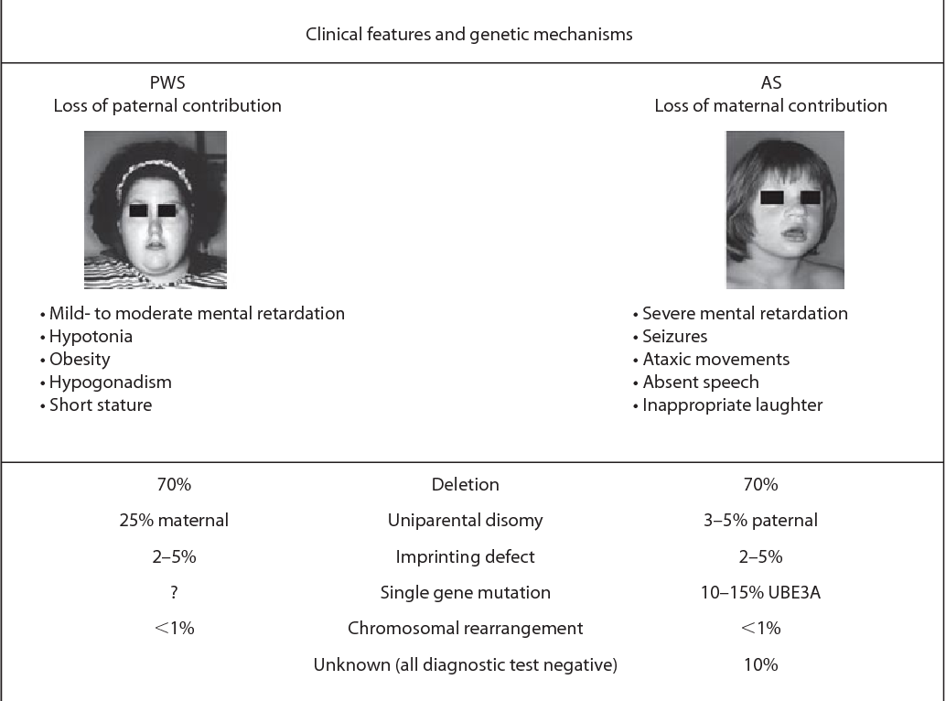

Slide 26
Clinical Cytogenetics
and Genome Analysis

Slide 27
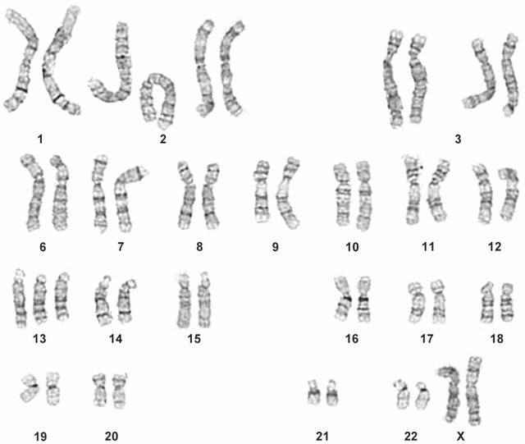

Slide 28
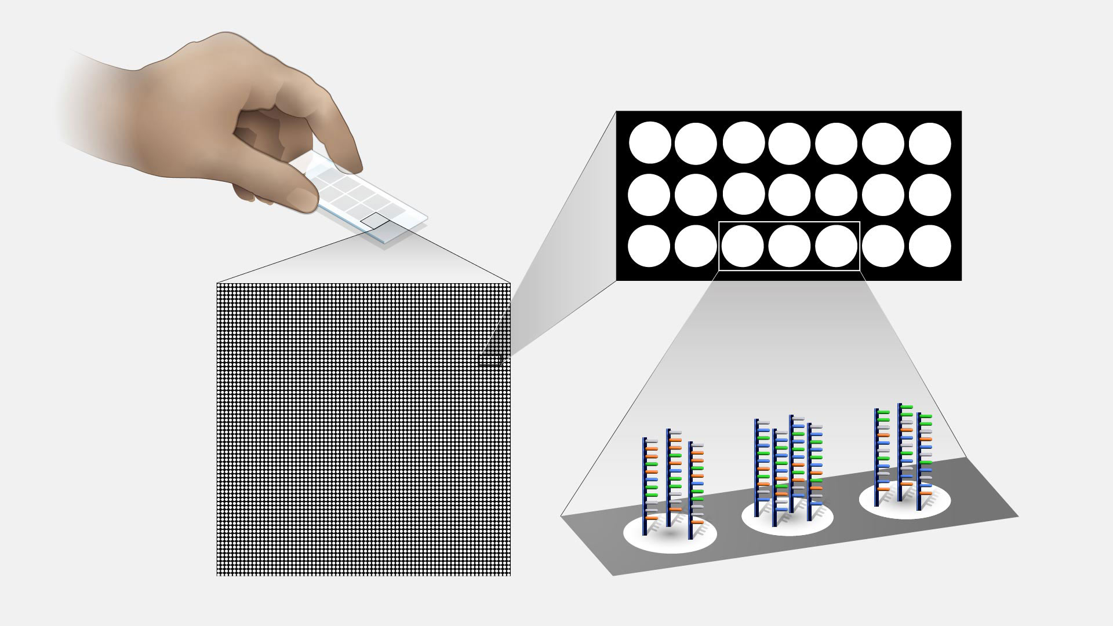
Microarray Technology

