Slide 1
Database Lab 00
Introduction to Database and General Discussion

Slide 2
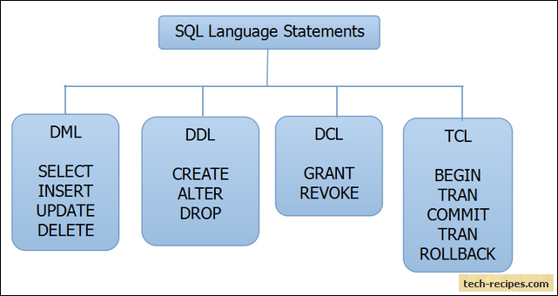
SQL
SQL is a standard language for storing, manipulating and retrieving data in databases.

Slide 3
DML
DML is abbreviation of Data Manipulation Language.
It is used to retrieve, store, modify, delete, insert and update data in database.
SELECT – Retrieves data from a table
INSERT – Inserts data into a table
UPDATE – Updates existing data into a table
DELETE – Deletes all records from a table

Slide 4
DDL
DDL is abbreviation of Data Definition Language.
It is used to create and modify the structure of database objects in database.
CREATE – Creates objects in the database
ALTER – Alters objects of the database
DROP – Deletes objects of the database
TRUNCATE – Deletes all records from a table and resets table identity to initial value.

Slide 5
DCL
DCL is abbreviation of Data Control Language.
It is used to create roles, permissions, and referential integrity as well it is used to control access to database by securing it.
GRANT – Gives user’s access privileges to database
REVOKE – Withdraws user’s access privileges to database given with the GRANT command

Slide 6
TCL
TCL is abbreviation of Transactional Control Language.
It is used to manage different transactions occurring within a database.
COMMIT – Saves work done in transactions
ROLLBACK – Restores database to original state since the last COMMIT command in transactions

