Slide 1
Chapter 03
Introduction to SQL

Slide 2
Modification of the Database
3.9

Slide 3
Deletion

Slide 4
Deletion

Slide 5
Insertion

Slide 6
INSERT INTO SELECT
The INSERT INTO SELECT statement copies data from one table and inserts it into another table.
The INSERT INTO SELECT statement requires that the data types in source and target tables match.
Note: The existing records in the sourse table are unaffected.

Slide 7
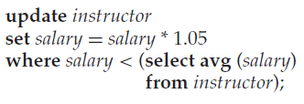
Updates

Slide 8
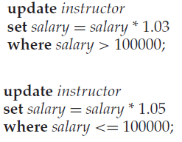
Updates
Suppose that all instructors with salary over $100,000 receive a 3 percent raise, whereas all others receive a 5 percent raise.
Note that the order of the two update statements is important. If we changed the order of the two statements, an instructor with a salary just under $100,000 would
receive an over 8 percent raise.

Slide 9
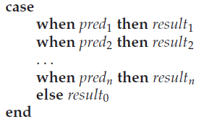
Updates
Suppose that all instructors with salary over $100,000 receive a 3 percent raise, whereas all others receive a 5 percent raise.

