Slide 1
CompSci 280 S2 2107 Introduction to Software Development
GUI 2

Slide 2
Today’s Agenda
Topics:
Java
JList, JComboBox
DefaultListModel
DefaultComboBoxModel
JTable & TableModel
DefaultTableMode
implements the AbstractTableModel
Event Handling
Python
QListView
QAbstractListModel
QTableView
QAbstractTableModel
Event Handling

Slide 3
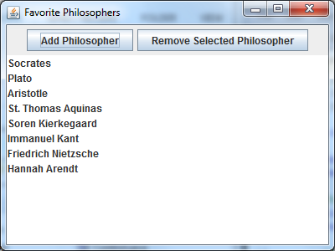
Java MVC Example
Example: PhilosophersJList.java
<<interface>>
Javax.swing.ListModel
Javax.swing.JList
Add/remove items
<<abstract>>
AbstractListModel
modifies
notifies
DefaultListModel
DefaultListModel
Javax.swing.JComponent
isEmpty(): boolean
getSize(): int
addElement(Object)
removeElement(Object)
elementAt(): Object
removeElementAt(int)
insertElementAt(int)
indexOf(Object): int
etc
JList
Example: JList
A ListModel is an object which maintains a list of objects: it knows how big the list is, which object is where in the list, etc, and can insert/remove objects
A JList is a graphical component giving a view of the list and able to receive user input to modify the list

Slide 4
Java Creating a Model (List and Combo Box)
To create a list model:
DefaultListModel — everything is pretty much taken care of for you.
ListModel — create a new class which implements the ListModel interface and implement the getSize and getElementAt methods
To create a combo box model:
DefaultComboBoxModel — everything is pretty much taken care of for you.
ComboBoxModel — create a new class which implements the ComboBoxModel interface and implement the setSelectedItem and getSelectedItem methods

Slide 5
Java Examples
Example: MV_ComboBoxDemo.java
DefaultComboBoxModel:
DefaultListModel:
JComboBox<String> ppComboBox;
...
DefaultComboBoxModel<String> cbm = new DefaultComboBoxModel<String>( new String[]
{ "person", "student", "employee" });
ppComboBox = new JComboBox<String>(cbm);
creates a mutable list model object, puts the initial items in it, and uses the list model to create a list:
JList<String> list;
...
DefaultListModel<String> listModel = new DefaultListModel<String>();
listModel.addElement("red");
listModel.addElement("orange");
listModel.addElement("yellow");
list = new JList<String>(listModel);

Slide 6
Java Using JTable
Tables are used to display data in a spreadsheet fashion
So key concepts in the model of a table:
cell, row, column
Value(s) in each
Every table gets its data from an object that implements the TableModel interface
You can use the DefaultTableModel, OR
You an create a new class which implements the AbstractTableModel interface and implements the following methods:
getColumnName
getRowCount
getColumnCount
getValueAt
import java.swingx.table.*;

Slide 7
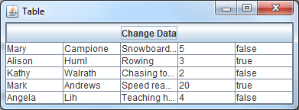
Java Using the DefaultTableModel
Example: DefaultTableModelDemo.java
Model might hold its data in an array, vector or from an database
Object[][] data = { {"Mary", "Campione","Snowboarding", new Integer(5) ...}
{"Alison", "Huml","Rowing", new Integer(3), new Boolean(true)} ...};
String[] columnNames = {"First Name","Last Name","Sport","# of Years","Vegetarian"};
DefaultTableModel defaultTableModel = new DefaultTableModel(data, columnNames);
...
table = new JTable(defaultTableModel);

Slide 8
Java Using the AbstractTableModel
Example: AbstractTableModelDemo.java
Steps in creating and using AbstractTableModel
Create an AbstractTableModel subclass
Implement the getRowCount() , getColumnCount() , and getValueAt() methods
JTable table = new JTable(new AbstractTableModel() {
public int getColumnCount() { return 10; }
public int getRowCount() { return 5;}
public Object getValueAt(int row, int col) {
return new Integer((row+1)*(col+1));
}
});
getContentPane().add(table, BorderLayout.CENTER);
extends AbstractTableModel

Slide 9
Java Controller
Example: DefaultTableModelDemo.java
A controller that takes user input on the view and translates that to changes in the model.”
Example:
You do NOT directly update JTable, T
Instead, you update the TableModel, TM, which automatically updates the Table, T
changeButton.addActionListener(new ActionListener() {
public void actionPerformed(ActionEvent e) {
DefaultTableModel tm = (DefaultTableModel) table.getModel();
for (int row=0; row<tm.getRowCount(); row++) {
int years = (Integer) tm.getValueAt(row, 3);
tm.setValueAt(years+1, row, 3);
}
}
});
Change the TableModel

Slide 10
Java Example
Update the ListModel
addButton.addActionListener( new ActionListener() {
public void actionPerformed( ActionEvent event ) {
String name = JOptionPane.showInputDialog(PhilosophersJList.this, "Enter Name" );
philosophers.addElement( name );
}
});
Change the ListModel
removeButton.addActionListener( new ActionListener() {
public void actionPerformed( ActionEvent event ) {
philosophers.removeElement(list.getSelectedValue() );
}
});
Change the ListModel

