Slide 1
Palestine Technical University (PTU) Fruit Science
Flowering and Fruiting
Dr. Daoud Abusafieh

Slide 2
Flowering
Because flowering is essential to fruit production, an understanding of factors affecting flowering is important in optimizing cultural practices.
An understanding of the flowering process permits wiser use of rootstocks, fertilizers, pruning, girdling, and growth regulating
Chemicals.

Slide 3
DEVELOPMENTAL PHASES:
Juvenility: is defined as that physiological state of a seedling plant during which it cannot be induced to flower. This state is followed by a transition phase in which flowering can occur but not as readily as later when the plant grows into the adult phase.
In woody plants, the juvenile phase may be very short or very long depending upon both environmental and genetic factors. The juvenile period can often be shortened by increasing the growth rate of the young seedling, because a minimum size must be attained to reach the adult state.

Slide 4
Seat of Juvenility:
The young seedling is juvenile in all its tissues until it grows into the transition phase. However, attainment of the transition and ultimately the adult phase does not alter the juvenile tissues. They remain in situ at the base of the tree for its entire life.
Thus an old seedling tree, cut off at the lower trunk, would produce juvenile sprouts from latent buds of the juvenile portion of the tree. In contrast to the seedling plant, varieties budded to seedling stocks are entirely adult above the bud union.

Slide 5
The seedling tree has a juvenile zone at the crown and lower region of the tree, a transition zone in the
mid-region, and an adult zone at the top and periphery. (B) The grafted or budded nursery tree, however, is entirely adult
above the bud union.

Slide 6
Marks of Juvenility:
Besides the inability to flower, juvenile plants are distinguished by several physiological and morphological traits, such as glabrous, lobed leaves, creeping stems, thorny stems, semi-evergreen habit (in deciduous species), ease of rooting of stems.
Adult Phase
Transition Zone
Transitional tissues are found between the purely juvenile and adult sections of stems of seedling trees Characteristics here are intermediate between juvenile and adult. Flowering can occur on transitional stems but not as readily as with the adult.

Slide 7
Adult Phase:
During this phase, shoot meristems have the potential to develop flower buds, and the plant produces flowers, fruits, and seeds.
The duration and expression of these phases represent fundamental variation in plant development, which is analogous to comparable phases in animal development.

Slide 8
Flower Bud Development
Affected by both external environmental conditions & internal physiological state
1. Induction: biochemical signals (CHOs, N, auxins, gibberellins) that induce a vegetative bud to become reproductive.
2. Initiation: when bud first becomes reproductive.
3. Differentiation: individual flower parts (sepals, petals, stamens, pistil) form.
4. Maturation: growth of flower parts during winter.
5. Anthesis: opening of flowers or bloom in spring.

Slide 9
Buds
Buds may be considered as unelongated shoots, with or without flowers parts, and form either at the tips of shoots or in the axils b/w the leaves and the stem.
In temperate fruit, flowers are formed within the buds during summer and fall, over winter, and then bloom the following spring.
Buds are of two main types: simple buds, which contain leaves or flowers, but not both, and mixed buds, containing both leaves and flowers.

Slide 10
Simple buds |  | Mixed buds
 |  | Inflorescence within Inflorescence bud is terminal is lateral
Buds produced terminally on (short or long) shoots | Loquat | Apples, pears, female walnut and pecan flowers | Guava, olives
Buds produced laterally on the shoot | Stone fruit, hazelnut, male pecan and walnut flowers |  | Figs, passionfruit, grapes, kiwifruit, persimon.

Slide 11
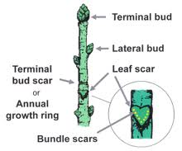

Slide 12
Types of Inflorescence
Flowers may occur singly or in closely associated clusters.
The arrangement of flowers on stem or axil is known as inflorescence.
The inflorescence may terminate in shoot or it may be borne in the axil of the leaf.
There are many types of inflorescences. Each type of inflorescence is determined by how the flowers are arranged.

Slide 13
Common Inflorescences
1. Solitary: A flower be borne singly in the axil of foliage at the terminus shoot or on specialized stalk. e.g.,quince, guava, peach, apricot, almond etc.
2. Racemose:This indeterminate type of inflorecence is by far the most common. There are various types of inflorescence in this class.
A. Raceme: Flowers are borne on the pedicles which are about equal in length.
B. Spike: Bears sessile (lacking a pedicel) or near sessile flowers, e.g., catkins of the walnut, chestnut
C. Corymb: Bears on a short peduncle several flowers having pedicels of nearly equal length, e.g., pear .

Slide 14
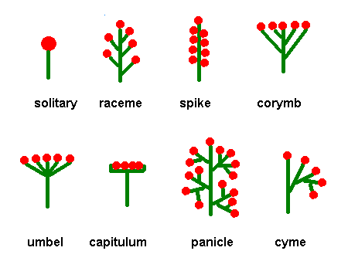
Types of Inflorescence

Slide 15
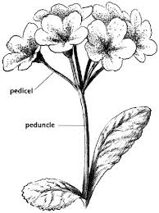

Slide 16
3. Cymose:
Cyme is a determinate and branched type of inflorescence .
In cymose inflorescence axis terminate in a flower.
Lateral branches of the flower develop below the terminal flower, each branch ends in a flower, they also produce lateral branches. Every axis terminates in a flower.
The cymose inflorescence is further of two types:
A. Fascile: cyme with flowers closely crowded on a very shorter peduncle and with pedicles of about equal length e.g., cherry (sweet and sour), plum.

Slide 17
B. Panicle: In this case main axis is indeterminate but the secondary and ultimate axis is a cymose e.g., grapes, mango, litchi, loquat, pistachio.
4. Special:
A. Spadix: it is a large, boat-shaped structure enclosing an inflorescence e.g., date palm, banana.
B. Hypanthodium: In this type of inflorescence the receptacle becomes spherical with a cavity inside. It opens to the outside with a small opening. Numerous small sessile flowers are produced from the inner surface of the receptacle. These flowers are of three types: male flowers, female flowers and sterile female flowers (gall flowers) e.g., Ficus.

Slide 18
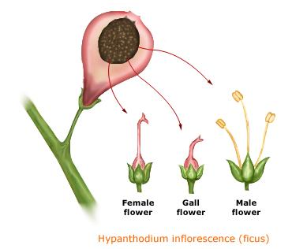

Slide 19
Determinate inflorescence
In determinate inflorescence the terminal axis is with a flower. In this type of inflorescence the youngest flowers are found on the bottom of an elongated axis or on the outside of a truncated axis.
During the flower time, the apical meristem produces a flowering bud arresting the growth of the peduncle.
Indeterminate inflorescence
Here the axis continues to grow. In this type of inflorescence the youngest flowers are present at the top of an elongated axis or on the center of a truncated axis.
Indeterminate inflorescence may be of many types like raceme, panicle, catkin, spike, corymb, umbrella head.

Slide 20
Forms of Flower
There are 3 types of flowers
Perfect | Apple, peach, plum , almond grape, mango, avocado, citrus, guava
Staminate | Papaya, mango, litchi, grape, date, olive
Pistillate | Papaya, mango, grape, date

Slide 21
Apple:
Apple have 2 kinds of buds: vegetative and mixed.
The inflorescence is determinate and domestic forms contain 5 flowers.
Flowers buds are usually borne termnially on shoots or short spurs, but in some cases occur on lateral buds of 1-year shoots.
Floral initiation occurs in early summer for next year’s crop.
The flower cluster is a cyme.

Slide 22
Pear:
Pear buds and inflorescence are similar to those of apple with two differences. The pear inflorescence contains 7 or 8 flowers and is indeterminate; that is, the side or lateral blossoms open first and the terminal bloom opens last .
Floral initiation of pears occurs about 60 days past full bloom. Flower buds are formed on terminals of shoots and short spurs 2 years old and older

Slide 23
Quince
The quince flower bud contains only one flower, borne at the end of current-season's shoot . Thus floral initiation takes place immediately prior to anthesis rather than during the previous season as it does for apple and pear.
Plums and prunes: Plums initiate flowers in lateral buds of both current season's shoots and new growth on older spurs Initiation occurs mostly in late summer, but has been noted as early as July 5 and as late as September.
Each bud produces 1–3 flowers but no leaves.
All terminal buds are vegetative.

Slide 24
Peach and Nectarine:
Peaches produce solitary flowers from unmixed axillary buds of last year's growth, so 40–50 cm of new growth each year are needed to maintain good cropping .
Floral initiation begins in midsummer and continues for several weeks. Enough flowers are formed each year for good annual cropping, but tend to bloom lighter following a heavy crop year.
The peach is precocious and often blooms the second or third year after planting.

Slide 25
Almond:
The flower bud of almond is similar to that of peach, being solitary, without leaves, and always in lateral rather than terminal position .
Many more flowers are normally formed than are needed to produce a full crop, but a much heavier set is required than with peach because the peach is very much larger at maturity.
Almonds are not thinned and heavy fruit set does not result in alternate bearing on healthy trees.

Slide 26
Apricot:
Floral initiation in apricot occurs during late summer on both current season's shoots and on short older spurs.
The solitary flowers have no basal leaves and are borne only on lateral buds. Most varieties are self-fertile.
Fig:
Fig is considered ever flowering plants (flower continuously throughout the year)
The fig inflorescence is inside out, with the succulent peduncle on the outside and the flowers on the inside, a syconium .

Slide 27
Flower initials typically form at the axil of each leaf, where a central vegetative bud is accompanied by 2 flower buds.
Initiation occurs in late summer for next year's first crop.
Olive:
Flowers are borne on panicles arising in the axils of leaves, usually laterally on last year's growth, or less often from dormant buds 1 or 2 years old.
Flowers are of 2 types: perfect, with both pistil and stamens, and staminate only with abortive, nonfunctional pistil.

Slide 28
Persimmon:
Floral initiation of persimmon appears to begin in July in buds that next season will be lateral buds at the axils of new leaves.
Hazelnut:
The hazelnut is monoecious (i.e., the staminate and pistillate flowers are borne on the same tree). Male flowers are borne on catkins from unmixed lateral buds. Female flowers are borne in clusters on lateral buds of last year's growth, and are terminal on a short shoot that develops from the mixed bud. They have no petals and appear only as small red tufts (stigmas) protruding from the bud in winter. Both male and female flowers are initiated the previous summer.

Slide 29
Chestnut:
Chestnuts also are monoecious. Both kinds of flowers are borne on the current season's shoots. The male catkins are found on lateral buds along the lower portion of the shoot. The female flowers are located at the base of one or more male catkins near the tip of the new shoot
Pistachio:
The pistachio is dioecious and thus about 1/6 of the trees in an orchard should be male trees. The apetalous female flowers are wind-pollinated and are borne laterally in panicles.

Slide 30
Heavy cropping causes initiated flower buds on the same branch to drop during the summer, resulting in biennial bearing.
Grape:
The grape produces flower clusters from a compound bud or "eye," which is more complex than the mixed bud of the pome fruits. Each eye, borne on last year's cane growth, contains a number of buds, but only the central bud usually develops. Floral initiation begins in midsummer for the flowers that open the next spring. Following bud break, a shoot and leaves appear first. The 2 or 3 flower clusters per shoot appear opposite the leaves. Tendrils, which are simply sterile inflorescences, also appear opposite the leaves.

Slide 31
Strawberry
The strawberry inflorescence is actually produced terminally, and later is laterally displaced by the uppermost axillary bud, so that the terminal bud appears in an axillary position. The cluster contains few to many flowers depending upon variety. The earliest flowers and largest fruits are in the pseudo-lateral position, the flowers in terminal position being late and smaller

Slide 32
Spring-bearing varieties initiate flowers the previous fall. Everbearing ones tend to initiate flowers continuously during the growing season.
Kiwifruit:
Actinidia are functionally dioecious. The pistillate flower appears perfect, but the pollen produced is nonviable.
Staminate plants may produce fruit, but they are small and inferior. Floral induction occurs in late summer, but visible differentiation is not evident until the following spring about 10 days before the new shoot emerges.
Flowers form cymes or are solitary in the axils of leaves on current season's shoots.

Slide 33
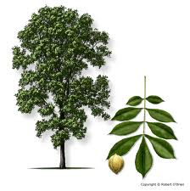

Slide 34
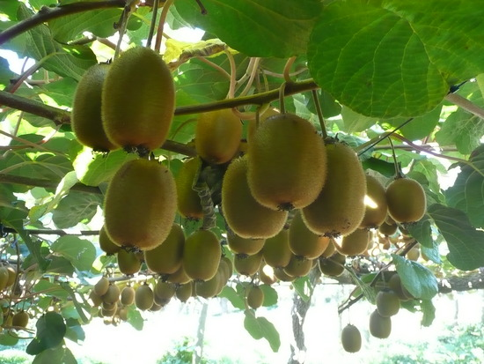

Slide 35
