Slide 1
Chapter 01
Introduction

Slide 3
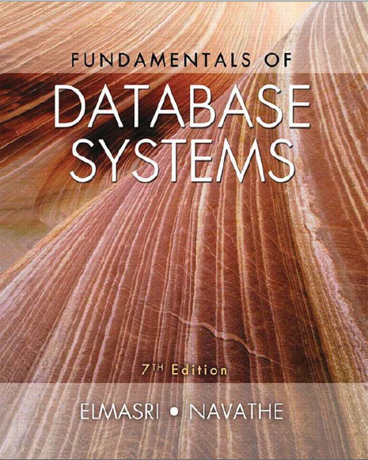

Slide 4
What is a Database?
“A set of information held in a computer”
Oxford English Dictionary
“One or more large structured sets of persistent data البيانات المستمرة , usually associated with software to update and query the data”
Free On-Line Dictionary of Computing
“A collection of data arranged for ease and speed of search and retrieval”
Dictionary.com

Slide 5
Why Study Databases?
Databases are useful
Many computing applications deal with large amounts of information
Database systems give a set of tools for storing, searching and managing this information
Databases in CS
Databases are a ‘core topic’ in computer science
Basic concepts and skills with database systems are part of the skill set you will be assumed to have as a CS graduate

Slide 6
Introduction
A database-management system (DBMS)
Database Management Systems (DBMS)
is a collection of interrelated data and a set of programs to access those data.
The collection of data, usually referred to as the database, contains information relevant to an enterprise.
The primary goal of a DBMS is to provide a way to store and retrieve database information that is both convenient and efficient.

Slide 7
Introduction [Cont.]
Database systems are designed to manage large bodies of information.
Management of data involves:
Defining structures for storage of information.
Providing mechanisms for the manipulation of information.
In addition, the database system must ensure the safety of the information stored, despite system crashes or attempts at unauthorized access.

Slide 8
Database-System Applications
1.1

Slide 9
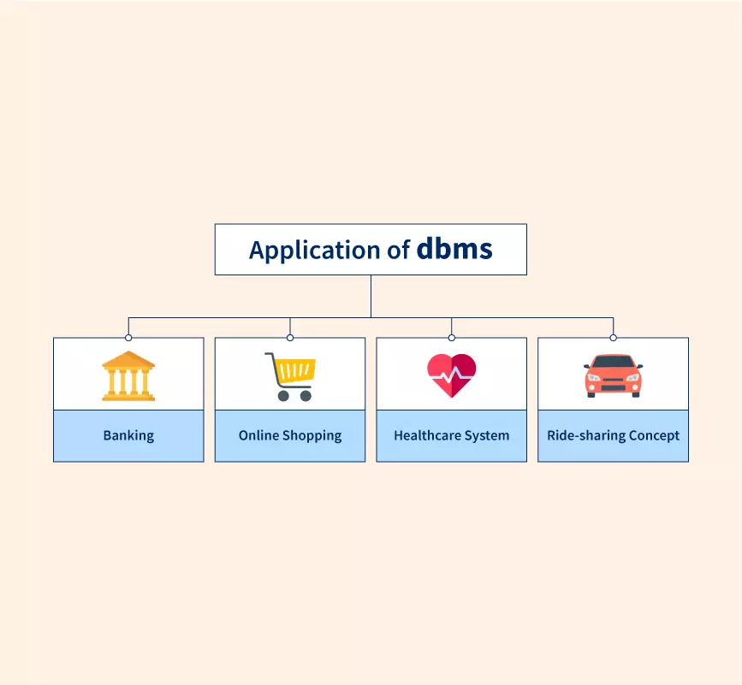
Database-System Applications
Enterprise Information.
Banking and Finance.
Universities.
Telecommunication.
Train timetables
Airline bookings
Credit card details
Student records
Customer histories
Stock market prices
Web indexes
Library catalogues
Medical records
Personnel systems
Product catalogues

Slide 10
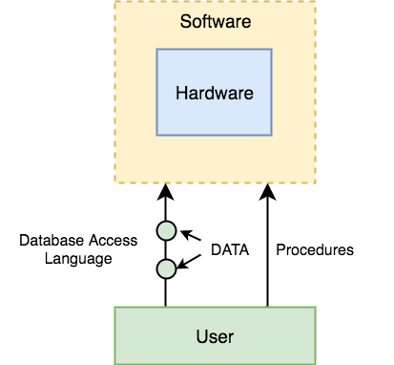
Database Systems
A database system consists of
Data (the database)
Software
Hardware
Users
We focus mainly on the software
Database systems allow users to
Store
Update
Retrieve
Organise
Protect
their data.

Slide 11
Purpose of Database Systems
1.2

Slide 12
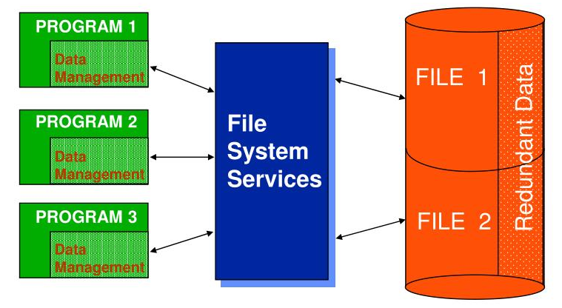
file-processing system
Before database management systems (DBMSs) were introduced, organizations usually stored information it in operating system files.

Slide 14
file-processing system disadvantages
Data redundancy and inconsistency.
Difficulty in accessing data.
Data isolation.
Integrity problems.
Atomicity problems.
Concurrent-access anomalies.
Security problems.

Slide 15
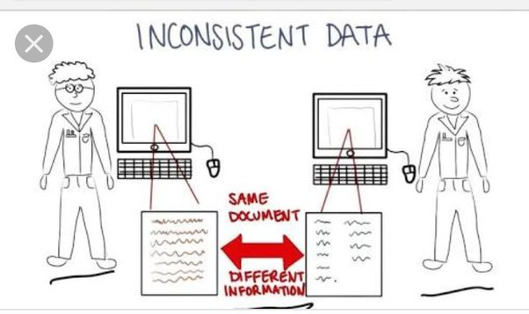
Data redundancy and inconsistency
Since different programmers create the files and application programs over a long period, the various files are likely to have different structures and the programs may be written in several programming languages.
Moreover, the same information may be duplicated in several places (files).

Slide 16
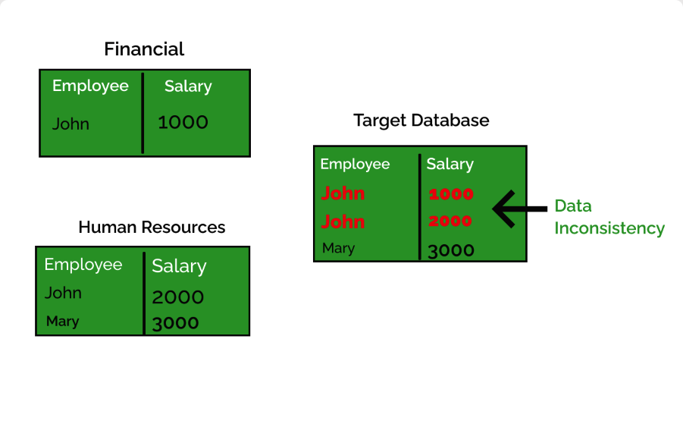

Slide 17
Difficulty in accessing data.
Conventional file-processing environments do not allow needed data to be retrieved in a convenient and efficient manner.
Need to write a new program to carry out each new task

Slide 18
Data isolation
Because data are scattered in various files, and files may be in different formats, writing new application programs to retrieve the appropriate data is difficult.

Slide 19
Integrity problems
The data values stored in the database must satisfy certain types of consistency constraints.

Slide 20
Atomicity problems
A computer system, like any other device, is subject to failure.
In many applications, it is crucial that, if a failure occurs, the data be restored to the consistent state that existed prior to the failure.

Slide 21
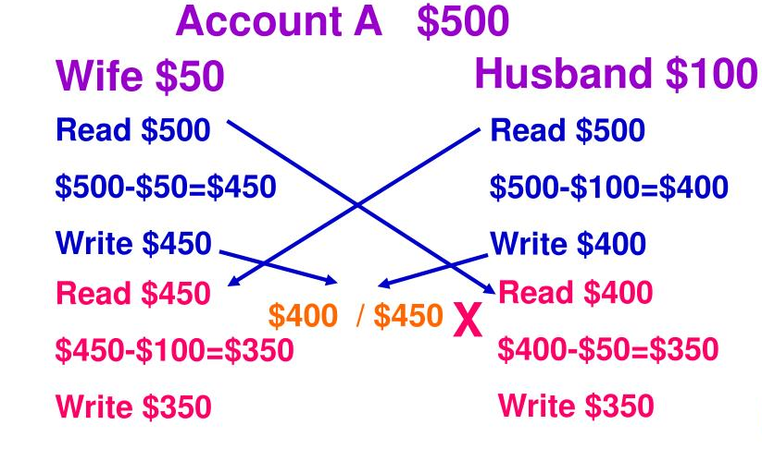
Concurrent-access anomalies شذوذ الوصول المتزامن

Slide 23
Security problems
Not every user of the database system should be able to access all the data.
And hard to provide user access to some -but not all- data
Database systems offer solutions to all the above problems

Slide 24
View of Data
1.3

Slide 25
view of the data
A major purpose of a database system is to provide users with an abstract view of the data.
That is, the system hides certain details of how the data are stored and maintained.

Slide 26
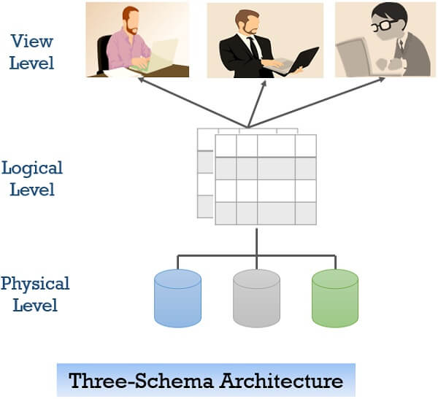
Data Abstraction
For the system to be usable, it must retrieve data efficiently.
The need for efficiency has led designers to use complex data structures to represent data in the database.
Since many database-system users are not computer trained, developers hide the complexity from users through several levels of abstraction, to simplify users’ interactions with the system:
Physical level.
Logical level.
View level.

Slide 27
Data Abstraction / Physical level
The lowest level of abstraction describes how the data are actually stored.
The physical level describes complex low-level data structures in detail.

Slide 28
Data Abstraction / Logical Level
What data are stored in the database
and what relationships exist among those data.

Slide 29
Data Abstraction / View Level
Describes only part of the entire database.
The system may provide many views for the same database.

Slide 30
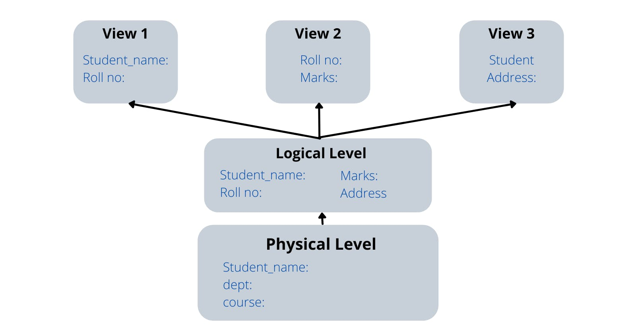

Slide 31
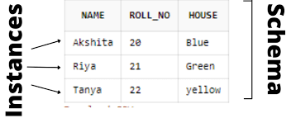
Instances and Schemas
The collection of information stored in the database at a particular moment is called an instance of the database.
The overall design of the database is called the database schema.

Slide 32
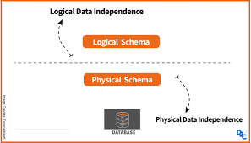
Physical data independence
Application programs are said to exhibit physical data independence if they do not depend on the physical schema, and thus need not be rewritten if the physical schema changes.

Slide 33
End of Lecture 01

