Slide 1
Types of Inheritance in human
Autosomal Dominant Inheritance
Autosomal Recessive Inheritance
X-Chromosomal Inheritance
Y-Chromosomal Inheritance
Mitochondrial Inheritance
Multifactorial Inheritance

Slide 2
X-Chromosomal Inheritance
Typical Characteristics of X-Chromosomal Inheritance
Males are severely affected; sometimes the disorder in males is incompatible with life.
Clinical symptoms in females are variable depending on the disease mechanism and the individual X- inactivation pattern; females may be asymptomatic carriers (the female is a functional mosaic for X-chromosomal traits).
A female may show signs of X-chromosomal mosaicism, as in incontinentia pigmenti
A heterozygous (carrier) female transmits the disease-causing mutation to 50% of her sons and 50% of her daughters.
A hemizygous (affected) male transmits the disease-causing mutation to all of his daughters and none of his sons

Slide 3
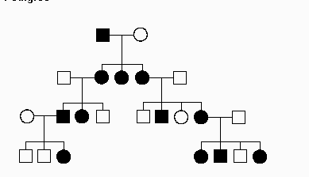
X-Chromosomal Inheritance

Slide 4
X-Chromosomal Inheritance
Examples of Disorders with X-Chromosomal Inheritance:
Muscular dystrophy types Duchenne and Becker
Hemophilias A and B
Lesch-Nyhan syndrome
Fragile X syndrome
color blindness, and incontinentia pigmenti.
.

Slide 5
Types of Inheritance in human
Autosomal Dominant Inheritance
Autosomal Recessive Inheritance
X-Chromosomal Inheritance
Y-Chromosomal Inheritance
Mitochondrial Inheritance
Multifactorial Inheritance
Others

Slide 6
Y-Chromosomal Inheritance
Assumed for all genes that are only present on the Y chromosome
Also known as holandric inheritance
An affected father transmits the disorder to all his sons and, as a result, only men would be affected by the disorder.
Most of the unique Y-chromosomal genes that are not homologous to X-chromosomal genes play a role in male sexual differentiation, the development of sex characteristics, and spermatogenesis. This means that mutations in these genes typically result in infertility and, therefore, are not transmitted to children.

Slide 7
Y-Chromosomal Inheritance
The pseudoautosomal regions (PAR1 and PAR2) are short regions of homology between the mammalian X and Y chromosomes.
Thus genes in this region are inherited in an autosomal rather than a strictly sex-linked fashion.

Slide 8
Types of Inheritance in human
Autosomal Dominant Inheritance
Autosomal Recessive Inheritance
X-Chromosomal Inheritance
Y-Chromosomal Inheritance
Mitochondrial Inheritance
Multifactorial Inheritance
Others

Slide 9
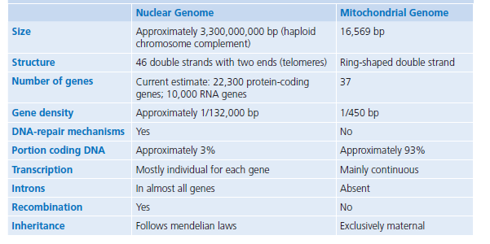
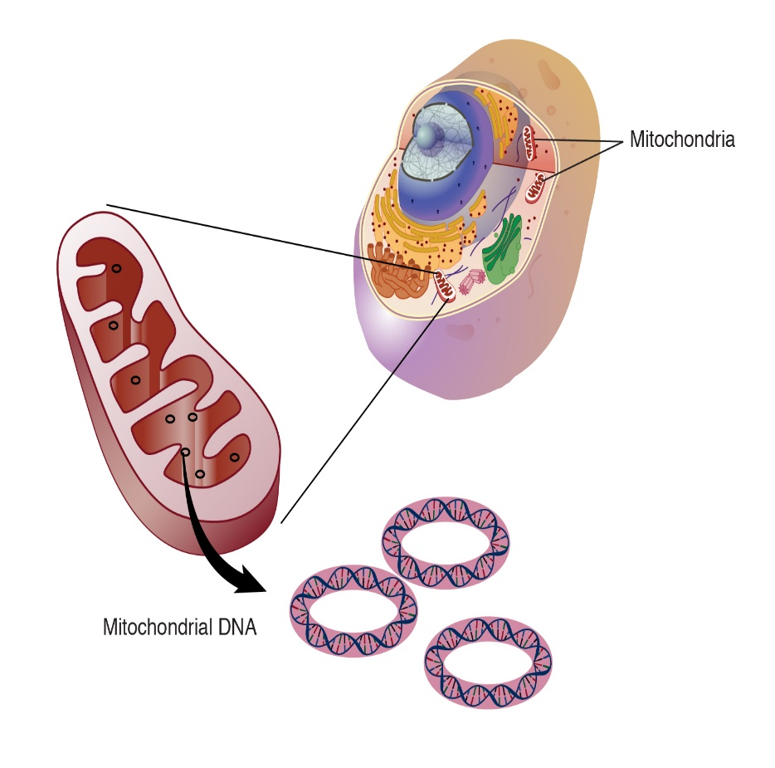
Mitochondrial Inheritance

Slide 10
Mitochondrial Inheritance
mtDNA is replicated independently of the cell cycle, and the individual copies are randomly distributed to the daughter cells during mitosis.
mtDNA contains a total of 37 genes. Of these, 13 code for proteins of the oxidative phosphorylation complex. The remaining 24 genes are transcribed into 22 transfer RNA (tRNA) and 2 ribosomal RNA (rRNA) molecules that are required for protein synthesis within the mitochondria

Slide 11
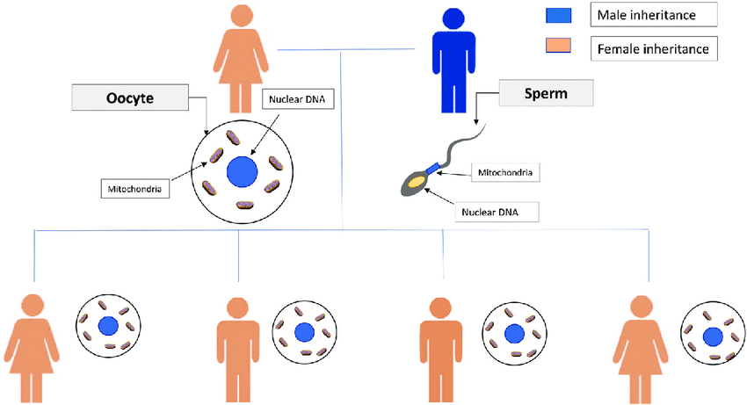
Mitochondrial Inheritance
Characteristics of Mitochondrial Inheritance.
Purely Maternal
Important Note:
Most mitochondrial disorders, are caused by mutations of the nuclear genome and are inherited according to the classic mendelian rules of inheritance.

Slide 12
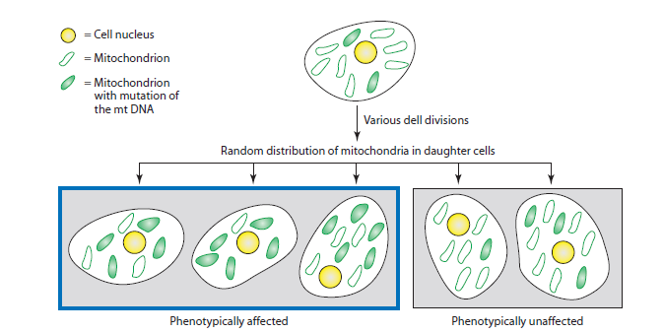
Mitochondrial Inheritance
Heteroplasmy: An mtDNA variant is found only in a portion of the cell’s mitochondria.
Homoplasmy: All mtDNA copies have the same sequence (e.g., all mtDNA copies contain a particular mutation).

Slide 13
Mitochondrial Inheritance
The proportion of normal and mutated mtDNA copies may vary considerably in different organs or in the course of successive cell divisions.
Patients with mitochondrially inherited disorders often report that individual symptoms change over time (e.g., cardiac arrhythmias have phases of different severity).

Slide 14
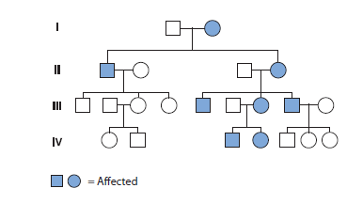
Mitochondrial Inheritance

Slide 15
Mitochondrial Inheritance
Examples of Mitochondrially Inherited Disorders
MELAS Syndrome: Mitochondrial Encephalopathy, Lactic Acidosis, and Stroke-like episodes
MERRF Syndrome: Myoclonic Epilepsy with Ragged Red Fibers

Slide 16
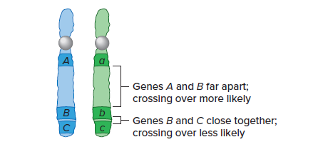
Other Forms of Inheritance
Linkage
Linkage is the close association of genes or other
DNA sequences on the same chromosome.
The closer two genes are to each other on the chromosome, the greater the probability that they will be inherited together.

Slide 17
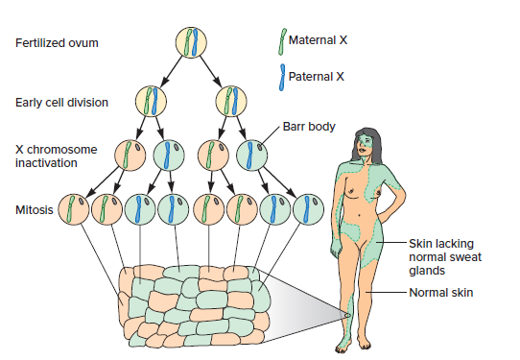
X Chromosome Inactivation
By the time the embryo of a female mammal consists of eight cells, about 75 percent of the genes on one X chromosome in each cell are inactivated, and the remaining 25 percent are expressed to different degrees in different females.
A female is a mosaic for expression of genes on the X chromosome because of the random inactivation of either the maternal or paternal X in each cell early in prenatal development.
X inactivation can alter the phenotype (gene expression), but not the genotype.
The change is reversed in germline cells destined to become oocytes, and this is why a fertilized ovum does not have an inactivated X chromosome.
anhidrotic ectodermal dysplasia

Slide 18
Genomic Imprinting
Genomic imprinting: refers to the phenomenon in which the expression of certain genes is determined by whether the gene is inherited from the female or male parent
A particular gene might function if it came from the father, but not if it came from the mother, or vice versa.
Maternally imprinted gene: the allele inherited from the mother is imprinted (inactive) (e.g. IGF2)
Paternally imprinted gene: the allele inherited from the father is imprinted (inactive) (e.g. IGF2R)
Genomic imprinting involves epigenetic alteration of the gene without affecting the sequence of the gene

Slide 19
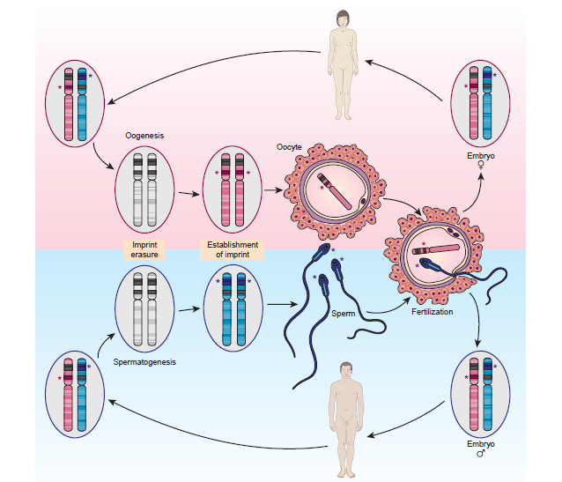
Genomic Imprinting

