Slide 15
E=1.35;
V=1.0; %Internal voltage of the generator and infinite bus voltage
H=9.94; %Inertia constant in Mw.S/MVA
X=0.65;
Pm=0.6;
D=0.138;
f0=50;
Pmax=E*V/X, d0=asin(Pm/Pmax) % initial rotor angle
Ps=Pmax*cos(d0) %Synchronizing Power Coefficient wn=sqrt(pi*60/H*Ps) %Natural Frequency of oscillation
z=D/2*sqrt(pi*60/(H*Ps)) %damping ratio
wd=wn*sqrt(1-z^2),fd=wd/(2*pi) %damped frequency of oscillation in rad/sec
tau=1/(z*wn) %Time constant of the second order system
th=acos(z) %Damping angle
Dd0=10*pi/180; %initial rotor angle

Slide 16
t=0:.01:3; %simulation time steps
Dd=Dd0/sqrt(1-z^2)*exp(-z*wn*t).*sin(wd*t+th); %update rotor angle
d=(d0+Dd)*180/pi; %instantaneous rotor angle in degrees
Dw=-wn*Dd0/sqrt(1-z^2)*exp(-z*wn*t).*sin(wd*t); %update rotor speed
f=f0+Dw/(2*pi); %instantaneous frequency in Hz
subplot(2,1,1),plot(t,d),grid
xlabel('t sec'),ylabel('Delta degree')
subplot(2,1,2),plot(t,f),grid
xlabel('t sec'),ylabel('frquency hertz')
subplot(111)

Slide 17
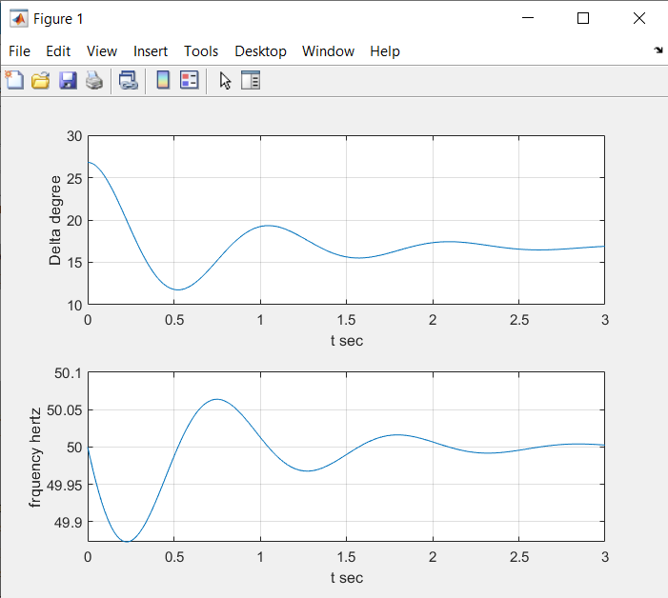

Slide 34
Voltage stability

