Slide 1
Chapter 3
Matrices
3.3 The Inverse of a Matrix

Slide 2
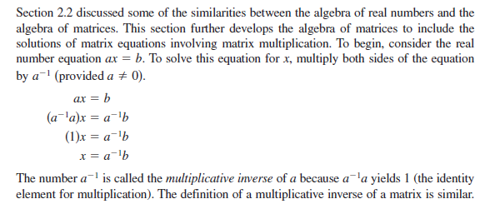

Slide 5
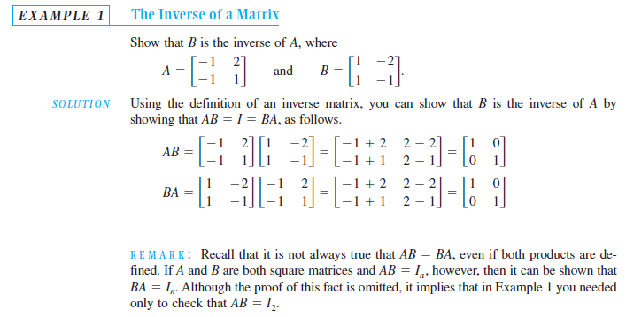

Slide 6
