Slide 1
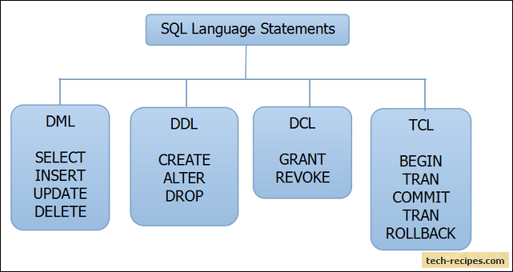
SQL
SQL is a standard language for storing, manipulating and retrieving data in databases.

Slide 2
DDL
DDL is abbreviation of Data Definition Language.
It is used to create and modify the structure of database objects in database.
CREATE – Creates objects in the database
ALTER – Alters objects of the database
DROP – Deletes objects of the database
TRUNCATE – Deletes all records from a table and resets table identity to initial value.

Slide 3
SQL CREATE TABLE Statement
The CREATE TABLE statement is used to create a new table in a database.
Simple Example:
CREATE TABLE Persons ( PersonID int, LastName varchar(255), FirstName varchar(255), Address varchar(255), City varchar(255) );

Slide 4
SQL DROP TABLE Statement
The DROP TABLE statement is used to drop an existing table in a database.
DROP TABLE table_name;

Slide 5
SQL TRUNCATE TABLE
The TRUNCATE TABLE statement is used to delete the data inside a table, but not the table itself.
TRUNCATE TABLE table_name;

Slide 6
SQL ALTER TABLE Statement
The ALTER TABLE statement is used to add, delete, or modify columns in an existing table.
The ALTER TABLE statement is also used to add and drop various constraints on an existing table.

Slide 7
Alter / Change Datatype
ALTER TABLE table_name MODIFY COLUMN column_name datatype;

Slide 8
Alter / Drop Columns
ALTER TABLE table_name DROP COLUMN column_name;
ALTER TABLE table_name DROP (column_name1, column_name2);
Ex
ALTER TABLE customers DROP customer_name;

Slide 9
Alter / Add Column
ALTER TABLE table_name ADD column_name column_definition;
ALTER TABLE table_name ADD (column_name1 column1_definition,
column_name2 column2_definition);
Ex:
ALTER TABLE customers ADD customer_name varchar(45);

Slide 10
Alter / Rename tables and columns
ALTER TABLE table_name RENAME TO new_table_name;
RENAME TABLE table_name TO new_table_name;
ALTER TABLE table_name RENAME COLUMN column_name TO new_column_name;
ALTER TABLE table_name CHANGE old_column_name new_column_name column_definition;

Slide 11
SQL Constraints
NOT NULL :
Ensures that a column cannot have a NULL value
UNIQUE :
Ensures that all values in a column are different
PRIMARY KEY :
A combination of a NOT NULL and UNIQUE. Uniquely identifies each row in a table
FOREIGN KEY :
Uniquely identifies a row/record in another table
CHECK :
Ensures that all values in a column satisfies a specific condition
DEFAULT :
Sets a default value for a column when no value is specified
INDEX :
Used to create and retrieve data from the database very quickly

Slide 12
NOT NULL
By default, a column can hold NULL values.
The NOT NULL constraint enforces a column to NOT accept NULL values.
This enforces a field to always contain a value, which means that you cannot insert a new record, or update a record without adding a value to this field.
CREATE TABLE Persons ( ID int NOT NULL, LastName varchar(255) NOT NULL, FirstName varchar(255) NOT NULL, Age int );

Slide 13
SQL UNIQUE Constraint
The UNIQUE constraint ensures that all values in a column are different.
Both the UNIQUE and PRIMARY KEY constraints provide a guarantee for uniqueness for a column or set of columns.
A PRIMARY KEY constraint automatically has a UNIQUE constraint.
However, you can have many UNIQUE constraints per table, but only one PRIMARY KEY constraint per table.
CREATE TABLE Persons ( ID int NOT NULL UNIQUE, LastName varchar(255) NOT NULL, FirstName varchar(255), Age int );

