Slide 1
Chapter 01
Introduction

Slide 2
Transaction Management
1.8

Slide 3
Transaction
A transaction is a collection of operations that performs a single logical function in a database application.
The transaction manager consists of the:
Concurrency-control manager
The recovery manager.

Slide 4
Database Architecture
1.9

Slide 5
Database Architecture

Slide 6
Data Mining and Information Retrieval
1.10

Slide 7
Database Users and Administrators
1.12

Slide 8
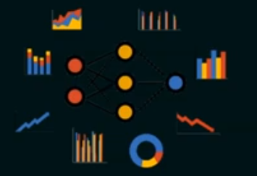
Database Users
Naive users:/end users
Are unsophisticated users who interact with the system by invoking one of the application programs that have been written previously.
Application programmers.
Are computer professionals who write application programs.
Sophisticated users.
Interact with the system without writing programs.
Specialized users:
Users who write specialized database applications that do not fit into the traditional data-processing framework, such as these application store data with complex data types (for example, graphics data and audio data)

Slide 9
The functions of a DBA include
Schema definition:
The DBA creates the original database schema by executing a set of data definition statements in the DDL.
Schema and physical-organization modification.
The DBA carries out changes to the schema and physical organization to reflect the changing needs of the organization.
Alter the physical organization to improve performance.

Slide 10
The functions of a DBA include
Granting of authorization for data access.
By granting different types of authorization, the database administrator can regulate which parts of the database various users can access.
Routine maintenance.
Periodically backing up the database.
Ensuring that enough free disk space is available for normal operations.
Monitoring jobs running on the database and ensuring that performance is not degraded by very expensive tasks submitted by some users.

Slide 11
End of lecture 04

