Slide 1
Chapter 03
Introduction to SQL

Slide 2
Overview of the SQL Query Language
3.1

Slide 3
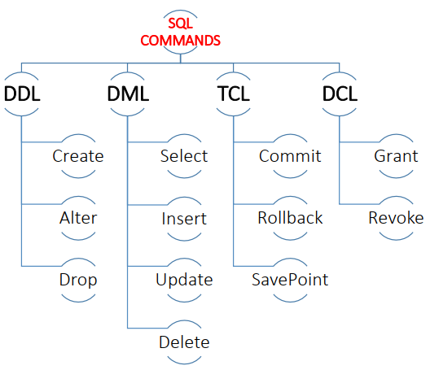
The SQL language has several parts:

Slide 4
The SQL language has several parts:
Data-definition language (DDL).
The SQL DDL provides commands for:
Defining relation schemas.
Deleting relations.
Modifying relation schemas.
Also includes commands for:
Integrity.
The SQL DDL includes commands for specifying integrity constraints that the data stored in the database must satisfy.
Updates that violate integrity constraints are disallowed.
View definition.
The SQL DDL includes commands for defining views.
Authorization.
The SQL DDL includes commands for specifying access rights to relations and views.

Slide 5
The SQL language has several parts:
Data-manipulation language (DML).
The SQL DML provides the ability to:
Query information from the database.
Insert tuples into database.
Delete tuples from database.
Modify tuples in the database
Transaction control Language (TCL).
SQL includes commands for specifying the beginning and ending of transactions.

Slide 6
The SQL language has several parts:
Data Control Language (DCL)
-Data Control Language (or DCL) consists of statements that control security and concurrent access to table data.
There are also some commands that are specialized in:
Embedded SQL and dynamic SQL.
Embedded and dynamic SQL define how SQL statements can be embedded within general-purpose programming languages, such as C, C++, and Java.

Slide 7
SQL Data Definition
3.2

Slide 8
SQL Data Definition
The SQL DDL allows specification of not only a set of relations, but also information about each relation, including:
The schema for each relation.
The types of values associated with each attribute.
The integrity constraints.
The set of indices to be maintained for each relation.
The security and authorization information for each relation.
The physical storage structure of each relation on disk.

Slide 9
Basic Data Types
char(n):
A fixed-length character string with user-specified length n.
The full form, character, can be used instead.
varchar(n):
A variable-length character string with user-specified maximum length n.
The full form, character varying, is equivalent.
int:
An integer (a finite subset of the integers that is machine dependent).
The full form, integer, is equivalent.
smallint:
A small integer (a machine-dependent subset of the integer type).

Slide 10
Basic Data Types
numeric(p, s):
A fixed-point number with user-specified precision.
The number consists of p digits (plus a sign), and s of the p digits are to the right of the decimal point.
Thus, numeric(3,1) allows 44.5 to be stored exactly, but neither 444.5 or 0.32 can be stored exactly in a field of this type.
real, double precision:
Floating-point and double-precision floating-point numbers with machine-dependent precision.
float(n):
A floating-point number, with precision of at least n digits.

Slide 12
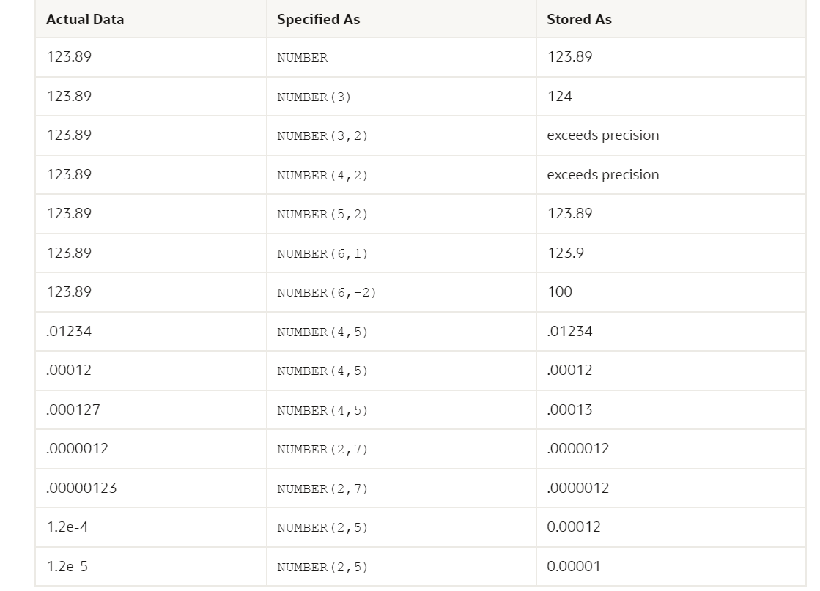

Slide 13
Basic Data Types ملخص للسابق
Before creating a Table you have to decide what type of data each column can contain. This is known as data type. Lets Discuss what data types are available in Oracle.
Datatype | Description
CHAR (size ) Or CHAR | Fixed-length (String) character data of length size bytes or characters (The size parameter specifies the column length in characters) (can contain letters, numbers, and special characters). Fixed for every row in the table. can be from 0 to 2000 byte. Default is 1 byte
VARCHAR (size) | A VARIABLE length string (can contain letters, numbers, and special characters). The size parameter specifies the maximum string length in characters - can be from 0 to 32767 byte Variable for each row.

Slide 14
Basic Data Types ملخص للسابق
Datatype | Description
INT Or INTEGER | An integer (a finite subset of the integers that is machine dependent).
SMALLINT | A small integer (a machine-dependent subset of the integer type).
FLOAT(p) Or FLOAT | A floating point number. MySQL uses the p value to determine whether to use FLOAT or DOUBLE for the resulting data type. If p is from 0 to 22, the data type becomes FLOAT(). If p is from 23 to 126, the data type becomes DOUBLE(), round the floating point number if greater than P
NUMBER (p , s) or NUMERIC(p , s) | Number having precision p and scale s. The precision p can range from 1 to 38. The scale s can range from -84 to 127. Both precision and scale are in decimal digits. A NUMBER value requires from 1 to 22 bytes.

Slide 15
Basic Data Types ملخص للسابق
Datatype | Description
DATE | Fixed-length date and time data, ranging from Jan. 1, 4712 B.C.E. to Dec. 31, 4712 C.E. Fixed at 7 bytes for each row in the table. Default format is a string (such as DD-MON-RR) specified by the NLS_DATE_FORMAT parameter.
TIMESTAMP (precision) | A value representing a date and time, including fractional seconds. (The exact resolution depends on the operating system clock.) Varies from 7 to 11 bytes, depending on the precision.
BLOB | For BLOBs (Binary Large Objects). Holds up to 65,535 bytes of data
BFILE | Binary data stored in an external file . Up to 2³² - 1 bytes, or 4 gigabytes.

Slide 17
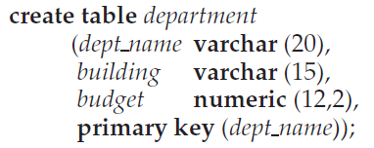
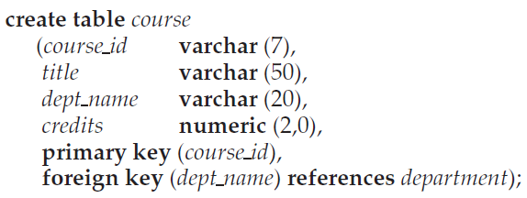
Basic Schema Definition

Slide 18
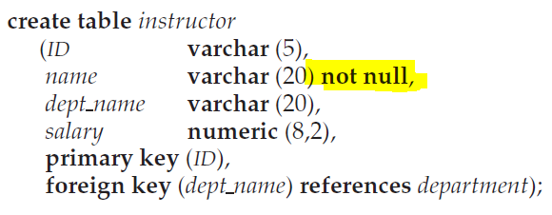
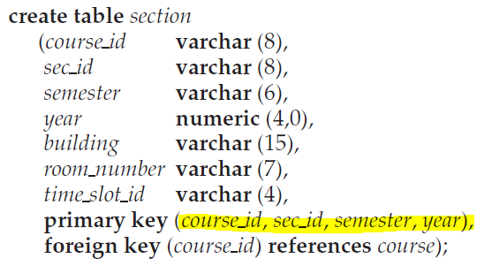
Basic Schema Definition

Slide 19
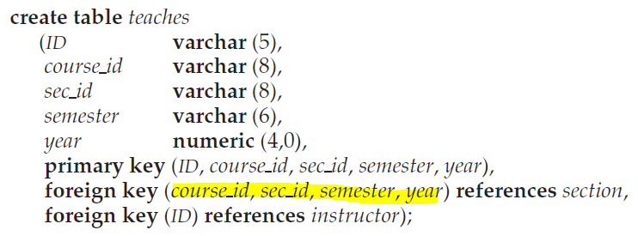
Basic Schema Definition

Slide 20
drop table
To remove a relation from an SQL database, we use the drop table command.
The drop table command deletes all information about the dropped relation from the database.

Slide 21
alter table
We use the alter table command to add attributes to an existing relation.
All tuples in the relation are assigned null as the value for the new attribute.
The form of the alter table command is
We can drop attributes from a relation by the command:

Slide 22
Basic Structure of SQL Queries
3.3

Slide 23
Basic Structure of SQL Queries
The basic structure of an SQL query consists of three clauses:
select
from
where.
The query takes as its input the relations listed in the from clause, operates on them as specified in the where and select clauses, and then produces a relation as the result.

Slide 24
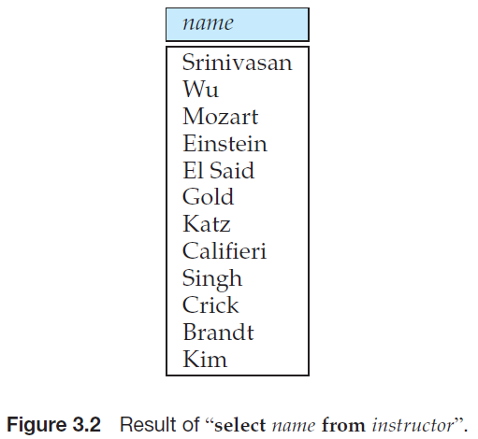
Queries on a Single Relation
Example:
Find the names of all instructors.
Select name from instructor;

Slide 25
Queries on a Single Relation
Example:
Find the names of all departments.
Select dept_name from department;
Select distinct dept_name from instructor;
Select distinct dept_name from course;

Slide 26
Queries on a Single Relation
Example:

Slide 27
Queries on a Single Relation
Example:

Slide 28
Queries on Multiple Relations
ينتج من خلالها تكرار الاعمدة المشتركة بين الجداول

Slide 29
The Natural Join
With natural join
لا ينتج من خلالها تكرار الاعمدة المشتركة بين الجداول
Without natural join
ينتج من خلالها تكرار الاعمدة المشتركة بين الجداول

Slide 30
The Natural Join
select *
from employees natural join departments;

Slide 31
The inner Join

Slide 32
The inner join
Select name, instructor.dept_name,building
From instructor join department using (dept_name)
كلاهما نفس النتيجة inner join

Slide 33
Inner join
select *
from employees,departments
where employees.department_id=departments.department_id;
select *
From employees inner join departments on employees.department_id=departments.department_id;
select *
from employees join departments using (department_id);

