Slide 1
Chapter 1
Linear Equations and Functions

Slide 2
1.5 Solutions of Systems of Linear Equations :
Objectives :
To solve systems of linear equations by substitution
To solve systems of linear equations by elimination

Slide 5
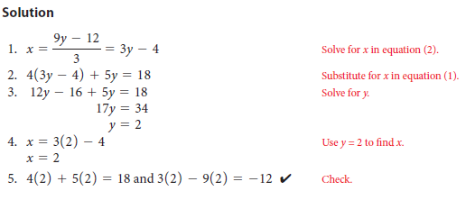
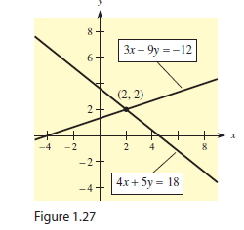

Slide 6
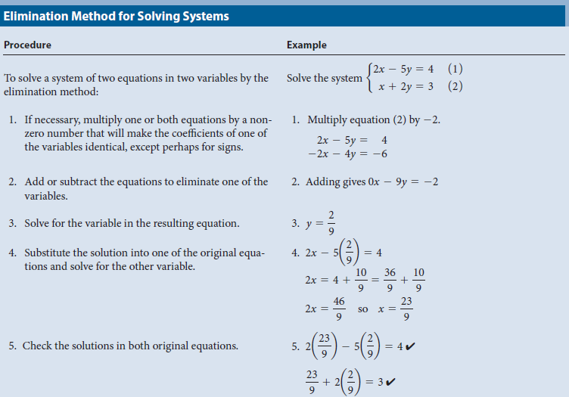

Slide 7
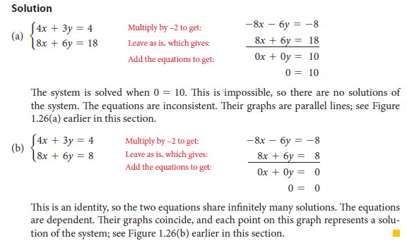

Slide 8
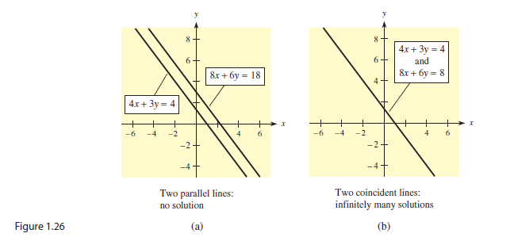

Slide 9
