Slide 1
SQL (DML)

Slide 2
The SQL GROUP BY Statement
The GROUP BY statement is often used with aggregate functions (COUNT, MAX, MIN, SUM, AVG) to group the result set by one or more columns.
The GROUP BY statement groups rows that have the same values into summary rows, like "find the number of customers in each country"
select avg(salary),department_id from employees group by(department_id);
AVG(SALARY) DEPARTMENT_ID
----------- -------------
8601.33333 100
4150 30
7000
19333.3333 90
9500 20
10000 70
10154 110
3475.55556 50
8955.88235 80
6500 40
5760 60
4400 10

Slide 3
select count(*), extract( year from hire_date) from employees group by extract(year from hire_date);
COUNT(*) EXTRACT(YEAR FROM HIRE_DATE)
---------- --------------------------
29 2005
1 2001
24 2006
19 2007
6 2003
10 2004
7 2002
11 2008

Slide 4
SQL JOIN
A JOIN clause is used to combine rows from two or more tables, based on a related column between them.
Ex.
select departments.department_name, locations.street_address from departments join locations on departments.location_ID = locations.location_id;

Slide 5
Different Types of SQL JOINs
(INNER) JOIN:
Returns records that have matching values in both tables.
LEFT (OUTER) JOIN:
Return all records from the left table, and the matched records from the right table.
RIGHT (OUTER) JOIN:
Return all records from the right table, and the matched records from the left table.
FULL (OUTER) JOIN:
Return all records when there is a match in either left or right table

Slide 6
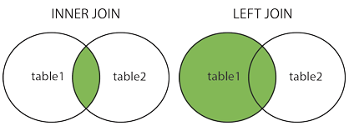
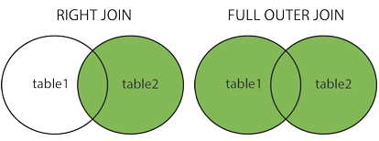
Different Types of SQL JOINs
Notes:
Retrieve employee first name, employee id , the department name for all employees who are working at some department.
Retrieve employee first name, employee id , the department name for all employees. note: if some employees are not working at some department, their information should be retrieved also.
Retrieve the department name, and the country at which the department is located for all departments.

Slide 7
SQL Self JOIN
A self JOIN is a regular join, but the table is joined with itself.
SELECT column_name(s) FROM table1 T1 join table1 T2 on T1.column_name = T2.column_name;
SELECT column_name(s) FROM table1 T1, table1 T2 WHERE condition;

Slide 8
The SQL UNION Operator
The UNION operator is used to combine the result-set of two or more SELECT statements.
Each SELECT statement within UNION must have the same number of columns
The columns must also have similar data types
The UNION operator selects only distinct values by default. To allow duplicate values, use UNION ALL:

Slide 9
The SQL UNION / UNION ALL OperatorS
SELECT column_name(s) FROM table1 UNION SELECT column_name(s) FROM table2;
SELECT column_name(s) FROM table1 UNION ALL SELECT column_name(s) FROM table2;

Slide 10
The SQL ANY and ALL Operators
The ANY operator returns true if any of the subquery values meet the condition.
The ALL operator returns true if all of the subquery values meet the condition.
SELECT column_name(s) FROM table_name WHERE column_name operator ANY (SELECT column_name FROM table_name WHERE condition);
Note: The operator must be a standard comparison operator (=, <>, !=, >, >=, <, or <=).

Slide 11
EX:
SELECT ProductName FROM Products WHERE ProductID = ANY (SELECT ProductID FROM OrderDetails WHERE Quantity = 10);

