Slide 1
CHAPTER 17
Process Costing

Slide 2
Job versus Process Costing
Job-Costing Systems
Distinct, identifiable
units of a product
or service
Examples:
Custom-made
machines,
houses
Process-Costing
Systems
Masses of identical
or similar units of a
product or service
Examples:
Food,
chemical processing

Slide 3
Process Costing
Process costing is a system where the unit cost of a product or service is obtained by assigning total costs to many identical or similar units.
Each unit receives the same or similar amounts of direct materials costs, direct labor costs, and manufacturing overhead.
Unit costs are computed by dividing total costs incurred by the number of units of output from the production process.
Notes:
3

Slide 4
Process-Costing Assumptions
Direct materials are added at the beginning of the production process, or at the start of work in a subsequent department down the assembly line.
Conversion costs are added equally along the production process.

Slide 5
Five-Step Process-Costing Allocation
Summarize the flow of physical units of output.
Compute output in terms of equivalent units.
Summarize total costs to account for .
Compute cost per equivalent unit.
Assign total costs to units completed and to units in ending work-in-process.

Slide 6
Equivalent Units
A derived amount of output units that:
Takes the quantity of each input in units completed and in unfinished units of work in process and
Converts the quantity of input into the amount of completed output units that could be produced with that quantity of input
Are calculated separately for each input (direct materials and conversion cost)
When calculating equivalent units in step 2, focus on quantities and disregard dollar amounts until after the equivalent units are computed

Slide 7
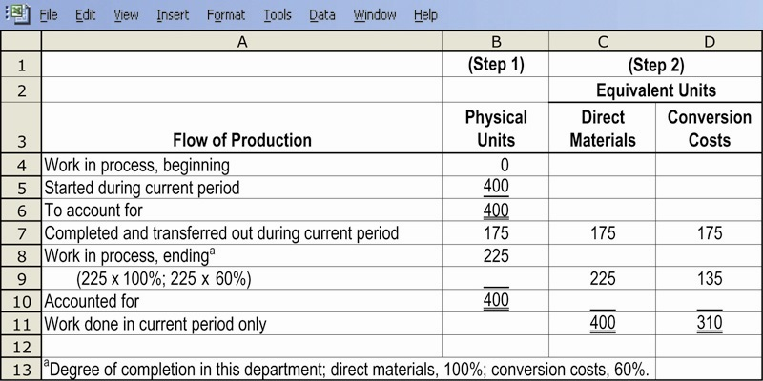
Steps 1 and 2 Illustrated

Slide 8
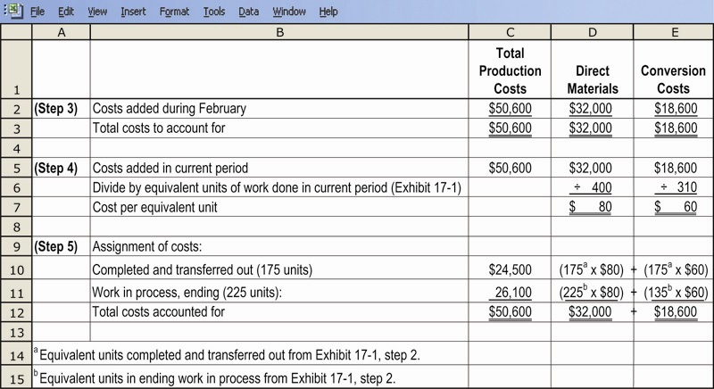
Steps 3, 4, and 5, Illustrated

Slide 9
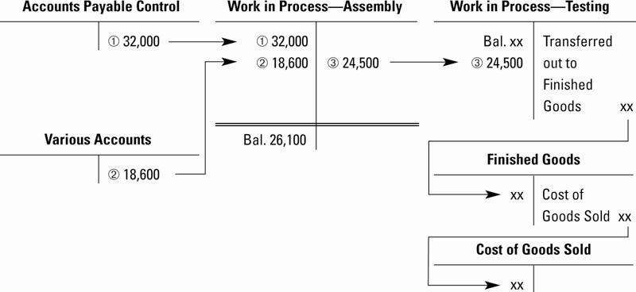
General Ledger Cost Flows Illustrated

Slide 10
Weighted-Average Process-Costing Method
Calculates cost per equivalent unit of all work done to date (regardless of the accounting period in which it was done)
Assigns this cost to equivalent units completed and transferred out of the process, and to incomplete units in still-in-process

Slide 11
Weighted-Average Process-Costing Method
Weighted-average costs is the total of all costs in the work-in-process account divided by the total equivalent units of work done to date.
The beginning balance of the work-in-process account (work done in a prior period) is blended in with current period costs.

Slide 12
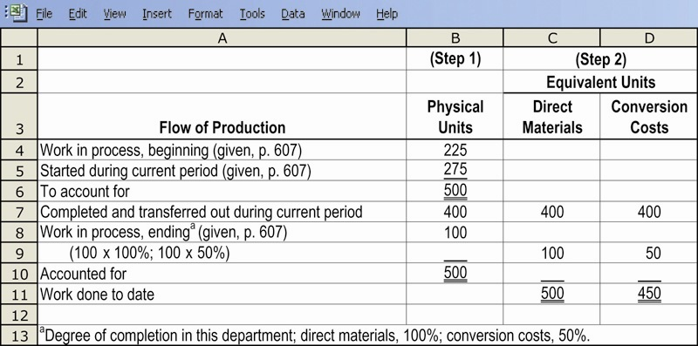
Steps 1 and 2 Illustrated

Slide 13
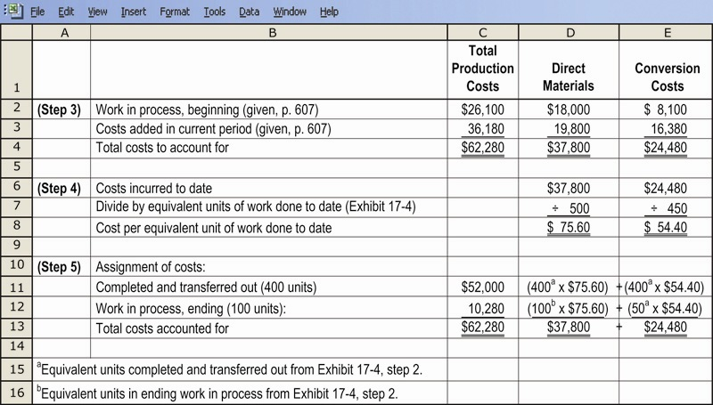
Steps 3, 4, and 5 Illustrated

Slide 14
Result of the Process
Two critical figures arise out of step 5 of the cost allocation process:
The amount of the journal entry transferring the allocated cost of units completed and sent from work-in-process inventory to finished goods inventory
The ending balance of the work-in-process inventory account that will appear on the balance sheet

Slide 15
First-in, First-Out Process-Costing Method
Assigns the cost of the previous accounting period’s equivalent units in beginning work-in-process inventory to the first units completed and transferred out of the process
Assigns the cost of equivalent units worked on during the current period first to complete beginning inventory, next to stat and complete new units, and lastly to units in ending work-in-process inventory

Slide 16
First-in, First-Out Process-Costing Method
A distinctive feature of FIFO process-costing method is that work done on beginning inventory is kept separate from work done in the current period.

Slide 17
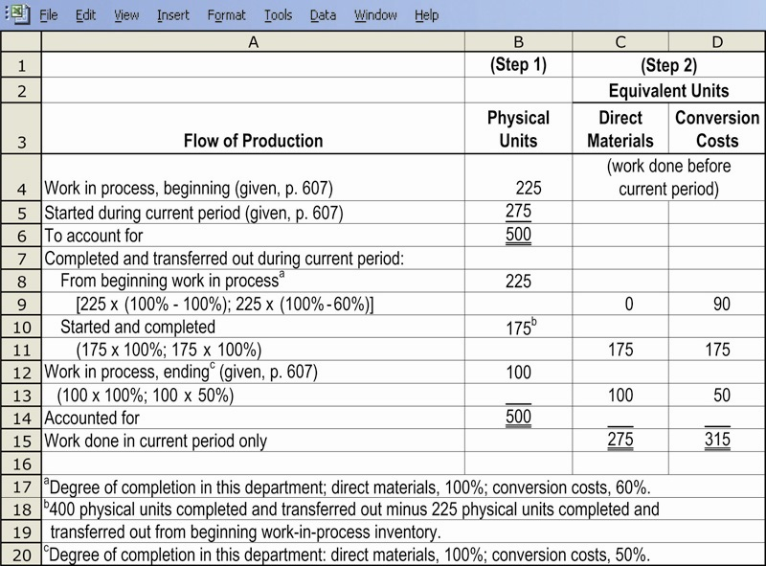
Steps 1 and 2, Illustrated

Slide 18
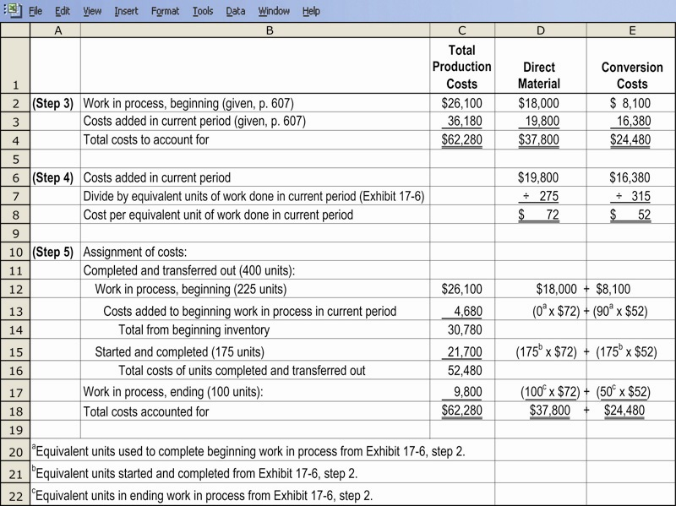
Steps 3, 4, and 5, Illustrated

Slide 19
Result of the Process (As Before)
Two critical figures arise out of step 5 of the cost-allocation process:
The amount of the journal entry transferring the allocated cost of units completed and sent from work-in-process inventory to finished goods inventory
The ending balance of the work-in-process inventory account that will appear on the balance sheet

Slide 20
Transferred-In Costs
Are costs incurred in previous departments that are carried forward as the products cost when it moves to a subsequent process in the production cycle.
Also called previous department costs.
Journal entries are made to mirror the progress in production from department to department.
Transferred-in costs are treated as if they are a separate type of direct material added at the beginning of the process.

Slide 21
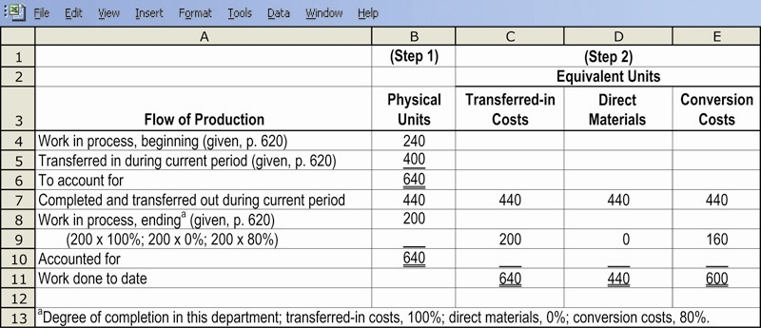
Steps 1 and 2, Illustrated

Slide 22
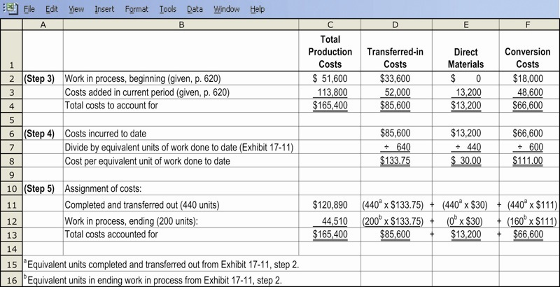
Steps 3, 4, and 5, Illustrated

Slide 23
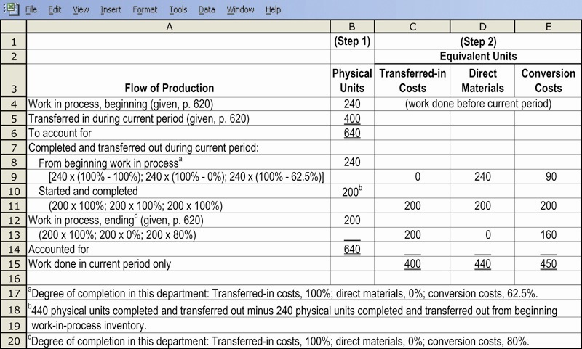
Steps 1 and 2, Illustrated

Slide 24
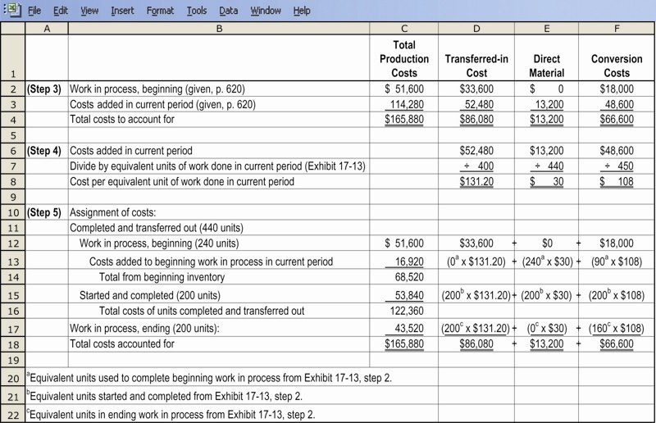
Steps 3, 4, and 5, Illustrated

Slide 25
Hybrid Costing Systems
A Hybrid-costing system blends characteristics from both job-costing and process-costing systems.
Many actual production systems are in fact hybrids.
Examples include manufacturers of televisions, dishwashers, and washing machines, as well as Adidas.

