Slide 1
Chapter 03
Introduction to SQL

Slide 2
Set Operations
3.5

Slide 3
Set Operations
The SQL operations union, intersect, and minus operate on relations and correspond to the mathematical set-theory operations ∪, ∩, and −.

Slide 4
Set Operations
The set of all courses taught in the Fall 2009 semester:
The set of all courses taught in the Spring 2010 semester:
Notes:
select course_id
from section
where semester='Fall' and year=2009;
select course_id
from section
where semester='Spring' and year=2010;

Slide 5
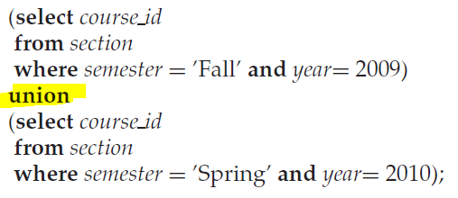
The Union Operation
To find the set of all courses taught either in Fall 2009 or in Spring 2010, or both, we write:
Notes:
select course_id
from section
where semester='Fall' and year=2009
Union
select course_id
from section
where semester='Spring' and year=2010;

Slide 6
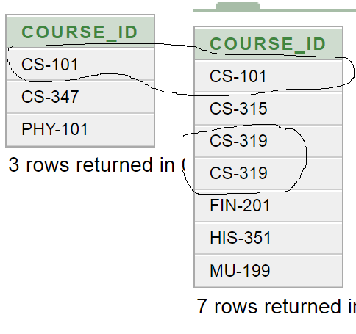

Slide 7
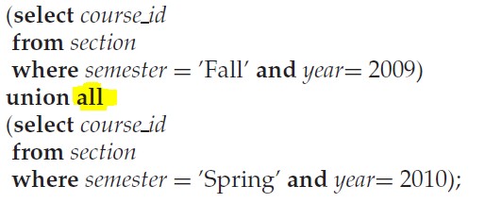
The Union Operation
To find the set of all courses taught either in Fall 2009 or in Spring 2010, or both, we write:

Slide 8
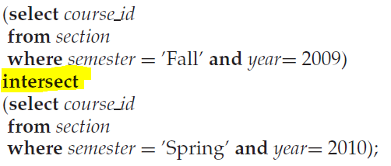
The Intersect Operation
To find the set of all courses taught in the Fall 2009 as well as in Spring 2010 we write:

Slide 9
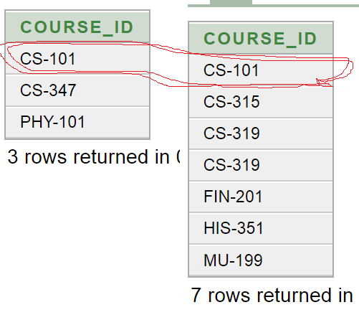

Slide 10
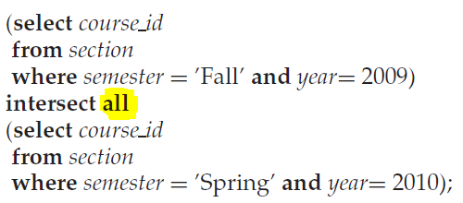
The Intersect Operation
To find the set of all courses taught in the Fall 2009 as well as in Spring 2010 we write:

Slide 11
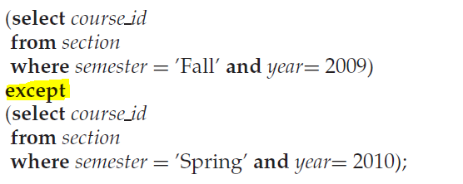
The MINUS Operation
To find all courses taught in the Fall 2009 semester but not in the Spring 2010 semester, we write:
Notes:
select course_id
from section
where semester='Fall' and year=2009
MINUS
select course_id
from section
where semester='Spring' and year=2010;

Slide 12
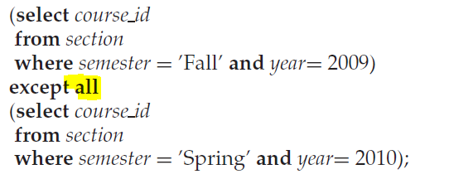
The MINUS ALL Operation
To find all courses taught in the Fall 2009 semester but not in the Spring 2010 semester, we write:

Slide 13
Null Values
3.6

Slide 14
Null
Null values present special problems in relational operations:
Arithmetic operations.
Comparison operations.
Set operations.

Slide 15
Arithmetic Expression Involving Null
The result of an arithmetic expression (involving, for example +, −, ∗, or /) is null if any of the input values is null.
For example, if a query has an expression r.A+5, and r.A is null for a particular tuple then the expression result must also be null for that tuple.

Slide 16
Comparisons Involving Nulls
Comparisons involving nulls are more of a problem.
For example, consider the comparison “1 < null”.
It would be wrong to say this is true since we do not know what the null value represents.
It would be wrong to claim this expression is false although.
SQL therefore treats as unknown the result of any comparison involving a null value

Slide 17
Boolean Operations Involving Null
X | Y | X and Y | X or Y | Not X
true | unknown | unknown | true | false
false | unknown | false | unknown | true
unknown | unknown | unknown | unknown | unknown
You can verify that if r.A is null:
Then “1 < r.A” as well as “not (1 < r.A)” evaluate to unknown.
If the where clause predicate evaluates to either false or unknown for a tuple, that tuple is not added to the result.

Slide 18
Null in a Predicate
Find all instructors who appear in the instructor relation with null values of their salary (unknown salary).
Notes:
select name
from instructor
where salary is null;

Slide 19
Null in a Predicate
Find all instructors who appear in the instructor relation with known salary.

Slide 20
Records with Nulls
The tuple (‘Ahmad’, NULL) is identical to the tuple (‘Ahmad’, NULL)
The above approach of treating tuples as identical if they have the same values for all attributes, even if some of the values are null, is also used for the set operations union, intersection and minus.

