Slide 1
Seed Production
Chapter 8
Seed Storage
Dr. Daoud Abusafieh

Slide 2
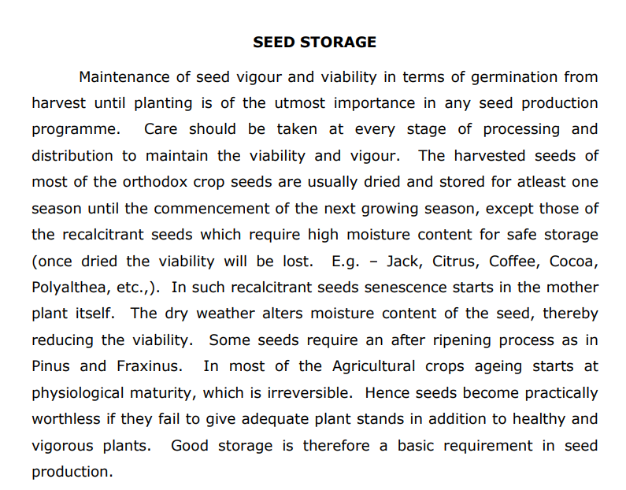

Slide 3
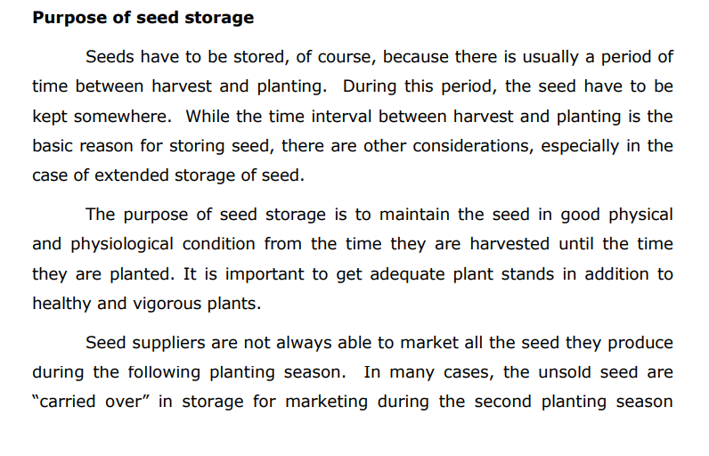

Slide 4
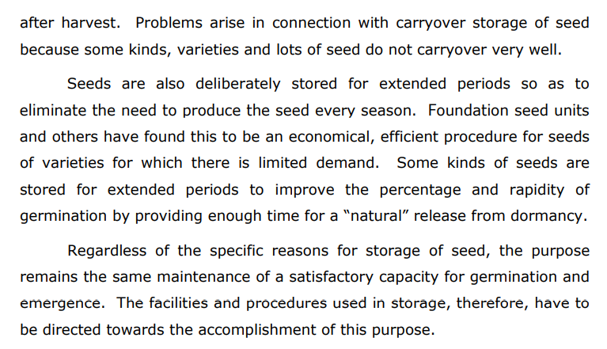

Slide 5
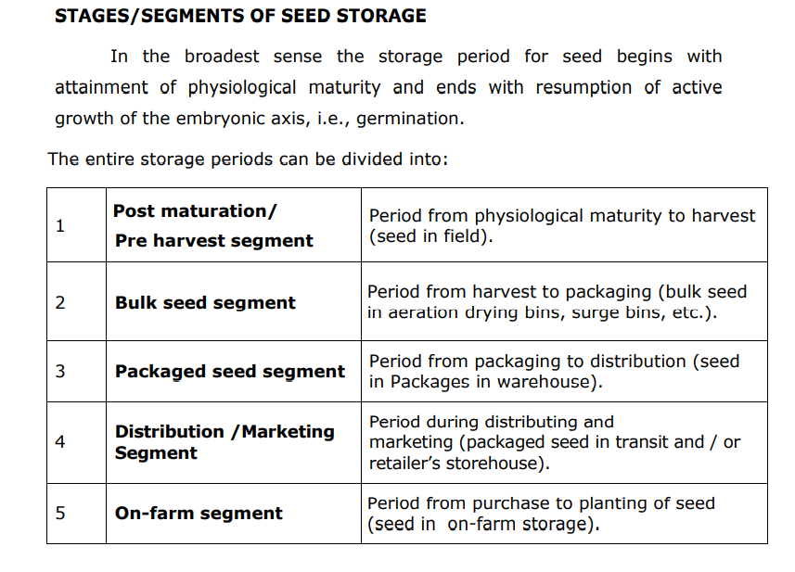

Slide 6
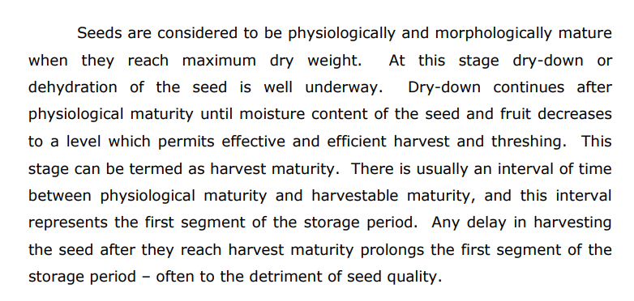

Slide 7
The second segment of the storage period extends from harvest to the
beginning of conditioning. Seed in the combine, grain wagon, and bulk
storage or drying bins are in storage and their quality is affected by the same
factors that affect the quality of seed during the packaged seed segment of
the storage period.
The third segment of the storage period begins with the onset of conditioning and ends with packaging. The fourth segment of the storage period is the packaged seed phase which has already been mentioned.
The packaged seed segment is followed by storage during distribution and marketing, and finally by storage on the farm before and during planting.
The seed quality can be considerably be affected at any of the stages or segments mentioned above unless sound principles involved in seed storage are practiced and the seeds are properly handled.

Slide 8
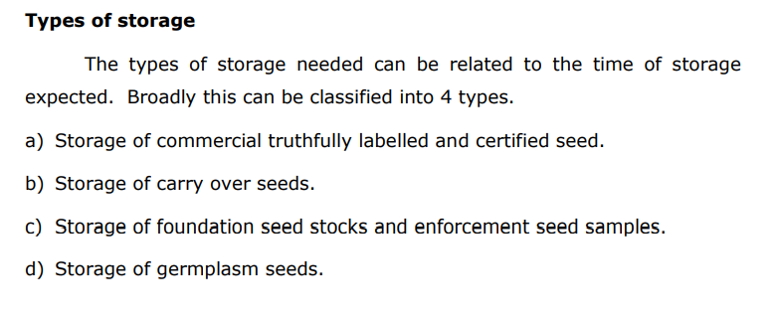

Slide 9
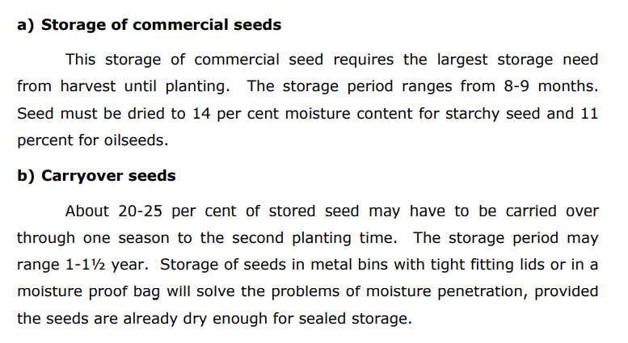

Slide 10
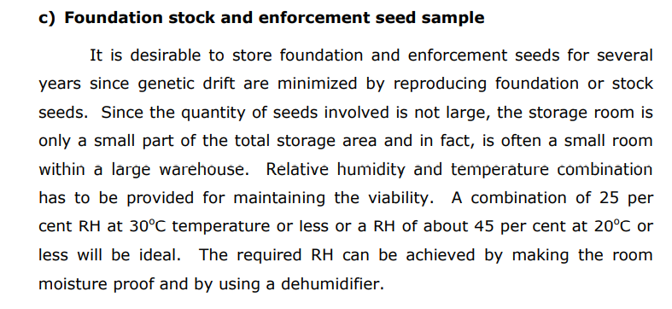

Slide 11
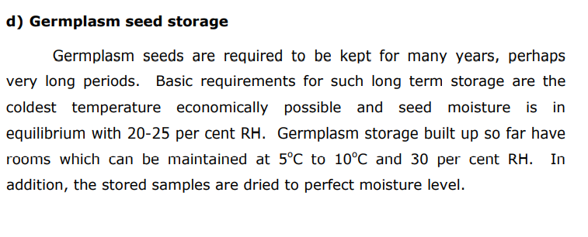
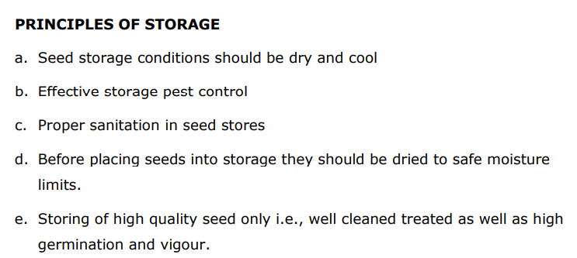

Slide 12
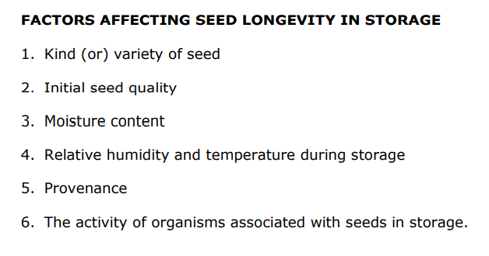

Slide 13
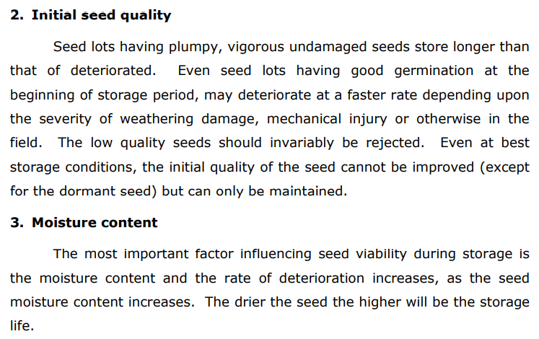

Slide 14
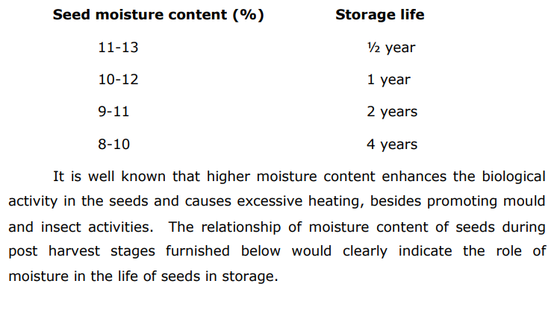

Slide 15
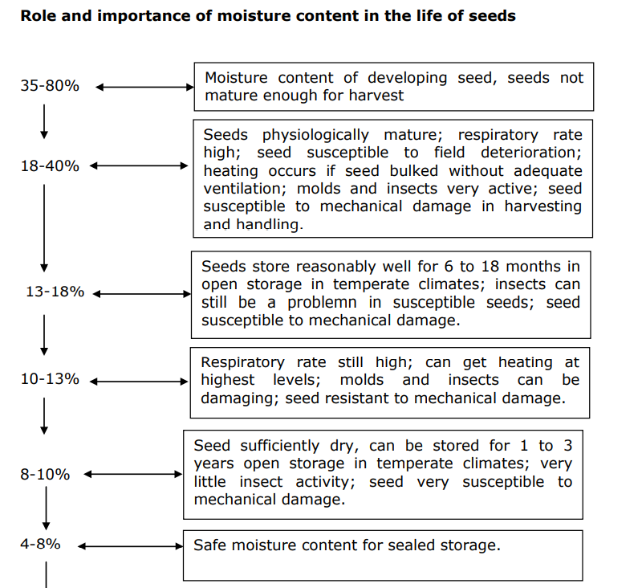

Slide 16
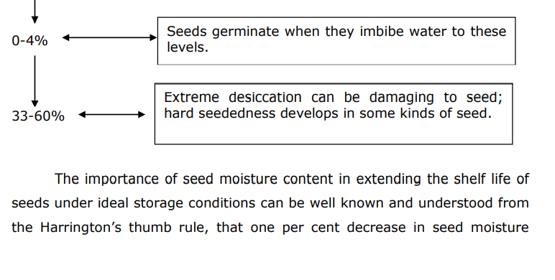

Slide 17
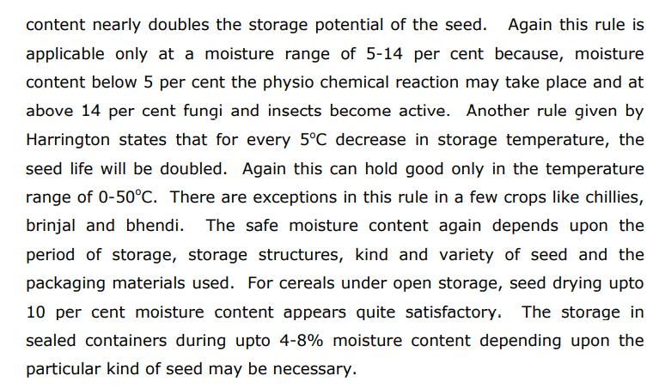

Slide 18
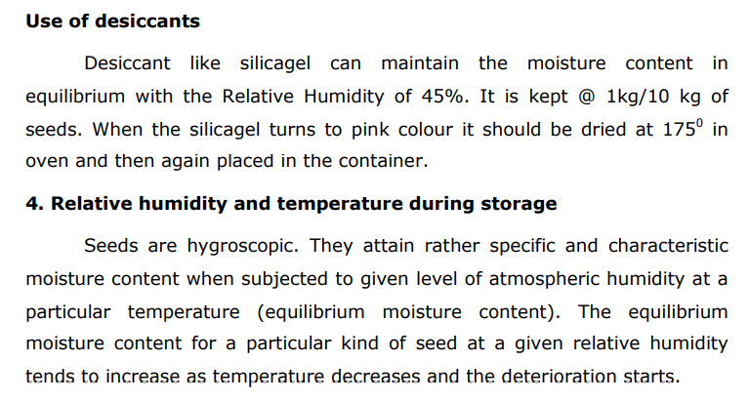

Slide 20
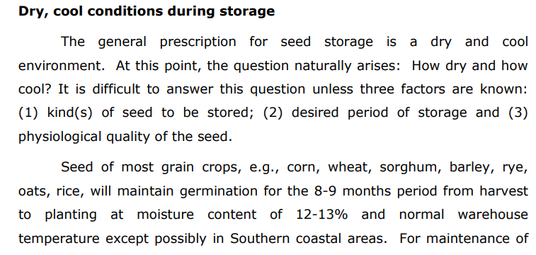

Slide 21
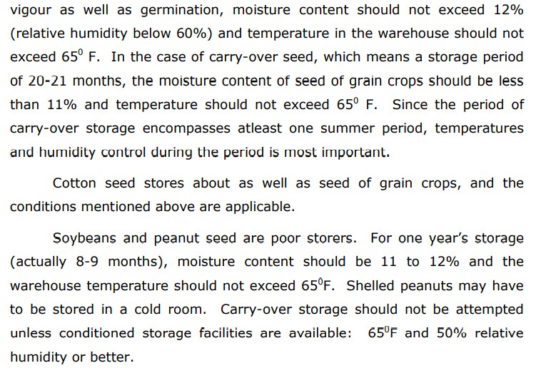

Slide 22
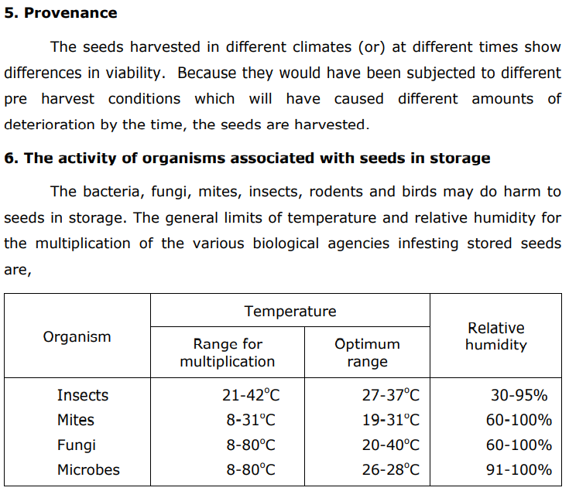

Slide 23
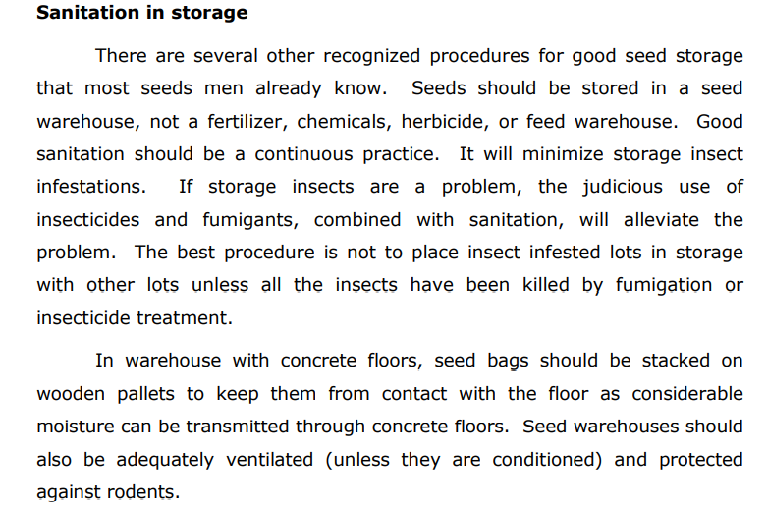

Slide 24
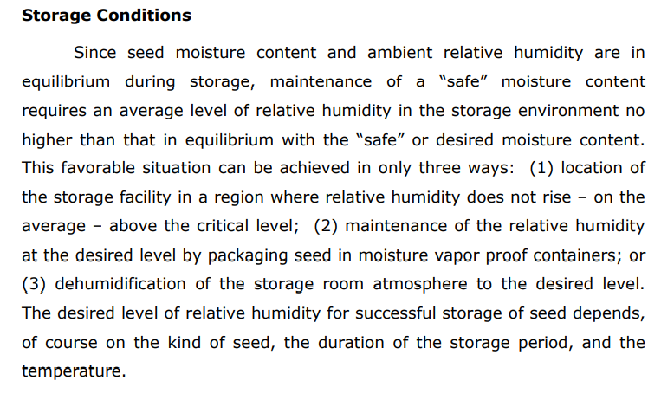

Slide 25
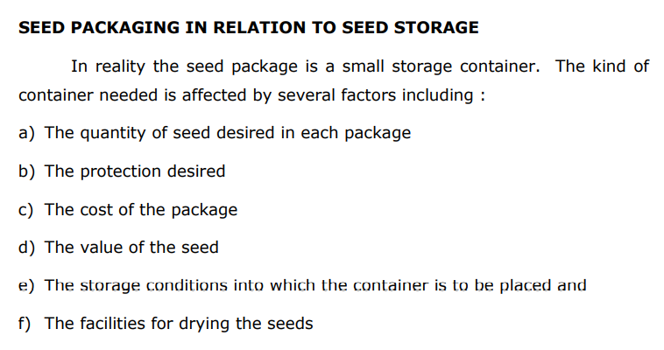

Slide 26
