Slide 1
Chapter 01
Introduction

Slide 2
Relational Databases
1.5

Slide 3
Relational Databases
A relational database is based on the relational model.
Uses a collection of tables to represent both data and the relationships among those data.
Relational Databases includes a DML and DDL.

Slide 5
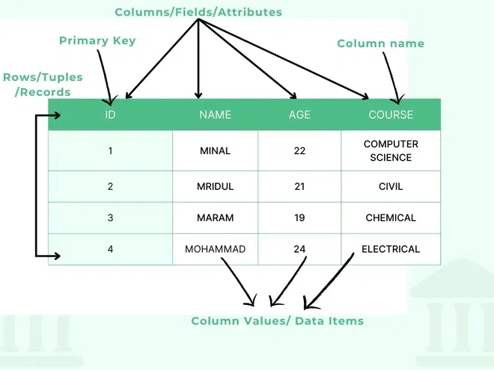
You must write the table/relation name as a example, the name of the table here is Students

Slide 6
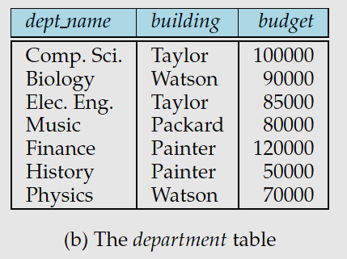
Tables

Slide 7
Data-Manipulation Language
The SQL query language is nonprocedural.
A query takes as input several tables (possibly only one) and always returns a single table.
Examples:

Slide 8
Data-Definition Language
SQL provides a rich DDL that allows one to define tables, integrity constraints, assertions, etc.
For instance, the following SQL DDL statement defines the department table:

Slide 9
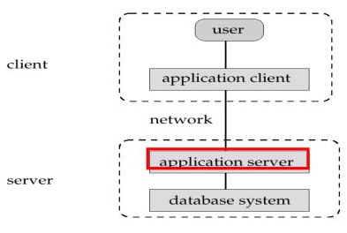
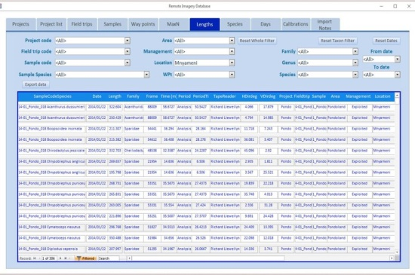
Database Access from Application Programs
There are some computations that are possible using a general-purpose programming language but are not possible using SQL.
SQL does not support actions such as input from users, output to displays, or communication over the network.

Slide 10
Database Design
1.6

Slide 11
Database Design
Database design mainly involves the design of the database schema.
The design of a complete database application environment that meets the needs of the enterprise being modeled requires attention to a broader set of issues.

Slide 12
Design Process
A high-level data model provides the database designer with a conceptual framework in which to specify:
The data requirements of the database users
How the database will be structured to fulfill (تحقق)these requirements.
The database designer needs to interact extensively with domain experts and users to carry out the requirement.
The outcome of this phase is a specification of user requirements.
The designer chooses a data model, and by applying the concepts of the chosen data model, translates the requirements into a conceptual schema of the database.
The designer reviews the schema to confirm that all data requirements are indeed بالفعل))satisfied and are not in conflict with one another.

Slide 13
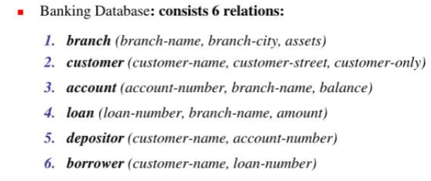

Slide 15
The Entity-Relationship Model
The entity-relationship (E-R) data model uses a collection of basic objects, called entities, and relationships among these objects.
An entity is a “thing” or “object” in the real world that is distinguishable from other objects.
For example, each person is an entity, and bank accounts can be considered as entities.
Entities are described in a database by a set of attributes.
For example, the attributes dept name, building, and budget may describe one particular department in a university, and they form attributes of the department entity set.

Slide 16
Relationship
A relationship is an association among several entities.
For example, a member relationship associates an instructor with his department.

Slide 18
Entity-relationship (E-R) diagram

Slide 19
Normalization
Another method for designing a relational database is to use a process commonly known as normalization.
The goal is to generate a set of relation schemas that allows us to store information without unnecessary redundancy.
Allows us to retrieve information easily.

Slide 20
Normalization [Con.]

Slide 21
Data Storage and Querying
1.7

Slide 22
Data Storage and Querying
A database system is partitioned into modules that deal with each of the responsibilities of the overall system.
The functional components of a database system can be broadly divided into:
The storage manager
The query processor components.

Slide 23
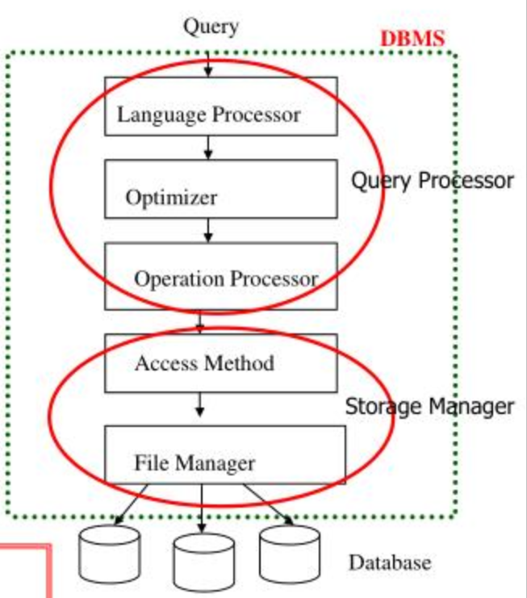

Slide 24
Storage Manager
The storage manager is the component of a database system that provides the interface between the low-level data stored in the database and the application programs and queries submitted to the system.
The storage manager is responsible for the interaction with the file manager.
The raw data are stored on the disk using the file system provided by the operating system.
The storage manager translates the various DML statements into low-level file-system commands.

Slide 25
The storage manager components
Authorization and integrity manager:
Which tests for the satisfaction of integrity constraints and checks the authority of users to access data.
Transaction manager:
Which ensures that
The database remains in a consistent (correct) state despite system failures.
Concurrent transaction executions proceed without conflicting.

Slide 26
The storage manager components
File manager:
Which manages the allocation of space on disk storage and the data structures used to represent information stored on disk.
Buffer manager:
Which is responsible for fetching data from disk storage into main memory, and deciding what data to cache in main memory.

Slide 27
Storage manager implements several data structures
Data files:
Which store the database itself.
Data dictionary.
Which stores metadata about the structure of the database, in particular the schema of the database.
Indices:
Which can provide fast access to data items.
Like the index in this textbook, a database index provides pointers to those data items that hold a particular value.

Slide 28
The Query Processor
DDL interpreter:
Which interprets DDL statements and records the definitions in the data dictionary.
DML compiler:
Which translates DML statements in a query language into an evaluation plan consisting of low-level instructions that the query evaluation engine understands.
Query evaluation engine:
Which executes low-level instructions generated by the DML compiler.

Slide 29
End of Lecture 03

