Slide 1
DNA analysis
Sabha Rabaya, MSc

Slide 2
Human Genetics and DNA analysis
Medical genetics utilizes a wide range of DNA analysis techniques for both
clinical practice and research
These techniques generally start with DNA from an affected family member, which can be extracted from any nucleated cells
The lymphocytes from a 10 ml anticoagulated venous blood sample yield
about 200–300 μ g of DNA, which is sufficient for multiple DNA analyses.
The most widely used basic techniques for DNA analysis in the diagnostic laboratory include the polymerase chain reaction (PCR) and its adaptations, automated DNA sequencing and array comparative genomic hybridisation (aCGH)

Slide 3
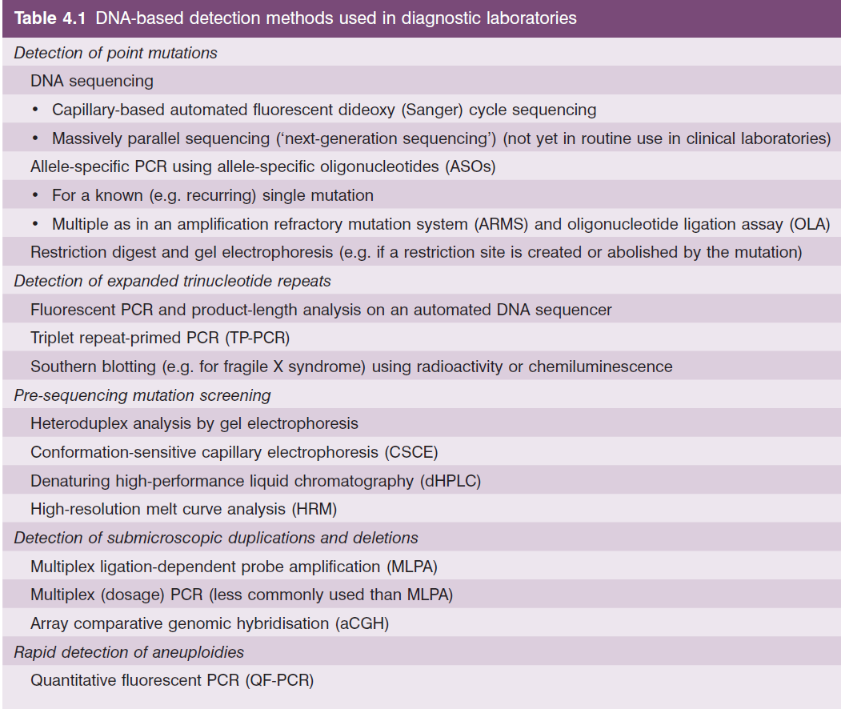

Slide 4
Basic Methods
Polymerase chain reaction
DNA amplification
PCR permits the production of enormous numbers of copies of a specific DNA sequence (i.e. DNA
amplification), starting with minute quantities (50 ng or less) of the initial target DNA.
Two oligonucleotide primers are required, which are designed to be complementary to the flanking sequences of the target segment of DNA that is to be amplified (which is commonly up to 1 kb
in length, occasionally up to 10 kb)
Each cycle consists of three steps: heat denaturation (i.e. rendering the DNA single stranded), primer annealing and strand elongation.
After 25 – 35 cycles (which takes 2 – 3 h in an automated procedure), the target DNA will, in theory, have been amplified 2^ 25 (or 3 × 10 7 ) to 2^35 (or 3 × 10 10 ) fold and the corresponding product will
constitute the bulk of all DNA present.
The DNA amplification product can then be checked by direct visualization under ultraviolet (UV) light following gel electrophoresis and staining with a DNA stain such as ethidium bromide (or a less mutagenic
compound such as SYBR Safe).
Commonly, to detect small changes such as nucleotide substitutions and small insertions or deletions, the DNA product will be sequenced by an automatic sequencing strategy

Slide 5
Basic Methods
Polymerase chain reaction
Alternatively, in order to detect a specific sequence change, the DNA can be subjected to an appropriate restriction enzyme digest and the resulting fragments
separated and visualised by gel electrophoresis and DNA staining.
The adaptations of PCR include quantitative fluorescent-PCR (QF - PCR), allele - specific PCR such as in the amplification-refractory mutation system (ARMS), triplet repeat – primed PCR and multiplex ligation - dependent probe amplification (MLPA)

Slide 6
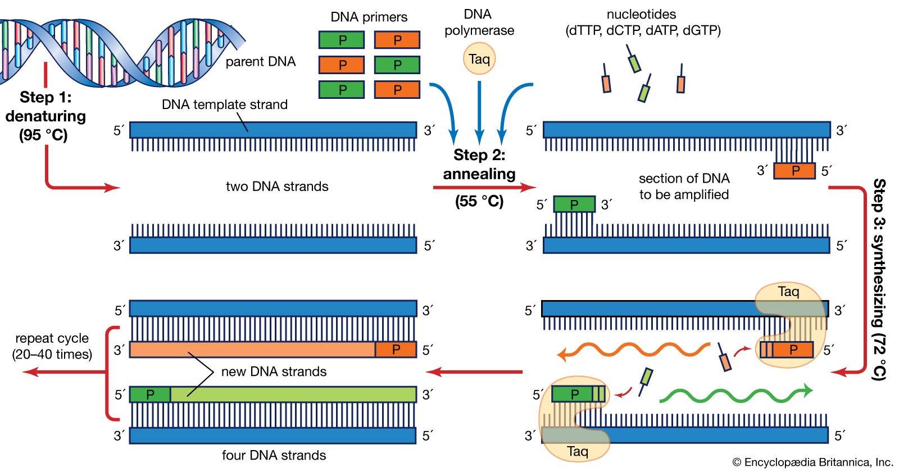
Polymerase chain reaction

Slide 7
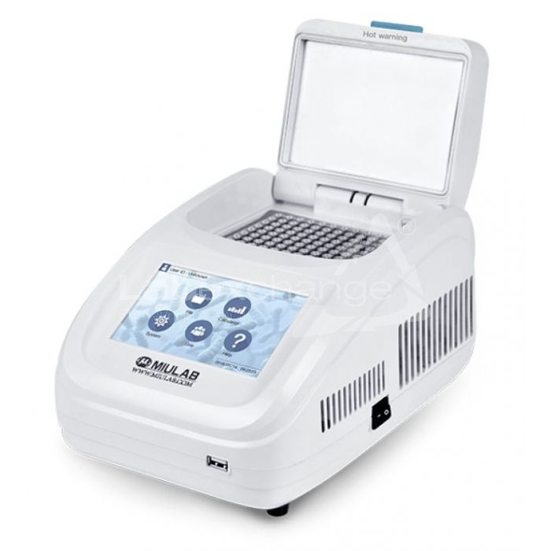
Thermocycler

Slide 8
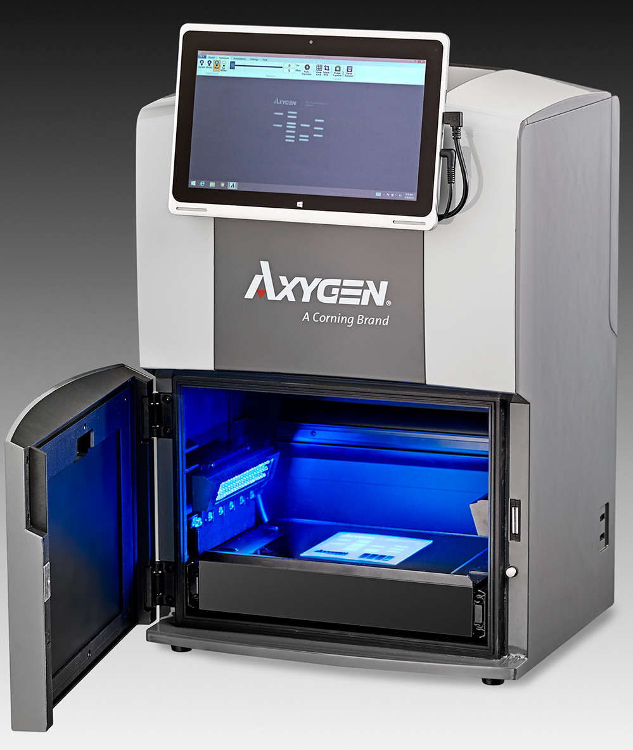
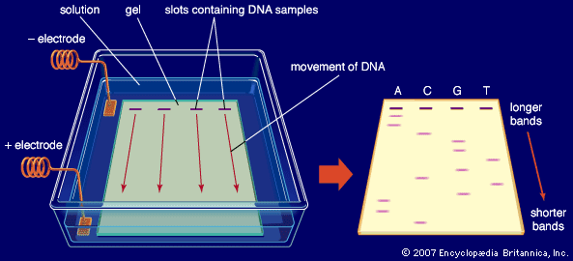

Slide 9
Basic Methods
Restriction digests
Restriction digests are reactions that use DNA cleavage enzymes, which will only cut at specific DNA sequences.
These sequence - specific enzymes are called restriction enzymes and they are found naturally in
bacteria where they function as adefence mechanism against the incorporation of foreign DNA.
More than 400 different restriction enzymes have been described, which together possess over 100 different recognition sites for DNA cleavage. Each enzyme is named after the organism from which it was first isolated (e.g. Eco RI was found in Escherichia coli ).
The recognition site is commonly 4 or 6 bp in length and the cleavage may produce flush ( ‘ blunt ’ ) or staggered ( ‘ sticky ’ ) ends. By convention, each recognition site is written 5 ′ to 3 ′ using the symbols A, T, C and G for specific bases, as well as N for any nucleotide, R for either purine (A or G) and Y for either pyrimidine (T or C).
A single nucleotide substitution in a patient can eliminate a restriction enzyme’s target sequence and can therefore be detected by testing the ability of a restriction enzyme to cut the patient’s DNA at that location.

Slide 10
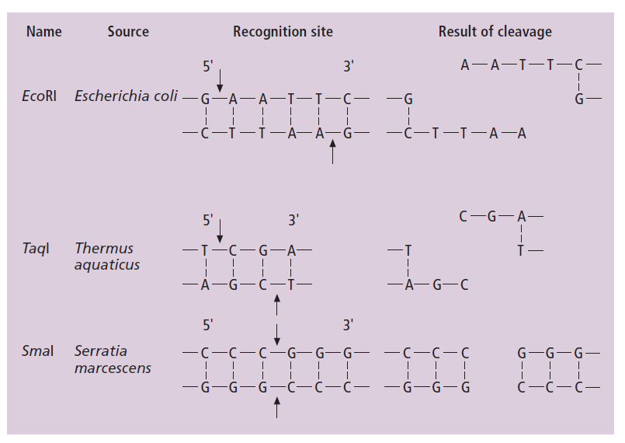

Slide 11
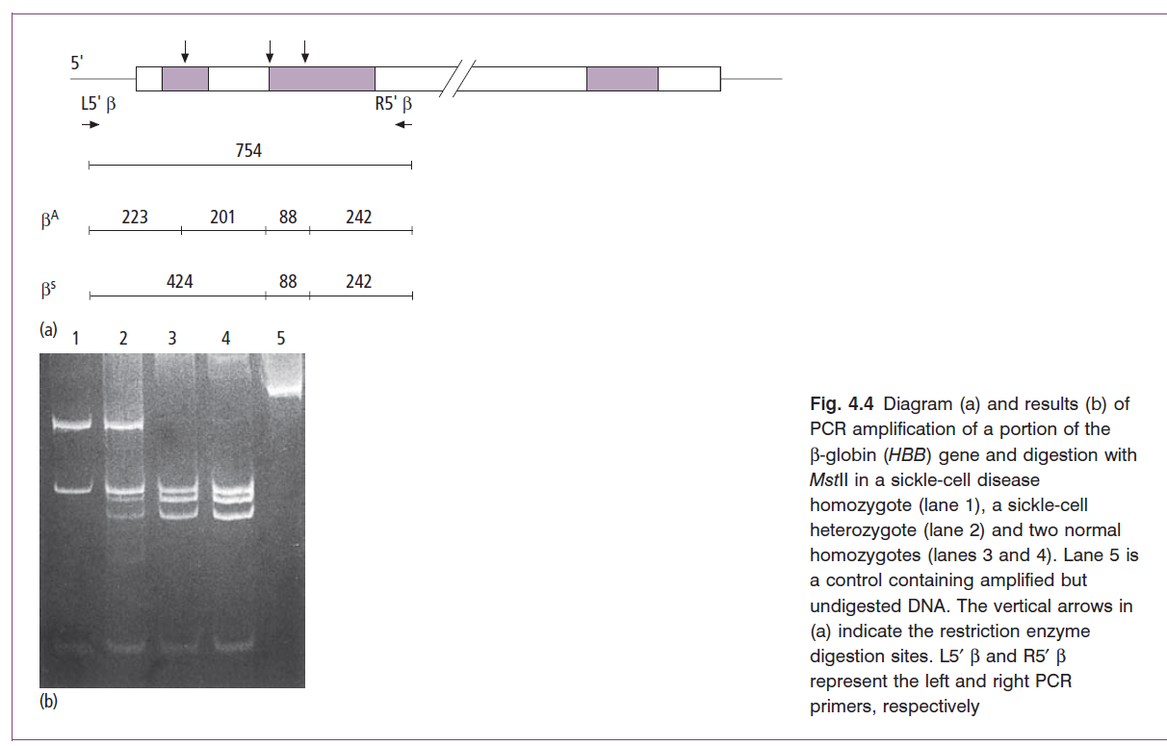

Slide 12
Mutation detection
Sanger (dideoxy) sequencing
DNA sequencing is the determination of the precise sequence of nucleotides in a section of DNA.
In diagnostic laboratories, at present, the sequencing method most commonly used is fluorescent dideoxy chain termination (based on the method originally developed in 1975 by the double Nobel prize winner Frederick Sanger).
In this method, a chemical reaction is first set up, which includes the DNA template (often, itself, a purified PCR product), a thermostable DNA polymerase, a single oligonucleotide primer and the four deoxynucleotide Nucleotide triphosphates (dNTPs: dATP, dCTP, dGTP and dTTP) In addition, a small quantity of dideoxynucleotide
triphosphates (ddNTPs: ddATP, ddCTP, ddGTP and ddTTP) are included together in a single tube, each with a different attached fluorescent chemical label (each emitting a
different wavelength or colour of light).
DNA polymerisation takes place, incorporating dATP, dCTP, dGTP and dTTP, generating a new strand of DNA that is exactly complementary to the DNA template. Eventually, however, at some point, a ddNTP will be incorporated by chance instead of a dNTP substrate molecule. At this point, further elongation of that chain is halted, because a ddNTP lacks the 3 ′ - OH group on the deoxyribose sugar that is necessary for the addition of the next nucleotide

Slide 13
Mutation detection
Sanger (dideoxy) sequencing
The result is a series (all present together within a single tube) of partially completed product chains each with a particular fluorescent ddNTP at its 3 ′ end.
Subsequently, in an automated sequencer machine, these product molecules can be separated on the basis of length by gel electrophoresis (in a very long capillary tube) and then electronically detected and identifed (by the wavelength of the emitted fluorescence, upon excitation by a laser) as they migrate through the gel
The order in which the four fluorescent labels are detected (corresponding to the sequence of the four different nucleotides in the DNA being analysed) can then be visualised and recorded using appropriate software.

Slide 14
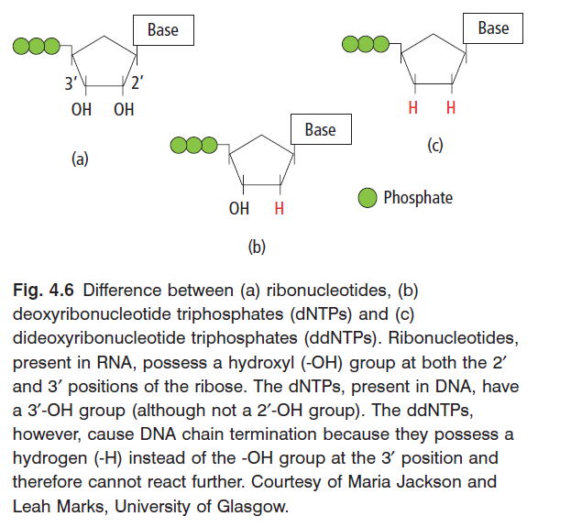

Slide 15
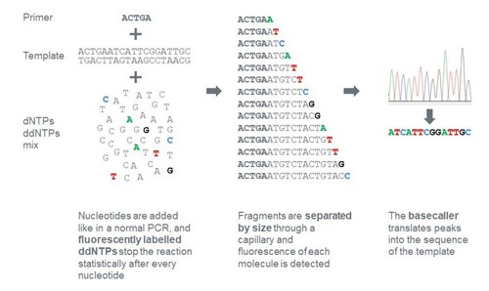

Slide 16
