Slide 1
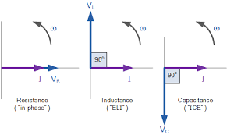
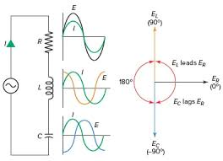
Circuit2 Lab
Summer Semester 2024/2025
Eng. Asma’ shara’b PTUK

Slide 2
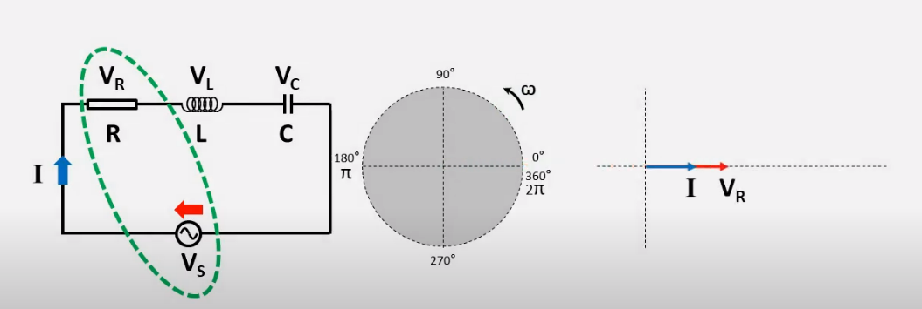
RLC Series Circuit

Slide 4
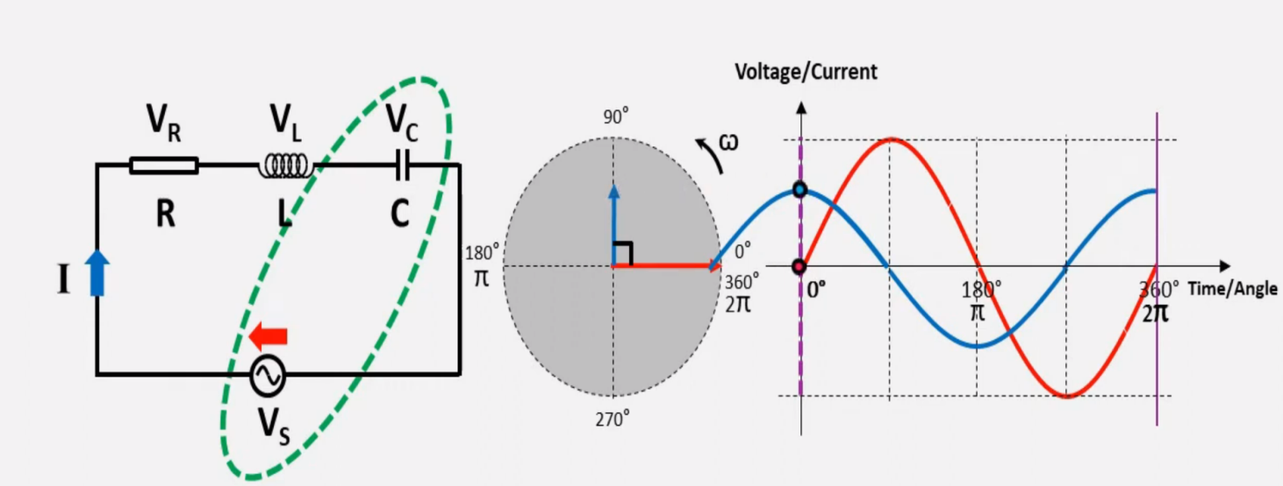
Eng. Asma’ shara’b PTUK

Slide 5
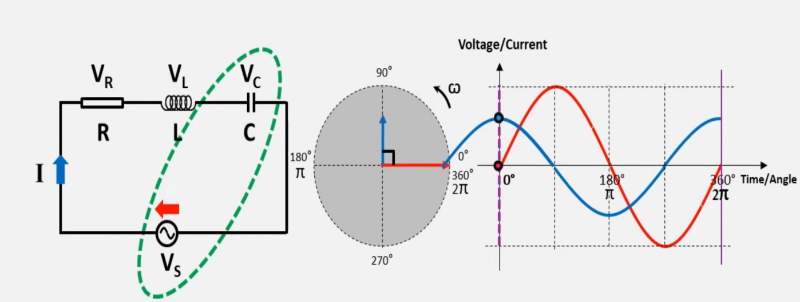
Eng. Asma’ shara’b PTUK

Slide 6
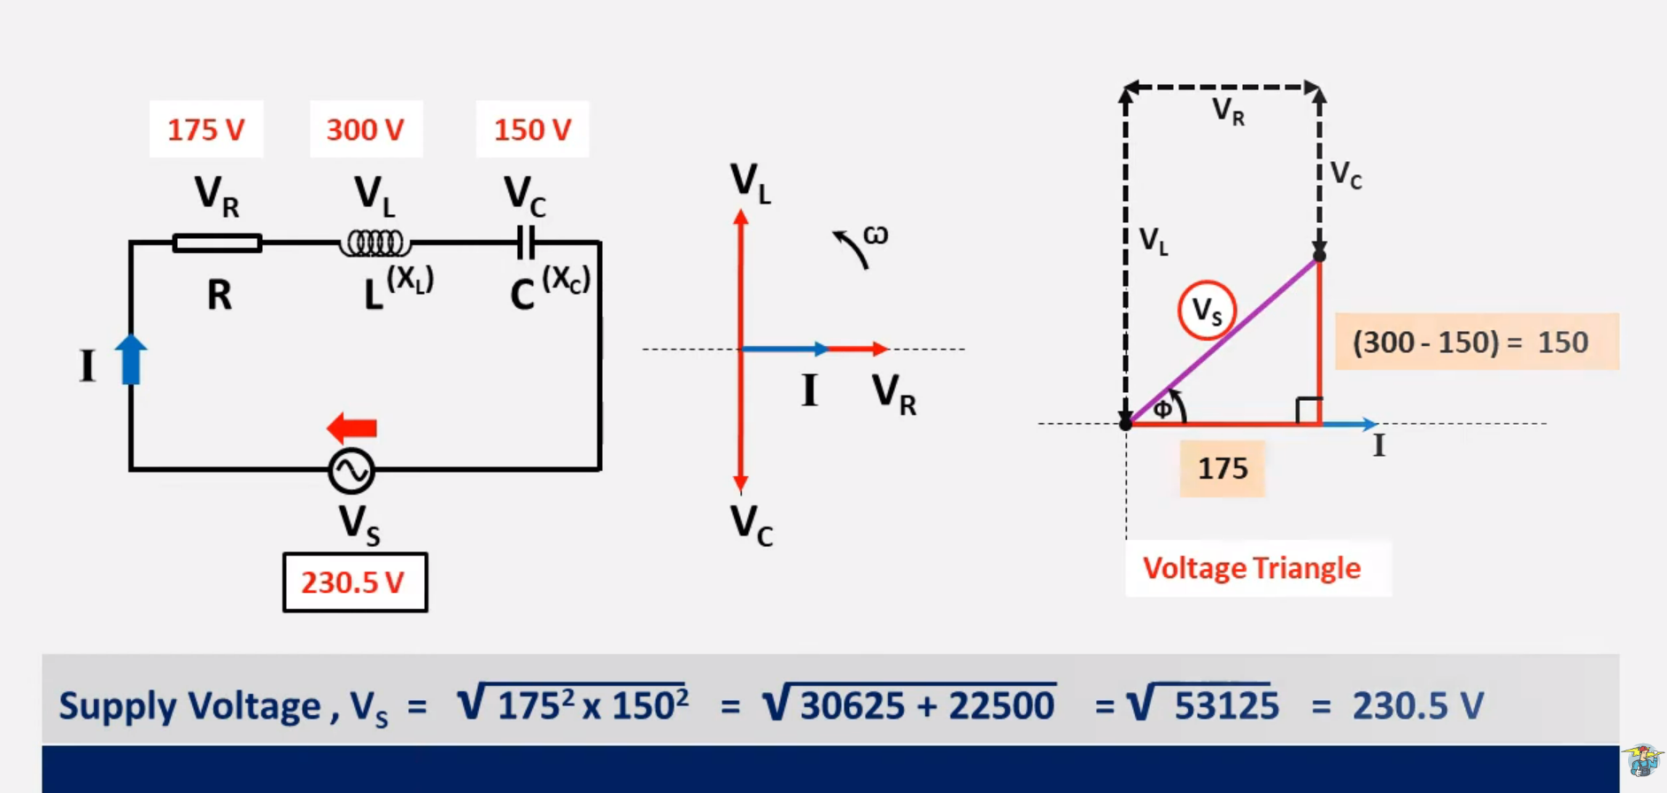
Eng. Asma’ shara’b PTUK

Slide 7
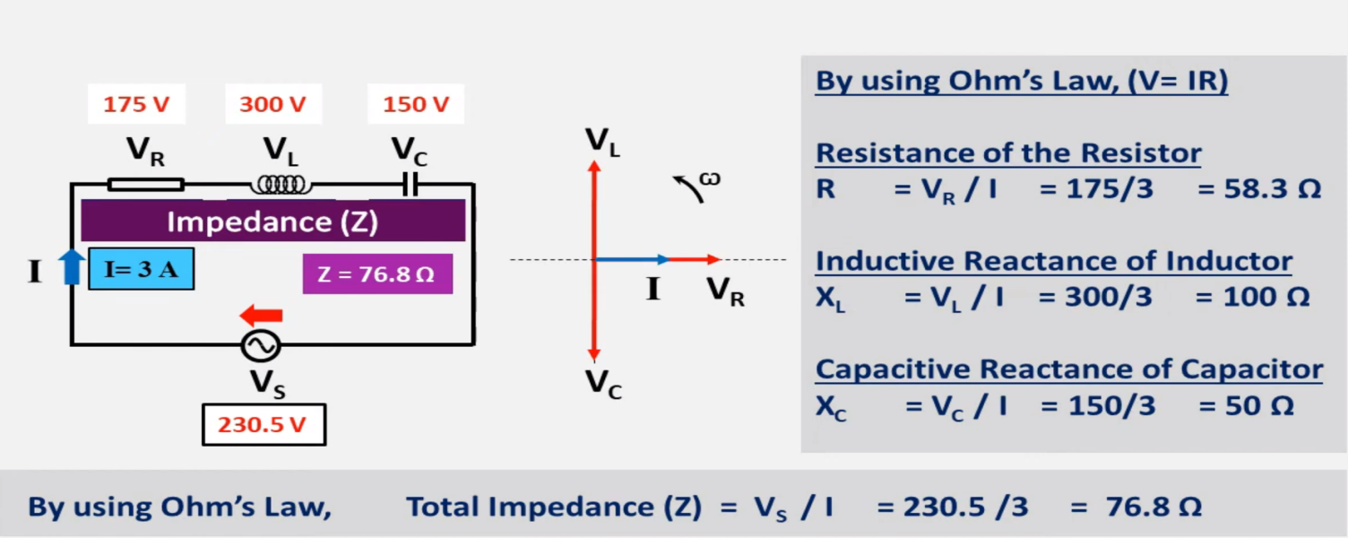
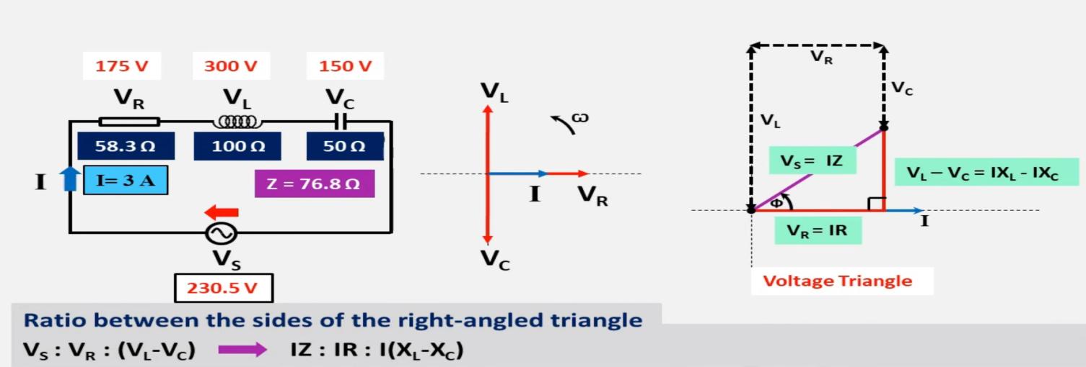
Eng. Asma’ shara’b PTUK

Slide 8
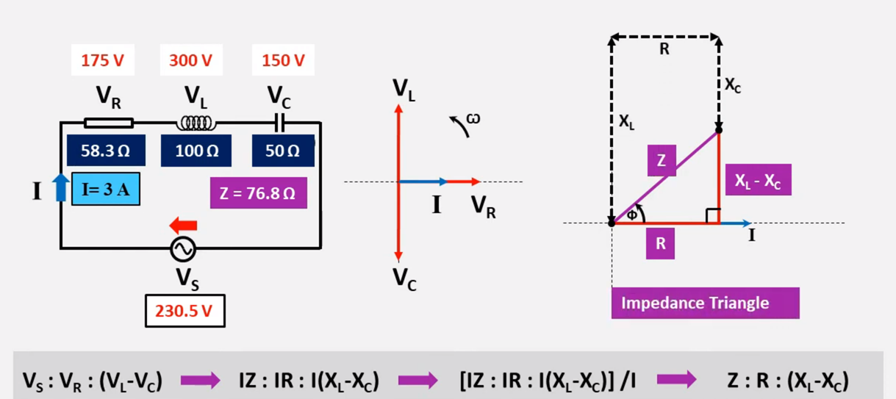
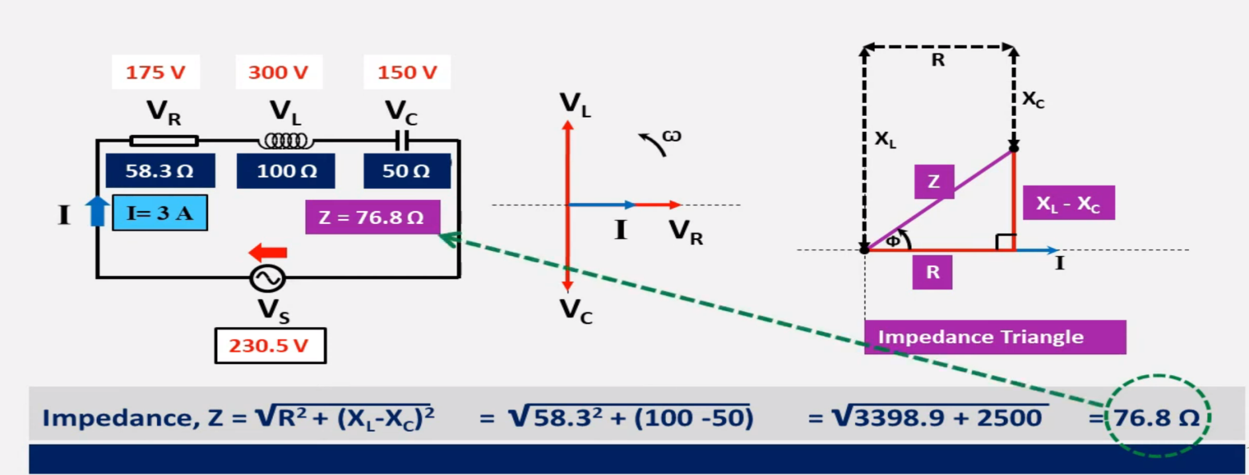
Eng. Asma’ shara’b PTUK

Slide 9
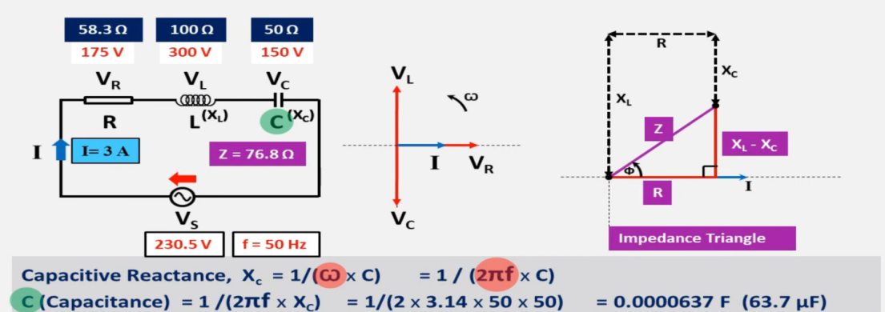
Eng. Asma’ shara’b PTUK

Slide 10
Eng. Asma’ shara’b PTUK

Slide 11
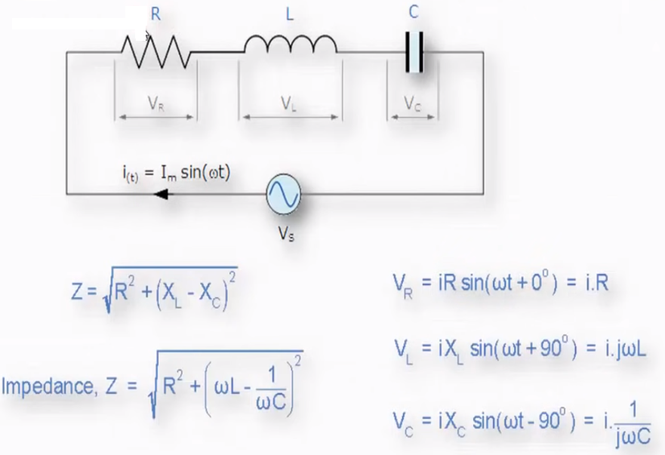
Eng. Asma’ shara’b PTUK

Slide 12
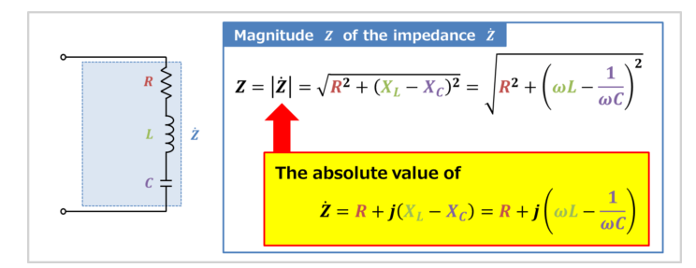
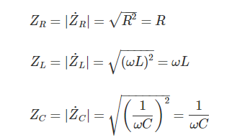
Magnitude of the impedance of the RLC series circuit
Eng. Asma’ shara’b PTUK

Slide 13
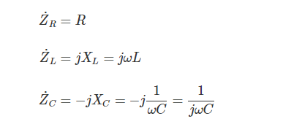
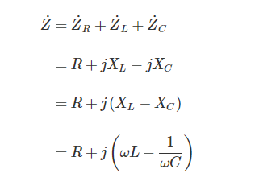

Slide 14
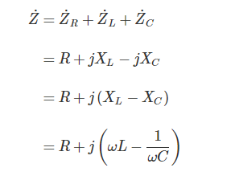
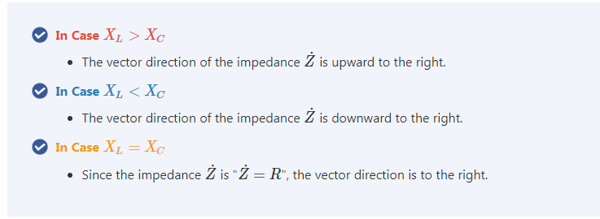
Eng. Asma’ shara’b PTUK

Slide 15
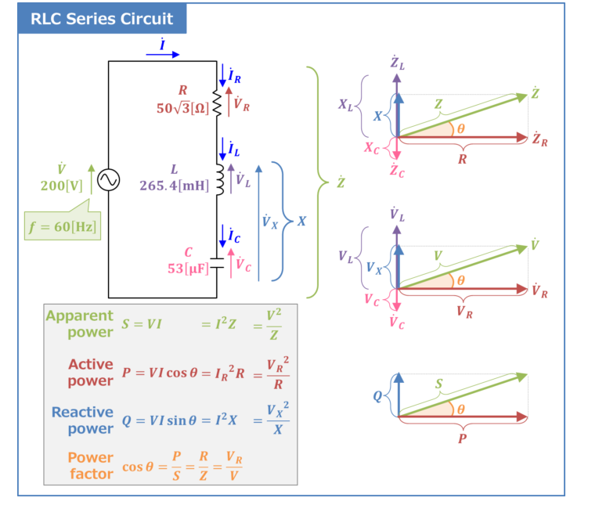
Eng. Asma’ shara’b PTUK

Slide 16
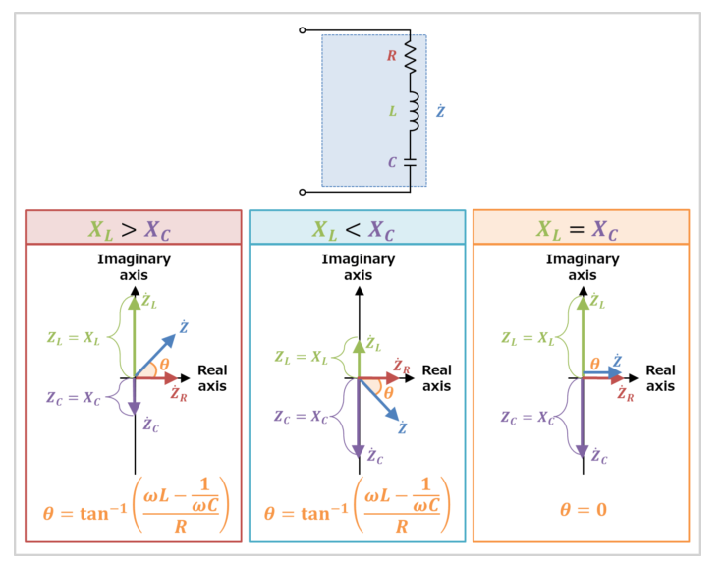
Eng. Asma’ shara’b PTUK

Slide 17
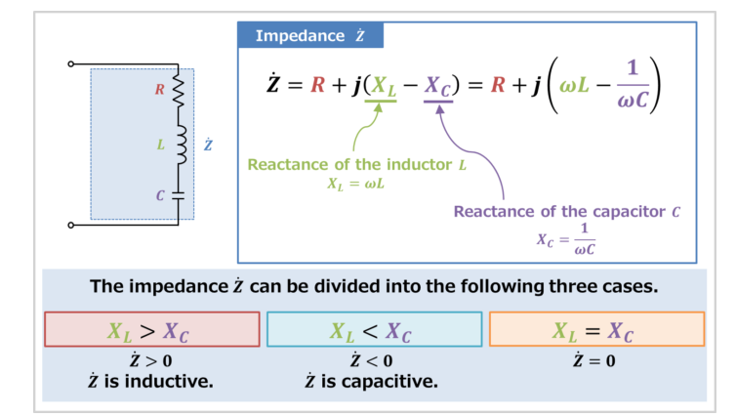
Eng. Asma’ shara’b PTUK

Slide 18
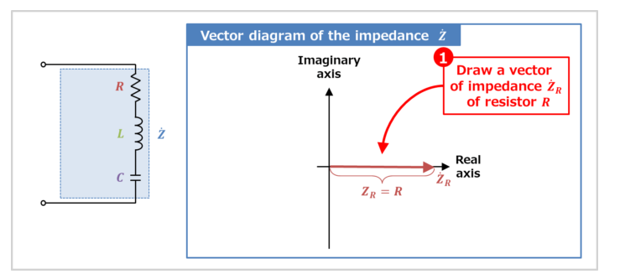
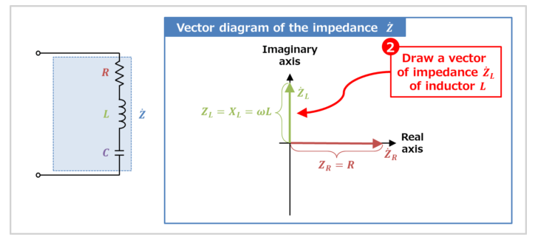
Eng. Asma’ shara’b PTUK

Slide 19
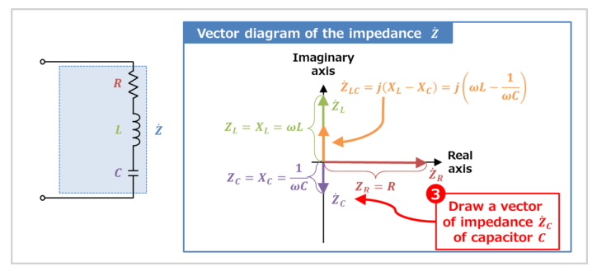
Eng. Asma’ shara’b PTUK

Slide 20
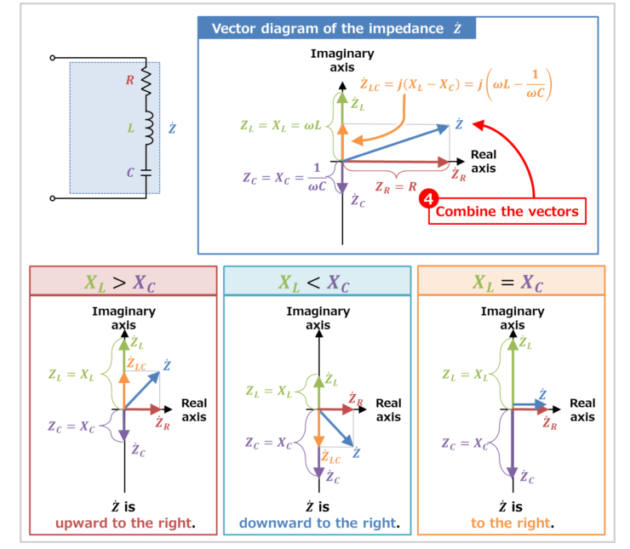
Eng. Asma’ shara’b PTUK

Slide 21
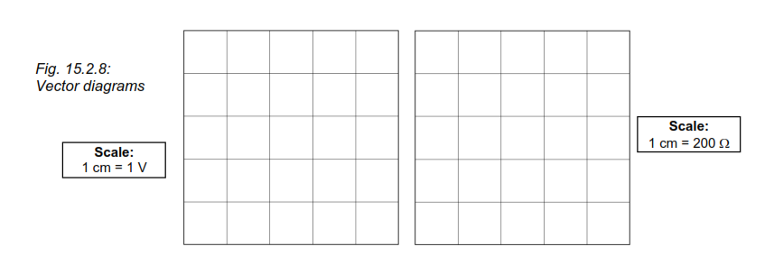
RLC Series Circuit
- Set the function generator to an output voltage of Urms = 4 V, fsine = 1 kHz.
- Measure the voltages across the components on a voltmeter.
- Calculate the current flowing in the circuit. Check the calculation by measurement.
- From the measured values, calculate the reactance XC and XL and the resistance R.
- Draw the vector diagrams for the voltages (UR, UC, UL, Utot) and the resistances (R, XC, XL, Z)
-
Eng. Asma’ shara’b PTUK

Slide 22
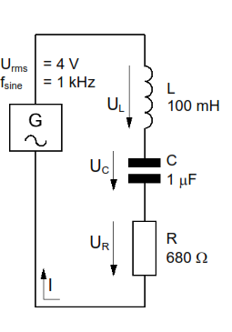
Eng. Asma’ shara’b PTUK

Slide 23
- Determine the impedance Z from the diagram and check the value by calculation using your measured values.
From the diagram: Z =
Calculation:
- Mark the phase angle in the diagram. Calculate the phase angle from your measured values.
Eng. Asma’ shara’b PTUK

Slide 24
RLC Parallel Circuit
Eng. Asma’ shara’b PTUK

Slide 25
Eng. Asma’ shara’b PTUK

Slide 26
Eng. Asma’ shara’b PTUK

Slide 27
Eng. Asma’ shara’b PTUK

Slide 28
Eng. Asma’ shara’b PTUK

Slide 29
Eng. Asma’ shara’b PTUK

Slide 30
Eng. Asma’ shara’b PTUK

Slide 31
Eng. Asma’ shara’b PTUK

Slide 33
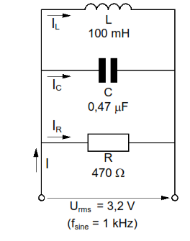
Exercise 3: RLC Parallel Circuit
Assemble the RLC parallel circuit in Fig. 15.3.5 on the Electronic Circuits Board. Set the function generator to an output voltage of Urms = 3,2 V, fsine = 1 kHz.
- Check your calculations by measurement on an ammeter.

Slide 34
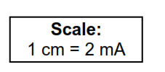
- Draw the vector diagram of currents
-From your drawing, determine the apparent current (total current) I.
Result: I =
- Check the value of I from the drawing by a calculation using the measured values of current.
Eng. Asma’ shara’b PTUK

Slide 35
- Calculate the phase shift between apparent current I and reactive current Ic.
How much active power P, is dissipated in the RLC circuit?
Calculate the value of apparent power S, using P and the phase angle φ.
- How does the RLC circuit in Fig. 15.3.5 load the AC voltage source, capacitive or inductive? Give reasons for your answer.
Eng. Asma’ shara’b PTUK

Slide 36
Eng. Asma’ shara’b PTUK

