Slide 1
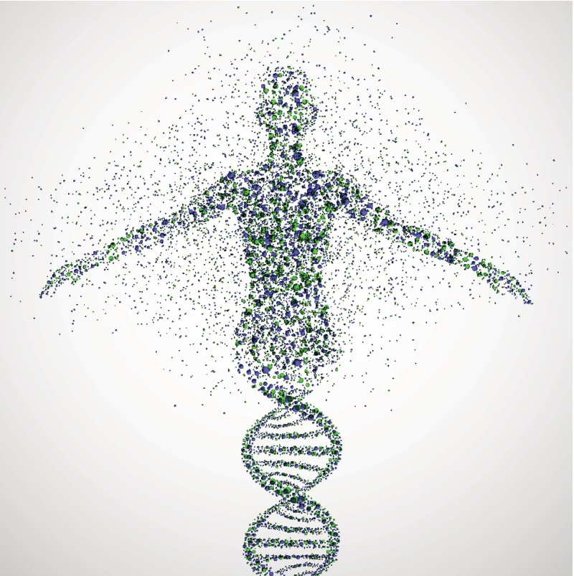
Human genetics syllabus
Sabha Rabaya, MSc

Slide 2
What Is This Course About?
Human heredity and variations
Human genetic disorders, clinical genetics
Human Genetics
Population genetics
developmental genetics
Behavioral genetics
Genetic counseling

Slide 3
What Is This Course About?
Human genetic disorders
This course
Genetic testing and diagnosis
Molecular genetic approaches in treatment

Slide 4
Human Genetics Course Organization
Introduction to human genetics
Transmission genetics
Human genetic variations
Human Genetic Disorders diagnostics
Genetic Disorders treatment and management
Genomics/population genetics/Personalized Medicine
Chromosomal abnormalities
gene mutations/
/Single-gene disorders
Multifactorial disorders/Complex inheritance/Cancer
Notes:
Inborn errors of metabolism
Carbohydrates : Lactase deficiency
Lipids: Familial hypercholesteremia
Proteins: Maple syrup urine
Nucleic acids: Lesch nyhan syndrome
Cell
Plasma membrane: cystic fibrosis
Nucleous: progeria
E.R./ cytoskeleton: Alzehimers disease
Lysosomes: tay sachs disease
Mitochondria: parkinsons

Slide 5
Course Outcomes
1.Gain a broad knowledge of human genetics and what approaches are used to expand our understanding.
2.Understand modes of inheritance and expression of traits ranging from Mendelian to multifactorial.
3.Learn about the human genome, from its organization into chromosomes to the DNA content.
4.Learn the major types of human genetic disorders and understand the mechanisms of major human genetic disorders
5.To appreciate how advances in biotechnology and genomics are personalizing all aspects of medicine including prevention, diagnostics, and treatment.
6.Acquire some basic skills in literature search and presentation.

Slide 6
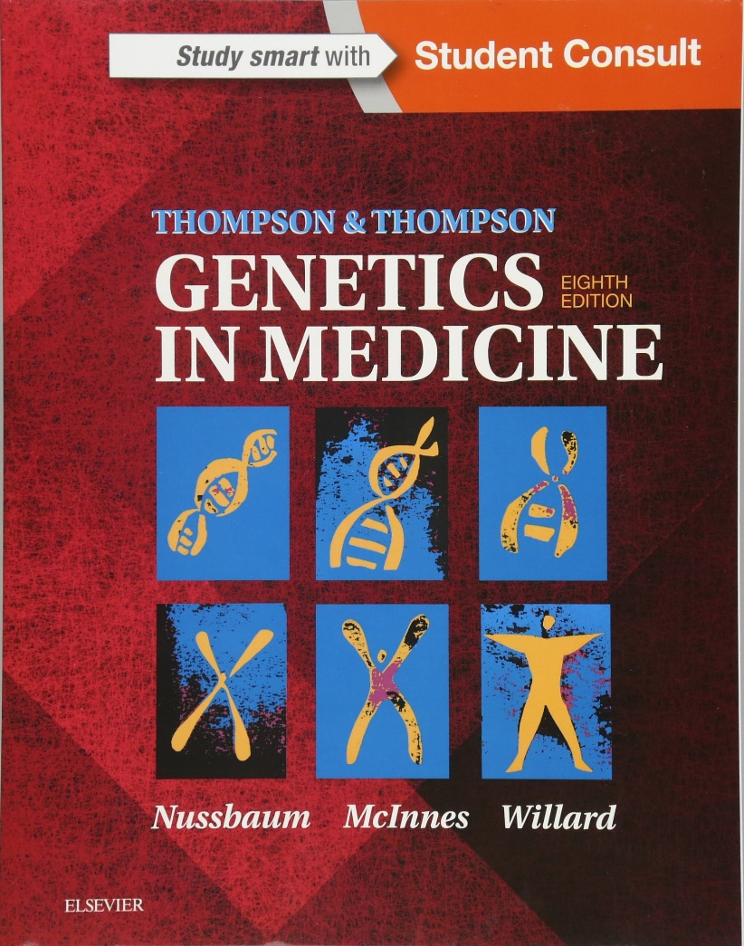
Textbooks and Course Material

Slide 7
Course Policies
Classroom Courtesy
Please turn off your cell phones and keep your side conversations to a minimum.
Preparation for Class
Please attend all classes, arrive on time and be ready to participate and learn.
It is encouraged to take notes during lectures
Always check Moodle platform
Notes:
Class Participation:
Learning requires students to actively contribute both inside the classroom and after class. Class participation is an integral part of the learning process. Answering questions posed during lecture, voting in class polls, and energetically being a member of groups in activities and on the discussion boards will reinforce your learning and help make the class enjoyable for all participants.

Slide 8
Course Policies
Quizzes, assignments and exams
You will have some assignments and lecture quizzes, please submit your assignments on time
You are required to give a graded presentation
There will be at least two exams. Exam material will be drawn from required readings, lecture material, and in-class activities.
Help & Resources
If you find yourself struggling, act quickly! Please contact me to set up an appointment.
sabharabaya1995@gmail.com
Office hours & location: For now email me for a time and we will make it happen.

Slide 9
Things to take into considerations
Attend all lectures: cumulative
Be organized: Do your work
Be involved
Share your opinion: your feedback matters
Ask for support

Slide 11
Self-test
In your words, try to define each of the following:
DNA
RNA
Replication
Transcription
Translation
Chromosome
Chromatid
Gene
Allele
Mutation
Mitosis
Meiosis
The central dogma

