Slide 1
Cancer Genetics
THOMPSON & THOMPSON GENETICS IN MEDICINE
CHAPTER 15 — Cancer Genetics and Genomics
Sabha Rabaya, MSc

Slide 2
What is Cancer?
Cancer:
Cancer is a group of diseases characterized by uncontrolled growth and spread of abnormal cells. If the spread is not controlled, it can result in death.
Uncontrolled proliferation of cells
Ability to spread (metastasize) to distant sites.
Notes:
Malignancy: A proliferating cell mass is malignant when it grows independently of control mechanisms,
being capable of transcending tissue boundaries, growing invasively, and metastasizing.
Neoplasia: uncontrolled growth of cells that is not under physiologic control

Slide 3
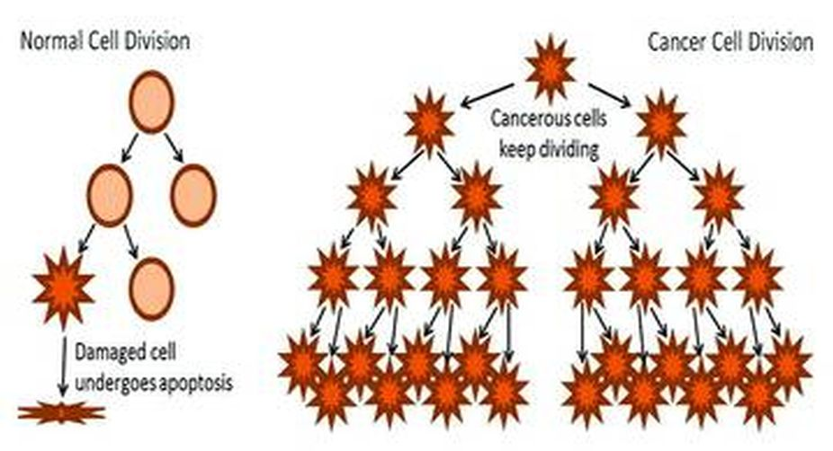

Slide 4
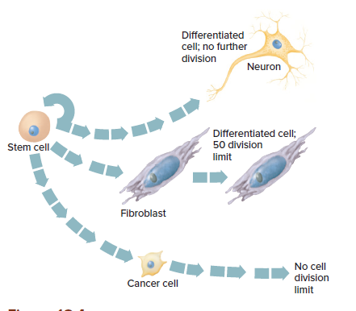
Loss of cell cycle control
The most fundamental characteristic of cancer is the underlying disruption of the cell cycle.

Slide 5
Incidence of Cancer
is a common disease
1 person in 3 can expect to contract cancer at some stage in their life
1 person in 5 can expect to die from it

Slide 6
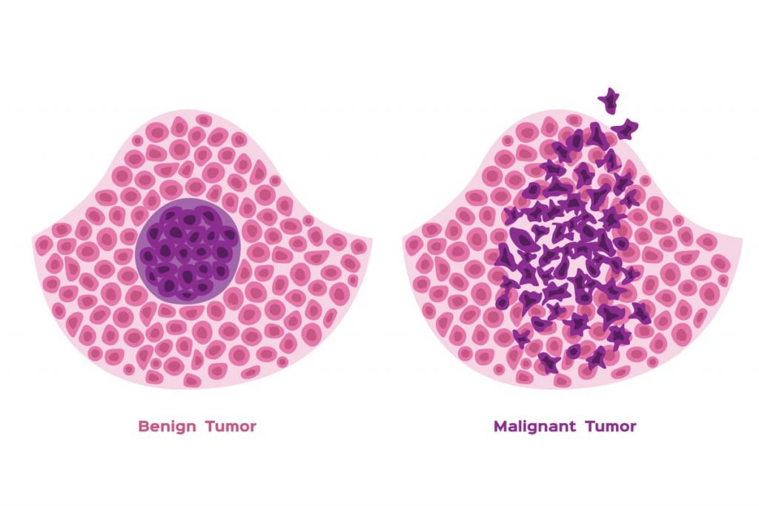
Tumor Classification
Benign tumors
Grow locally
May cause problems by pressure (brain) or
obstruction ( colon)
Histologically resemble the tissue of origin
Do not spread to distant sites

Slide 7
Tumor Classification
2. Cancer
Fully developed malignant tumors with the specific capacity to invade and destroy the underlying mesenchyme.
Pieces of a malignant tumor can enter the bloodstream or lymphatic vessels and travel to other areas of the body, where the cancer cells “seed” the formation of new tumors.
Metastasis
Stimulate angiogenesis and development of blood supply

Slide 8
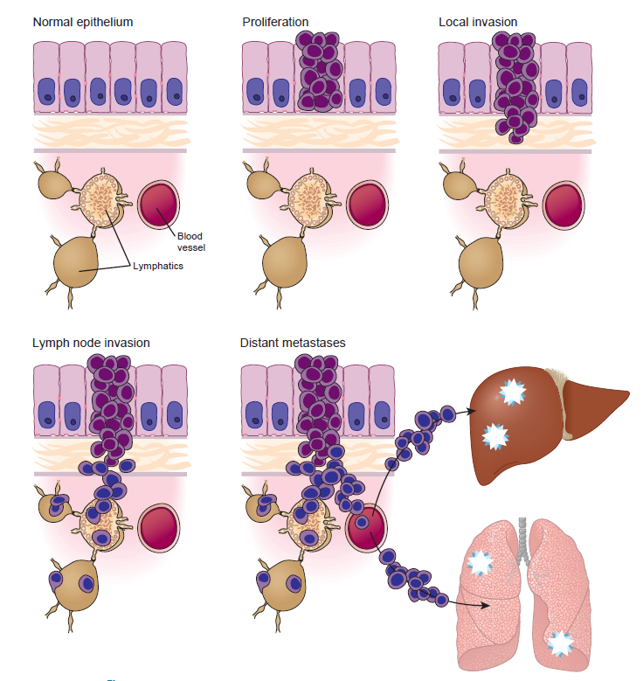

Slide 9
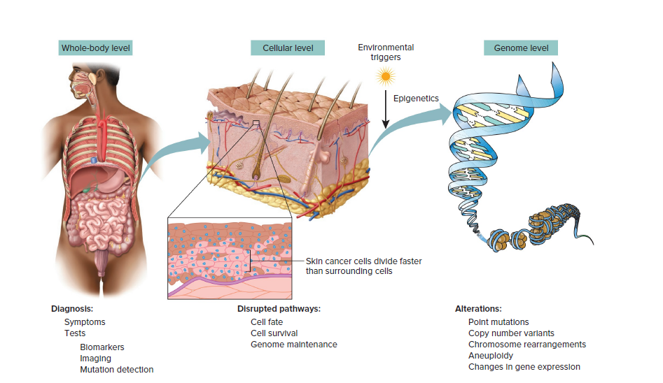
Cancer is a Complex Disorder

Slide 10
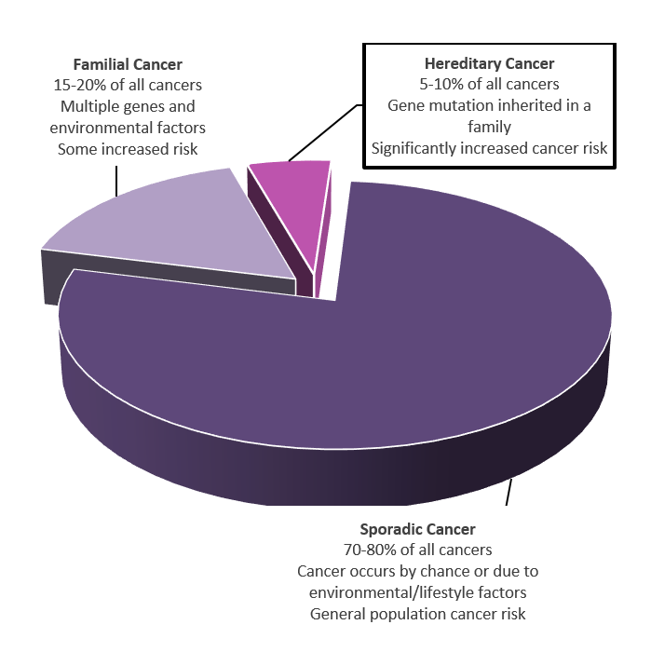
Cancer is a Genetic Disorder
It is caused by changes in DNA
Can be:
Hereditary
Familial
Sporadic
Hereditary: result from inheriting a cancer susceptibility allele from a parent. The inherited allele is a germline mutation. Hereditary cancers are rare, but they have high penetrance and tend to strike earlier in life than do sporadic cancers.
The majority of cancers are sporadic, and caused by
somatic mutations

Slide 11
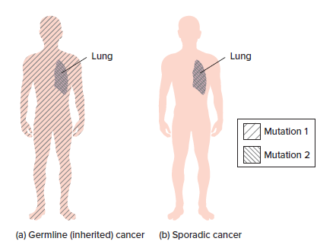

Slide 12
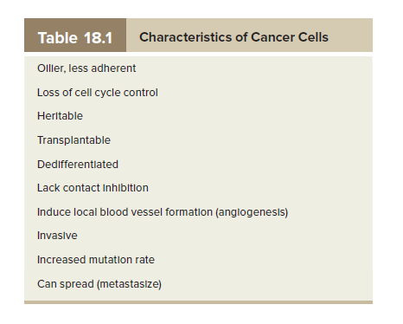
Cancer at the Cellular Level

Slide 13
Types of cancer
There are three
main classes of cancer:
• Sarcomas, in which the tumor has arisen in mesenchymal
tissue, such as bone, muscle, or connective
tissue, or in nervous system tissue;
• Carcinomas, which originate in epithelial tissue, such
as the cells lining the intestine, bronchi, or mammary
ducts
• Hematopoietic and lymphoid malignant neoplasms,
such as leukemia and lymphoma, which spread
throughout the bone marrow, lymphatic system, and
peripheral blood.

Slide 14
Genetic basis of cancer
The number of mutations present in a tumor can vary from just a few to many tens of thousands
Messenger mutations: appear to be random, not recurrent in particular cancer types, and probably occurred as the cancer developed, rather than directly causing the neoplasia to develop or progress
Driver mutations: at high frequency in many samples of the same type of cancer or even in multiple different types of cancers, mutated in fact far too frequently to simply be
passenger mutations.
These genes are thus presumed to be involved in the development or progression of the cancer . They are therefore referred to as “driver” genes, that is, they harbor mutations (so-called driver gene mutations) that are likely to be causing a cancer
to develop or progress.
Although many driver genes are specific to particular tumor types, some, such as those
in the TP53 gene encoding the p53 protein, are found in the vast majority of cancers

Slide 15
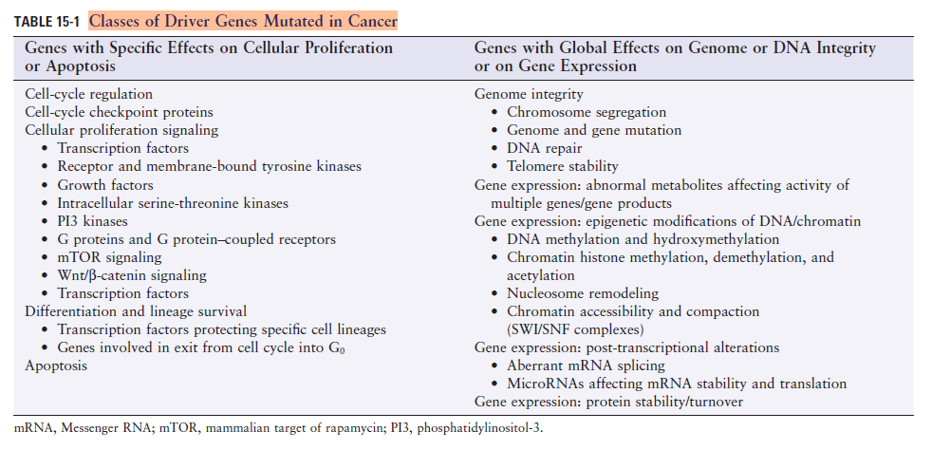

Slide 16
Oncogenes and Tumor Suppressor Genes
Driver genes can be further subdivided into one of two functional categories depending on how, if mutated, they drive oncogenesis.
proto-oncogenes:
are normal genes that, when mutated in very particular ways, become driver genes through alterations that lead to excessive levels of activity. Once mutated in this way, driver genes of this type are referred to as activated oncogenes.
Only a single mutation at one allele can be sufficient for activation, and the mutations that activate a proto-oncogene can range from highly specific point
mutations causing dysregulation or hyperactivity of a protein, to chromosome translocations that drive overexpression of a gene, to gene amplification events that create an overabundance of the encoded mRNA and protein product

Slide 17
Oncogenes and Tumor Suppressor Genes
Driver genes can be further subdivided into one of two functional categories depending on how, if mutated, they drive oncogenesis.
tumor suppressor genes (TSGs), mutations in which cause a loss of expression of proteins necessary to control the development of cancers. To drive oncogenesis, loss of function of a TSG typically requires mutations at both alleles.
There are many ways that a cell can lose the function of TSG alleles. Loss-of function mechanisms can range from missense, nonsense, or frame-shift mutations to gene deletions or loss of a part or even an entire chromosome. Loss of function of TSGs can also result from epigenomic transcriptional silencing due to altered chromatin conformation or promoter Methylation, or from translational silencing by miRNAs or disturbances in other components of the translational machinery

Slide 18
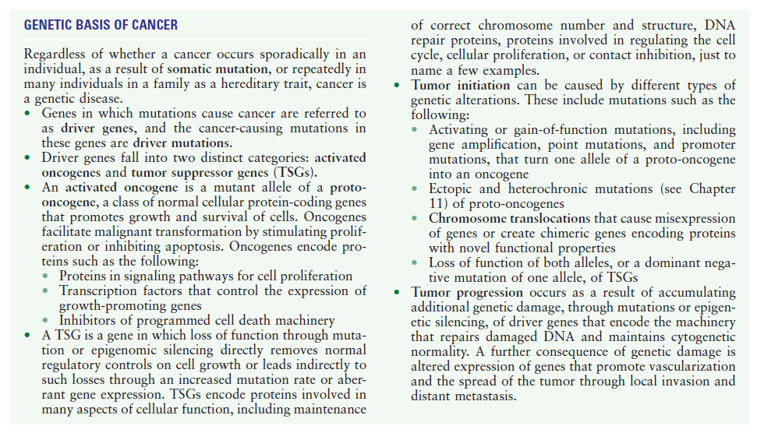

Slide 19
Cancer in Families
Although essentially all individuals are at risk for some cancer at some point during their lives, many forms of cancer have a higher incidence in relatives of patients than in the general population
In some cases, this increased incidence is due primarily to inheritance of a single mutant gene with high penetrance. These mutations result in hereditary cancer syndromes following mendelian patterns of inheritance
Among these syndromes, approximately 100 different genes in which deleterious mutations increase the risk for cancer many-fold higher than in the general population
Examples of family cancer syndromes are hereditary breast and ovarian cancer syndrome, Li-Fraumeni syndrome, Cowden syndrome, and Lynch syndrome.

