Slide 1
Chapter 01
Introduction

Slide 2
Data Models
data model: a collection of conceptual tools for describing data, data relationships, data semantics, and consistency constraints.
Relational Model.
Entity-Relationship Model.
Object-Based Data Model.
Semistructured Data Model.

Slide 3
Relational Model
The relational model uses a collection of tables to represent both data and the relationships among those data.
Each table has multiple columns, and each column has a unique name.
Tables are also known as relations.
Each table contains records of a particular type.
Each record type defines a fixed number of fields, or attributes.

Slide 4
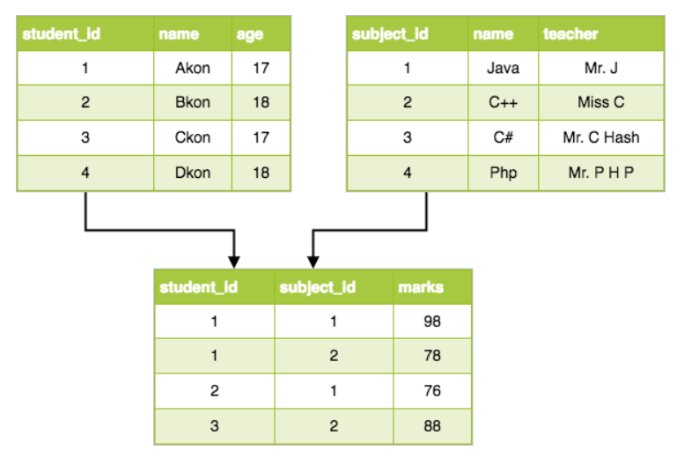
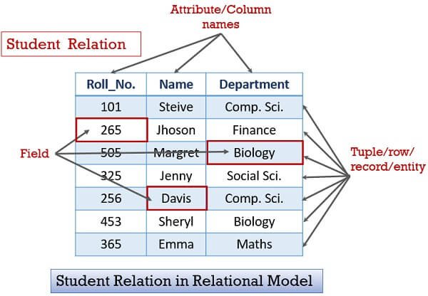

Slide 5
Entity-Relationship Model
The entity-relationship (E-R) data model uses a collection of basic objects, called entities, and relationships among these objects.
An entity is a “thing” or “object” in the real world that is distinguishable from other objects.
The entity-relationship model is widely used in database design, and Chapter 7 explores it in detail.

Slide 6
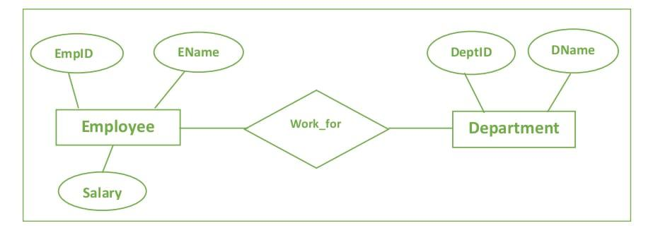

Slide 7
Object-Based Data Model
Object-oriented programming (especially in Java, C++, or C#) has become the dominant software-development methodology.
This led to the development of an object-oriented data model that can be seen as extending the E-R model with notions of encapsulation, methods (functions), and object identity.
The object-relational data model combines features of the object-oriented data model and relational data model.

Slide 8
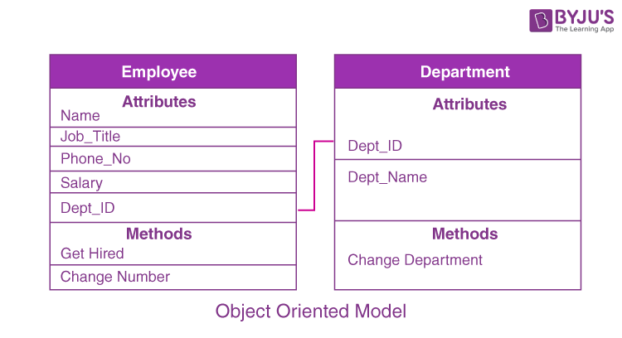

Slide 9
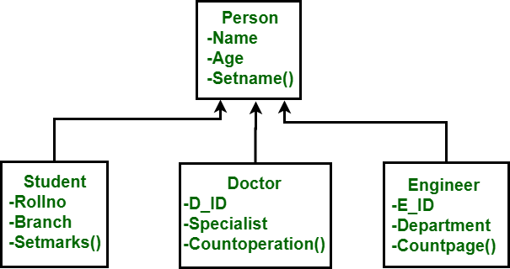
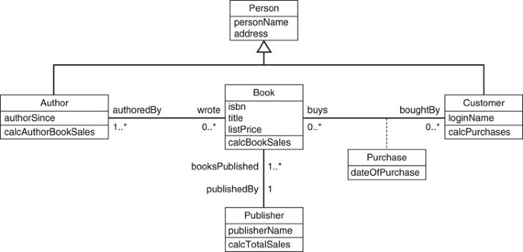

Slide 10
Semi-structured Data Model
The semi-structured data model permits the specification of data where individual data items of the same type may have different sets of attributes.
This is in contrast to the data models mentioned earlier, where every data item of a particular type must have the same set of attributes.

Slide 12
Database Languages
1.4

Slide 13
Database Languages
A database system provides:
A data-definition language:
To specify the database schema.
A data-manipulation language:
To express database queries and updates.
In practice, the data-definition and data-manipulation languages are not two separate languages; instead they simply form parts of a single database language, such as the widely used SQL language.

Slide 14
Data-Manipulation Language
A data-manipulation language (DML) is a language that enables users to access or manipulate data.
Retrieval of information stored in the database.
Insertion of new information into the database.
Deletion of information from the database.
Modification of information stored in the database.

Slide 15
Data-Definition Language
We specify a database schema by a set of definitions expressed by a special language called a data-definition language (DDL).

Slide 16
Consistency Constraints
A database consistency constraint defines a restriction on the data that can be legitimately stored in the database.
Why is Data Consistency in DBMS Important?
In a database, maintaining accuracy and usability are vital to ensuring consistency.
Mismatching data can destabilize or corrupt systems, thus undermining the integrity of the database.
For that reason, all users must input data in a way that is consistent with current database records; this is normally accomplished by isolating data fields to avoid conflicting transactions.
Consistency is critical in a database for many reasons such as ensuring accuracy of information , optimizing database space and facilitating faster and more efficient retrieval of data.

Slide 17
Domain Constraints
A domain of possible values must be associated with every attribute (for example, integer types, character types, date/time types).
Declaring an attribute to be of a particular domain acts as a constraint on the values that it can take.
Domain constraints are the most elementary form of integrity constraint.
They are tested easily by the system whenever a new data item is entered into the database.

Slide 18
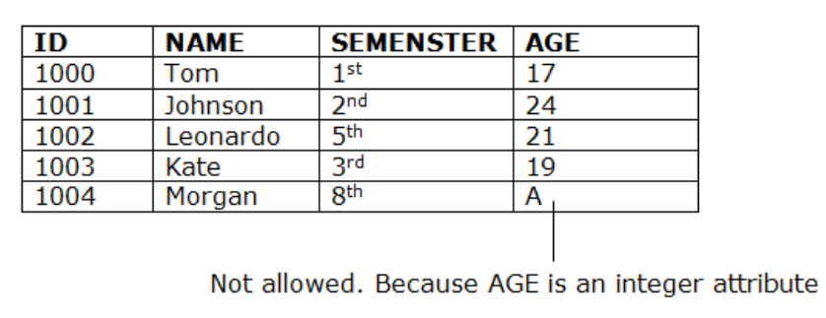

Slide 19
Referential Integrity
There are cases where we wish to ensure that a value that appears in one relation for a given set of attributes also appears in a certain set of attributes in another relation (referential integrity).
For example, the department listed for each course must be one that actually exists.
Database modifications can cause violations of referential integrity.
When a referential-integrity constraint is violated, the normal procedure is to reject the action that caused the violation.

Slide 20
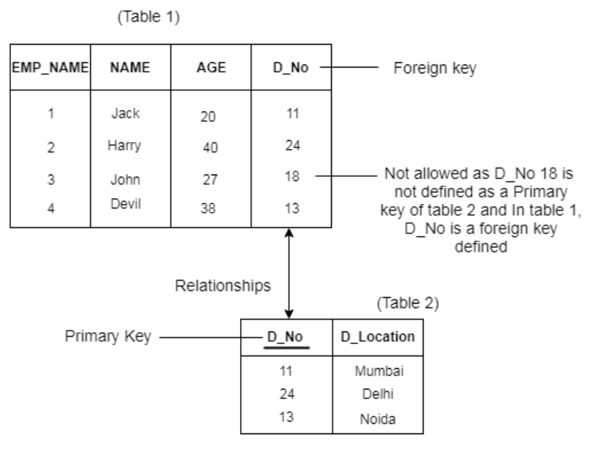

Slide 21
Assertions
An assertion is any condition that the database must always satisfy.
Domain constraints and referential-integrity constraints are special forms of assertions.
However, there are many constraints that we cannot express by using only these special forms.
For example, “Every department must have at least five courses offered every semester” must be expressed as an assertion.
When an assertion is created, the system tests it for validity.
If the assertion is valid, then any future modification to the database is allowed only if it does not cause that assertion to be violated.

Slide 22
Authorization
We may want to differentiate among the users as far as the type of access they are permitted on various data values in the database.
These differentiations are expressed in terms of authorization, the most common being:
read authorization, which allows reading, but not modification, of data.
insert authorization, which allows insertion of new data, but not modification of existing data.
update authorization, which allows modification, but not deletion, of data.
delete authorization, which allows deletion of data.
We may assign the user all, none, or a combination of these types of authorization.

Slide 23
The DDL, just like any other programming language, gets as input some instructions (statements) and generates some output.
The output of the DDL is placed in the data dictionary, which contains metadata—that is, data about data.

Slide 24
