Slide 1
Chapter 02
Introduction to the Relational
Model

Slide 2
Relational Query Languages
2.5

Slide 3
Relational Query Languages
A query language is a language in which a user requests information from the database.
Query languages can be categorized as either:
Procedural:
The user instructs the system to perform a sequence of operations on the database to compute the desired result.
Nonprocedural:
The user describes the desired information without giving a specific procedure for obtaining that information.

Slide 4
Relational Operations
2.6

Slide 5
Relational Operations
All procedural relational query languages provide a set of operations that can be applied to either a single relation or a pair of relations.
Selection.
Projection.
Natural join.
Cartesian product.
Set operations:
Union.
Intersection.
Difference.

Slide 6
Selection
The most frequent operation is the selection of specific tuples from a single relation (say instructor) that satisfies some particular predicate (say salary > $85,000).
The result is a new relation that is a subset of the original relation (instructor).

Slide 8
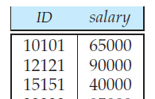
Projection
Another frequent operation is to select certain attributes (columns) from a relation.
The result is a new relation having only those selected attributes.

Slide 9
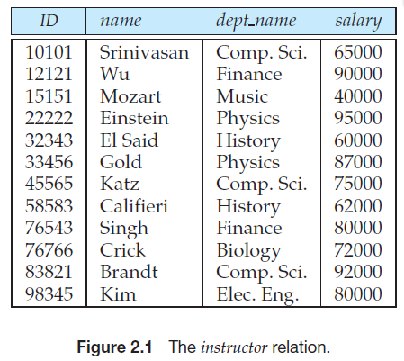
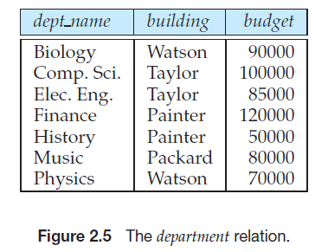
Natural join
The join operation allows the combining of two relations by merging pairs of tuples, one from each relation, into a single tuple.

Slide 10
Natural join

Slide 11
Cartesian product
The Cartesian product operation combines tuples from two relations.
But unlike the join operation, its result contains all pairs of tuples from the two relations, regardless of whether their attribute values match.

Slide 12
Cartesian product

Slide 13
Set Operations
Because relations are sets, we can perform normal set operations on relations.
The union operation performs a set union of two “similarly structured” tables (say a table of all graduate students and a table of all undergraduate students).
Other set operations, such as intersection and set difference can be performed as well.

Slide 14
Example
Find the ID and salary for those instructors who have salary greater than $85,000.
We would perform two operations in our example above.
First we select those tuples from the instructor relation where the salary value is greater than $85,000. “Selection”
Second we select the two attributes ID and salary. “Projection”

Slide 15
End of the lecture
**

