Slide 1
Power electronics lab
Single phase
Uncontrolled rectifier
Eng :Eman Abu Hany

Slide 2
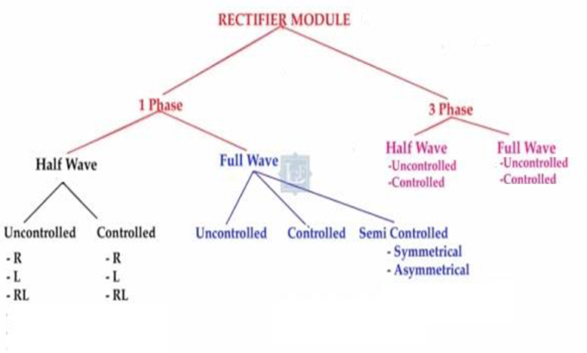

Slide 4
Single Phase Uncontrolled Rectifier
1- the Uncontrolled single - pulse Mid – point circuit M1U
2- the Uncontrolled Double - pulse Bridge Circuit B2U

Slide 5
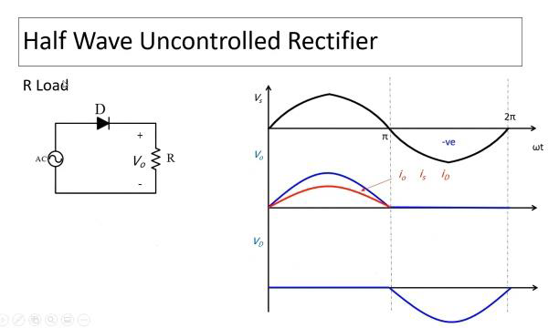

Slide 9
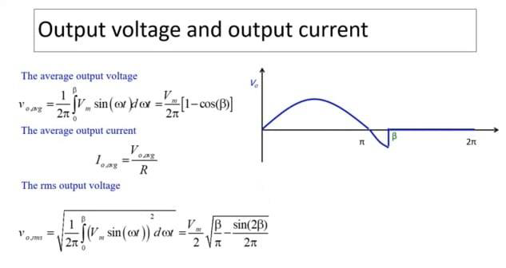
Iorms =? Vorms/R

Slide 13
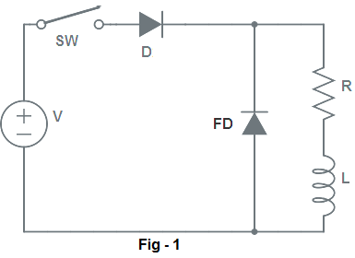
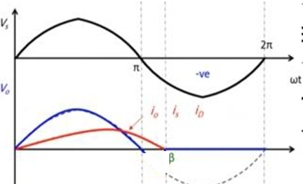
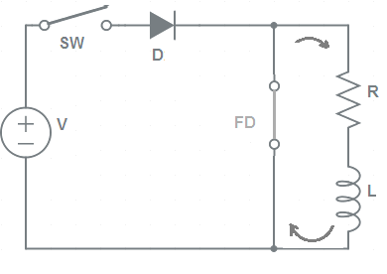

Slide 14
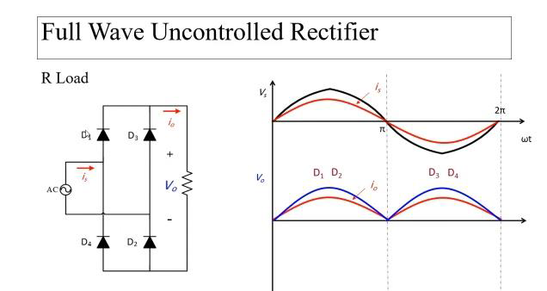

Slide 15
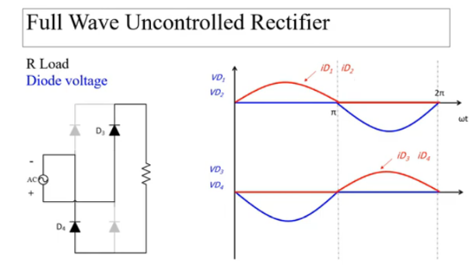

Slide 17
Isavg=0
Isrms= Iorms

Slide 18
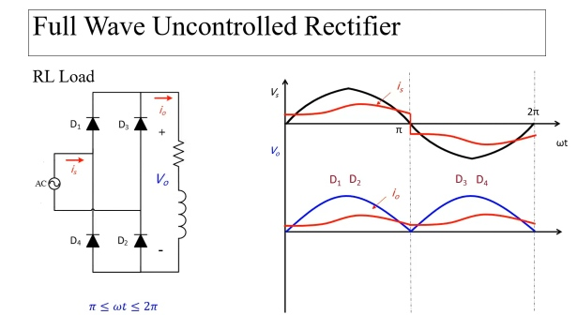

Slide 19
