Slide 1
Chapter 02
Introduction to the Relational
Model

Slide 2
Structure of Relational Databases
2.1

Slide 3
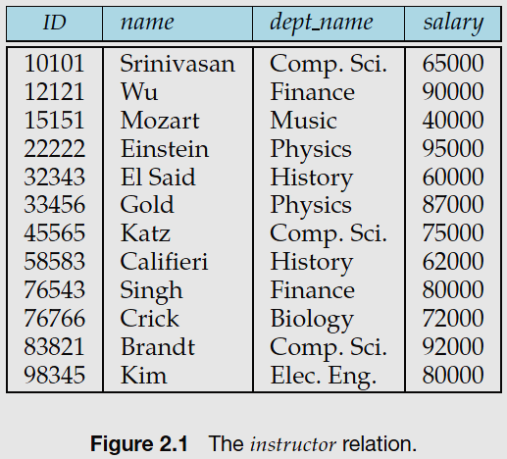
Structure of Relational Databases
A relational database consists of a collection of tables, each of which is assigned a unique name.
For example:
Consider the instructor table of Figure 2.1, which stores information about instructors.
The table has four column headers: ID, name, dept name, and salary.
Each row of this table records information about an instructor

Slide 4
Relational Model Terminologies
The term relation is used to refer to a table.
The term tuple is used to refer to a row.
The term attribute refers to a column of a table.
Relation instance is used to refer to a specific instance of a relation,
i.e., containing a specific set of rows.

Slide 5
Structure of Relational Databases
For each attribute of a relation, there is a set of permitted values, called the domain of that attribute.
A domain is atomic if elements of the domain are considered to be indivisible units.
The null value is a special value that signifies that the value is unknown or does not exist.

Slide 6
Database Schema
2.2

Slide 7
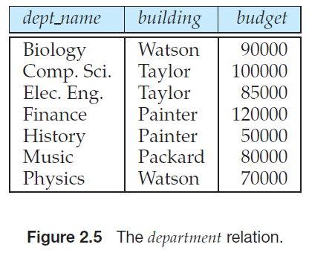
Database Schema
The database schema is the logical design of the database.
The database instance is a snapshot of the data in the database at a given instant in time.

Slide 8
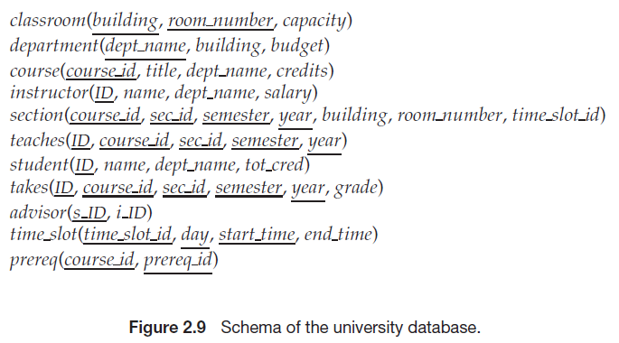

Slide 11
Keys
We must have a way to specify how tuples within a given relation are distinguished.
This is expressed in terms of their attributes.
The values of a tuple must be uniquely identify the tuple.
No two tuples in a relation are allowed to have exactly the same value for all attributes.
A superkey is a set of one or more attributes that allow us to identify uniquely a tuple in the relation.
For example, the ID attribute of the relation instructor is sufficient to distinguish one instructor tuple from another.
Thus, ID is a superkey.

Slide 13
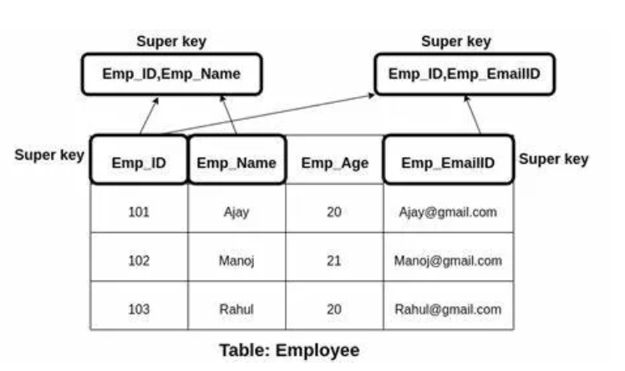

Slide 14
Candidate keys
A superkey may contain extraneous اضافي attributes.
For example, the combination of ID and name is a superkey for the relation instructor.
We are often interested in superkeys for which no proper subset is a superkey.
Such minimal superkeys are called candidate keys.

Slide 16
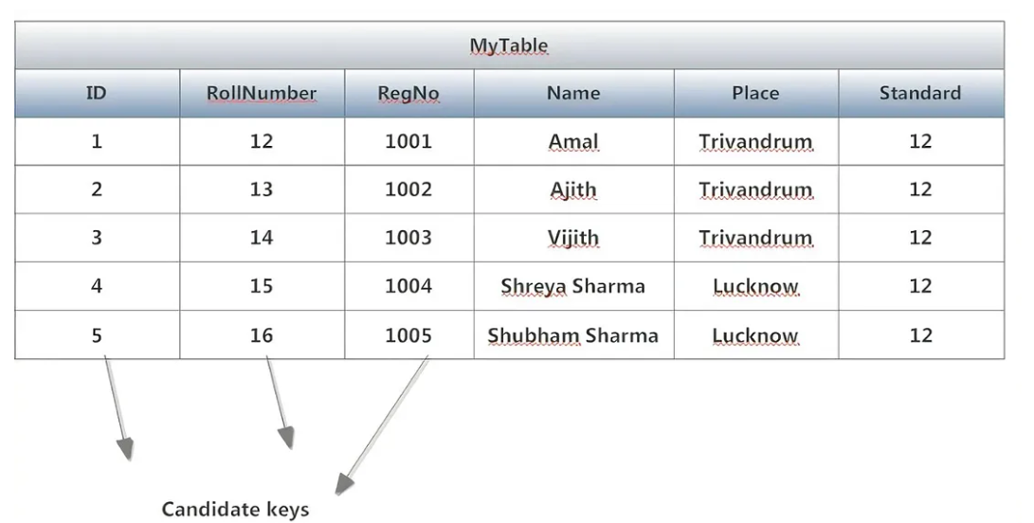

Slide 17
Primary key
The primary key is a candidate key that is chosen by the database designer to distinguish the tuples.
A key (whether primary, candidate, or super) is a property of the entire relation, rather than of the individual tuples.
Any two individual tuples in the relation are prohibitedممنوع from having the same value on the key attributes at the same time.

Slide 19
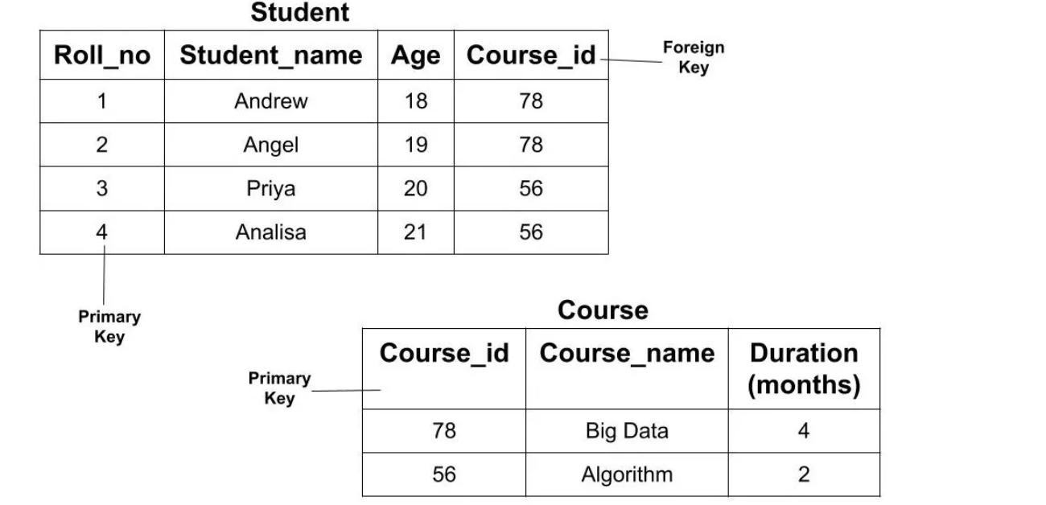

Slide 20
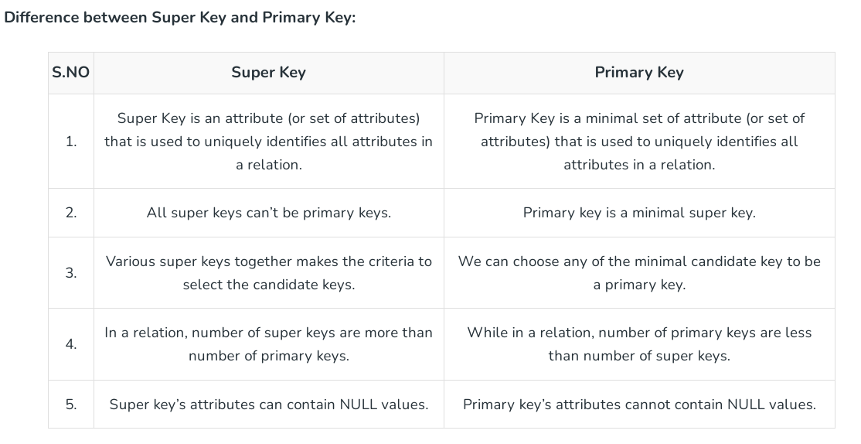

Slide 21
Foreign key
A relation, say r1, may include among its attributes the primary key of another relation, say r2.
This attribute is called a foreign key from r1, referencing r2.
The relation r1 is called the referencing relation of the foreign key dependency.
The relation r2 is called the referenced relation of the foreign key.
Referential Integrity السلامة المرجعيةConstraint
A referential integrity constraint requires that the values appearing in specified attributes of any tuple in the referencing relation also appear in specified attributes of at least one tuple in the referenced relation.
R2
R1

Slide 23
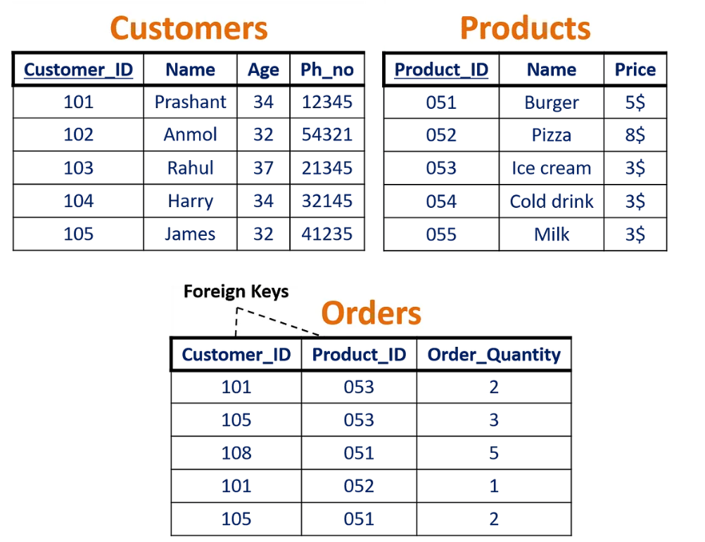

Slide 24
Schema Diagrams
2.4

Slide 25
Schema Diagrams
Schema diagrams is a database schema along with primary key and foreign key dependencies.

Slide 26
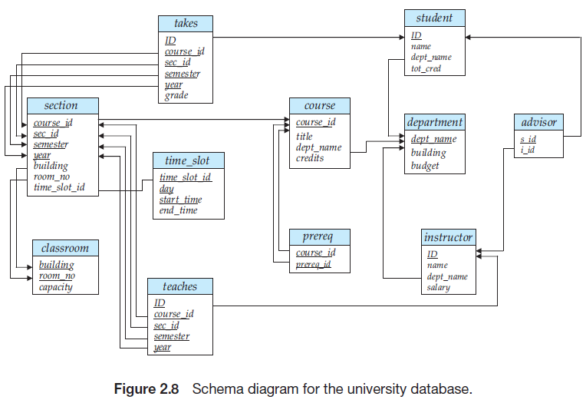

Slide 27
