Slide 1
Writing a Lab Report
Second Semester 2024/2025
Eng. Asma’ shara’b PTUK

Slide 2
Your gon'na need to know it eventually.
Eng. Asma’ shara’b PTUK

Slide 3
Every report must say...
• Who - who wrote it, for whom it was written
• What - what is the subject of the report
• Why - why the report was prepared
• How - how you did the analysis or study or investigation
• Where - the context/location
Eng. Asma’ shara’b PTUK

Slide 4
Writing Lab Reports
Writing lab reports follows a straightforward and structured procedure. It is important to recognize that each part of a lab report is important, so take the time to complete each carefully. A lab report is broken down into eight sections:
Title, abstract, introduction, methods and materials, results, discussion, conclusion, and references.
Eng. Asma’ shara’b PTUK

Slide 5
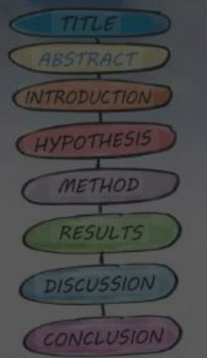
Writing Lab Reports
Eng. Asma’ shara’b PTUK

Slide 6
Title
The title of the lab report should be descriptive of the experiment and reflect what the experiment analyzed.
Ex: "Determining the Free Chlorine Content of Pool Water"
Eng. Asma’ shara’b PTUK

Slide 7
Abstract
Abstracts are a summary of the experiment as a whole and should familiarize the reader with the purpose of the research.
Abstracts will always be written last, even though they are the first paragraph of a lab report.
Not all lab reports will require an abstract. However, they are often included in upper-level lab reports and should be studied carefully.
When writing an abstract, try to answer these questions:
Why was the research done or experiment conducted?
What problem is being addressed?
What results were found?
What are the meaning of the results?
How the problem is better understood now than before, if at all?
Eng. Asma’ shara’b PTUK

Slide 8
Introduction
The introduction of a lab report discusses the problem being studied and other theory that is relevant to understanding the findings.
The hypothesis of the experiment and the motivation for the research are stated in this section.
Write the introduction in your own words. Try not to copy from a lab manual or other guidelines. Instead, show comprehension of the experiment by briefly explaining the problem.
Eng. Asma’ shara’b PTUK

Slide 9
Methods &Materials
The methods and materials section provides an overview of any equipment, apparatus, or other substances used in the experiment, as well as the steps taken during the experiment. If using any specific amounts of materials, make sure the amount is listed.
Ex: pipette, graduated cylinder, 1.13mg of Na, 0.67mg Ag
List the steps taken as they actually happened during the experiment, not as they were supposed to happen.
If written correctly, another researcher should be able to duplicate the experiment and get the same or very similar results.
Eng. Asma’ shara’b PTUK

Slide 10
Results
The results show the data that was collected or found during the experiment.
Explain in words the data that was collected.
If using graphs, charts, or other figures, present them in the results section of the lab report.
Tables should be labeled numerically, as "Table 1", "Table 2", etc. Other figures should be labeled numerically as "Figure 1", "Figure 2", etc.
Calculations to understand the data can also be presented in the results.
Eng. Asma’ shara’b PTUK

Slide 11
Discussion
The discussion section is one of the most important parts of the lab report. It analyzes the results of the experiment and is a discussion of the data.
If any results are unexpected, explain why they are unexpected and how they did or did not affect the data obtained.
Analyze the strengths and weaknesses of the design of the experiment and compare your results to other similar experiments.
If there are any experimental errors, analyze them.
Explain your results and discuss those using relevant terms and theories.
When writing a discussion, try to answer these questions:
What do the results indicate?
What is the significance of the results?
Are there any gaps in knowledge?
Are there any new questions that have been raised?
Eng. Asma’ shara’b PTUK

Slide 12
Conclusion
The conclusion is a summation of the experiment. It should clearly and concisely state what was learned and its importance.
If there is future work that needs to be done, it can be explained in the conclusion.
Eng. Asma’ shara’b PTUK

Slide 13
References
If using any outside sources to support a claim or explain background information, those sources must be cited in the references section of the lab report.
In the event that no outside sources are used, the references section may be left out.
Eng. Asma’ shara’b PTUK

Slide 14
Eng. Asma’ shara’b PTUK

Slide 15
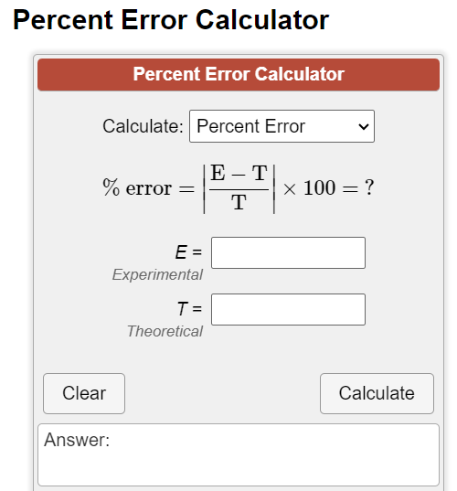
https://www.calculatorsoup.com/calculators/algebra/percent-error-calculator.php
Eng. Asma’ shara’b PTUK

Slide 16
Eng. Asma’ shara’b PTUK

