Slide 1
Time Complexity Lecture#2

Slide 2
Time Complexities for Data Structure Operations
Many operations on the data structures we’ve seen so far are clearly O(1): retrieving the size, testing emptiness, etc
We can often recognize the time complexity of an operation that modifies the data structure without a formal proof

Slide 3
Time Complexities for Array Operations
Array elements are stored contiguously in memory, so the time required to compute the memory address of an array element arr[k] is independent of the array’s size: It’s the start address of arr plus k * (size of an individual element)
So, storing and retrieving array elements are O(1) operations

Slide 4
Time Complexities for Array-Based List Operations
Assume an n-element List:
insert operation is O(n) in the worst case, which is adding to the first location: all n elements in the array have to be shifted one place to the right before the new element can be added

Slide 5
Time Complexities for Array-Based List Operations
Inserting into a full List is also O(n):
replaceContainer copies array contents from the old array to a new one (O(n))
All other activies (allocating the new array, deleting the old one, etc) are O(1)
Replacing the array and then inserting at the beginning requires O(n) + O(n) time, which is O(n)

Slide 6
Time Complexities for Array-Based List Operations
remove operation is O(n) in the worst case, which is removing from the first location: n-1 array elements must be shifted one place left
retrieve, replace, and swap operations are O(1): array indexing allows direct access to an array location, independent of the array size; no shifting occurs
find is O(n) because the entire list has to be searched in the worst case

Slide 7
Time Complexities for Linked List Operations
Singly linked list with n nodes:
addHead, removeHead, and retrieveHead are all O(1)
addTail and retrieveTail are O(1) provided that the implementation has a tail reference; otherwise, they’re O(n)
removeTail is O(n): need to traverse to the second-last node so that its reference can be reset to NULL

Slide 8
Time Complexities for Linked List Operations
Singly linked list with n nodes (cont’d):
Operations to access an item by position (add , retrieve, remove(unsigned int k), replace) are O(n): need to traverse the whole list in the worst case
Operations to access an item by its value (find, remove(Item item)) are O(n) for the same reason

Slide 9
Time Complexities for Linked List Operations
Doubly-linked list with n nodes:
Same as for singly-linked lists, except that all head and tail operations, including removeTail, are O(1)
Ordered linked list with n nodes:
Comparable operations to those found in the linked list class have the same time complexities
add(Item item) operation is O(n): may have to traverse the whole list

Slide 10
Time Complexities for Stack Operations
Stack using an underlying array:
All operations are O(1), provided that the top of the stack is always at the highest index currently in use: no shifting required
Stack using an array-based list:
All operations O(1), provided that the tail of the list is the top of the stack
Exception: push is O(n) if the array size has to double

Slide 11
Time Complexities for Stack Operations
Stack using an underlying linked list:
All operations are, or should be, O(1)
Top of stack is the head of the linked list
If a doubly-linked list with a tail pointer is used, the top of the stack can be the tail of the list

Slide 12
Time Complexities for Queue Operations
Queue using an underlying array-based list:
peek is O(1)
enqueue is O(1) unless the array size has to be increased (in which case it’s O(n))
dequeue is O(n) : all the remaining elements have to be shifted

Slide 13
Time Complexities for Queue Operations
Queue using an underlying linked list:
As long as we have both a head and a tail pointer in the linked list, all operations are O(1)
important: enqueue() should use addTail() dequeue() should use removeHead()
Why not the other way around?
No need for the list to be doubly-linked

Slide 14
Time Complexities for Queue Operations
Circular queue using an underlying array:
All operations are O(1)
If we revise the code so that the queue can be arbitrarily large, enqueue is O(n) on those occasions when the underlying array has to be replaced

Slide 15
Time Complexities for OrderedList Operations
OrderedList with array-based m_container:
Our implementation of insert(item) (see slide 10-12) uses “linear search” that traverses the list from its beginning until the right spot for the new item is found – linear complexity O(n)
Operation remove(int pos) is also O(n) since items have to be shifted in the array

Slide 16
Basic Search Algorithms and their Complexity Analysis

Slide 17
Linear Search: Example 1
The problem: Search an array a of size n to determine whether the array contains the value key; return index if found, -1 if not found
Set k to 0.
While (k < n) and (a[k] is not key)
Add 1 to k.
If k == n Return –1.
Return k.

Slide 18
Analysis of Linear Search
Total amount of work done:
Before loop: a constant amount a
Each time through loop: 2 comparisons, an and operation, and an addition: a constant amount of work b
After loop: a constant amount c
In worst case, we examine all n array locations, so T(n) = a +b*n + c = b*n + d, where d = a+c, and time complexity is O(n)

Slide 19
Analysis of Linear Search
Simpler (less formal) analysis:
Note that work done before and after loop is independent of n, and work done during a single execution of loop is independent of n
In worst case, loop will be executed n times, so amount of work done is proportional to n, and algorithm is O(n)

Slide 20
Analysis of Linear Search
Average case for a successful search:
Probability of key being found at index k is 1 in n for each value of k
Add up the amount of work done in each case, and divide by total number of cases:
((a*1+d) + (a*2+d) + (a*3+d) + … + (a*n+d))/n
= (n*d + a*(1+2+3+ … +n))/n
= n*d/n + a*(n*(n+1)/2)/n = d + a*n/2 + a/2 = (a/2)*n + e, where constant e=d+a/2, so expected case is also O(n)

Slide 21
Analysis of Linear Search
Simpler approach to expected case:
Add up the number of times the loop is executed in each of the n cases, and divide by the number of cases n
(1+2+3+ … +(n-1)+n)/n = (n*(n+1)/2)/n = n/2 + 1/2; algorithm is therefore O(n)

Slide 22
Linear Search for LinkedList
Linear search can be also done for LinkedList
exercise: write code for function
Complexity of function find(key) for class LinkedList should also be O(n)
template <class Item> template <class Equality>
int LinkedList<Item>::find(Item key) const { …}

Slide 23
Binary Search (on sorted arrays)
General case: search a sorted array a of size n looking for the value key
Divide and conquer approach:
Compute the middle index mid of the array
If key is found at mid, we’re done
Otherwise repeat the approach on the half of the array that might still contain key
etc…

Slide 24
Example: Binary Search For Ordered List
int binarySearch(m_container, key) {
int first = 1, last = m_container.getLength();
while (first <= last) { // start of while loop
int mid = (first+last)/2;
Item val = retrieve(mid);
if (key < val) last = mid-1;
else if (key > val) first = mid+1;
else return mid;
} // end of while loop
return –1;
}

Slide 25
Analysis of Binary Search
The amount of work done before and after the loop is a constant, and independent of n
The amount of work done during a single execution of the loop is constant
Time complexity will therefore be proportional to number of times the loop is executed, so that’s what we’ll analyze

Slide 26
Analysis of Binary Search
Worst case: key is not found in the array
Each time through the loop, at least half of the remaining locations are rejected:
After first time through, <= n/2 remain
After second time through, <= n/4 remain
After third time through, <= n/8 remain
After k^{th} time through, <= n/2^{k} remain

Slide 27
Analysis of Binary Search
Suppose in the worst case that maximum number of times through the loop is k; we must express k in terms of n
Exit the do..while loop when number of remaining possible locations is less than 1 (that is, when first > last): this means that n/2^{k} < 1

Slide 28
Analysis of Binary Search
Also, n/2^{k-1} >=1; otherwise, looping would have stopped after k-1 iterations
Combining the two inequalities, we get:
n/2^{k} < 1 <= n/2 ^{k-1}
Invert and multiply through by n to get:
2^{k} > n >= 2 ^{k-1}

Slide 29
Analysis of Binary Search
Next, take base-2 logarithms to get:
k > log₂(n) >= k-1
Which is equivalent to:
log₂(n) < k <= log₂(n) + 1
Thus, binary search algorithm is O(log₂(n)) in terms of the number of array locations examined

Slide 30
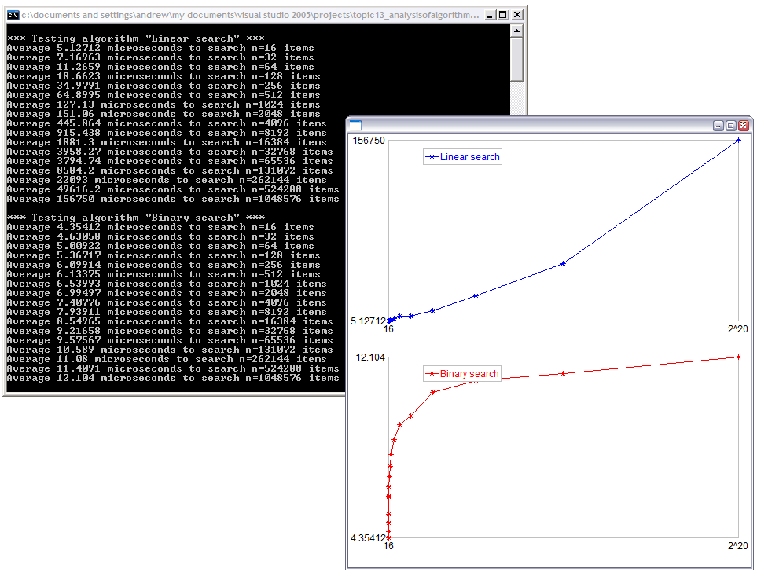
Binary vs. Liner Search
t
n
t
search for one
out of n
ordered integers
n
see demo: www.csd.uwo.ca/courses/CS1037a/demos.html

Slide 31
Basic Sorting Algorithms and their Complexity Analysis

Slide 32
Analysis: Selection Sort Algorithm
Assume we have an unsorted collection of n elements in an array or list called container; elements are either of a simple type, or are pointers to data
Assume that the elements can be compared in size ( <, >, ==, etc)
Sorting will take place “in place” in container

Slide 33
Analysis: Selection Sort Algorithm
- sorted portion of the list
- minimum element in unsorted portion
Find smallest element in unsorted portion of container
6
4
2
9
3
Interchange the smallest element with the one at the front of the unsorted portion
2
4
6
9
3
Find smallest element in unsorted portion of container
2
4
6
9
3
2
3
6
9
4
Interchange the smallest element with the one at the front of the unsorted portion

Slide 34
Analysis: Selection Sort Algorithm
- sorted portion of the list
- minimum element in unsorted portion
2
3
6
9
4
Find smallest element in unsorted portion of container
Interchange the smallest element with the one at the front of the unsorted portion
2
3
4
9
6
2
3
4
9
6
Find smallest element in unsorted portion of container
2
3
4
6
9
Interchange the smallest element with the one at the front of the unsorted portion
After n-1 repetitions of this process, the last item has automatically fallen into place

Slide 35
Selection Sort for (array-based) List
// A new member function for class List<Item>, needs additional template parameter
void selectionSort(list,items) {
unsigned int minSoFar, i, k;
for (i = 1; i < items; i++ ) { // ‘unsorted’ part starts at given ‘i’
minSoFar = i;
for (k = i+1; k <= items; k++) // searching for min Item inside ‘unsorted’
if (list[k]<list[minSoFar]) minSoFar = k;
swap( list[i], list[minSoFar]);
} // end of for-i loop
}

Slide 36
Analysis: Selection Sort Algorithm
We’ll determine the time complexity for selection sort by counting the number of data items examined in sorting an n-item array or list
Outer loop is executed n-1 times
Each time through the outer loop, one more item is sorted into position

Slide 37
Analysis: Selection Sort Algorithm
On the k^{th} time through the outer loop:
Sorted portion of container holds k-1 items initially, and unsorted portion holds n-k+1
Position of the first of these is saved in minSoFar; data object is not examined
In the inner loop, the remaining n-k items are compared to the one at minSoFar to decide if minSoFar has to be reset

Slide 38
Analysis: Selection Sort Algorithm
2 data objects are examined each time through the inner loop
So, in total, 2*(n-k) data objects are examined by the inner loop during the k^{th} pass through the outer loop
Two elements may be switched following the inner loop, but the data values aren’t examined (compared)

Slide 39
Analysis: Selection Sort Algorithm
Overall, on the k^{th} time through the outer loop, 2*(n-k) objects are examined
But k ranges from 1 to n-1 (the number of times through the outer loop)
Total number of elements examined is:
T(n) = 2*(n-1) + 2*(n-2) + 2*(n-3) + … + 2*(n-(n-2)) + 2*(n-(n-1))
= 2*((n-1) + (n-2) + (n-3) + … + 2 + 1) (or 2*(sum of first n-1 ints)
= 2*((n-1)*n)/2) = n² – n, so the algorithm is O(n²)

Slide 40
Analysis: Selection Sort Algorithm
This analysis works for both arrays and array-based lists, provided that, in the list implementation, we either directly access array m_container, or use retrieve and replace operations (O(1) operations) rather than insert and remove (O(n) operations)

Slide 41
Analysis: Selection Sort Algorithm
The algorithm has deterministic complexity
the number of operations does not depend on specific items, it depends only on the number of items
all possible instances of the problem (“best case”, “worst case”, “average case”) give the same number of operations T(n)=n²–n=O(n²)

Slide 42
Summary
Time complexity is a measure of algorithm efficiency
Efficient algorithm plays the major role in determining the running time.
Q: Is it possible to determine running time based on algorithm’s time complexity alone?
Minor tweaks in the code can cut down the running time by a factor too.
Other items like CPU speed, memory speed, device I/O speed can help as well.
For certain problems, it is possible to allocate additional space & improve time complexity.

