Slide 5
$f\left(x\right)is increasing on \left(−2,0\right),(3,∞$)
$f\left(x\right)is decreasing on \left(−∞,−2\right),(0,3$)
Relative minimum= $\frac{ 8}{3} ,\frac{−31}{4}$
Relative minimum at x = $−2 ,3$
Relative maximum= 8
Relative maximum at x= $0$

Slide 6
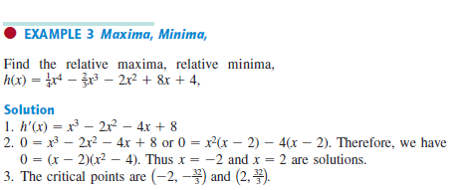

Slide 7
$$f\left(x\right)is increasing on \left(−2,∞\right)$$
$$f\left(x\right)is decreasing on \left(−∞,−2\right)$$
Relative minimum is $f(−2)=\frac{−32}{3}$
Relative minimum at x = $−2$
F(x) doesn’t have a Relative maximum
No Relative maximum at x= $0$

Slide 10
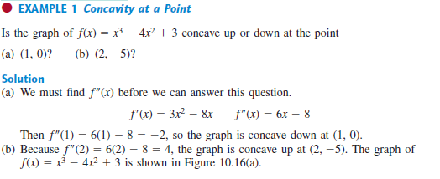

Slide 11
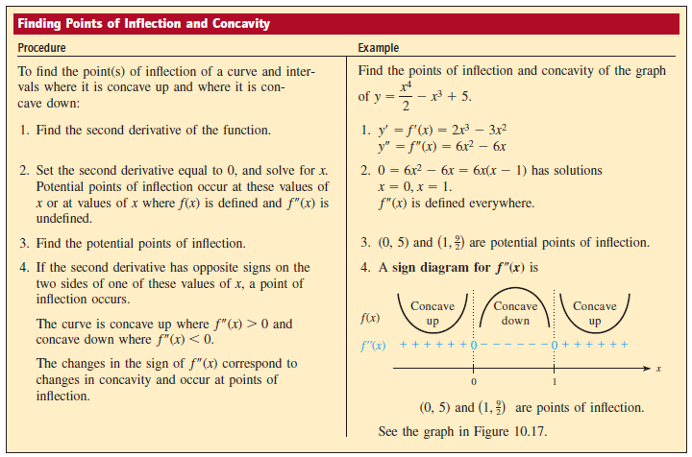

Slide 13
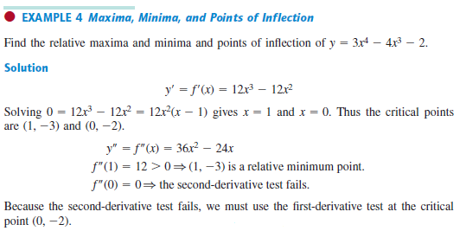
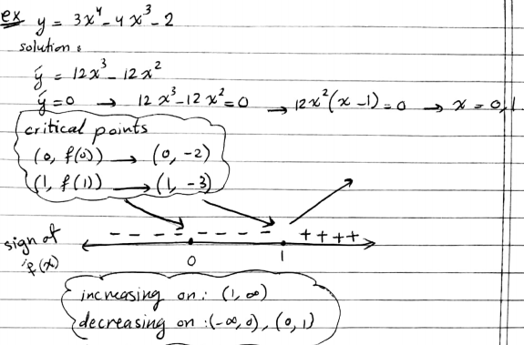

Slide 14
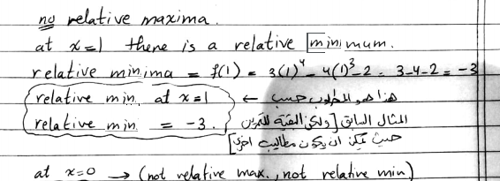
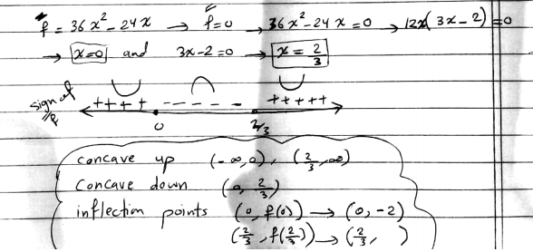

Slide 16
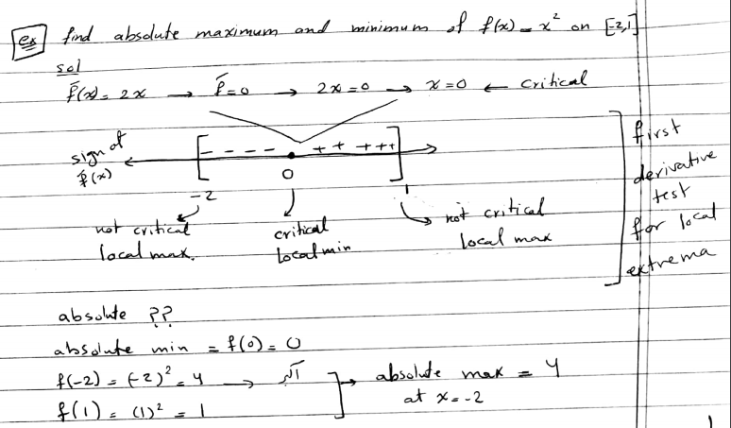
Absolute maximum is the largest relative maxima
Absolute minimum is the lest relative minima

Slide 18
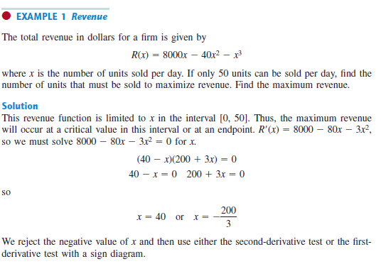

Slide 19
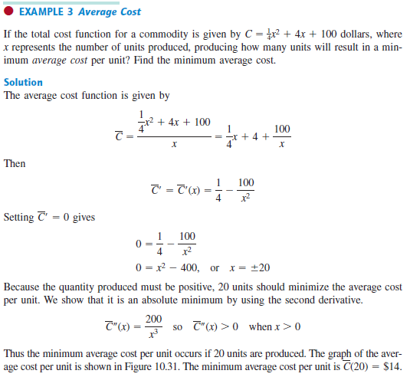

Slide 20
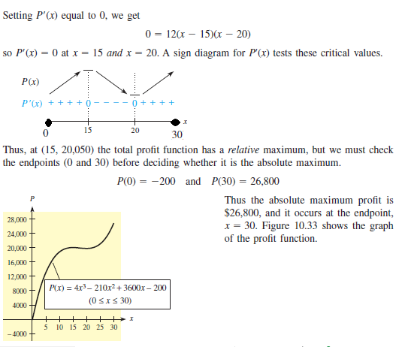
Relative max at x=15,30
F(30)=26800
F(15)=20050
26800 So absolute max is
Relative min at x=0,20
F(0)= -200
F(20)=19800
So absolute min is -200

Slide 21
