Slide 2
5.1

Slide 3
$$2^{−3}=\frac{1}{2^{3}}=\frac{1}{8}$$

Slide 4
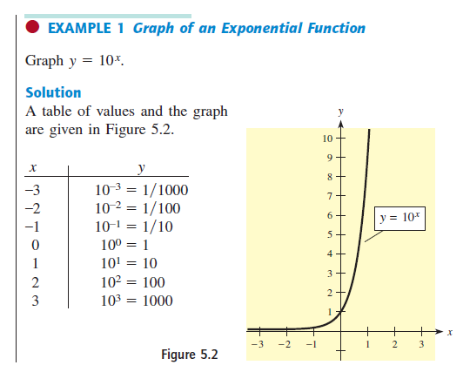
$${10}^{−2}=\frac{1}{{10}^{2}}=\frac{1}{100}$$

Slide 5
$$f(x)=3(5^{x})$$

Slide 7
$${y(x)=2}^{−x}$$
$${y(−3)=2}^{−(−3)}=2^{3}=8$$
$${y(3)=2}^{−(3)}=\frac{1}{2^{3}}=\frac{1}{8}$$

Slide 9
$${f\left(x\right)=6(2^{−x}) }^{}$$
$${f\left(x\right)=6\left(2^{−x}\right)=6(2^{−1})}^{x}={6(\frac{1}{2})}^{x}$$

