Slide 1
Lecture-2
Chapter-1

Slide 2
Mintzberg’s Managerial Roles and a Contemporary Model of Managing
Managerial Roles: specific actions or behaviors expected of and exhibited by a manager. Think of the different roles you play - student, employee, student organization member, volunteer and sibling, and the different things you’re expected to do in these roles.
Mintzberg identified 10 roles grouped around
A. interpersonal relationships, B. the transfer of information, and C. decision-making.
Notes:
Henry Mintzberg, a well-known management researcher, studied actual managers at work. In his first comprehensive study, Mintzberg concluded that what managers do can best be described by looking at the managerial roles they engage in at work. The term managerial roles refers to specific actions or behaviors expected of, and exhibited by, a manager.

Slide 3
Types of Roles
A. Interpersonal
1- Figurehead: the manager is seen as a symbol of status and authority.
2- leader: the Leader builds relationships with employees and communicates with, motivates, and coaches them.
3- Liaison: maintaining a network of contacts outside the work unit to obtain information.
Notes:
As shown in Exhibit 1-5, these 10 roles are grouped around interpersonal relationships, the transfer of information, and decision-making.

Slide 4
Types of Roles
B. Informational: involve collecting, receiving, and disseminating information.
4- Monitor: internal and external information about issues that can affect the organization.
5- Disseminator: transmit information from one person or place to another.
6- Spokesperson: transmits information about the organization to outsiders (keep stakeholders updated).

Slide 5
Types of Roles
C. Decisional: entail making decisions or choices
7- Entrepreneur: acts as an initiator, designer, developer and encourage change and innovation.
8- disturbance handler: takes corrective action when the organization faces important, unexpected difficulties.
9- resource allocator: distributes resources of all types, including time, funding, equipment, and human resources.
10- negotiator: takes part in official discussion to reach agreement

Slide 6
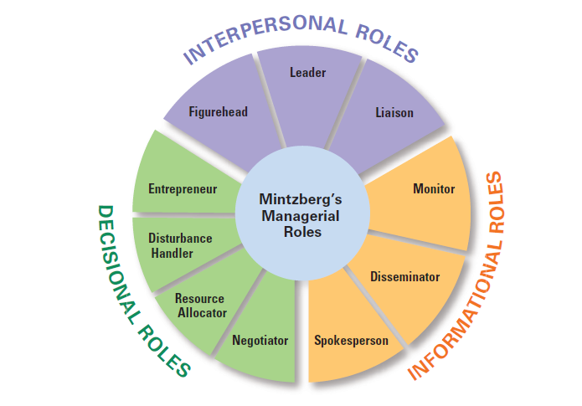
Exhibit 1-5 Mintzberg’s Managerial Roles
A
C
B
Notes:
Source: Based on H. Mintzberg, The Nature of Managerial Work (New York: Prentice Hall, 1983).

Slide 7
Management Skills
Technical skills
Knowledge and proficiency in a specific field. They are practical and often relate to scientific tasks, mechanical or information technology (e.g. data analysis, project management, programming)
Human skills
The ability to work well with other people (e.g. understanding language body, empathy, communication).
Conceptual skills
The ability to think and conceptualise about abstract and complex situations concerning the organization (e.g. decision making skills, critical thinking skills).
Notes:
What types of skills do managers need? Robert L. Katz proposed that managers need three critical skills in managing: technical, human, and conceptual.
Technical skills are the job-specific knowledge and techniques needed to proficiently perform work tasks. These skills tend to be more important for first-line managers because they typically manage employees who use tools and techniques to produce the organization’s products or service the organization’s customers.
Human skills involve the ability to work well with other people both individually and in a group. Because all managers deal with people, these skills are equally important to all levels of management.
Finally, conceptual skills are the skills managers use to think and to conceptualize about abstract and complex situations. Using these skills, managers see the organization as a whole, understand the relationships among various subunits, and visualize how the organization fits into its broader environment. These skills are most important
to top managers.

Slide 8
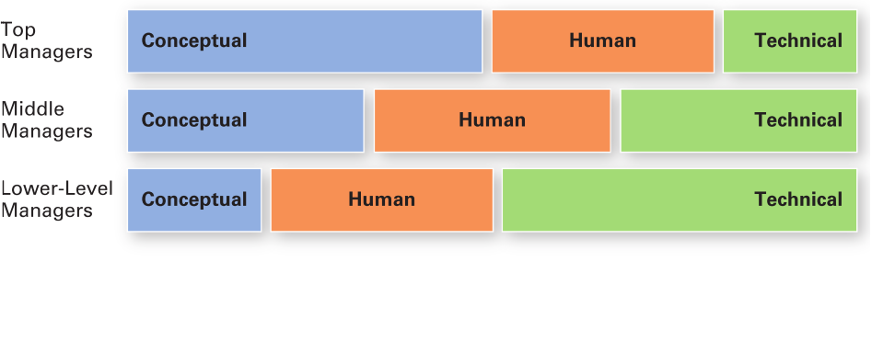
Exhibit 1-6 Skills Needed at Different Managerial Levels

Slide 9
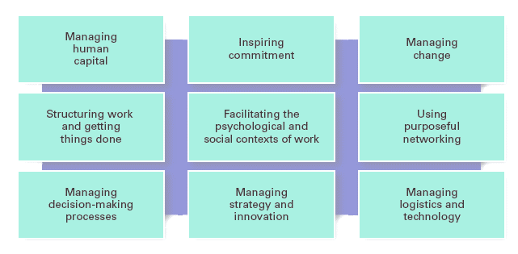
Exhibit 1-7 Important Managerial Skills
Notes:
Source: Based on Workforce Online; J. R. Ryan, Bloomberg BusinessWeek Online; In-Sue Oh and C. M. Berry; and R. S. Rubin and E. C. Dierdorff.

Slide 10
How is the manager’s job changing?

Slide 11
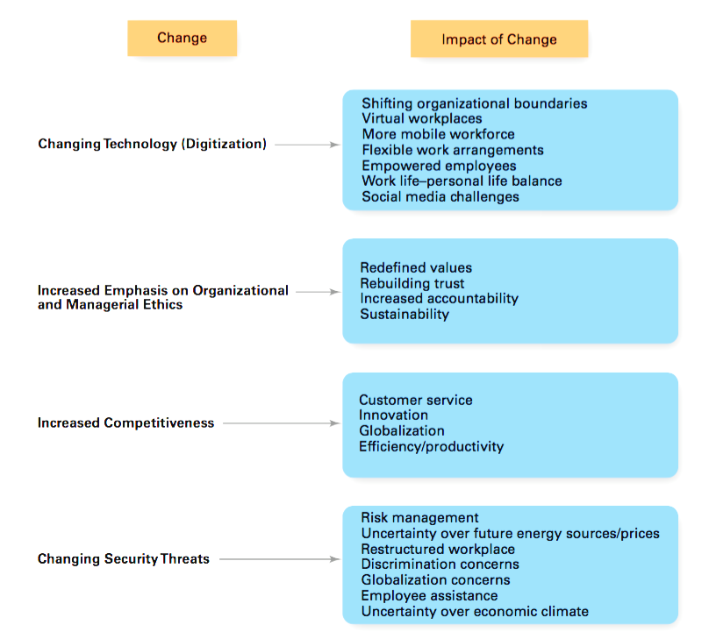
Exhibit 1-8 Changes Facing Managers
Notes:
In today’s world, managers are dealing with global economic and political uncertainties, changing workplaces, ethical issues, security threats, and changing technology. It’s likely that more managers will have to manage under such demanding circumstances, and the fact is that how managers manage is changing. Exhibit 1-8 shows some of the most important changes facing managers.

Slide 12
Focus on the Customer
Without customers, most organizations would cease to exist
Managing customer relationships is the responsibility of all managers and employees
Consistent, high-quality customer service is essential
Managers must create a customer-responsive organization where employees are friendly, accessible, knowledgeable, prompt in responding to customer needs, and willing to do what’s necessary to please the customer.
Notes:
You need customers. Without them, most organizations would cease to exist. Yet, focusing on the customer has long been thought to be the responsibility of marketing types. Today, the majority of employees in developed countries work in service jobs. Almost 77 percent of the U.S. labor force is employed in service industries.

Slide 13
Focus on Technology
Managers must get employees on board with new technology
Managers must oversee the social interactions and challenges involved in using collaborative technologies
Managers help people to get them comfortable with the technology and the benefits of using technology and how it affects their lives.
Notes:
Managers must work with employees to understand why new technology is an improvement over present ways of conducting business. According to Didier Bonnet, coauthor of Leading Challenge, “The job of a manager is to help people cross the bridge—to get them comfortable with the technology, to get them using it, and to help them understand how it makes their lives better.”
It is a myth that social skills have become less important because there is more technology in the workplace. Particularly in team settings, workers rely on each other’s expertise, and they are able to adapt to changing circumstances than is made possible by software. As a result, managers are continually challenged to oversee team building and problem solving.

Slide 14
Focus on Social Media
Social media: forms of electronic communication through which users create online communities to share ideas, information, personal messages, and other content
Managers encourage employees to use social media to reduce reliance on e-mail.
Managers need to understand and be able to manage the social media.
Notes:
Today, the new frontier is social media, forms of electronic communication through which users create online communities to share ideas, information, personal messages, and other content. And employees don’t just use these on their personal time, but also for work purposes. That’s why managers need to understand and manage the power and peril of social media.
Increasingly, many companies encourage employees to use social media to become employee activists. For this purpose, employee activists draw visibility to their workplace, defend their employers from criticism, and serve as advocates, both online and off.
Internally, social media also becomes problematic when it becomes a way for boastful employees to brag about their accomplishments, for managers to publish one-way messages to employees, or for employees to argue or gripe about something or someone they don’t like at work—then it has lost its usefulness. To avoid this, managers need to remember that social media is a tool that needs to be managed to be beneficial.

Slide 15
Focus on Innovation
Innovation: exploring new territory, taking risks, and doing things differently
Managers need to get employees to constantly suggest new ideas to deal with potential challenges and uncertainties.
Notes:
Innovation means doing things differently, exploring new territory, and taking risks. Innovation isn’t just for high-tech or other technologically sophisticated organizations. Innovative efforts can be found in all types of organizations.

Slide 16
Focus on Sustainability
Sustainability: a company’s ability to achieve its business goals and increase long-term shareholder value by integrating economic, environmental, and social opportunities into its business strategies
Sustainability associates with meeting our own needs without compromising the ability of future generations to meet their own needs.
Notes:
What’s emerging in the twenty-first century is the concept of managing in a sustainable way, which has had the effect of widening corporate responsibility not only to managing in an efficient and effective way, but also to responding strategically to a wide range of environmental and societal challenges. From a business perspective, sustainability has been defined as a company’s ability to achieve its business goals and increase long-term shareholder value by integrating economic, environmental, and social opportunities into its business strategies.

Slide 17
Focus on the Employee
Treating employees well is not only the right thing to do, it is also good business
Successful managers regularly provide performance feedback and encouragement to employees
The company stands to benefit through higher employee satisfaction, talent retention (the practices implemented in order to keep talents within the organization), and higher employee engagement.
Notes:
Progressive companies recognize the importance of treating employees well not only because it’s simply the right thing to do, but also because it is good business. Well-treated employees are more likely to go the extra mile when performing their job
Successful managers regularly provide performance feedback that serves as an evaluation of an employee’s performance and provides the foundation for discussing developmental opportunities. Effective performance appraisal outcomes depend on clearly communicating performance expectations and the resources available to help employees perform well and providing feedback on how well expectations were met.
Successful managers often embrace work-life practices and provide encouragement to employees who wish to use them.

