Slide 1
lecture2
chapter2

Slide 2
APPROACHES to decision making

Slide 3
Rationality
Rational Decision-Making: choices that are logical and consistent and maximize value
Assumptions of rationality:
Rational decision maker is logical and objective
Problem faced is clear and unambiguous
Decision maker would have clear, specific goal and be aware of all alternatives and consequences
The alternative that maximizes achieving this goal will be selected
Decisions are made in the best interest of the organization
Notes:
We assume that managers will use rational decision-making; that is, they’ll make logical and consistent choices to maximize value. After all, managers have all sorts of tools and techniques to help them be rational decision makers. Managers aren’t always rational. What does it mean to be a “rational” decision maker? A rational decision maker would be fully objective and logical. The problem faced would be clear and unambiguous, and the decision maker would have a clear and specific goal and know all possible alternatives and consequences. Finally, making decisions rationally would consistently lead to selecting the alternative that maximizes the likelihood of achieving that goal.
These assumptions apply to any decision—personal or managerial. However, for managerial decision making, we need to add one additional assumption—decisions are made in the best interests of the organization. These assumptions of rationality aren’t very realistic and managers don’t always act rationally, but the next concept can help explain how most decisions get made in organizations.

Slide 4
Exhibit 2-5 Decisions Managers May Make: Planning and Organizing
Notes:
Although everyone in an organization makes decisions, decision-making is particularly important to managers. As Exhibit 2-5 shows, it’s part of all four managerial functions. In fact, that’s why we say that decision-making is the essence of management. And that’s why managers—when they plan, organize, lead, and control—are called decision makers.

Slide 5
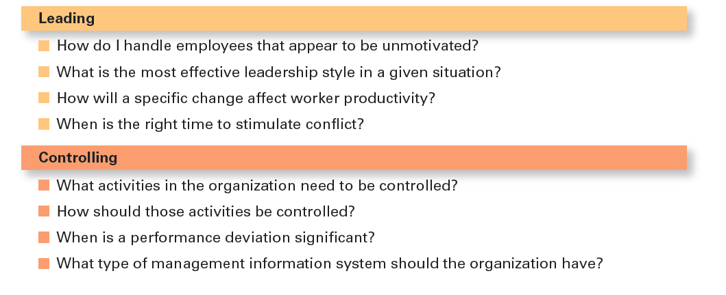
Exhibit 2-5 Decisions Managers May Make: Leading and Controlling

Slide 6
Bounded Rationality
Bounded rationality: decision making that’s rational, but limited by an individual’s ability to process information
Satisfice: accepting solutions that are “good enough”
Escalation of commitment: an increased commitment to a previous decision despite evidence it may have been wrong
Notes:
A more realistic approach to describing how managers make decisions is the concept of bounded rationality, which says that managers make decisions rationally, but are limited (bounded) by their ability to process information. Because they can’t possibly analyze all information on all alternatives, managers satisfice, rather than maximize. That is, they accept solutions that are “good enough.” They’re being rational within the limits (bounds) of their ability to process information.
However, keep in mind that their decision-making is also likely influenced by the organization’s culture, internal politics, power considerations, and by a phenomenon called escalation of commitment, an increased commitment to a previous decision despite evidence that it may have been wrong.
Examples for teachers only “satisfice”
Suppose you’re a finance major and upon graduation you want a job, preferably as a personal financial planner with a minimum salary of $55,000 and within 100 miles of your hometown. You accept a job offer as a business credit analyst—not exactly a personal financial planner but still in the finance field—at a bank 50 miles from home at a starting salary of $47,500. If you had done a more comprehensive job search, you would have discovered a job in personal financial planning at a trust company only 25 miles from your hometown and starting at a salary of $55,000. You weren’t a perfectly rational decision maker because you didn’t maximize your decision by searching all possible alternatives and then choosing the best. But because the first job offer was satisfactory (or “good enough”), you behaved in a bounded-rationality manner by accepting it.
Examples for teachers only escalation of commitment
Going back to the initial example, sticking with a job that you hate is certainly an instance of escalation of commitment. You know that quitting and looking for a new job is an option, but you’ve invested so much time and effort into your role that it’s difficult to face the idea of just leaving. You’ve too worked hard to leave— maybe you’ve even taken part in training or earned credentials to do this specific job — and it all seems like a waste if you just quit

Slide 7
Intuition
Intuitive decision-making: making decisions on the basis of experience, feelings, and accumulated judgment
Researchers studying managers’ use of intuitive decision making have identified five different aspects of intuition.
How common is intuitive decision making? One survey found that almost half of the executives surveyed “used intuition more often than formal analysis to run their companies.”
Notes:
What is intuitive decision-making? It’s making decisions on the basis of experience, feelings, and accumulated judgment. Researchers studying managers’ use of intuitive decision-making have identified five different aspects of intuition, which are described in Exhibit 2-6.

Slide 8
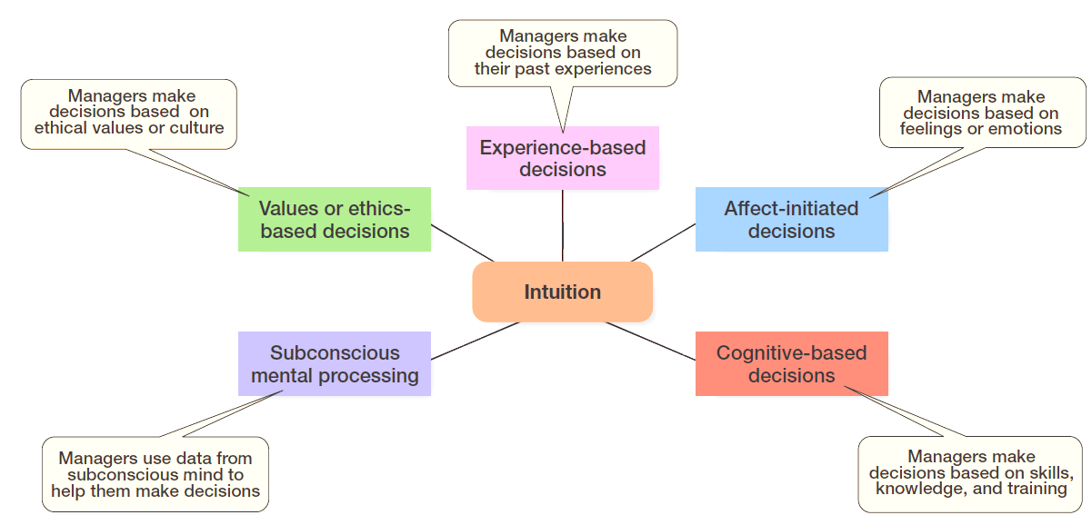
Exhibit 2-6 What is Intuition?

Slide 9
Evidence-Based Management
Evidence-based management (EBMgt): the systematic use of the best available evidence to improve management practice.
“Any decision-making process is likely to be enhanced through the use of relevant and reliable evidence, whether it’s buying someone a birthday present or wondering which new washing machine to buy.” That’s the premise behind evidence-based management (EBMgt), the “systematic use of the best available evidence to improve management practice.
Notes:
EBMgt is quite relevant to managerial decision-making. The four essential elements of EBMgt are the decision maker’s expertise and judgment; external evidence that’s been evaluated by the decision maker; opinions, preferences, and values of those who have a stake in the decision; and relevant organizational (internal) factors such as context, circumstances, and organizational members.

Slide 10
Types of Decisions: Structured Problems and Programmed Decisions
Structured problems: straightforward or uncomplicated, familiar, and easily defined problems
Programmed decisions: repetitive decisions that can be handled by a routine approach
Notes:
Some problems are straightforward. The decision maker’s goal is clear, the problem is familiar, and information about the problem is easily defined and complete. Such situations are called structured problems because they’re straightforward, familiar, and easily defined. Because it’s not an unusual occurrence, there’s probably some standardized routine for handling it. This is what we call a programmed decision, a
repetitive decision that can be handled by a routine approach. Because the problem is structured, the manager doesn’t have to go to the trouble and expense of going through an involved decision process. The “develop-the-alternatives” stage of the decision-making process either doesn’t exist or is given little attention. Why? Because once the structured problem is defined, the solution is usually self-evident or at least reduced to a few alternatives that are familiar and have proved successful in the past.

Slide 11
Types of Programmed Decisions
Procedure: a series of sequential steps used to respond to a well-structured problem
Rule : an explicit or “clear” statement that tells managers what can or cannot be done
Policy: a guideline for making decisions
Notes:
A procedure is a series of sequential steps a manager uses to respond to a structured problem. The only difficulty is identifying the problem. Once it’s clear, so is the procedure. For instance, a purchasing manager receives a request from a warehouse manager for 15 tablets for the inventory clerks.
A rule is an explicit statement that tells a manager what can or cannot be done. Rules are frequently used because they’re simple to follow and ensure consistency. For example, rules about lateness and absenteeism permit supervisors to make disciplinary decisions rapidly and fairly.
The third type of programmed decisions is a policy, a guideline for making a decision. In contrast to a rule, a policy establishes general parameters for the decision maker rather than specifically stating what should or should not be done. Policies typically contain an ambiguous term that leaves interpretation up to the decision maker.

Slide 12
Types of Decisions: Unstructured Problems and Nonprogrammed Decisions
Unstructured problems: problems that are new or unusual and for which information is ambiguous or incomplete
Nonprogrammed decisions: unique and nonrecurring and involve custom made solutions
Notes:
Not all the problems managers face can be solved using programmed decisions. Many organizational situations involve unstructured problems, new or unusual problems for which information is ambiguous or incomplete. Whether to build a new manufacturing facility in China is an example of an unstructured problem.

Slide 13
Exhibit 2-7 Programmed vs Nonprogrammed Decisions
Characteristic | Programmed Decisions | Nonprogrammed Decisions
Type of problem | Structured | Unstructured
Managerial level | Lower levels | Upper levels
Frequency | Repetitive, routine | New, unusual
Information | Readily available | Ambiguous or incomplete
Goals | Clear, specific | Vague
Time frame for solution | Short | Relatively long
Solution relies on… | Procedures, rules, policies | Judgment and creativity
Notes:
Exhibit 2-7 describes the differences between programmed and nonprogrammed decisions. Lower-level managers mostly rely on programmed decisions (procedures, rules, and policies) because they confront familiar and repetitive problems. As managers move up the organizational hierarchy, the problems they confront become more unstructured.

Slide 14
Decision-Making Conditions
Certainty: a situation in which a manager can make accurate decisions because all outcomes are known
Risk: a situation in which the decision maker is able to estimate the likelihood of certain outcomes
Uncertainty: a situation in which a decision maker has neither certainty nor reasonable probability estimates available
Notes:
The ideal situation for making decisions is one of certainty, a situation where a manager can make accurate decisions because the outcome of every alternative is known. For example, when Wyoming’s state treasurer decides where to deposit excess state funds, he knows exactly the interest rate offered by each bank and the amount that will be earned on the funds. He is certain about the outcomes of each alternative. As you might expect, most managerial decisions aren’t like this.
A far more common situation is one of risk, conditions in which the decision maker is able to estimate the likelihood of certain outcomes. Under risk, managers have historical data from past personal experiences or secondary information that lets them assign probabilities to different alternatives.
What happens if you face a decision where you’re not certain about the outcomes and can’t even make reasonable probability estimates? We call this condition uncertainty. Managers face decision-making situations of uncertainty. Under these conditions, the choice of alternative is influenced by the limited amount of available information and by the psychological orientation of the decision maker.

