Slide 1
Two-Dimensional Arrays

Slide 2
Two-Dimensional Arrays
Can define one array for multiple sets of data
Like a table in a spreadsheet
Use two size declarators in definition:
const int ROWS = 4, COLS = 3; int exams[ROWS][COLS];
First declarator is number of rows; second is number of columns

Slide 3
Two-Dimensional Array Representation
const int ROWS = 4, COLS = 3; int exams[ROWS][COLS];
Use two subscripts to access element:
exams[2][2] = 86;
columns
exams[0][0] | exams[0][1] | exams[0][2]
exams[1][0] | exams[1][1] | exams[1][2]
exams[2][0] | exams[2][1] | exams[2][2]
exams[3][0] | exams[3][1] | exams[3][2]
r
o
w
s

Slide 4
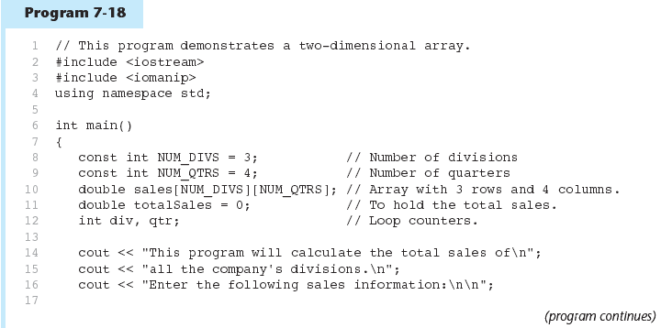

Slide 5
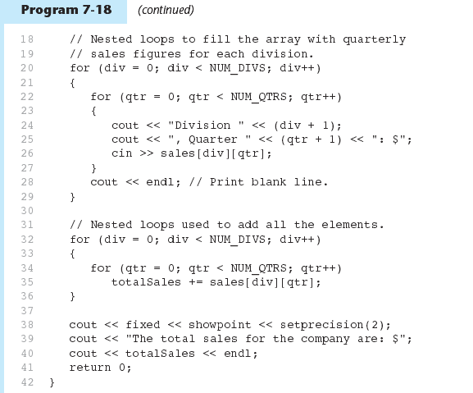

Slide 6
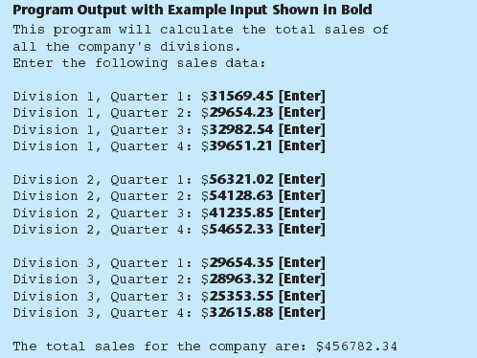

Slide 7
2D Array Initialization
Two-dimensional arrays are initialized row-by-row: const int ROWS = 2, COLS = 2; int exams[ROWS][COLS] = { {84, 78},
{92, 97} };
Can omit inner { }, some initial values in a row – array elements without initial values will be set to 0 or NULL
84 | 78
92 | 97

Slide 8
Two-Dimensional Array as Parameter, Argument
Use array name as argument in function call:
getExams(exams, 2);
Use empty [] for row, size declarator for column in prototype, header: const int COLS = 2; // Prototype void getExams(int [][COLS], int); // Header void getExams(int exams[][COLS], int rows)

Slide 9
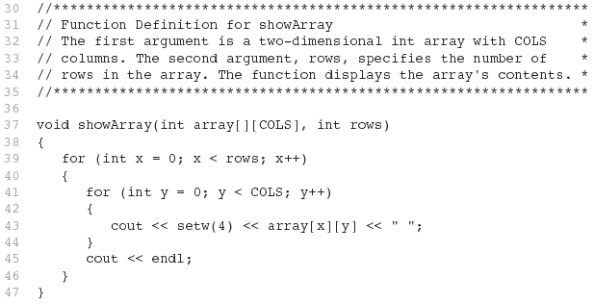
Example – The showArray Function from Program 7-19

Slide 10
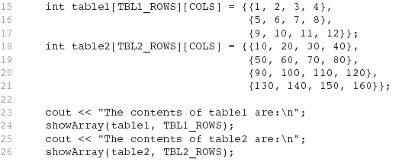
How showArray is Called

Slide 11
Summing All the Elements in a Two-Dimensional Array
Given the following definitions:
const int NUM_ROWS = 5; // Number of rows
const int NUM_COLS = 5; // Number of columns
int total = 0; // Accumulator
int numbers[NUM_ROWS][NUM_COLS] =
{{2, 7, 9, 6, 4},
{6, 1, 8, 9, 4},
{4, 3, 7, 2, 9},
{9, 9, 0, 3, 1},
{6, 2, 7, 4, 1}};

Slide 12
Summing All the Elements in a Two-Dimensional Array
// Sum the array elements.
for (int row = 0; row < NUM_ROWS; row++)
{
for (int col = 0; col < NUM_COLS; col++)
total += numbers[row][col];
}
// Display the sum.
cout << "The total is " << total << endl;

Slide 13
Summing the Rows of a Two-Dimensional Array
Given the following definitions:
const int NUM_STUDENTS = 3;
const int NUM_SCORES = 5;
double total; // Accumulator
double average; // To hold average scores
double scores[NUM_STUDENTS][NUM_SCORES] =
{{88, 97, 79, 86, 94},
{86, 91, 78, 79, 84},
{82, 73, 77, 82, 89}};

Slide 14
Summing the Rows of a Two-Dimensional Array
// Get each student's average score.
for (int row = 0; row < NUM_STUDENTS; row++)
{
// Set the accumulator.
total = 0;
// Sum a row.
for (int col = 0; col < NUM_SCORES; col++)
total += scores[row][col];
// Get the average
average = total / NUM_SCORES;
// Display the average.
cout << "Score average for student "
<< (row + 1) << " is " << average <<endl;
}

Slide 15
Summing the Columns of a Two-Dimensional Array
Given the following definitions:
const int NUM_STUDENTS = 3;
const int NUM_SCORES = 5;
double total; // Accumulator
double average; // To hold average scores
double scores[NUM_STUDENTS][NUM_SCORES] =
{{88, 97, 79, 86, 94},
{86, 91, 78, 79, 84},
{82, 73, 77, 82, 89}};

Slide 16
Summing the Columns of a Two-Dimensional Array
// Get the class average for each score.
for (int col = 0; col < NUM_SCORES; col++)
{
// Reset the accumulator.
total = 0;
// Sum a column
for (int row = 0; row < NUM_STUDENTS; row++)
total += scores[row][col];
// Get the average
average = total / NUM_STUDENTS;
// Display the class average.
cout << "Class average for test " << (col + 1)
<< " is " << average << endl;
}

Slide 17
Arrays with Three or More Dimensions

Slide 18
Arrays with Three or More Dimensions
Can define arrays with any number of dimensions:
short rectSolid[2][3][5];
double timeGrid[3][4][3][4];
When used as parameter, specify all but 1st dimension in prototype, heading:
void getRectSolid(short [][3][5]);

