Slide 1
Management
Fourteenth Edition, Global Edition
Chapter 14
Interpersonal and Organizational Communication
Copyright © 2018 Pearson Education, Ltd. All Rights Reserved

Slide 2
Learning Objectives
14.1 Define the nature and function of communication.
14.2 Describe methods and challenges of interpersonal communication.
Develop your skill at listening effectively.
Know how to overcome barriers to communication.
14.3 Explain how communication can flow most effectively in organizations.
14.4 Describe how the Internet and social media affect managerial communication and organizations.
14.5 Summarize communication issues in today’s organizations.
14.6 Discuss how to become a better communicator.

Slide 3
What is Communication?
Communication: the transfer and understanding of meaning. For communication to be successful, the meaning must be imparted and understood.
Another point to keep in mind is that good communication is often erroneously defined by the communicator as agreement with the message instead of clear understanding of the message
Interpersonal communication: communication between two or more people
Organizational communication: all the patterns, networks, and systems of communication within an organization
Notes:
Communication is the transfer and understanding of meaning. Note the emphasis on the transfer of meaning: If information or ideas have not been conveyed, communication hasn’t taken place. The speaker who isn’t heard or the writer whose materials aren’t read hasn’t communicated. More importantly, however, communication involves the understanding of meaning.
Communication encompasses both interpersonal communication—communication between two or more people—and organizational communication, which is all the patterns, networks, and systems of communication within an organization. Both types are important to managers.

Slide 4
Functions of Communication
Control
Motivation
Emotional expression
Information
Notes:
Communication acts to control employee behavior in several ways. As we know from Chapter 10, organizations have authority hierarchies and formal guidelines that employees are expected to follow. Informal communication also controls behavior. When a work group teases a member who’s ignoring the norms by working too hard, they’re informally controlling the member’s behavior.
Communication acts to motivate by clarifying to employees what is to be done, how well they’re doing, and what can be done to improve performance if it’s not up to par. As employees set specific goals, work toward those goals, and receive feedback on progress toward goals, communication is required.
For many employees, their work group is a primary source of social interaction. The communication that takes place within the group is a fundamental mechanism by which members share frustrations and feelings of satisfaction. Communication, therefore, provides a release for emotional expression of feelings and for fulfillment of social needs.
Finally, individuals and groups need information to get things done in organizations. Communication provides that information.

Slide 5
Methods and Challenges of Interpersonal Communication
Message: a purpose to be conveyed
Encoding: converting a message into symbols
Channel: the medium a message travels along
Decoding: retranslating a sender’s message
Notes:
Before communication can take place, a purpose, expressed as a message to be conveyed, must exist. It passes between a source (the sender) and a receiver. The message is converted to symbolic form (called encoding) and passed by way of some medium (channel) to the receiver, who retranslates the sender’s message (called decoding). The result is the transfer of meaning from one person to another.

Slide 6
Methods
Communication process: the seven elements involved in transferring meaning from one person to another
Noise: any disturbances that interfere with the transmission, receipt, or feedback of a message
Notes:
Note that the entire communication process is susceptible to noise—disturbances that interfere with the transmission, receipt, or feedback of a message. Typical examples of noise include illegible print, phone static, inattention by the receiver, or background sounds of machinery or coworkers. However, anything that interferes with understanding can be noise, and noise can create distortion at any point in the communication process.

Slide 7
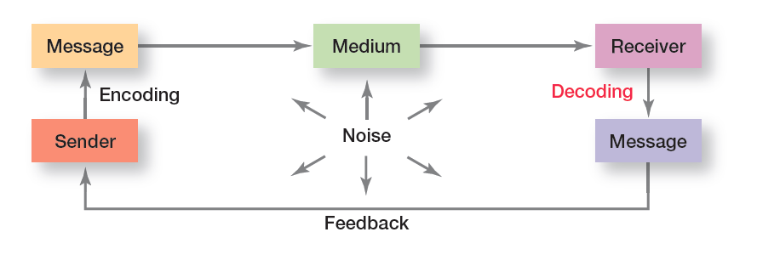
Exhibit 14-1 The Interpersonal Communication Process
Exhibit 14-1 illustrates the elements of the communication process.

Slide 8
Which Communication Method Should Be Used?
Criteria | Question
Feedback | How quickly can the receiver respond to the message?
Complexity capacity | Can the method effectively process complex messages?
Breadth potential | How many different messages can be transmitted using this method?
Confidentiality | Can communicators be reasonably sure their messages are received only by those intended?
Encoding ease | Can sender easily and quickly use this channel?
Decoding ease | Can receiver easily and quickly decode messages?
Time-space constraint | Do senders and receivers need to communicate at the same time and in the same space?
Cost | How much does it cost to use this method?
Interpersonal warmth | How well does this method convey interpersonal warmth?
Formality | Does this method have the needed amount of formality?
Scanability | Does this method allow the message to be easily browsed or scanned for relevant information?
Time of consumption | Does the sender or receiver exercise the most control over when the message is dealt with?
Notes:
Managers have a wide variety of communication methods from which to choose and can use 12 questions to help them evaluate these methods.

Slide 9
Nonverbal Communication
Nonverbal communication: communication transmitted without words
Body language: gestures, facial configurations, and other body movements that convey meaning
Verbal intonation: an emphasis given to words or phrases that conveys meaning
Notes:
An important part of interpersonal communication is nonverbal communication—that is, communication transmitted without words. Some of the most meaningful communications are neither spoken nor written.
Body language refers to gestures, facial expressions, and other body movements that convey meaning. A person frowning “says” something different from one who’s smiling. Hand motions, facial expressions, and other gestures can communicate emotions or temperaments such as aggression, fear, shyness, arrogance, joy, and anger.
Verbal intonation refers to the emphasis someone gives to words or phrases in order to convey meaning. To illustrate how intonations can change the meaning of a message, consider the student who asks the instructor a question. The instructor replies, “What do you mean by that?” The student’s reaction will vary, depending on the tone of the instructor’s response. A soft, smooth vocal tone conveys interest and creates a different meaning from one that is abrasive and puts a strong emphasis on saying the last word.

Slide 10
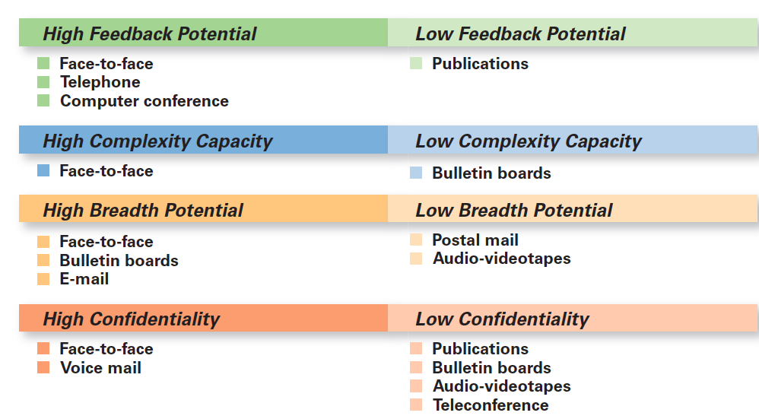
Exhibit 14-2 Comparison of Communication Methods (1 of 3)
Exhibit 14-2 provides a comparison of various communication methods.
Notes:
Source: Based on P. G. Clampitt, Communicating for Managerial Effectiveness (Newbury Park, CA: Sage Publications, 1991), p. 136.

Slide 11
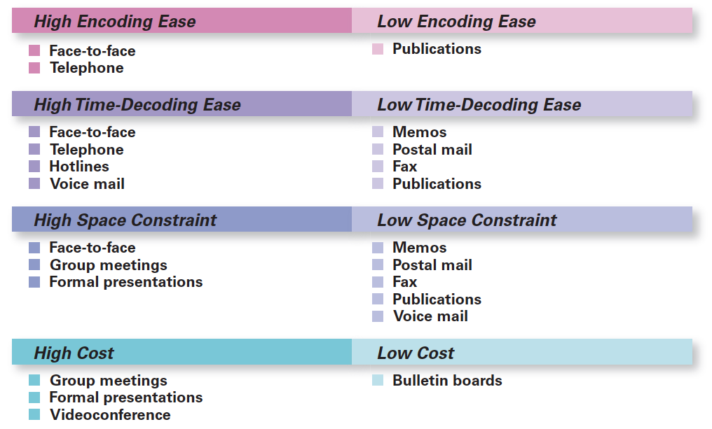
Exhibit 14-2 Comparison of Communication Methods (2 of 3)
Exhibit 14-2 provides a comparison of various communication methods.
Notes:
Source: Based on P. G. Clampitt, Communicating for Managerial Effectiveness (Newbury Park, CA: Sage Publications, 1991), p. 136.

Slide 12
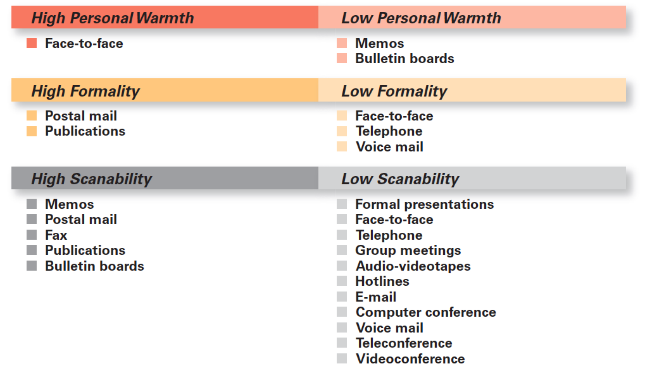
Exhibit 14-2 Comparison of Communication Methods (3 of 3)
Exhibit 14-2 provides a comparison of various communication methods.
Notes:
Source: Based on P. G. Clampitt, Communicating for Managerial Effectiveness (Newbury Park, CA: Sage Publications, 1991), p. 136.

Slide 13
Barriers to effective communication
1-COGNITIVE
Information overload: when information exceeds our processing capacity
Filtering: the deliberate manipulation of information to make it appear more favorable to the receiver
2-EMOTIONS How a receiver feels influences how he or she interprets it
Jargon: specialized terminology or technical language that members of a group use to communicate among themselves
3-NATIONAL CULTURE. Example, For technological and cultural reasons, the Chinese people dislike voice mail.
Notes:
Let’s look at barriers to effective communication:
It’s not possible to fully read and respond to each message without facing information overload, which is when information exceeds our processing capacity. Today’s employees frequently complain of information overload. Statistics show that 87 percent of employees use e-mail and that the average business e-mail user devotes 107 minutes a day to e-mail—about 25 percent of the workday.
Filtering is the deliberate manipulation of information to make it appear more favorable to the receiver. For example, when a person tells his or her manager what the manager wants to hear, information is being filtered. Or if information being communicated up through organizational levels is condensed by senders, that’s filtering.
In an organization, employees come from diverse backgrounds and have different patterns of speech. Even employees who work for the same organization but in different departments often have different jargon—specialized terminology or technical language that members of a group use to communicate among themselves.

Slide 14
Overcoming the Barriers
Use feedback
Simplify language
Listen actively
Active listening: listening for full meaning without making premature judgments or interpretations
Constrain emotions
Watch nonverbal cues
Notes:
Many communication problems are directly attributed to misunderstanding and inaccuracies. These problems are less likely to occur if the manager gets feedback, both verbal and nonverbal. A manager can ask questions about a message to determine whether it was received and understood as intended.
Because language can be a barrier, managers should consider the audience to whom the message is directed and tailor the language to them. Remember, effective communication is achieved when a message is both received and understood.
Many of us are poor listeners. Why? Because it’s difficult, and most of us would rather do the talking. Listening, in fact, is often more tiring than talking. Unlike hearing, active listening, which is listening for full meaning without making premature judgments or interpretations, demands total concentration.

Slide 15
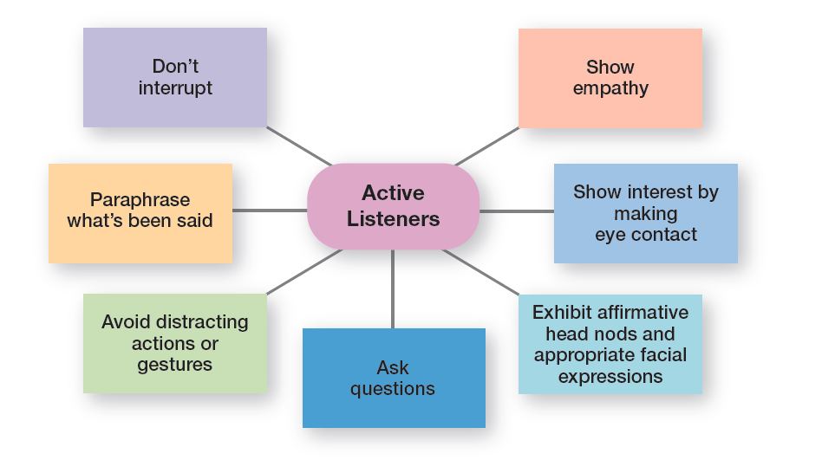
Exhibit 14-3 Active Listening Behavior
Specific behaviors that active listeners demonstrate are listed in Exhibit 14-3.
Notes:
Sources: Based on J. V. Thill and C. L. Bovee, Excellence in Business Communication, 9th ed. (Upper Saddle River, NJ: Prentice Hall, 2011), pp. 48–49; and S. P. Robbins and P. L. Hunsaker, Training in Interpersonal Skills, 5th ed. (Upper Saddle River, NJ: Prentice Hall, 2009), pp. 90–92.

Slide 16
Formal Versus Informal
Formal communication: communication that takes place within prescribed organizational work arrangements (e.g., when an employee communicates a problem to his or her manager)
Informal communication: communication that is not defined by the organization’s structural hierarchy
Notes:
Communication within an organization is described as formal or informal. Formal communication refers to communication that takes place within prescribed organizational work arrangements. For example, when a manager asks an employee to complete a task, that’s formal communication.
Informal communication is organizational communication not defined by the organization’s structural hierarchy. When employees talk with each other in the lunch room, as they pass in hallways, or as they’re working out at the company wellness facility, they engage in informal communication. Employees form friendships and communicate with each other. The informal communication system fulfills two purposes in organizations: (1) it permits employees to satisfy their need for social interaction and (2) it can improve an organization’s performance by creating alternative, and frequently faster and more efficient, channels of communication.

Slide 17
Direction of Flow (1 of 2)
Downward: communication that flows downward from a manager to employees
Town hall meeting: informal public meetings where information can be relayed, issues can be discussed, or employees can be brought together to celebrate accomplishments. For example, India’s Flipkart regularly holds town hall meetings with employees to discuss the online retailer’s financial results and proposed internal policies. A spokesman says these town hall meetings are part of its “culture of openness”.
Notes:
CEOs at companies such as Starbucks and Apple use town hall meetings to communicate with employees. These town hall meetings are informal public meetings where top executives relay information, discuss issues, or bring employees together to celebrate accomplishments. These are examples of downward communication which is communication that flows from a manager to employees. It’s used to inform, direct, coordinate, and evaluate employees.

Slide 18
Direction of Flow (2 of 2)
Upward communication: communication that flows upward from employees to managers
Lateral communication: communication that takes place among any employees on the same organizational level
Diagonal communication: communication that cuts across work areas and organizational levels
Notes:
Upward communication is communication that flows from employees to managers. It keeps managers aware of how employees feel about their jobs, their coworkers, and the organization in general. Managers also rely on upward communication for ideas on how things can be improved. Some examples of upward communication include performance reports prepared by employees, suggestion boxes, employee attitude surveys, grievance procedures, manager–employee discussions, and informal group sessions in which employees have the opportunity to discuss problems with their manager or representatives of top-level management.
Communication that takes place among employees on the same organizational level is called lateral communication. In today’s dynamic environment, horizontal communications are frequently needed to save time and facilitate coordination. Cross-functional teams, for instance, rely heavily on this form of communication interaction.
Diagonal communication is communication that crosses both work areas and organizational levels. A credit analyst who communicates directly with a regional marketing manager about a customer’s problem—note the different department and different organizational level—uses diagonal communication.

Slide 19
Networks
Communication networks: the variety of patterns of vertical and horizontal flows of organizational communication.
TYPES OF COMMUNICATION NETWORKS:
1-chain network
2-wheel network.
3- all-channel network
Grapevine: the informal organizational communication network. E.g., Rumors
Notes:
The vertical and horizontal flows of organizational communication can be combined into a variety of patterns called communication networks. In the chain network, communication flows according to the formal chain of command, both downward and upward. The wheel network represents communication flowing between a clearly identifiable and strong leader and others in a work group or team. The leader serves as the hub through whom all communication passes. Finally, in the all-channel network, communication flows freely among all members of a work team.
The grapevine is the informal organizational communication network. The grapevine is active in almost every organization. Is it an important source of information? You bet! One survey reported that 63 percent of employees say they hear about important matters first through rumors or gossip on the grapevine.

Slide 20
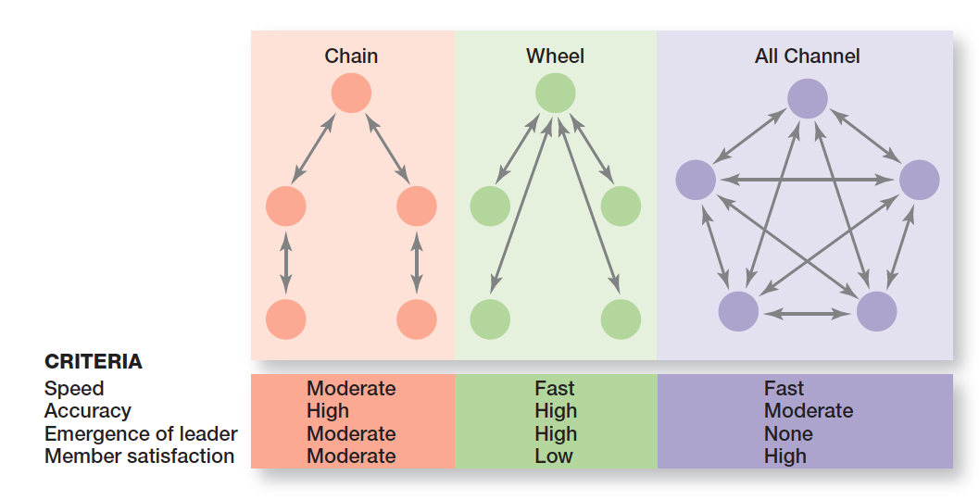
Exhibit 14-4 Organizational Communication Networks
Exhibit 14-4 illustrates three common communication networks.
Notes:
In the chain network, communication flows according to the formal chain of command, both downward and upward. The wheel network represents communication flowing between a clearly identifiable and strong leader and others in a work group or team. The leader serves as the hub through whom all communication passes. Finally, in the all-channel network, communication flows freely among all members of a work team.

Slide 21
Workplace Design and Communication
Open workplaces: workplaces with few physical barriers and enclosures.
Research shows that a workplace design should successfully support four types of employee work: focused work, collaboration, learning, and socialization.
If it’s important that employees communicate and collaborate, managers need to consider visibility, density and availability in workplace design.
Notes:
Focused work is when an employee needs to concentrate on completing a task. In collaboration, employees need to work together to complete a task. Learning is when employees are engaged in training or doing something new and could involve both focused work and collaboration. And socialization happens when employees informally gather to chat or to exchange ideas. A survey found that when workers had these types of “oases” or informal meeting places nearby, they had 102 percent more face-to-face communication than people who had only minimal access to such spots.39 Because communication can and does take place in each of these settings, the workplace design needs to accommodate these organizational and interpersonal communications—all directions and all types—in order to be most effective.

Slide 22
The 24/7 Work Environment
IT has made it possible to stay connected around the clock, seven days per week.
IT has made it possible for people in organizations to be fully accessible, at any time, regardless of where they are.
Notes:
There was a time not so long ago when most employees rarely communicated after traditional work hours. IT has made it possible to stay connected around the clock, seven days per week. And IT has radically changed the way organizational members communicate. For example, IT has significantly improved a manager’s ability to monitor individual and team performance, has allowed employees to have more complete information to make faster decisions, and has provided employees more opportunities to collaborate and share information.
In addition, IT has made it possible for people in organizations to be fully accessible, at any time, regardless of where they are. Employees don’t have to be at their desk with their computers running to communicate with others in the organization.

Slide 23
Working From Anywhere
Wireless communication technology has the ability to improve work for managers and employees.
Notes:
Internet access is increasingly available through Wi-Fi and wireless access hotspots. And the number of these hotspot locations continues to grow.
With more than 50 million “mobile” workers in the United States, smartphones, notebook computers, computing devices such as iPad, and other pocket communication devices have generated whole new ways for managers to “keep in touch.” And the number of mobile communication users keeps increasing.
Employees don’t have to be at their desks to communicate with others in the organization. As wireless technology continues to improve, we’ll see more organizational members using it as a way to collaborate and share information.

Slide 24
Social Media
Devoting a channel for information exchange about a specific topic can help compartmentalize the conversation.
It can also start a useful conversation in which employees can share their experiences and make suggestions for creating competitive advantage.
Facebook, YouTube, Instagram….etc.
Notes:
This approach provides two important benefits. First, most employees send and receive dozens of business e-mails every day, and sometimes important e-mails get lost in crowded inboxes. Devoting a channel for information exchange about a specific topic can help compartmentalize the conversation. Second, the sales manager in this example is not only conveying important information, but he also is starting a useful conversation in which employees can share their experiences and make suggestions for creating competitive advantage. While YouTube has become a popular social media tool, Monsanto is using a YouTube type of approach to raise the visibility of some projects and make a stronger argument for bioengineered crops. The company sent camera crews to the Philippines, Australia, and other countries to film testimonials from farmers using Monsanto products to grow bioengineered crops.

Slide 25
Balancing the Pluses and Minuses
Communication and the exchange of information among organizational members are no longer constrained by geography or time.
Constantly staying connected has its downsides, such as impeding creativity.
Notes:
Collaborative work reports among widely dispersed individuals and teams, sharing of information, and integration of decisions and work throughout an entire organization have the potential to increase organizational efficiency and effectiveness. However, companies need to guard against relying exclusively on IT for collaborative work. For example, constantly staying connected has its downsides, such as impeding creativity.
Some companies recognize the importance of downtime. For example, what is the psychological cost of an employee always being accessible? Will it lead to increased pressure for employees to “check in” even during their o hours? How important is it for employees to separate their work and personal lives? These questions don’t come with easy answers, and managers will have to face these and similar issues.

Slide 26
Choosing the Right Media
It is important for managers to understand the situations in which one or more media facilitates effective communication.
Being an effective communicator in today’s organizations means being connected—not only to employees and customers, but to all of the organization’s stakeholders.
Notes:
Electronic media—social media, e-mail, and instant messaging—are all effective and efficient methods for communicating relatively straightforward information to one or more individuals. For instance, electronic communication is appropriate for announcing meeting times, locations, and an overview of the agenda. However, exchanging confidential information about an employee’s performance or a company’s competitive secrets should be left for face-to-face meetings or telephone conversations.
This should also be the case for complex issues such as communicating revisions to project schedules. The electronic form of face-to-face meetings, videoconferencing, can bring geographically dispersed colleagues together to share multiple perspectives of key stakeholders. For instance, making strategy for a new marketing campaign requires the participation of the client and marketing department employees for creative input and finance department employees for budgetary advice.

Slide 27
Managing Communication in a Digitally Connected World
Legal and security issues
Although e-mail, blogs, tweets, and other forms of online communication are quick and easy ways to communicate, managers need to be aware of potential legal problems from inappropriate usage.
Personal interaction
It can be especially challenging to achieve understanding and collaborate on getting work done when communication takes place in a virtual environment.
Notes:
Managers are learning, the hard way sometimes, that all this new technology has created special communication challenges. The two main ones are (1) legal and security issues and (2) lack of personal interaction.
It may be called social media, but another communication challenge posed by the Internet age we live and work in is the lack of personal interaction. Even when two people are communicating face-to-face, understanding is not always achieved. However, it can be especially challenging to achieve understanding and collaborate on getting work done when communication takes place in a virtual environment. In response, some companies have banned e-mail on certain days, as we saw earlier.

Slide 28
Managing the Organization’s Knowledge Resources
Managers need to enable employees to communicate and share knowledge so they can learn from each other.
For example, William Wrigley Jr. Co. launched an interactive website that allows sales agents to access marketing data and other product information.
Notes:
Today’s managers need to make it easy for employees to communicate and share their knowledge so they can learn from each other ways to do their jobs more effectively and efficiently. One way organizations can do this is to build online information databases that employees can access.

Slide 29
The Role of Communication in Customer Service
Customer
An organization with a strong service culture already values taking care of customers—finding out what their needs are, meeting those needs, and following up to make sure that their needs were met satisfactorily.
2. service organization
In addition, communication is part of the specific customer service strategies the organization pursues. One strategy that many service organizations use is personalization
3. individual service provider
The quality of the interpersonal interaction between the customer and that contact employee does influence customer satisfaction, especially when the service encounter isn’t up to expectations
Notes:
What communication takes place and how it takes place can have a significant impact on a customer’s satisfaction with the service and the likelihood of being a repeat customer. Managers in service organizations need to make sure that employees who interact with customers are communicating appropriately and effectively with those customers. How? By first recognizing the three components in any service delivery process: the customer, the service organization, and the individual
service provider

Slide 30
Getting Employee Input
Letting employees know that their opinions matter is an essential first step in building effective suggestions systems.
Notes:
But what happens afterward is also critically important. Managers should explain how suggestions are reviewed, and feedback about the feasibility of suggestions should be shared, not just whether the ideas are feasible, but also why suggestions are feasible or not. For feasible ideas, the next steps leading toward possible implementation should be communicated. Approaching suggestions systems in this manner will go a long way toward encouraging employees to think about how they can improve the way work gets done, providing better customer service, and possibly contributing to positive financial outcomes.

Slide 31
Exhibit 14-5 How to Let Employees Know Their Input Matters
Suggestion
Hold town hall meetings where information is shared and input solicited
Provide information about what’s going on, good and bad.
Invest in training so that employees see how they impact the customer experience.
Analyze problems together—managers and employees.
Make it easy for employees to give input by setting up different ways for them to do so (online, suggestion box, preprinted cards, and so forth).
Notes:
Managers do business in a world today where you can’t afford to ignore such potentially valuable information. Exhibit 14-5 lists some suggestions for letting employees know that their opinions matter.

Slide 32
Communicating Ethically
Ethical communication: communication that includes all relevant information, is true in every sense, and is not deceptive in any way.
Example for Unethical communication: Although British Petroleum attempted to communicate openly and truthfully about the Gulf Coast oil spill in the summer of 2010, the public still felt that much of the company’s communication contained some unethical elements.
Notes:
It’s particularly important today that a company’s communication efforts be ethical. Ethical communication “includes all relevant information, is true in every sense, and is not deceptive in any way.”
On the other hand, unethical communication often distorts the truth or manipulates audiences. What are some ways that companies communicate unethically? It could be by omitting essential information. For instance, not telling employees that an impending merger is going to mean some of them will lose their jobs is unethical.

Slide 33
Sharpening Your Persuasion Skills
Persuasion skills: skills that enable a person to influence others to change their minds or behavior
Notes:
Apart from brevity, there are other elements to effective persuasion. For instance, communication expert Mark Rodgers indicates that effective persuasion starts with stating the importance of following a course of action and the likely benefits. Another characteristic of persuasive messages is to use descriptive language such as metaphors, humor, and analogies.

Slide 34
Sharpening Your Speaking Skills
Speaking skills: skills that refer to the ability to communicate information and ideas in talking so others will understand.
Once you develop greater confidence to speak before others, it is necessary to understand the characteristics of effective speaking. Attending successful business professionals’ presentations or watching them online is a good starting point. You will likely notice the following speaker’s characteristics in effective speakers: authenticity, humility, brevity, and a clear understanding of the audience.
Notes:
One survey revealed that 70 percent of employees who make presentations say that good presentation skills are important to career success. Yet, discomfort with public speaking holds some employees back.
Characteristics in effective speakers include authenticity, humility, brevity, and a clear understanding of the audience.

Slide 35
Sharpening Your Writing Skills
Writing skills: skills that entail communicating effectively in text as appropriate for the needs of the audience
Notes:
Abbreviations and jargon that are standard in texting among friends and family are not always appreciated in a business setting.
Some additional points: First, don’t be in a rush to press the send button or drop the memo in the mail. Oftentimes, poorly constructed e-mail messages or written memos are the result of rushing. The same applies to sending communiques when you’re emotionally upset. Set your message aside; then, review it with fresh eyes. You might also ask a colleague to review it. Second, express information and ideas logically and don’t switch back and forth between topics. Third, check the accuracy of the content. For instance, the meeting is scheduled for 3 pm, but 2 pm was written in error. Finally, read the message carefully to ensure that an inaccurate word for the context doesn’t slip in. Spell-check programs can x misspellings but not the wrong word choice.

Slide 36
Sharpening Your Reading Skills
Reading skills: skills that entail an understanding of written sentences and paragraphs in work-related documents.
Notes:
As discussed earlier, employees receive an average of 121 work e-mails daily, and that number is expected to rise. They also receive many written memos, reports, and policy statements. The sheer volume alone requires good reading skills. What are they? Reading skills entail an understanding of written sentences and paragraphs in work-related documents. If your reading skills aren’t up to par—either in comprehension or speed—don’t be afraid to sign up for a reading-improvement class.

Slide 37
Review Learning Objective 14.1
Define the nature and function of communication.
Communication
Interpersonal
Organizational
Functions
Controlling
Motivating
Expressing emotion
Informing
Notes:
Communication is the transfer and understanding of meaning. Interpersonal communication is communication between two or more people. Organizational communication includes all the patterns, networks, and systems of communication within an organization.
The functions of communication include controlling employee behavior, motivating employees, providing a release for emotional expression of feelings and fulfillment of social needs, and providing information.

Slide 38
Review Learning Objective 14.2
Describe methods and challenges of interpersonal communication.
Communication process
Evaluating communication methods
Communication methods
Barriers
Notes:
The communication process contains seven elements. First, a sender has a message. A message is a purpose to be conveyed. Encoding converts a message into symbols. A channel is the medium a message travels along. Decoding happens when the receiver retranslates a sender’s message. Finally, feedback occurs.
Managers can evaluate the various communication methods according to their feedback, complexity capacity, breadth potential, confidentiality, encoding ease, decoding ease, time-space constraint, cost, interpersonal warmth, formality, scanability, and time of consumption.
The communication methods include face-to-face, telephone, group meetings, formal presentations, memos, traditional mail, fax, employee publications, bulletin boards, other company publications, audio- and videotapes, hotlines, e-mail, computer conferencing, voice mail, teleconferences, and videoconferences.
The barriers to effective communication include filtering, emotions, information overload, defensiveness, language, and national culture.
Managers can overcome these barriers by using feedback, simplifying language, listening actively, constraining emotions, and watching for nonverbal clues.

Slide 39
Review Learning Objective 14.3
Explain how communication can flow most effectively in organizations.
Formal/informal
Direction of flow
Communication networks
Workplace design
Notes:
Formal communication is communication that takes place within prescribed organizational work arrangements. Informal communication is not defined by the organization’s structural hierarchy. Communication in an organization can flow downward, upward, laterally, and diagonally.
The three communication networks include the chain, in which communication flows according to the formal chain of command; the wheel, in which communication flows between a clearly identifiable and strong leader and others in a work team; and the all-channel, in which communication flows freely among all members of a work team.
Managers should manage the grapevine as an important information network. The negative consequences of rumors can be minimized by communicating openly, fully, and honestly with employees.
Workplace design also influences organizational communication. That design should support four types of employee work: focused work, collaboration, learning, and socialization. In each of these circumstances, communication must be considered.

Slide 40
Review Learning Objective 14.4
Describe how the Internet and social media affect managerial communication and organizations.
24/7 work environment
Social media
Choosing the right media
Notes:
Technology has changed the way we live and work. It has created a 24/7 work environment as it is possible to stay connected around the clock and work from anywhere.
Social media allows managers to communicate through one channel and encourages sharing experiences.
While IT allows collaborative work, managers must be cautious that they do not overuse technology and impede creativity. Managers must also choose the right media for the message they are sending.

Slide 41
Review Learning Objective 14.5
Summarize communication issues in today’s organizations.
Legal and security issues
Making it easy for employees to communicate and share knowledge
Customer service
Employee input
Ethical communication
Notes:
The two main challenges of managing communication in an Internet world are the legal and security issues and the lack of personal interaction.
Organizations can manage knowledge by making it easy for employees to communicate and share their knowledge, which can help them learn from each other ways to do their jobs more effectively and efficiently. One way is through online information databases and another way is through creating communities of practice.
Communicating with customers is an important managerial issue since what communication takes place and how it takes place can significantly affect a customer’s satisfaction with the service and the likelihood of being a repeat customer.
It’s important for organizations to get input from their employees. Such potentially valuable information should not be ignored. Managers should explain how suggestions are reviewed and feedback about the feasibility of suggestions should be shared.
Finally, a company’s communication reports need to be ethical. Ethical communication can be encouraged through clear guidelines and through answering questions that force a communicator to think through the communication choices made and the consequences of those choices.

Slide 42
Review Learning Objective 14.6
Discuss how to become a better communicator.
Active listening
Persuasion skills
Speaking skills
Writing skills
Reading skills
Notes:
You can become a better communicator through sharpening your active listening, persuasion, speaking, writing, and reading skills.

