Slide 1
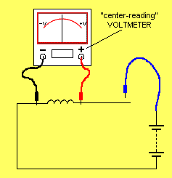
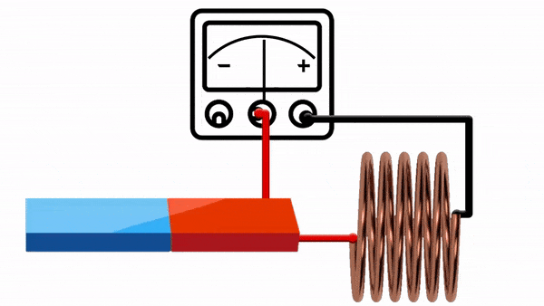
Circuit2 Lab
Summer Semester 2024/2025
Eng. Asma’ shara’b PTUK

Slide 2
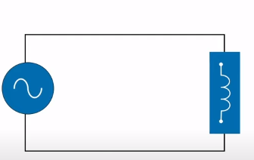
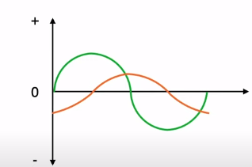
Eng. Asma’ shara’b PTUK

Slide 3
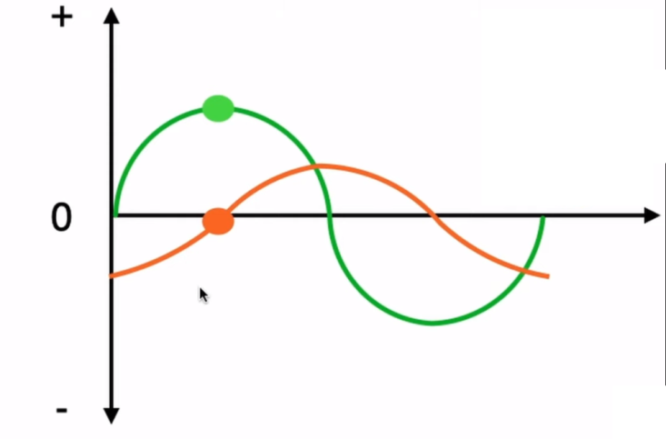
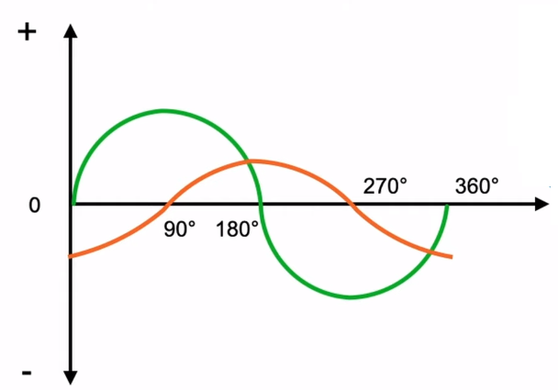
Inductor oppose the change in current by dropping a voltage directly proportional to rate of change of current!
inductive circuit voltage and current are said to be 90 degree out of phase
► Inductor oppose the change in current by drawing or supplying the voltage. And hence, in inductive circuit, when current is max. Voltage is zero and vice versa.
Eng. Asma’ shara’b PTUK

Slide 4
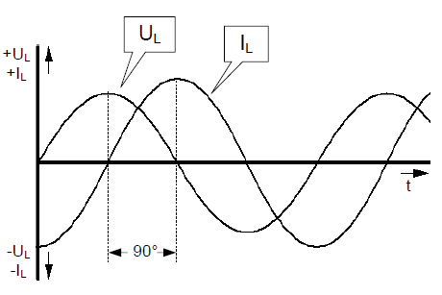
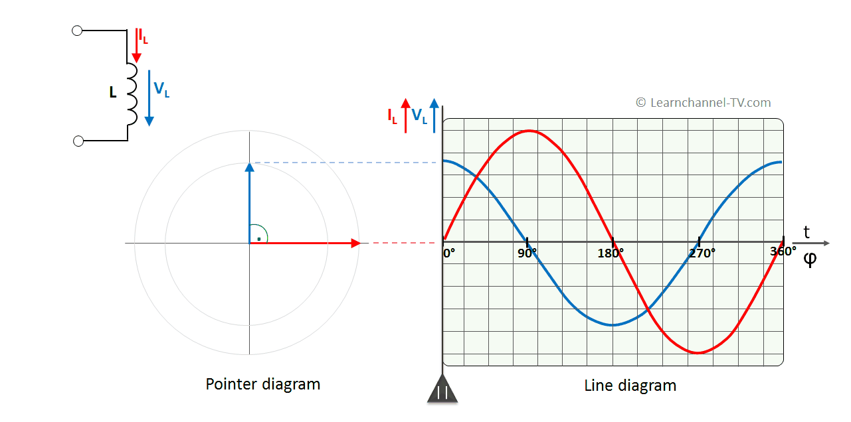
Inductance with a Sine-wave Voltage
14.4.1 Phase Shift between Current and Voltage
Eng. Asma’ shara’b PTUK

Slide 5
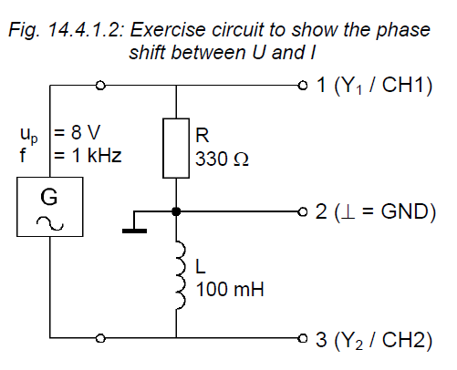
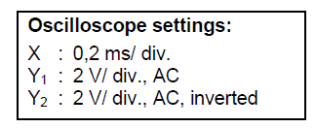
- In the circuit of Fig. 14.4.1.2, the resistance of 330 Ω in increased to 1 ΚΩ. What effects do you expect to see on the signals displayed on the oscilloscope? What is the tendency of events and check your considerations by measurement.
Eng. Asma’ shara’b PTUK

Slide 6
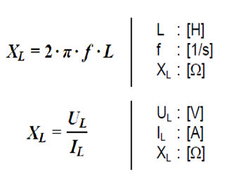
14.4.2 Inductive Reactance, XL
On an inductance, a sinusoidal voltage generates a magnetic field that periodically reverses in polarity. The coil presents a limiting resistance to the current produced that lags on the voltage by 90°. At this resistance, there is no thermal (active) power dissipated, therefore the resistance is known as 'inductive reactance, X₁'.
The magnitude of the inductive reactance XL is proportional to the inductance L of the coil and the frequency f of the applied sinusoidal voltage :
With a given coil current IL and a known coil voltage UL, Ohm's law can be used for calculating the value of XL:
Eng. Asma’ shara’b PTUK

Slide 7
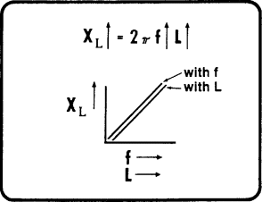
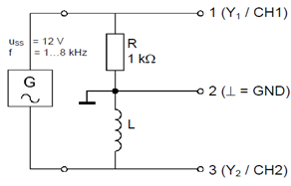
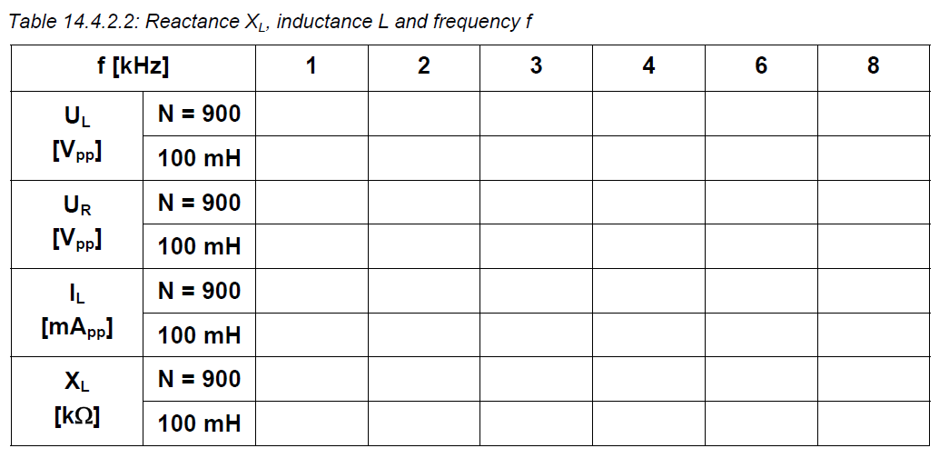
Fig. 14.4.2.1: Exercise circuit to examine the relationship between X₁, f and L
Eng. Asma’ shara’b PTUK

Slide 8
Draw the characteristic XL = f(f) for both coils.
Check the measured values by calculation at XL = f (6 kHz) for the coil L = 100 mH.
- Check the nominal value of the coil L = 100 mH by calculation. Use the values measured at 4 kHz.
Eng. Asma’ shara’b PTUK

Slide 9
Explain the deviation between the two check calculations?
Calculate the unknown inductance L of the transformer coil (N = 900) from the value measure at XL = f(3 kHz).
What rules or relationships can be deduced from the shape of the characteristics?
- What tendency does the reactance X₁ of a coil L = 0,01 H (= 10 mH), show at very high (> 10 MHz) and very low (<100 Hz) frequencies?
Eng. Asma’ shara’b PTUK

Slide 10
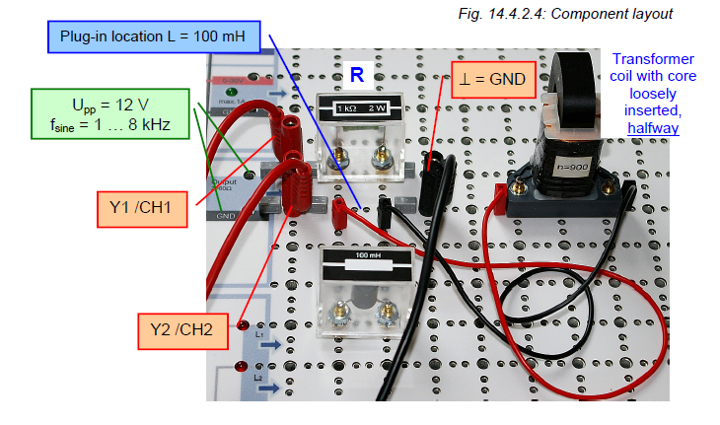
Eng. Asma’ shara’b PTUK

Slide 11
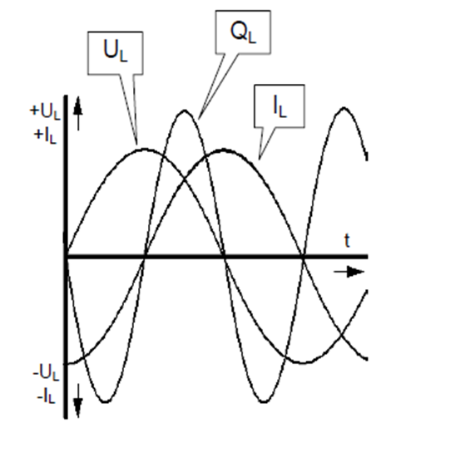
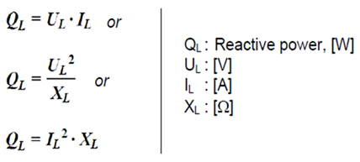
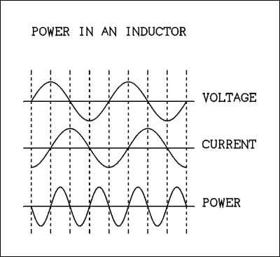
The active power (P) consumed by a coil is the result of unwanted but unavoidable losses. They must be accepted within reason, due to the physical limits in the manufacture of coils.
The reactive power Q at a coil is given by the product of coil voltage and reactive current. It can be represented as a multiplication of the instantaneous values of u₁ and in in a line chart with the phase relationships (Fig. 14.4.3.2).
The reactive power Q₁ is calculated from:
Eng. Asma’ shara’b PTUK

Slide 12
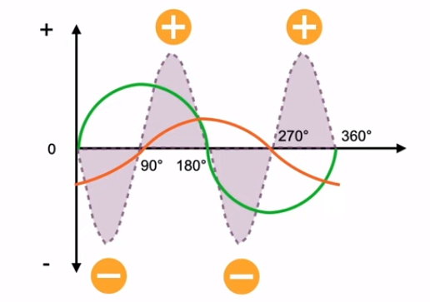
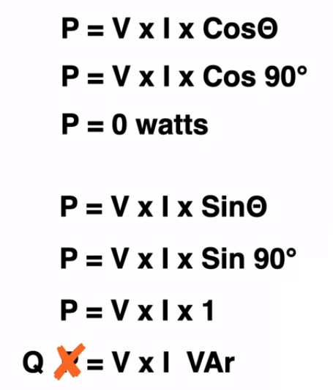
► Purely inductive circuit do not consume real power. Power consumed by inductive circuit is imaginary power or reactive power
Eng. Asma’ shara’b PTUK

Slide 13
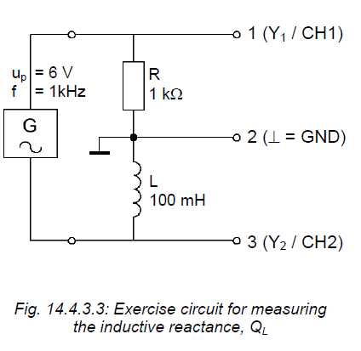
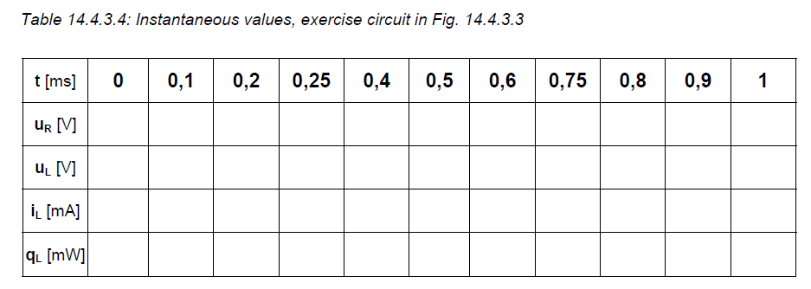
Eng. Asma’ shara’b PTUK

Slide 14
Sketch the voltage curve U₁ = f(t), the current curve I₁ = f(t) and the power curve Q₁ = f (t) as accurately as possible, in the chart given in Fig. 14.4.3.5.
Fig. 14.4.3.5: Waveforms of voltage UL, reactive current I₁ and reactive power Q₁ at the coil
Eng. Asma’ shara’b PTUK

Slide 15
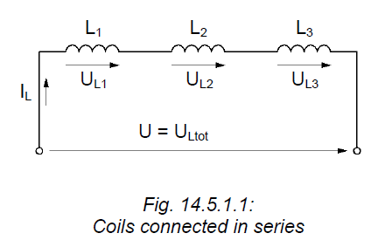
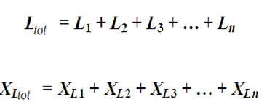
14.5 Coils Connected in Series
14.5.1 Response of Coils Connected in Series
The total inductance Ltot is given by the sum of the individual inductances:
Also, the total inductive reactance XLtot is given by the sum of the individual inductances:
Eng. Asma’ shara’b PTUK

Slide 16
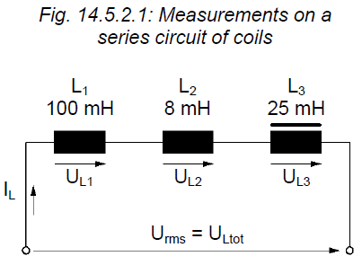
14.5.2 Practical Proof of the Coil Response in a Series Circuit
Eng. Asma’ shara’b PTUK

Slide 17
From the values measured and using Ohm's law, determine the reactances XLn and XLtot.
Calculate the total reactance XLtot as a check, using 2 different methods.
Use your results from calculating the reactance, to determine the inductances, Ln and Ltot.
Calculate the total reactance Ltot, using 2 different methods.
In the circuit of Fig. 14.5.2.1, a transformer coil (N = 900) with half a core inserted.
Insert the full core. Now, determine the changed inductance of the transformer coil L3 and the total inductance of the circuit. Use as few measurements as possible.
Eng. Asma’ shara’b PTUK

Slide 18
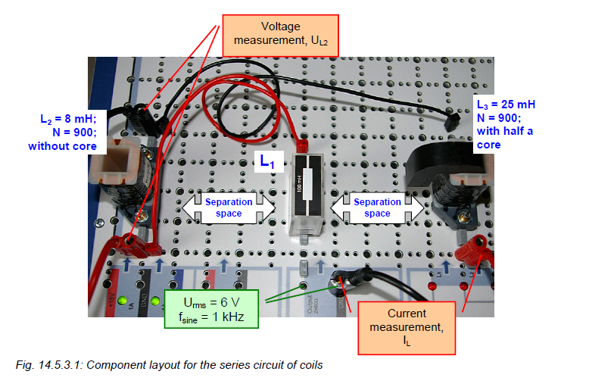
14.5.3 Exercise Assembly of a Series Circuit of Coils on the Electronic Circuits Board
Eng. Asma’ shara’b PTUK

Slide 19
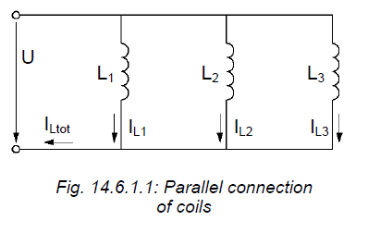
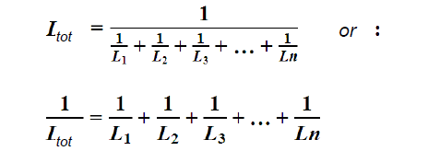
14.6 Coils Connected in Parallel
14.6.1 Response of Coils Connected in Parallel
The equation can be simplified for a parallel connection of only 2 coils :
The total current Itot is divided in the individual branches of coils, inversely proportional to the corresponding inductance in each branch. The inductive reactance of the circuit XLtot is less than the smallest single reactance XLn:
Eng. Asma’ shara’b PTUK

Slide 20
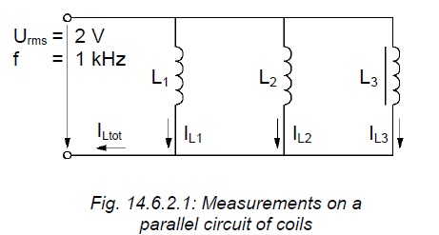
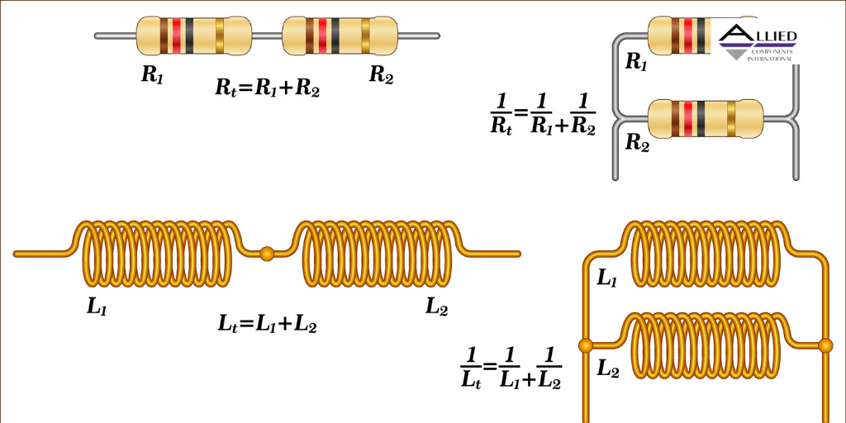
14.6.2 Practical Proof of the Coil Response in a Parallel Circuit
Eng. Asma’ shara’b PTUK

Slide 21
-From the values measured and using Ohm's law, determine the reactance's XLn and Xltot
-Use your results from calculating the reactance, to determine the inductances, Ln and Ltot. Calculate the total reactance Ltot, using 2 different methods.
- How do the values change of the variables given below, when half of the core in L3 is removed? Indicate the tendency in the form of up and down arrows.
L3:
XL3:
IL3:
IL:
Ltot:
-Check your conclusions for the current changes, by measurement in the circuit of Fig. 14.6.2.1.
Eng. Asma’ shara’b PTUK

Slide 22
https://www.youtube.com/watch?v=Bh23k_oqYLg
Eng. Asma’ shara’b PTUK

